Slide 1
Source Code Plagiarism Detection
Group Members
Deven Bhalerao 05
Manish Jain 28
Vishal Jha 29
Kunal Naik 45
Guided By
Prof. Prasad Padalkar

Slide 2
Introduction
Plagiarism is the practice of taking someone else's work or ideas and passing them off as one's own.
Plagiarism in source-code files occurs when source-code is copied and edited without proper acknowledgment of the original author.(lexical and structural )
The plagiarism tool is to detect similarity in source code.

Slide 3
Problem Statement
To develop a tool for detecting plagiarism in software source code using the machine learning algorithms.

Slide 4
Scope
For the first level of implementation, tool will be on a local machine for checking plagiarism.
The source and target program should be in Java.

Slide 5
Current Scenario
 | MOSS | SHERLOCK | JPLAG | CODEMATCH
Cost | Free | Open Source | Free | It is a Commercial Tool
Safety | Sign-in Required | Executes at Local machine | Sign-in Required | Executes at Local machine
Service | Internet | Standalone | Web-Service | Standalone
Algorithm | Winowing | Token Matching | Greedy String Tiling | String Matching
Speed | Fast | More files requires more time | Fast | More files requires more time

Slide 6
The 1st type of plagiarism (exact copy) was easily detected by all the tools.
MOSS has the most trouble with a lot of the types of plagiarism as it tries very hard to avoid false-positives, thus discarding a lot of information.
Sherlock has a lot of trouble with the 2nd type of plagiarism (comments changed) as it compares the entire source codes without ignoring the comments.
CodeMatch has the most trouble with the 3rd type of plagiarism (identifiers changed) as its algorithms must make some sort of match between identifiers.

Slide 7
Summary of Papers/Thesis
Computer Algorithms for Plagiarism Detection –
Described the various levels of plagiarism and the different metrics(approaches) like Halstead metric, ACCUSE metric, FORTRAN programs, etc.

Slide 8

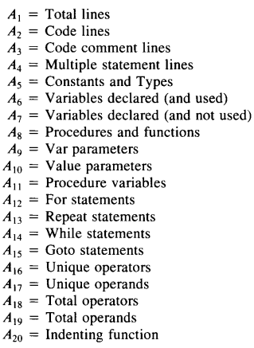
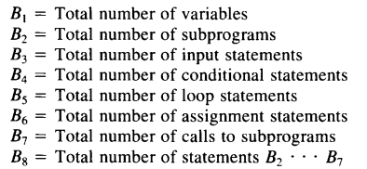
Software Metrics
Halsted Metric | U.S. Airforce Accuse metric | Bowling Green State University metric

Slide 9
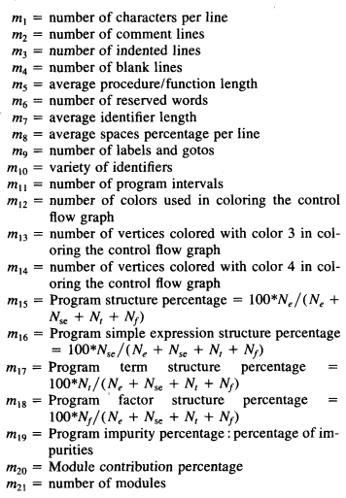
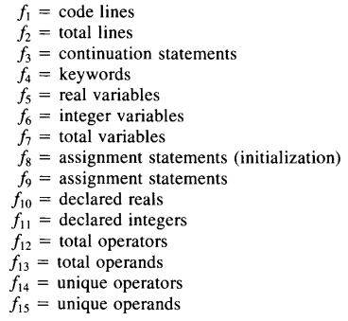
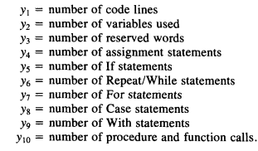
Berghel and Sallach metric | Jankowitz at Southampton University metric | Brunel University metric

Slide 10
Software/Hardware Requirements
Software Requirements :
Java JDK 1.4 or more
Operating System : Window/Linux.
Front-End : Java Fx.
Back-End : MySQL.
Hardware Requirements :
Minimum Memory : 512 Mb Ram
Hard disk space : 1 GB

Slide 11
Demo/Algorithms
Level 0 plagiarism
Read contents of both files
While all lines of file 1 and file 2 have not been visited
if lines in file 1 and file 2 are not perfect match
print “found difference”
break out of loop
if all lines are perfect match
print plagiarised

Slide 12
Level 1 Plagiarism
Read contents of both files
While all lines of file 1 and file 2 have not been visited
While current lines in file 1 & file 2 are not code lines
If line starts with “//” or is empty
Skip line
If line starts with /*
Skip all lines until */ is detected
If line is code line
set iterator condition as fulfilled and end loop
if lines in file 1 and file 2 are not perfect match
print “found difference”
break out of loop
if all lines are perfect match print plagiarised

Slide 13
Level 3 Plagiarism
Read contents of both files
While all lines of file 1 and file 2 have not been visited
While current lines in file 1 & file 2 are not code lines
If line starts with “//” or is empty
Skip line
If line starts with /*
Skip all lines until */ is detected
If line is code line
count number of variables in code line
If number of variables in both files are equal
print plagiarised

Slide 14
References
[D. Fonte, V. Martins, R. Henriques and D. da Cruz, 1st ed. Portugal, 1998, pp. 147-148.
Cosma, Georgina. A Thesis Submitted In Partial Fulfilment Of The Requirements For The Degree Of Doctor Of Philosophy In Computer Science. 1st ed. Warwick: N.p., 2008. Print.
Parker, Alan and James Hamblen. Computer Algorithms For Plagiarism Detection. 2nd ed. Atlanta: N.p., 1989. Print.
Ali, Asim M. El Tahir and Vaclav Snase. Overview And Comparison Of Plagiarism Detection Tools. 1st ed. Czech Republic: N.p. Web.
MUFTAH, AHMED JABR AHMED. Document Plagiarism Detection algorithm using semantic network. 1st ed. Malaysia: N.p., 2009. Print.
Haider, Khurram Zeeshan, Tabassam Nawaz, and Ali Javed. Efficient Source Code Plagiarism Identification Based On Greedy String Tilling. 10th ed. Taxila: N.p., 2010. Web. 23 Aug. 2016.
[Online]. Available: http://ceur-ws.org/Vol-706/poster22.pdf. Accessed: Aug. 23, 2016

