Slide 1

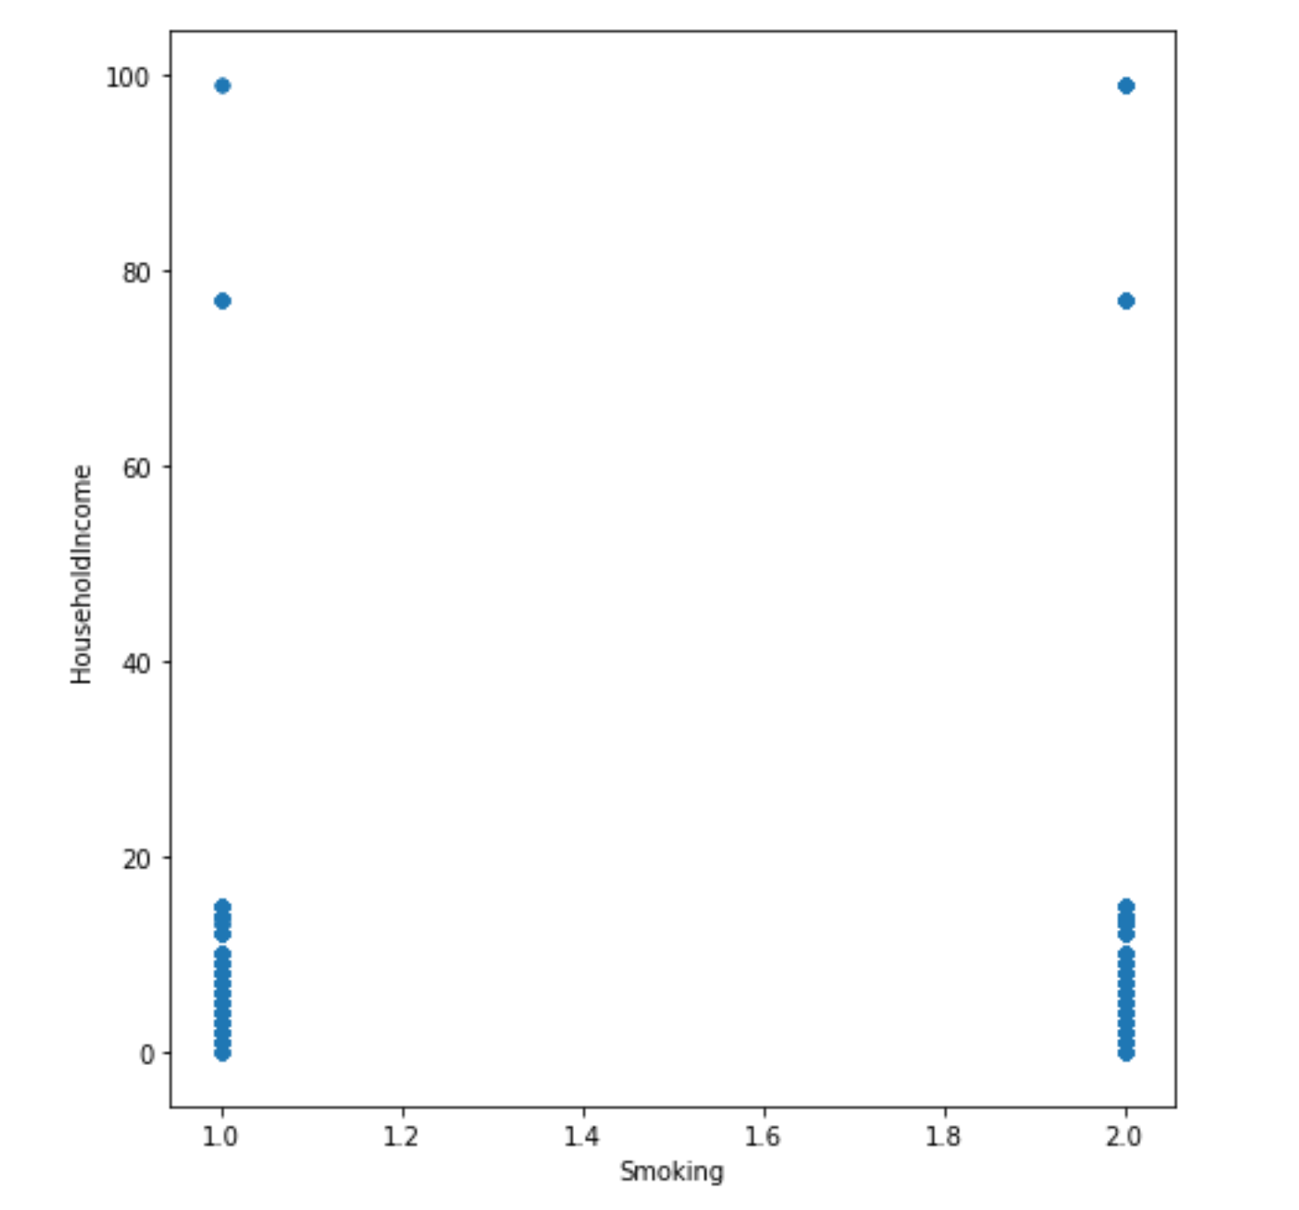
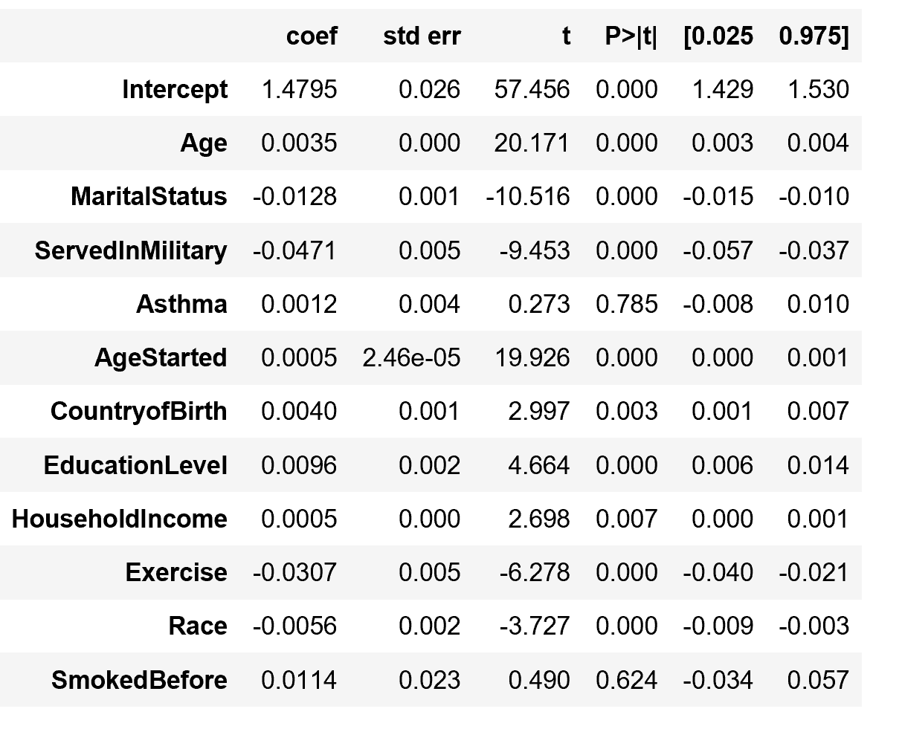
Predicting if Someone is A Smoker from Basic Data
Deven Hurt
dhurt@college.Harvard.edu
CS182
Fall 2017
Introduction
The goal of this project was to see use general medical information, such as that which would be routinely collected by a doctor to predict whether a person is a smoker. If this methodology proved to be statistically viable, it is something that I planned to use in my own startup to provide doctors information about what medical conditions their patients may be at risk for.
The baseline data came from the 2013-14 National Health and Nutrition Examination Survey which is administered annually by the CDC. The survey contains several hundred questions and several thousand respondents every year.
Theoretically using data similar to that which would be provided to doctor in a standard physician questionnaire would allow me to test whether these types of questions are sufficient to predict lifestyle choices or other medical conditions.
blah blah blah
Data
Dsa
Conclusions
Figure1. The distribution between smokers and non-smokers by household income is nearly equal. Many commonly perceived indicators of smoking actually held relatively uniform distributions.
The most basic questions, such as those a doctor would as in a standard questionnaire, were not sufficient to determine whether someone was a smoker with significant statistical probability.
This forces the question as to whether the data gathered in these surveys is sufficient in of itself to provide doctors with meaningful results. It appears the answer is likely no, unless there is a direct relationship between a response and a medical condition (ie prolonged sadness and depression).
Approach
Results
blah blah blah
Isolate general demographic and lifestyle questions
Further narrow down existing pool of questions to questions which could be related to smoking, but did not explicitly mention smoking (ie Age, Education Level)
Use linear regressions and naive bayes analysis to determine with what accuracy an individual’s smoker status could be predicted
If results are poor, continue to incorporate more questions which may be related to smoking status, continually incorporating questions increasingly related to smoking
Similarly, remove questions which do not provide much meaningful information about smoker status
Predicting a smoker’s status as a smoker appeared to be almost impossible using demographic/general medical data provided by the survey.
Citations and Links
Joseph Adwere-Boamah. 2011. Multiple logistic regression analysis of cigarette use among high school students . Journal of Case Studies in Education.
https://www.kaggle.com/cdc/national-health-and-nutrition-examination-survey
Figure 2. The above questions were able to predict smoking status via linear regression with an r-squared value of .445. Before incorporating whether the individual had smoked before, the r-squared values were below .2.
John A. Paulson School of Engineering and Applied Sciences

