Slide 1
Patient Record System
By:
Deven Shrestha
Nobel Baral
Sandesh Bastola
Susil Neupane

Slide 2
Project Summary
In short, our program “Patient Record System” will assist in easier management of Patient’s record using a computer system. This program will allow the user to add new patient with their details which are their name, address, disease, age, sex, severity and prescribed medicine and the program will automatically assign the patient with an unique code which can later be used to easily identify a specific user easily within our program. You can also search for an already existing patient using their patient code or general information to either update their data, show their data or remove them from the “ongoing treatment” section and move them to “treated” or if they transferred to another hospital then move them to the “transferred” section. If a patient has already been in the hospital before and has arrived again, you can search within the “treated or transferred” to view their previous data and update the data and move him/her to “ongoing treatment” section and assign them a new patient code. The user can even remove the patient’s data.

Slide 3
Introduction
Our program “Patient Record System” will allow the users to add and manage patient’s data efficiently. This program will assign each patient a unique code and that code can be used to effectively search, modify, view, move or remove the data. That way, even if multiple patient’s have the same name and diseases and other information, it will not cause a problem in the workflow. If the patient who wants to add their data into the database has already been to our hospital, then the program will ask for their previous code and their new info and assign them a new code. In addition to that, our program will be written in C programming language, which is a middle level language for ensuring great performance. So, our system “Patient Record System” is a feature-full and user-friendly system which will facilitate the hospital which implement it to be more advanced and efficient. It is also very fast and optimized allowing for the computer to efficiently perform various activities without being pulled down by it.

Slide 4
Problem Statement
Many hospitals store their patient’s data in physical files which are very prone to damage from fire and water. In addition to that, those files take a very long time to search through and the quality of those files can degrade overtime. This program will solve such issue by providing an interface to store patient’s data digitally. So, the hospitals which implement our program will not have to worry about managing the files and can easily access, view, modify, move and remove data easily and efficiently.

Slide 5
Objective
The objective of creating this program are as follows:
Provide easy to use and manage interface to record and manage patient’s data
To save patient’s data digitally

Slide 6
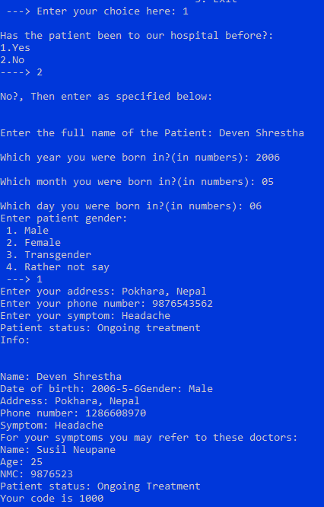
Progress Report
What is completed:
Our program can now add patient’s in the database after
getting information such as their name, age, etc.

Slide 7
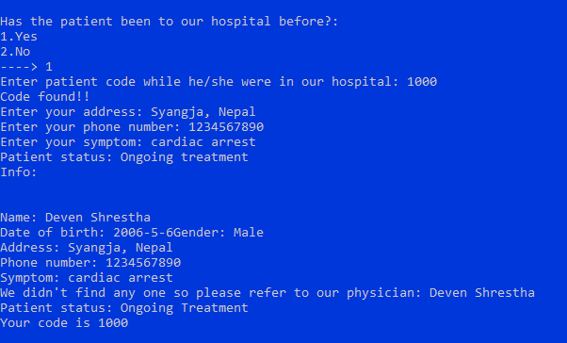
If a patient is repeated or old visitor who has already been to our hospital or at our record system now they can skip the basic information section and move forward to changing information such as address and phone numbers.

Slide 8
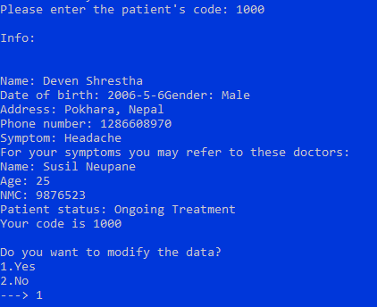
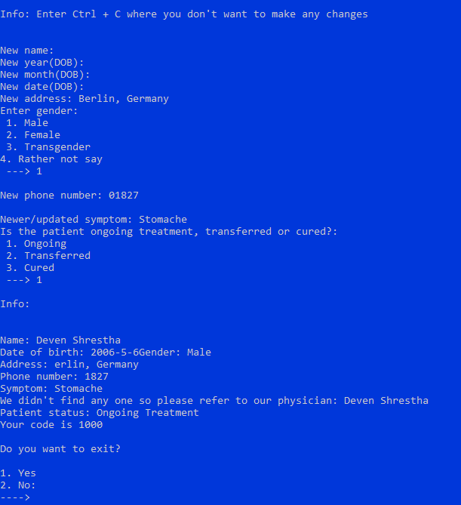
Now user can search patient by their code and can modify data and information as needed.
Search
Modify

Slide 9
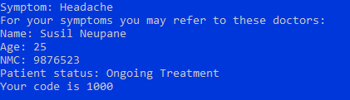
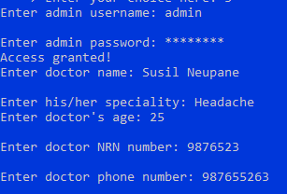
In addition to that our program can now analyze patient symptoms and assign doctors according to patients symptoms.
Now the admin has to enter the username and password or pass the security factor authentication to open the system from their they can manage or view doctor information.

Slide 10
Algorithm
Add patient to the database:
Step 1: Start
Step 2: Declare variables name, age, address, disease, severity and prescription
Step 2: Ask if the patient has been to our hospital before
Step 3: If yes then ask for his/her code, search through the “cured or transferred” section, if the patient is not found then go to step 2, if the patient is found then ask for new age, disease, severity and prescribed medicine, if no then ask to input patient’s name, age, address, disease, severity and prescription.
Step 4: Assign the patient his/her patient code which will be the array number they happen to have their data stored on
Step 5: Ask if the user wants to add another patient
Step 6: If yes then go to Step 2, if no then move onto the next step
Step 7: End

Slide 11
Algorithm
Search/View/Update/Move/Remove patient’s data:
Step 1: Start
Step 2: Ask to input patient’s code
Step 3: If patient’s code exist, then show the patient’s data, if this doesn’t then print “Wrong or Invalid Code” and go to Step 2
Step 4: Ask if the user wants to update, move or remove the patient’s data
Step 5: If the user chooses to update, then it will allow the user to type the patient’s newer information, if the user chooses to move, it will ask whether the user wants to move the data to “cured” or “transferred”, if the user chooses “cured” then the patient’s data will be moved to the cured section and if the user chooses “transferred” then the patient’s data will be moved to the transferred section, if the user chooses remove, then the patient’s data will be deleted.
Step 6: Ask if the user wants to modify other patient’s data
Step 7: If yes then go to Step 2, if no then move onto the next step
Step 8: End

Slide 12
Algorithm
Admin:
Step 1: Start
Step 2: Ask to input admin username and password
Step 3: Provide interface to manage doctor’s and patient’s data
Step 4: End

Slide 13
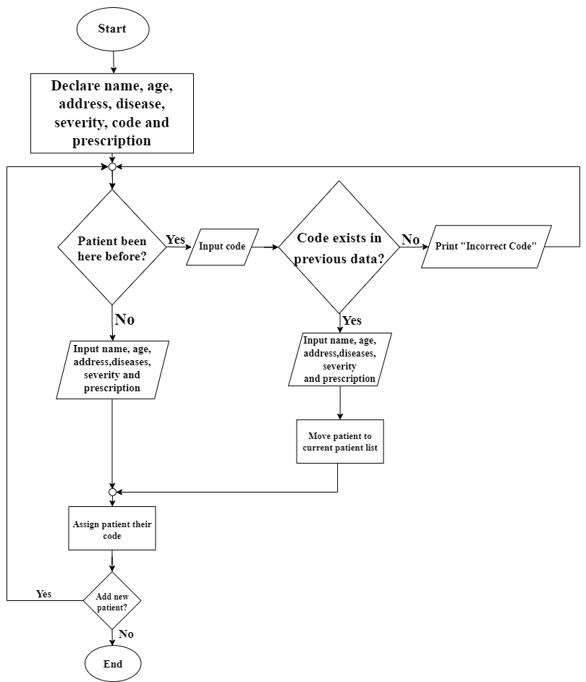
Flowchart
Add patient to the database

Slide 14
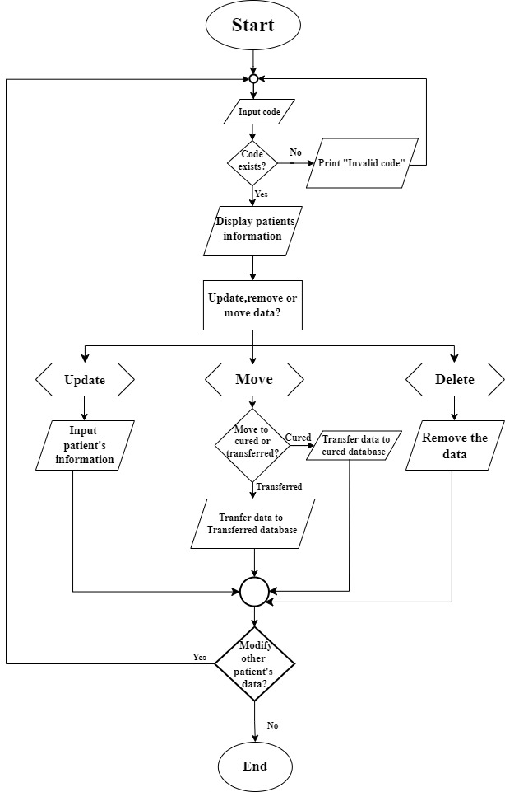
Flowchart
Search/View/Update/Move/Remove patient’s data

Slide 15
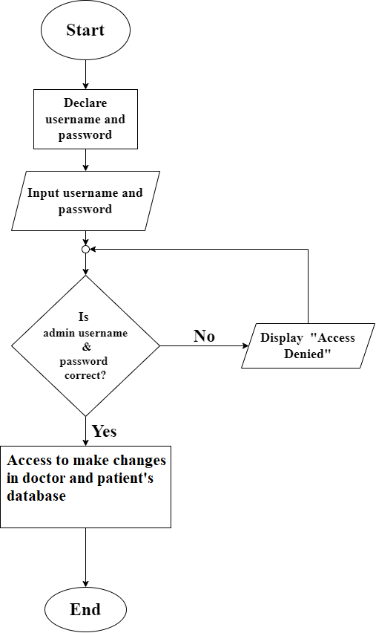
Flowchart
Admin access

Slide 16
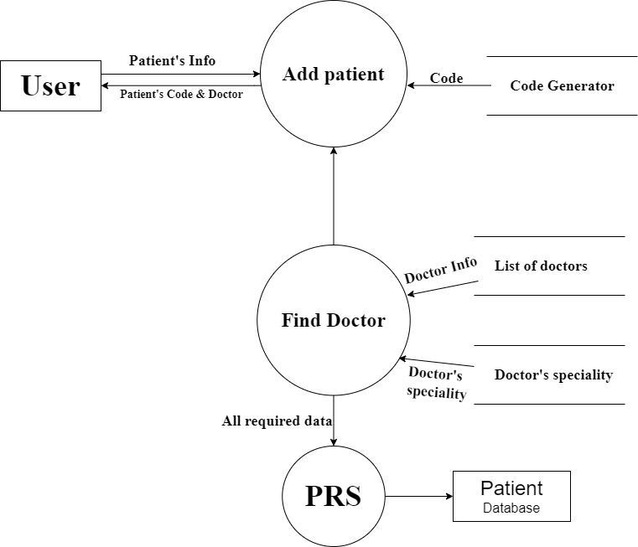
Data flow diagram(Level 2)
Add patient to the database

Slide 17
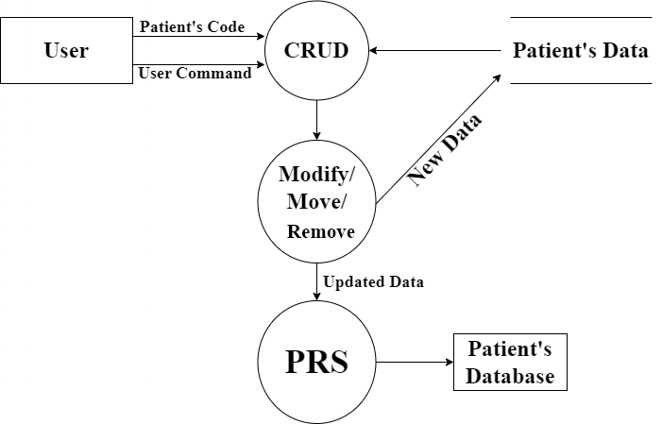
DFD
Search/Modify Patient’s data

Slide 18
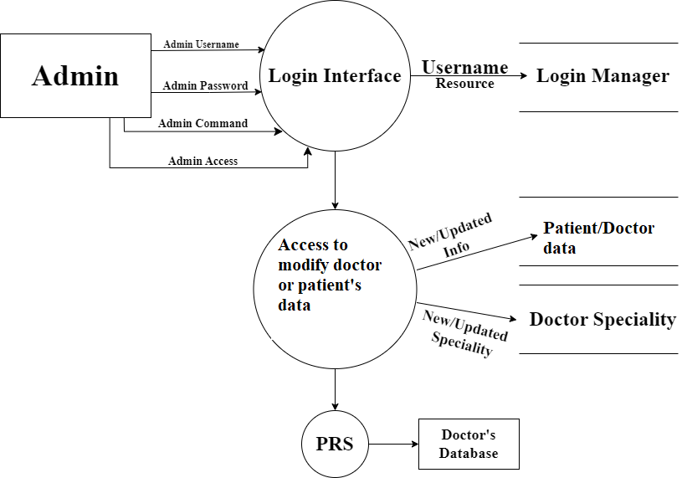
DFD
Admin Access

Slide 19
What needs to be done
File handling so we can store data in files permanently and can process data from the files.
Ability to change admin username and password by the admin
Fix some annoying issues such as first letter of Address not showing when updating patient’s data
Make symptoms detection better because if the doctor specializes in stomach and the patient types stomache, it will not suggest the doctor
Make error handler better for example if we type words where number should be typed, the program goes insane.
Move updating patient’s data to the admin section
Ability to remove patient’s data

Slide 20
Bottlenecks
Error handler: We have yet to research how to handle type error such as giving characters when number is asked for
Symptom detection: We are puzzled on how to make symptoms such as stomache refer to doctor who specializes in stomach

Slide 21
Individual members of group Report:
Deven Shrestha:
Nobel Baral:
Susil Neupane:
Sandesh Bastola

Slide 22
Gantt Chart

Slide 23
References
Dick, R. S., Steen , E. B., & Detmer, D. E. (1997). The Computer-Based Patient Record: Revised Edition: An Essential Technology
for Health Care. Retrieved from National Library of Medicine: https://www.ncbi.nlm.nih.gov/books/NBK233055/

