Slide 1
Patient Record System
By:
Deven Shrestha
Nobel Baral
Sandesh Bastola
Susil Neupane

Slide 2
Project Summary
In short, our program “Patient Record System” will assist in easier management of Patient’s record using a computer system. This program will allow the user to add new patient with their details which are their name, address, disease, age, sex, severity and prescribed medicine and the program will automatically assign the patient with an unique code which can later be used to easily identify a specific user easily within our program. You can also search for an already existing patient using their patient code or general information to either update their data, show their data or remove them from the “ongoing treatment” section and move them to “treated” or if they transferred to another hospital then move them to the “transferred” section. If a patient has already been in the hospital before and has arrived again, you can search within the “treated or transferred” to view their previous data and update the data and move him/her to “ongoing treatment” section and assign them a new patient code. The user can even remove the patient’s data.

Slide 3
Introduction
Our program “Patient Record System” will allow the users to add and manage patient’s data efficiently. This program will assign each patient a unique code and that code can be used to effectively search, modify, view, move or remove the data. That way, even if multiple patient’s have the same name and diseases and other information, it will not cause a problem in the workflow. If the patient who wants to add their data into the database has already been to our hospital, then the program will ask for their previous code and their new info and assign them a new code. In addition to that, our program will be written in C programming language, which is a middle level language for ensuring great performance. So, our system “Patient Record System” is a feature-full and user-friendly system which will facilitate the hospital which implement it to be more advanced and efficient. It is also very fast and optimized allowing for the computer to efficiently perform various activities without being pulled down by it.

Slide 4
Problem Statement
Many hospitals store their patient’s data in physical files which are very prone to damage from fire and water. In addition to that, those files take a very long time to search through and the quality of those files can degrade overtime. This program will solve such issue by providing an interface to store patient’s data digitally. So, the hospitals which implement our program will not have to worry about managing the files and can easily access, view, modify, move and remove data easily and efficiently.

Slide 5
Objective
The objective of creating this program are as follows:
Provide easy to use and manage interface to record and manage patient’s data
To save patient’s data digitally

Slide 6
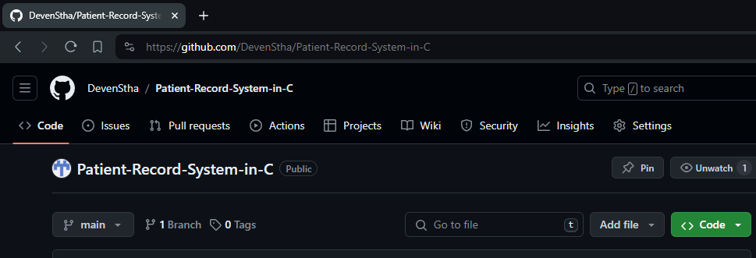
Methodology
We are going to use various programming techniques we will learn through the internet and in college to create the PRS system. Here are the current methodology we have planned that we will use to create the system:
All members of our group will create a github account and commit all their contributions in a repo named Patient-Record-System-in-C

Slide 7
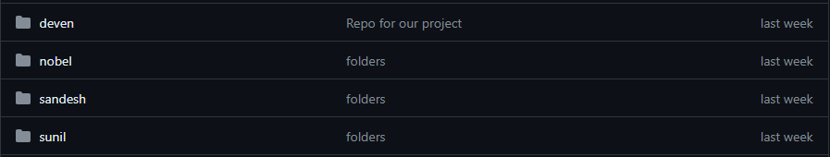
(continuation from previous page)
There will be different folders for each members corresponding to our names in the repository, each members will commit only in their corresponding repository and after discussion with each member the approved code will be applied in the main program.
The program will store previous patient’s data and current patient’s data.
Each patient will have their own unique patient code.
When the program runs, it will first ask if the patient has been in our hospital before and if he/she has, the program will ask the patient code of the patient while he/she were admitted in the hospital and search through the previous patient’s data and the user can update the data and the patient will be assigned a new code.

Slide 8
(continuation from previous page)
If the patient has not been in our hospital then it will ask the user to enter patient’s name, address, age, sex, disease, severity and prescribed medicine.
The user can search for current and previous patient records using the patient’s code to update, view, move or remove them.
We have created various algorithms, flowcharts and Data Flow
Diagrams(DFD) to make making our software easier and make it
easier to explain.

Slide 9
Algorithm

