Slide 1


APPLIED MACHINE LEARNING FOR TEXT ANALYTICS (24ALT3101)
REVIEW – 2
Project Title
CyberGraph-X: Multilingual Cyber Threat Intelligence
Team No-21
Roll No Name
2420030673 M.Jathin
2420030772 Roshan
2420030270 B.Devendar
Department of Computer Science and Engineering
KONERU LAKSHMAIAH EDUCATION FOUNDATION

Slide 2
OUTLINE
Introduction
Objectives
Literature Survey
Proposed Method
Conclusion

Slide 3
Introduction
Cybersecurity teams receive large volumes of unstructured threat reports containing information about malware, threat actors, vulnerabilities, and IoCs in multiple languages. Manually analyzing these reports is time-consuming, while existing NLP systems often struggle with cybersecurity-specific, multilingual, and code-mixed text.
CyberGraph-X addresses this problem by using fine-tuned XLM-RoBERTa, Named Entity Recognition, relation extraction, and Neo4j knowledge graphs to automatically extract, connect, and visualize cyber threat information. The system helps SOC analysts and cybersecurity teams identify threats, discover relationships, and analyze attack campaigns more efficiently.

Slide 4
Objectives
Develop a fine-tuned XLM-RoBERTa model for multilingual and code-mixed cybersecurity text.
Identify Threat Actors, Malware, CVEs, IPs, Domains, and IoCs using NER.
Extract relationships between cybersecurity entities using Relation Extraction.
Build a Neo4j Knowledge Graph to connect and visualize threats.
Detect and correlate similar attack campaigns across different reports and languages.
Evaluate the model using Precision, Recall, and F1-Score.

Slide 5
Literature Survey
NLP for Cyber Threat Intelligence: Recent research shows that NLP can automate the extraction of useful information from large volumes of unstructured cybersecurity reports, including entities, relationships, and attack information. However, challenges remain in handling noisy and domain-specific cybersecurity language.
Cybersecurity NER: MalwareTextDB demonstrated the use of annotated malware reports for cybersecurity text analytics and NER, providing 39 APT reports with 6,819 annotated sentences.
Entity & Relation Extraction: Recent approaches such as KnowCTI and CyberEntRel combine deep learning with entity and relation extraction to create structured threat intelligence and knowledge graphs. These works show that identifying relationships between threat actors, malware, vulnerabilities, and attacks provides more useful intelligence than entity extraction alone.
Knowledge Graphs: Research shows that cybersecurity knowledge graphs can integrate heterogeneous CTI sources and support threat correlation, visualization, and reasoning.

Slide 6
Proposed Method
The proposed CyberGraph-X system uses a fine-tuned XLM-RoBERTa Transformer to analyze multilingual and code-mixed cybersecurity reports. The extracted entities such as threat actors, malware, CVEs, IPs, and IoCs are processed through relation extraction to identify connections between threats. These entities and relationships are then stored in a Neo4j Knowledge Graph for threat correlation and visualization. Finally, a web-based dashboard provides threat analysis, campaign discovery, and attack relationship visualization for cybersecurity analysts.

Slide 7
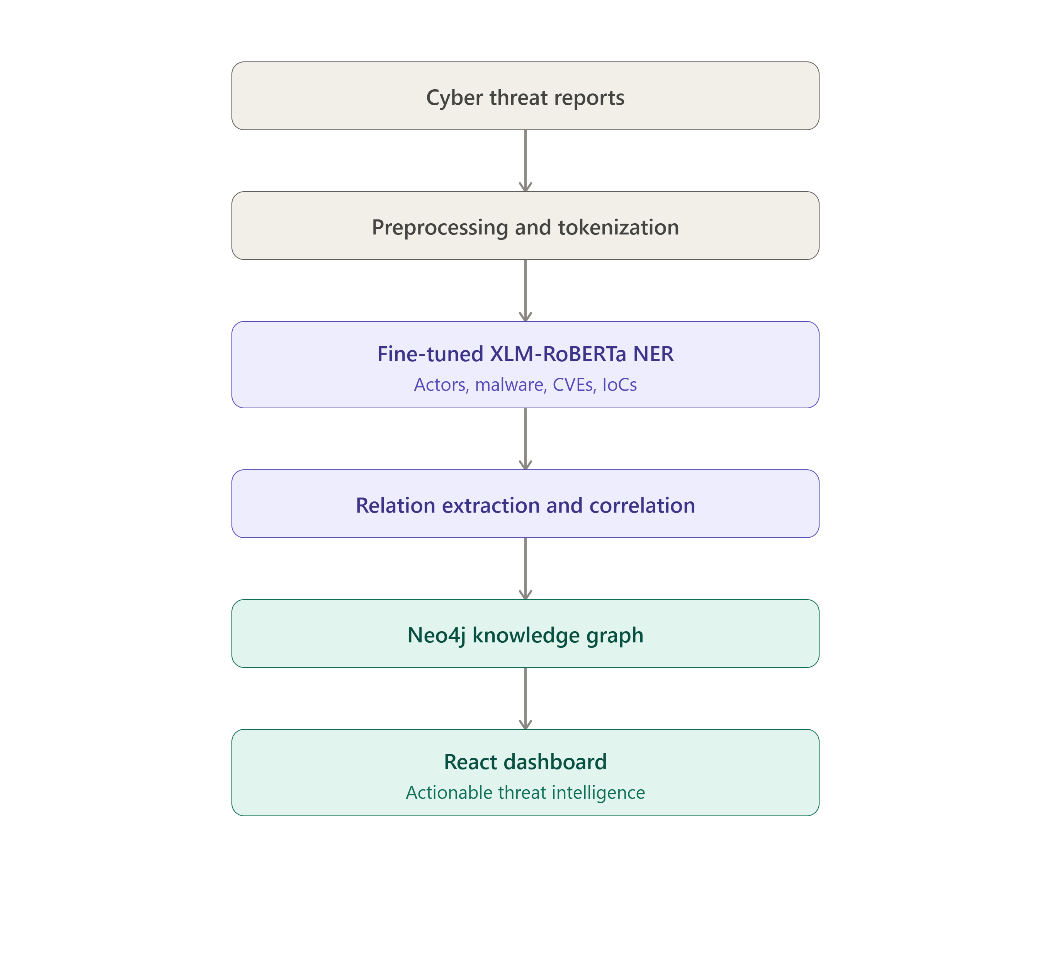
Work Flow

Slide 8
Conclusion:
CyberGraph-X provides an intelligent approach to analyzing multilingual and code-mixed cyber threat reports using fine-tuned XLM-RoBERTa. The system automatically extracts cybersecurity entities, identifies relationships, and represents them through a Neo4j Knowledge Graph. It helps correlate threats, discover attack patterns, and reduce manual analysis for cybersecurity teams. The project demonstrates how Transformer-based Text Analytics can be applied to real-world Cyber Threat Intelligence, with potential for future integration with real-time threat feeds and predictive threat analysis.

Slide 9
THANK YOU

