Slide 1








Atliq Hardware
Consumer Good Ad-hoc Insights
Presented by – Devender
SQL Challenge Project

Slide 2
Agenda
• Introduction & Objective
• About Products • About Data
• Ad hoc Requests & Insights

Slide 3
Introduction & Objective
• Atliq Hardware is one of the leading computer hardware producer in India and well
expanded in other countries too.
• However, the management noticed that they do not get enough insights to make quick
and smart data-informed decisions.
• It has total of 74 customers, in 27 Countries worldwide. Also in Asia Pacific Region
(APAC), North America (NA), Europe (EU) and Latin America (LATAM).
• It has 3 main divisions of products – Peripherals and Accessories (P&A) , Network and
Storage (N&A), Personal Computers (PC).

Slide 4
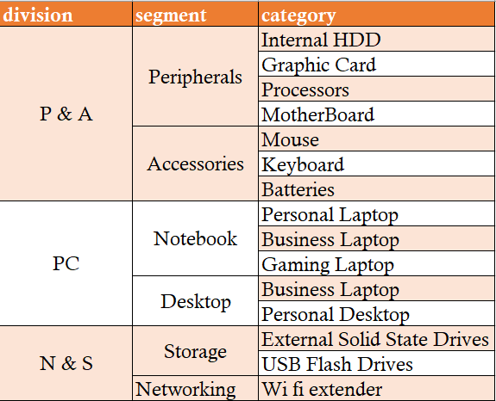
About Products

Slide 5
About Data
• The dataset of fiscal year 2020 and 2021 is available.
• Atliq Hardware fiscal year starts from 1st September and ends on 31stAugust
• Atliq Hardware Database has 6 tables.
• dim_customer : contains customer related data
• dim_product : contains products related data
• fact_gross_price : contains gross price information for each product
• fact_manufacturing_cost : contains the cost incurred in the production of each product
• fact_pre_invoice_deductions: contains pre-invoice deductions information for each product
• fact_sales_monthly : contains monthly sales data for each product

Slide 6
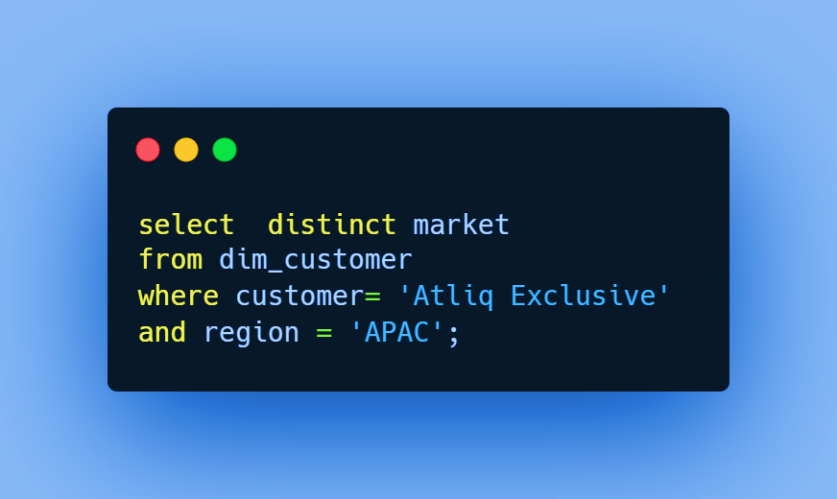
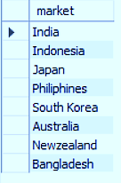
Ad hoc Requests & Insights
1. Provide the list of markets in which customer "Atliq Exclusive" operates its business in the APAC region.

Slide 7
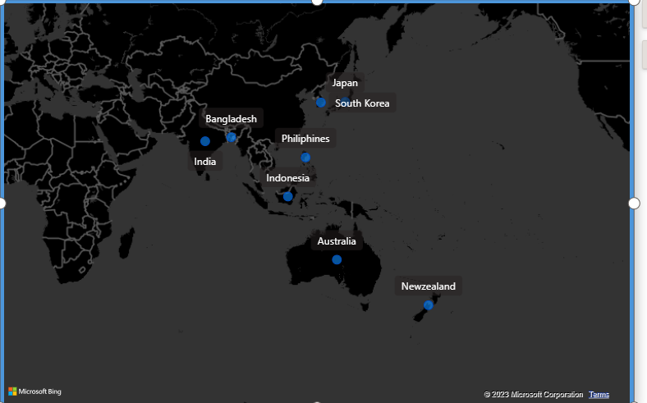
List of markets for Atliq Exclusive in APEC
INSIGHTS :
The customer ‘ Atliq Exclusive ‘ operates
in 3 regions - APAC, EU, NA.
In APAC region it operates its business in
Australia, Bangladesh, India, Indonesia,
Japan, New Zealand, Philippines and
South Korea.

Slide 8
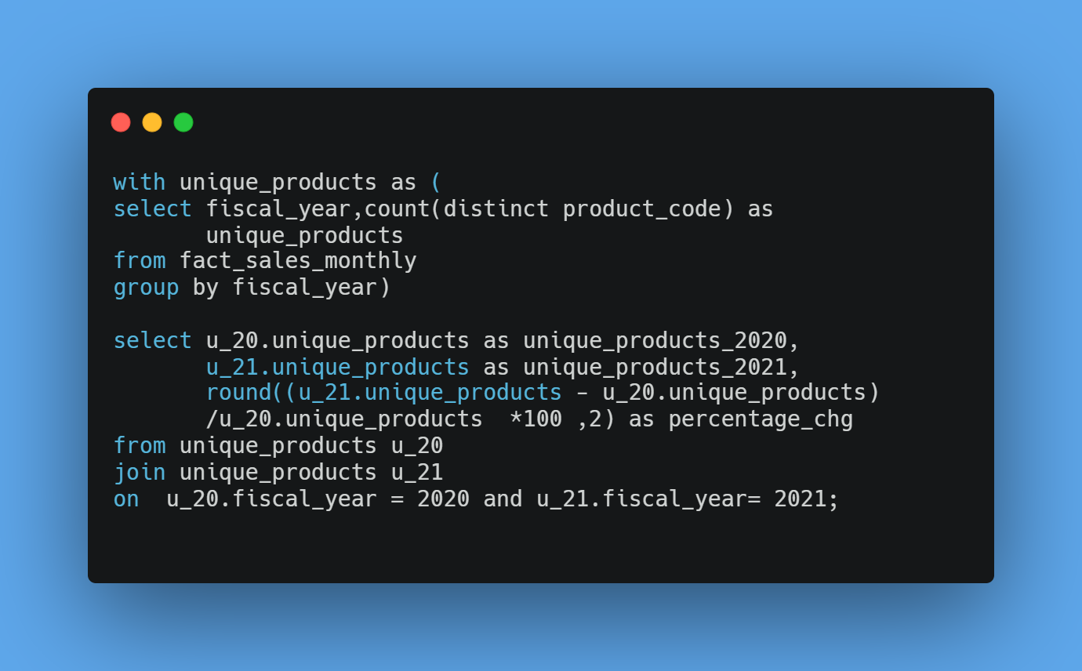

2. What is the percentage of unique product increase in 2021 vs. 2020? The final output contains these fields, unique_products_2020 unique_products_2021 percentage_chg

Slide 9
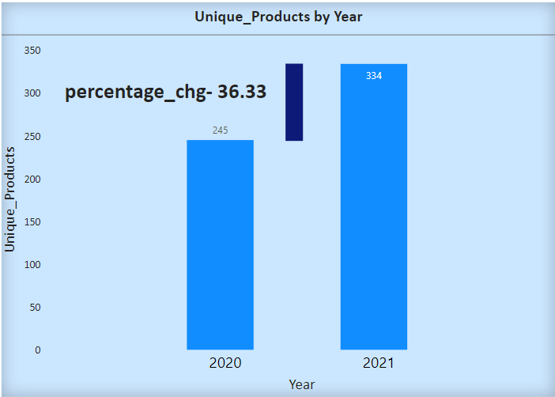
Percentage of unique product count increase in 2021 from 2020
INSIGHTS :
Based on results comparing fiscal years 2020 and 2021, the number of unique products increased in 2021 is 89 and the percentage growth is 36.33%.

Slide 10
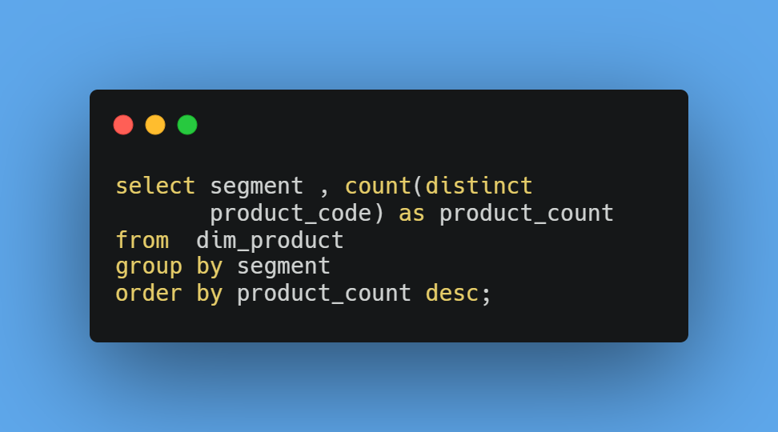
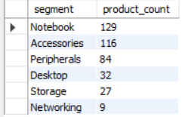
3. Provide a report with all the unique product counts for each segment
and sort them in descending order of product counts. The final output contains 2 fields, segment , product_count

Slide 11
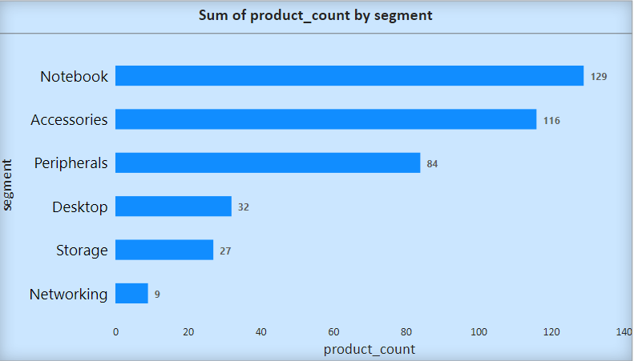
How many products are there in each segment?
INSIGHTS :
The products are divided into 6 segments - Notebook, Accessories, Peripherals, Desktop, Storage and Networking.
First 3 segments having the more products and bottom 3 segments have the less products compared to top 3 segments

Slide 12
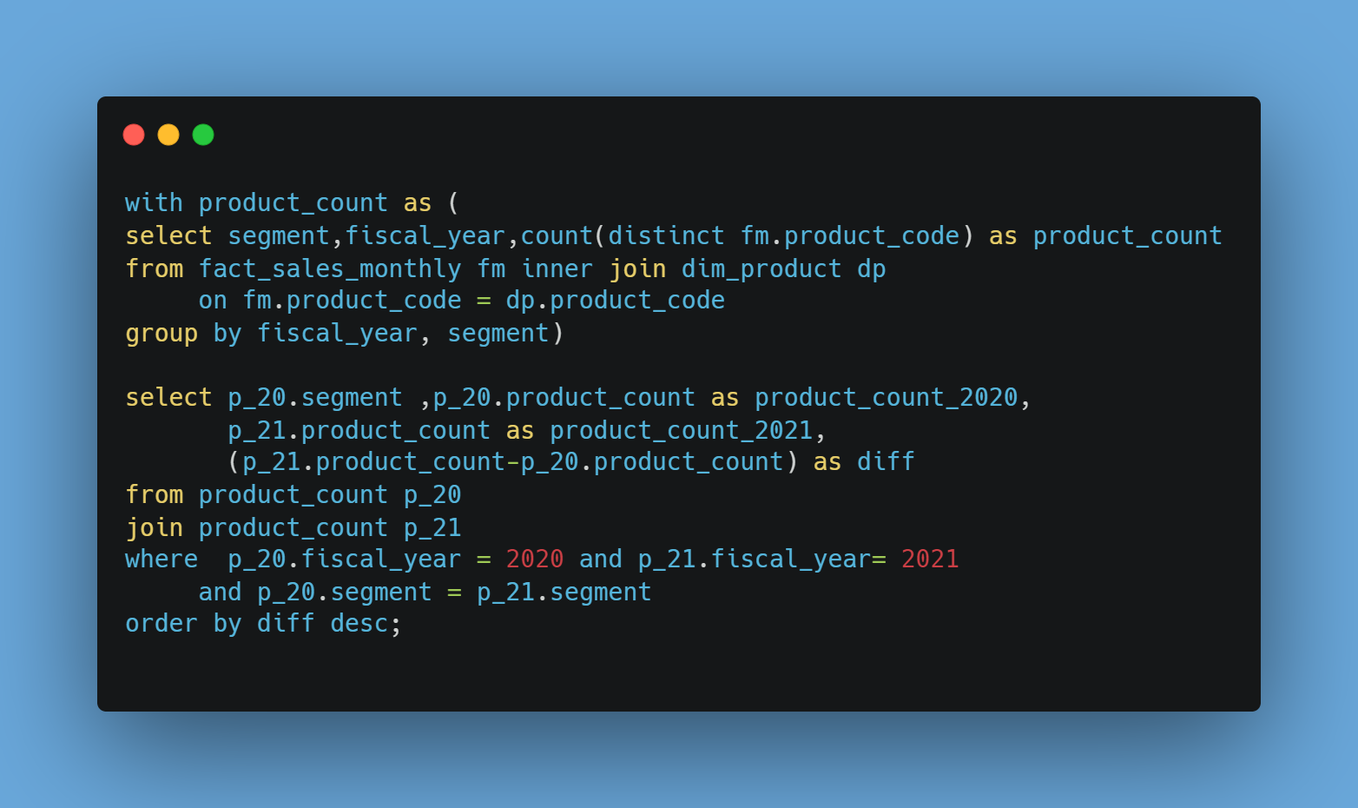
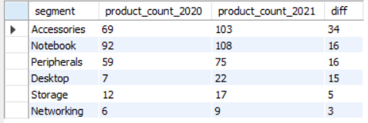
4. Follow-up : Which segment had the most increase in unique products in 2021 vs 2020 ? The final output contains these fields , segment product_count_2020 product_count_2021 difference

Slide 13
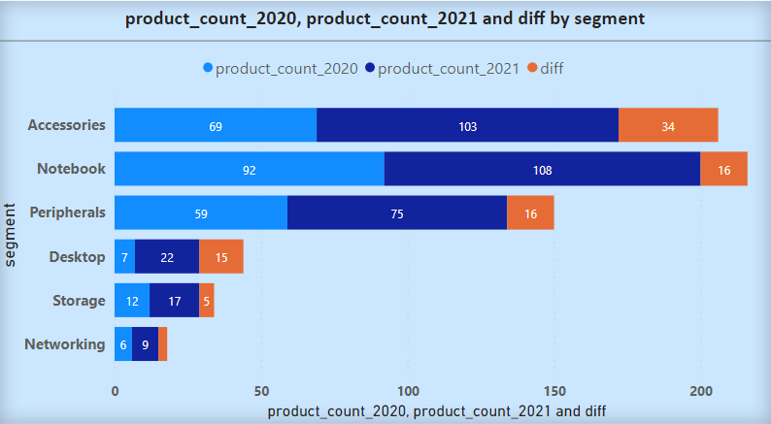
Which segment had the most increase in new product in 2021 ?
INSIGHTS :
Overall 89 unique products were added in 2021.
The count of new products are highest increased in Accessories following notebook and Peripherals.
The percentage of products are increased highest in desktop 214% compared to 2020 and networking 50% compared to 2020

Slide 14
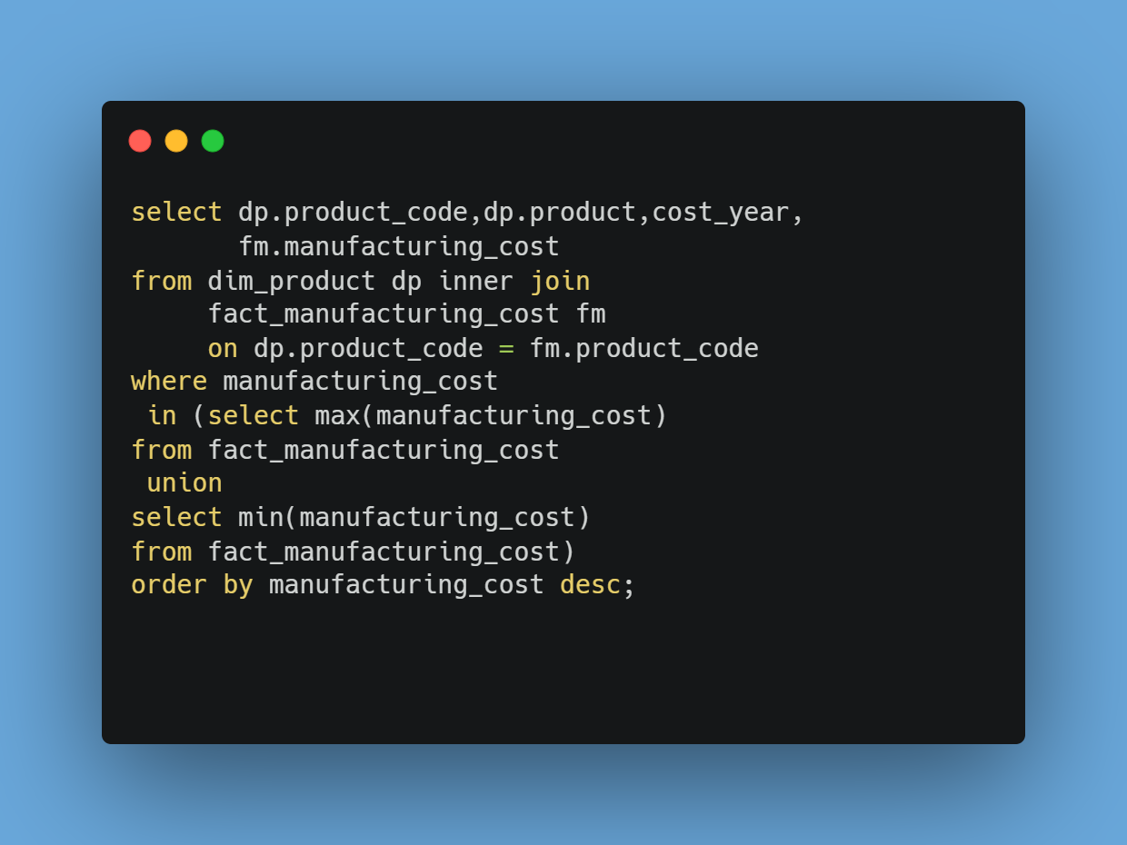

5. Get the products that have the highest and lowest manufacturing costs. The final output should contain these fields, product_code product manufacturing_cost

Slide 15
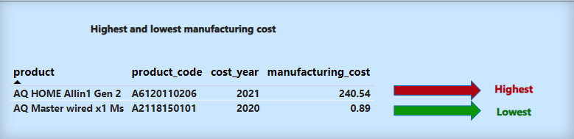
Which product have the highest and lowest manufacturing costs.
INSIGHTS :
Mouse: AQ Master wired * 1 MS has the lowest manufacturing cost.
Personal Desktop : AQ Home Allin 1 Gen 2 has the highest manufacturing cost.

Slide 16
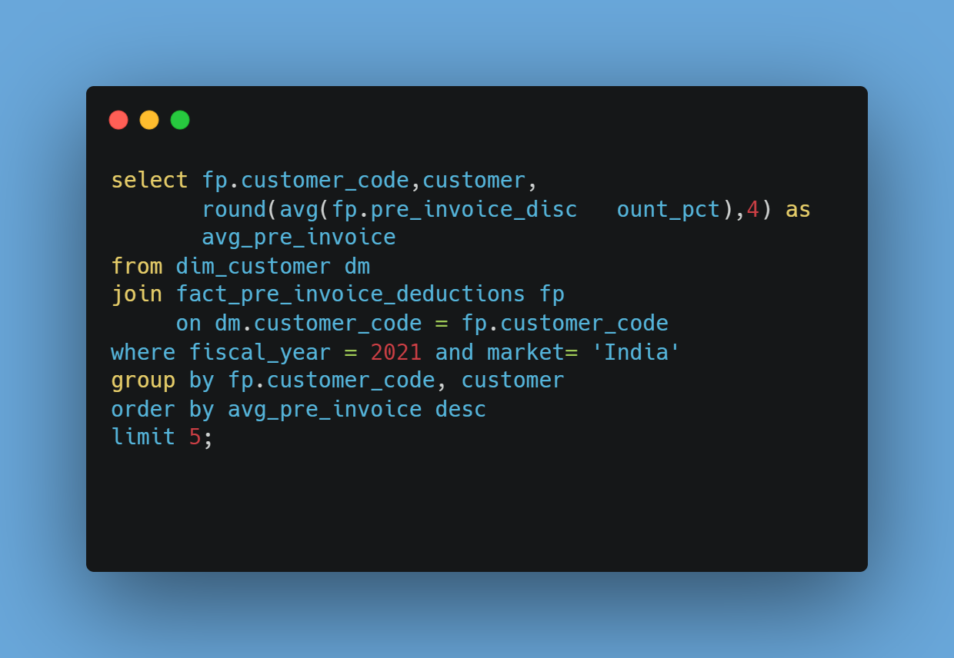
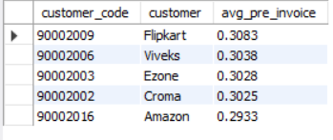
6. Generate a report which contains the top 5 customers who received an average high pre_invoice_discount_pct for the fiscal year 2021 and in the Indian market. The final output contains these fields, customer_code customer average_discount_percentage

Slide 17
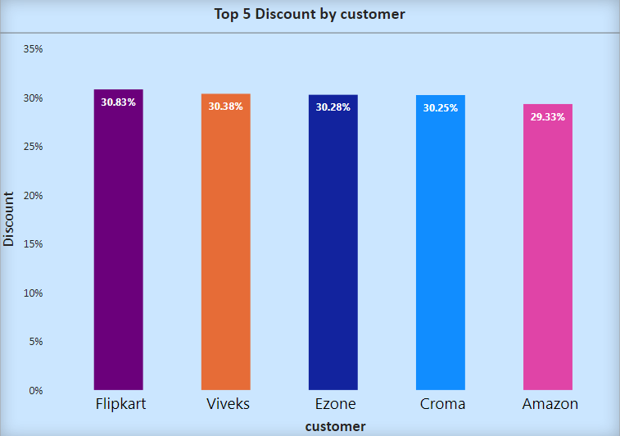
Which customer we offered the highest average discount ?
INSIGHTS :
The average high pre invoice discount percentage for the fiscal year 2021 given by top 5 companies in Indian market are Flipkart, Vivek's, Ezone, Croma, Amazon.
Among all Flipkart received high discount and Amazon received slightly low discount

Slide 18
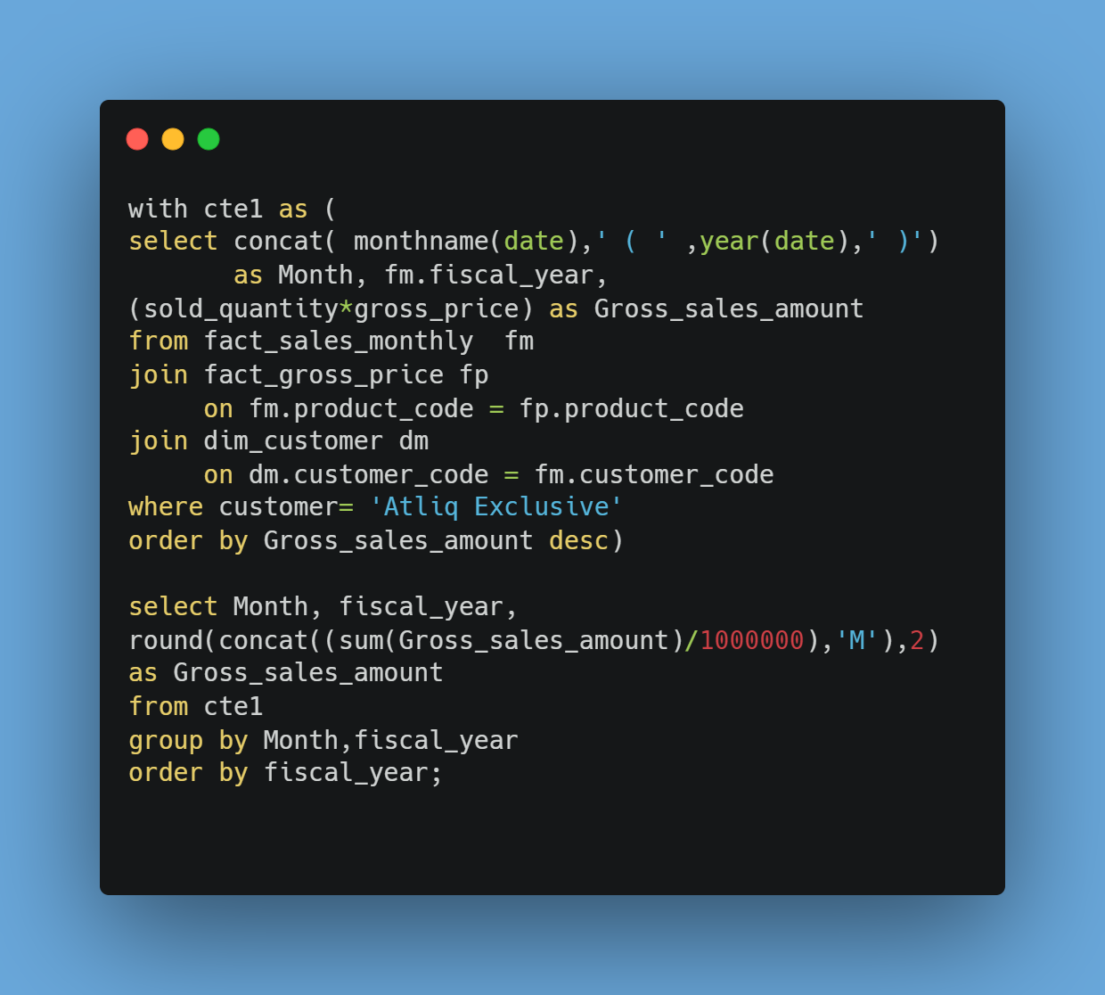
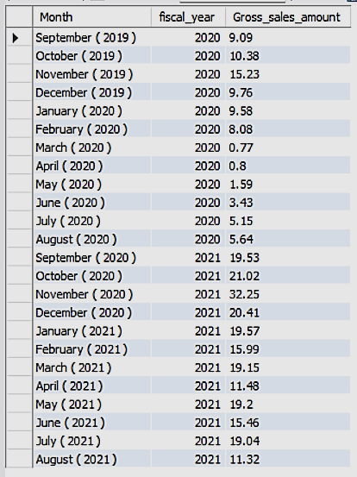
7. Get the complete report of the Gross sales amount for the customer “Atliq Exclusive” for each month . This analysis helps to get an idea of low and high-performing months and take strategic decisions. The final report contains these columns: Month Year Gross sales Amount

Slide 19
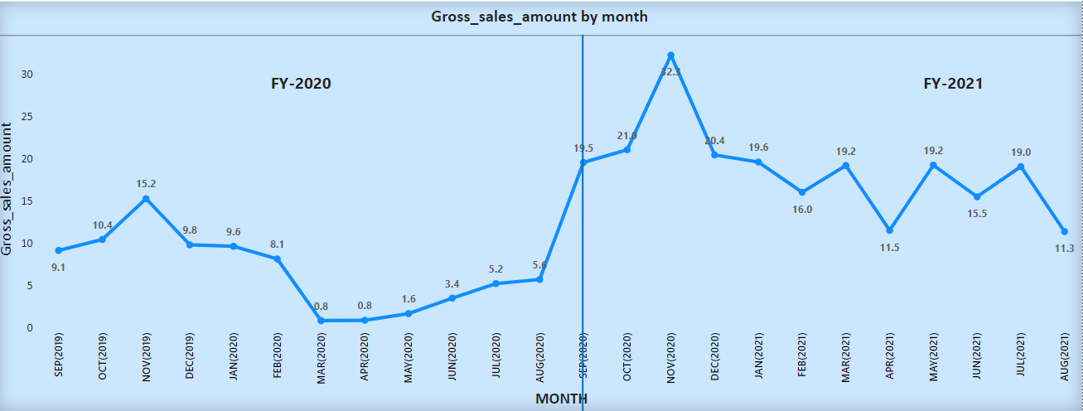
What is MoM trend for gross sales from 2019 to 2021 ?
INSIGHTS :
For the fiscal year 2020, March - 2020 was the least performing month and November - 2020 was the highest performing month in fiscal year 2021.

Slide 20
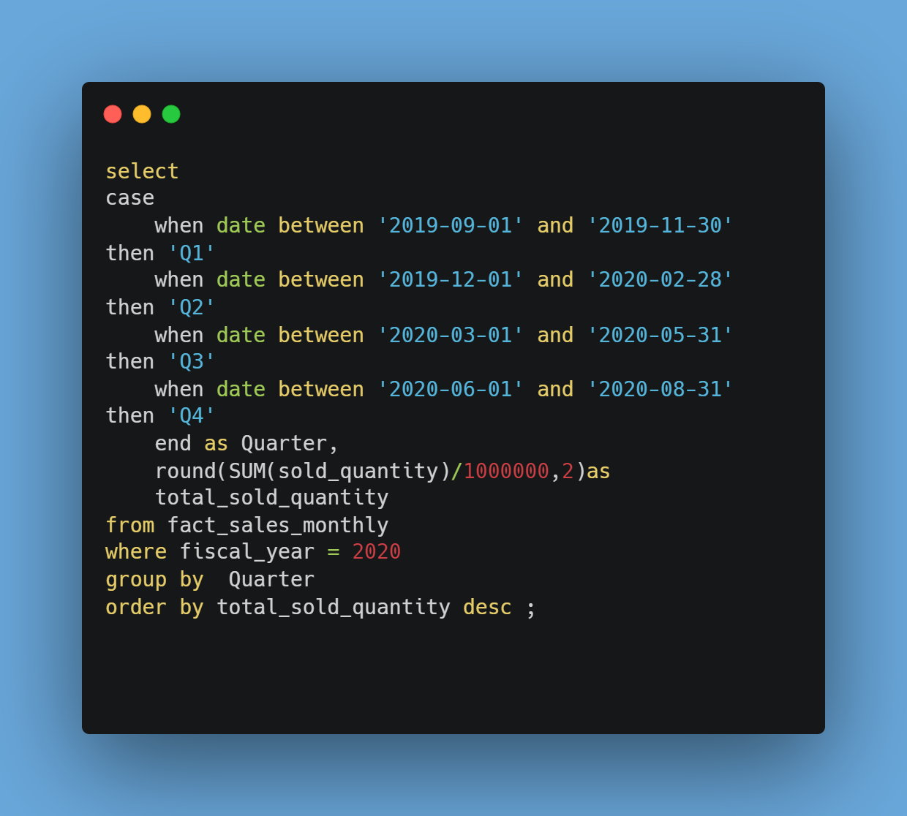
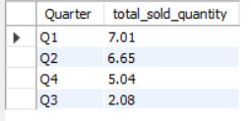
8. In which quarter of 2020, got the maximum total_sold_quantity? The final output contains these fields sorted by the total_sold_quantity, Quarter, total_sold_quantity

Slide 21
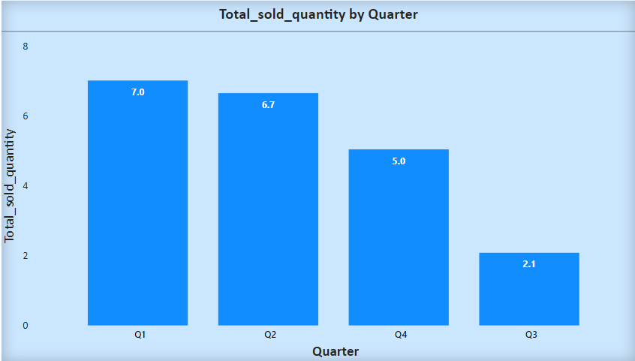
Which Quarter we had max product sales?
INSIGHTS :
Quarter 1 ('September' , 'October' , 'November') got the maximum total sold quantity. Quarter 3 ('March' , 'April' , 'May') got the minimum total sold quantity.
Q1 have the high production then drastically decrease in Q2 to Q3 then slightly increase in year end Q4

Slide 22
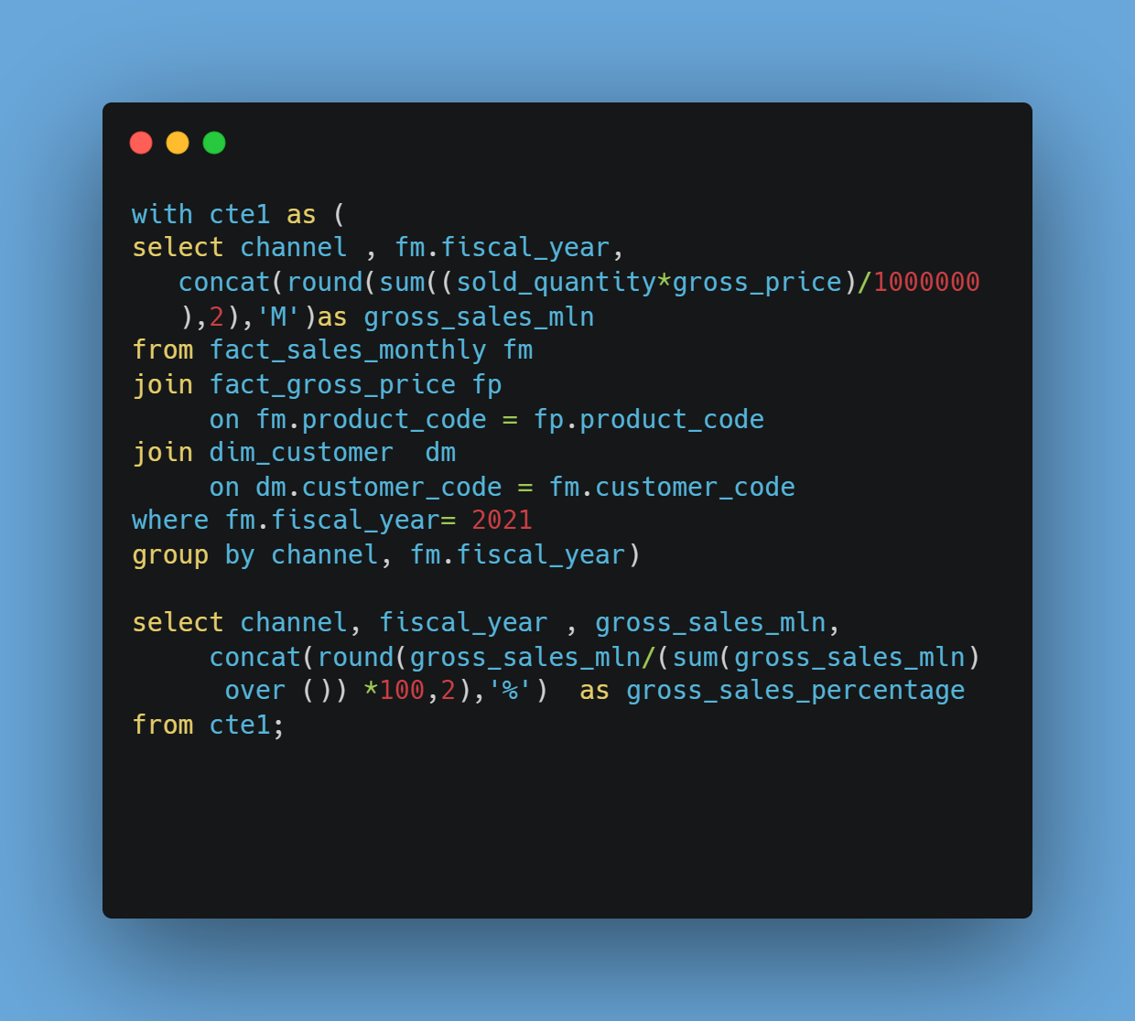
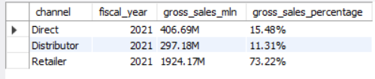
9. Which channel helped to bring more gross sales in the fiscal year 2021 and the percentage of contribution? The final output contains these fields, channel, gross_sales_mln ,percentage

Slide 23
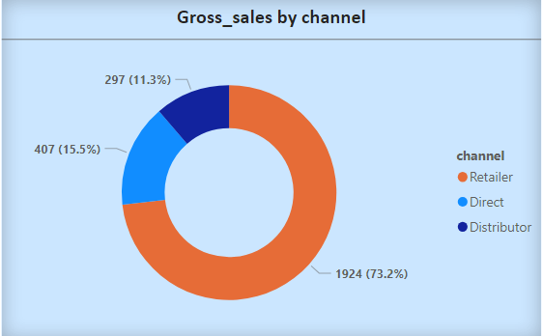
Which channel contributed the most in Gross sales
INSIGHTS :
Retailer channel helped to bring more gross sales in the fiscal year 2021 and the percentage of contribution is 73.22%.
Distributor channel has less gross sales in the fiscal year 2021 and the percentage of contribution is 11.31%.

Slide 24
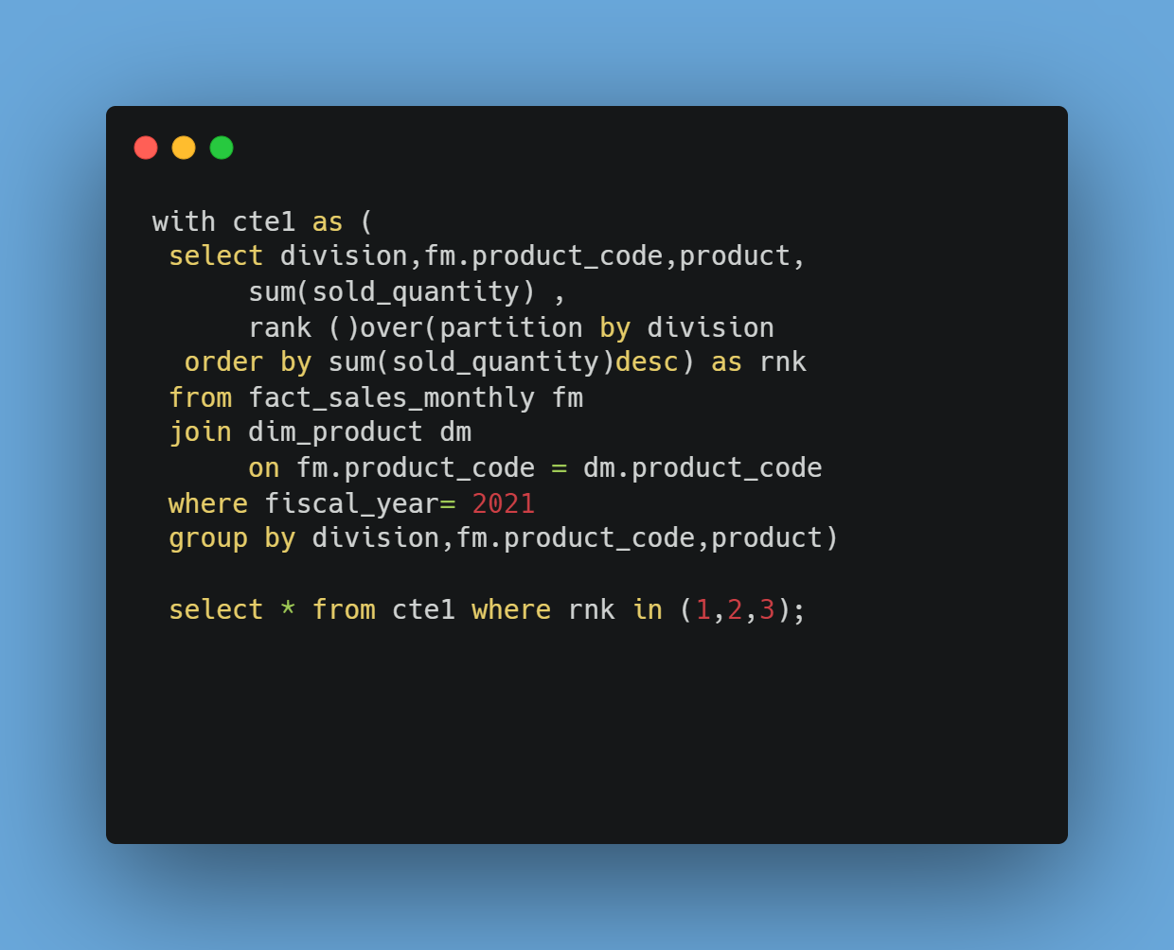
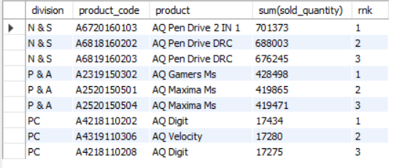
10. Get the Top 3 products in each division that have a high total_sold_quantity in the fiscal_year 2021? The final output contains these fields, division ,product_code, product, total_sold_quantity, rank_order

Slide 25
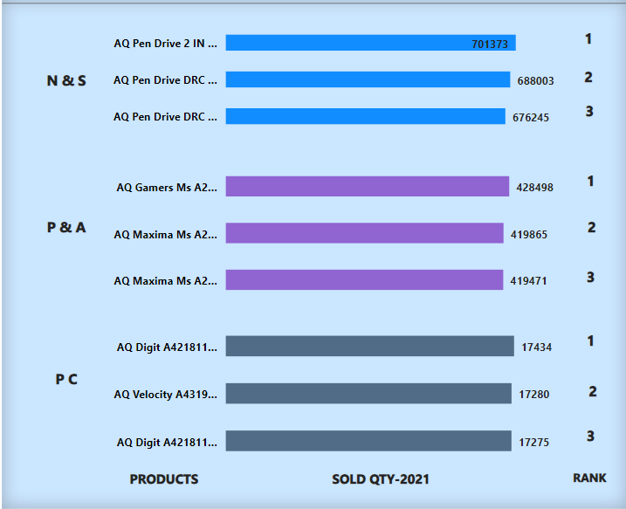
What are highest sold products in each division ?
INSIGHTS :
AQ Pen Drive 2 in 1 has highest demand and top 1 quantity sold in N & S where as AQ Digital Standard blue also have top 1 quantity sold in PC division . In P & A division AQ gamers Ms standard is the top 1 quantity sold product.

Slide 26
Thank you!

