Slide 1
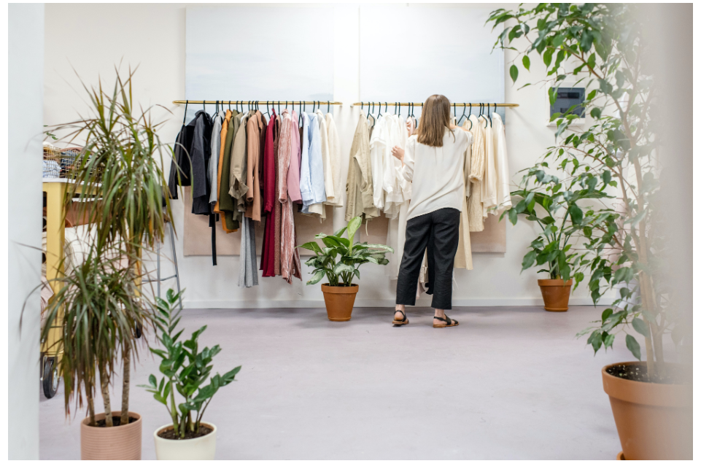
Marketing Analysis

Slide 2
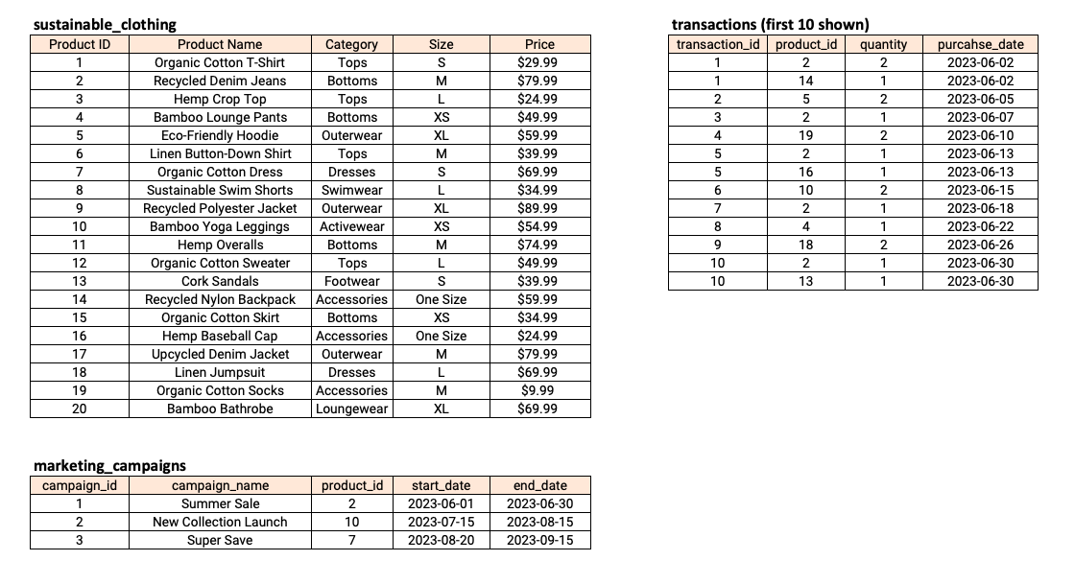
Introduction:
Marketing Analyst The 'Sustainable Clothing Co.' have been running several marketing campaigns and have asked you to provide your insight into whether they have been successful or not. Analyze the following data and answer the questions to form your answer.
Tables

Slide 3
Requirements :
1. How many transactions were completed during each marketing campaign?
2. Which product had the highest sales quantity?
3. What is the total revenue generated from each marketing campaign?
4. What is the top-selling product category based on the total revenue generated?
5. Which products had a higher quantity sold compared to the average quantity sold?
6. What is the average revenue generated per day during the marketing campaigns?
7. What is the percentage contribution of each product to the total revenue?
8. Compare the average quantity sold during marketing campaigns to outside the
marketing campaigns
9. Compare the revenue generated by products inside the marketing campaigns to
outside the campaigns
10. Rank the products by their average daily quantity sold

Slide 4
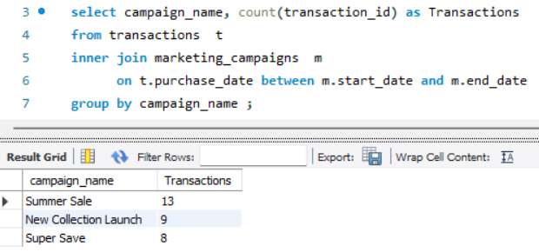
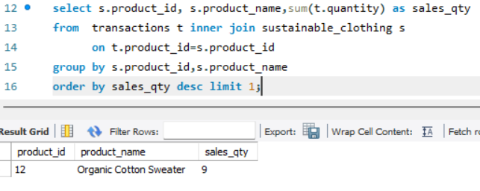
1. How many transactions were completed during each marketing campaign?
2. Which product had the highest sales quantity?

Slide 5
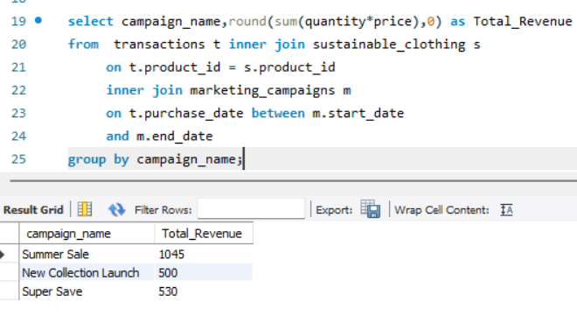
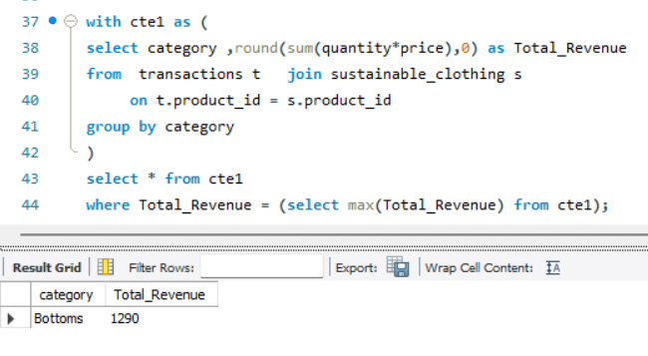
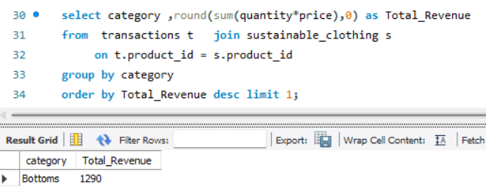
3. What is the total revenue generated from each marketing campaign?
4. What is the top-selling product category based on the total revenue generated?

Slide 6
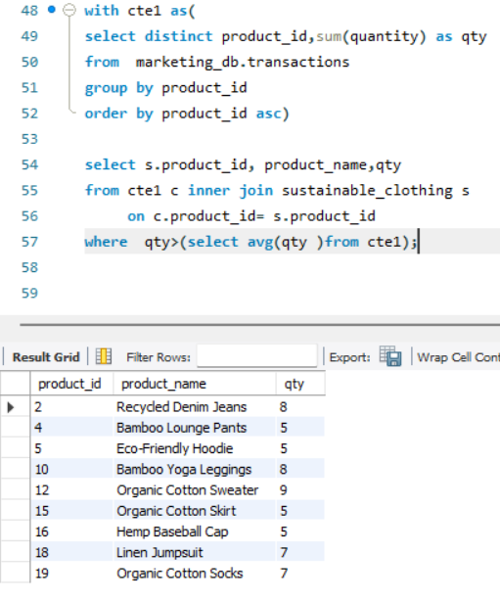
5. Which products had a higher quantity sold compared to the average quantity sold?

Slide 7
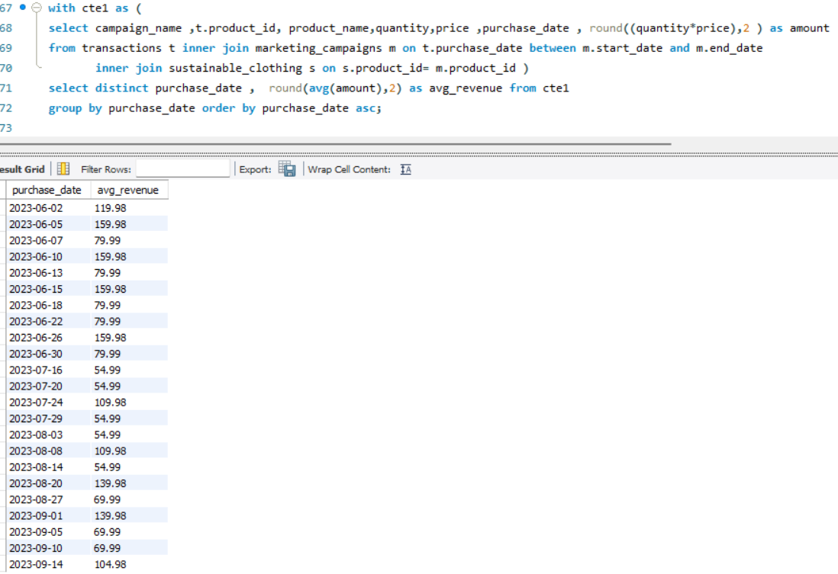
6. What is the average revenue generated per day during the marketing campaigns?

Slide 8
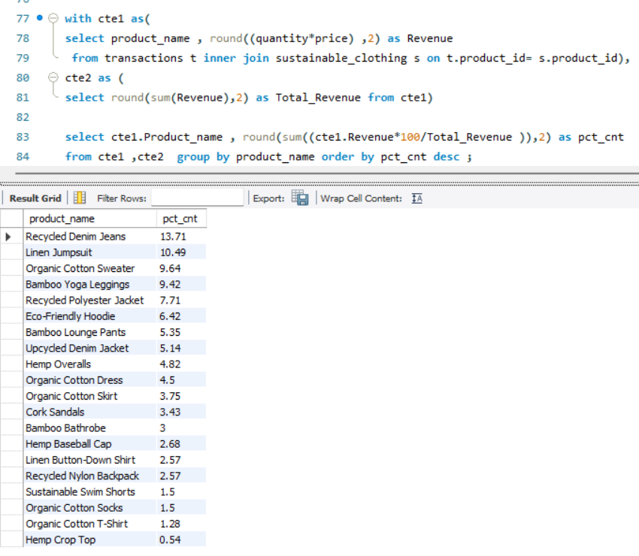
7. What is the percentage contribution of each product to the total revenue?

Slide 9
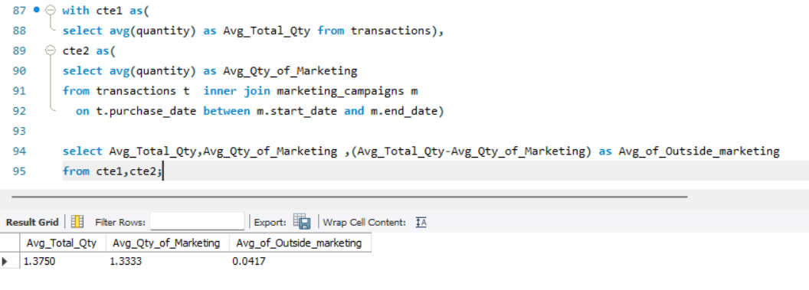
8. Compare the average quantity sold during marketing campaigns to the outside marketing campaigns

Slide 10
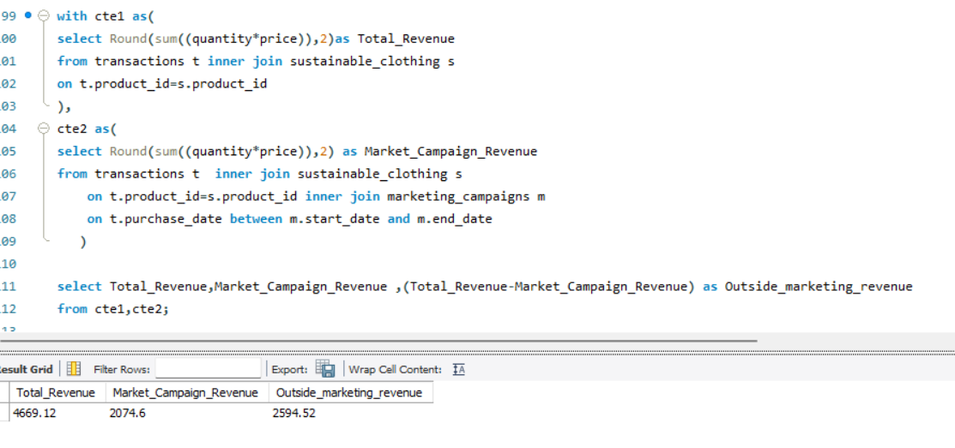
9. Compare the revenue generated by products inside the marketing campaigns to
outside the campaigns

Slide 11
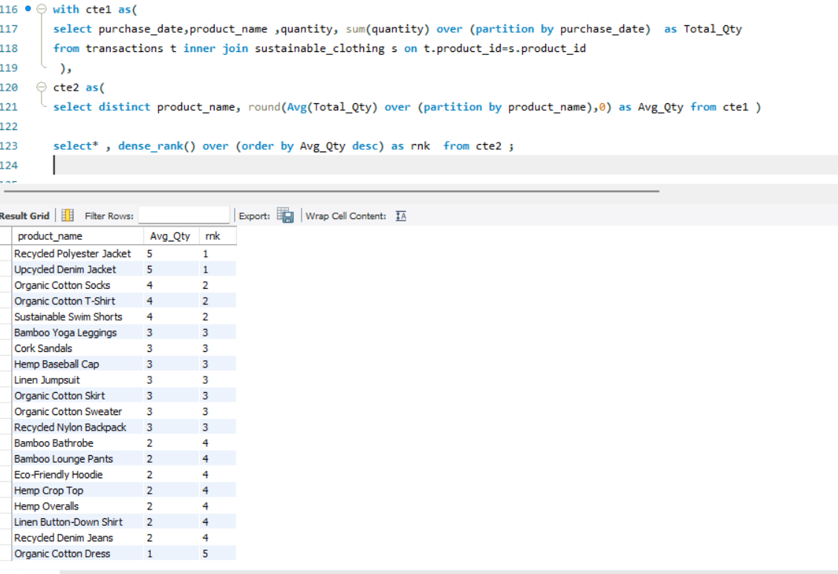
10. Rank the products by their average daily quantity sold

Slide 12
Findings:
Summer Sale campaign has achieved more sales compare to other campaign, and generated revenue of 1045 among all 3 campaign.
2. Top of the product has Organic Cotton Sweater among all 20 products and
category wise Bottom category products has generated more revenue.
3. Recycled Denim Jeans has the more revenue contribution share 13.7% compared
to all products.
4. Although the average number of quantities sold has higher during campaigns, the
total revenue generated outside the campaign exceeded the total revenue during
the campaign.

Slide 13
THANK YOU

