Slide 1
SAFE ALERT APPLICATION
B. Amarnadh(Y23CA005)
P. Jaya Venkata Sai Ram(Y23CA036)
T. Siva Koteswararao(Y23CA056)
Under the guidance of: T. Hymavathi

Slide 2
ABSTRACT
"Safe Alert" is an innovative mobile application designed to enhance personal safety by enabling users to quickly send emergency alerts and location information to predefined contacts in times of distress. The app allows users to register emergency contacts, send real-time alerts with location data, and able to make quick calls to emergency hotlines , making it a practical tool for ensuring personal security.

Slide 3
Problem Statement
Personal safety concerns have grown significantly with increasing incidents of harassment, violence, and emergencies in various settings. Individuals often face situations where they are unable to reach out for help immediately or convey their location to family or friends. Existing safety solutions lack comprehensive features such as real-time location tracking, emergency contact alerts, and self-defense resources. There is a need for an integrated application that provides instant communication and guidance during emergencies.

Slide 4
EXISTING SYSTEM
In the existing system, users rely on manual efforts to ensure their safety, such as calling emergency contacts or informing others about their location. This approach is time-consuming, stressful in critical situations, and may lead to delays or confusion in seeking help, reducing the overall effectiveness of personal safety measures.

Slide 5
DISADVANTAGES
Time-consuming process in critical situations.
Relying on manual efforts can delay emergency response.
Lack of automated features wastes effort during emergencies.
The process leads to confusion and inefficiency in seeking help.

Slide 6
PROPOSED SYSTEM
In the proposed system, users will have a more efficient and reliable way to ensure their safety. The system will streamline the process of sending alerts and notifying emergency contacts, reducing the time and effort needed in critical situations. This system is designed to help users make quick decisions and receive help promptly, improving overall personal security.

Slide 7
ADVANTAGES
It saves time by quickly sending alerts and notifying emergency contacts.
It ensures a faster response by automatically sharing live location coordinates.
It reduces confusion and delays during emergencies.
It is easy to use, allowing quick access to safety features.
It helps users act faster and feel more secure in critical situations

Slide 8
System requirements
HARDWARE REQUIREMENTS
Processor : Intel 11th gen i5 processor
Hard disk : 512 GB SSD
RAM : 16 GB RAM
Monitor : 15’’ CRT or LCD monitor

Slide 9
SOFTWARE REQUIREMENTS
Operating system : Windows 10
Frond End : XML
Back End : Java
Data Base : SQLite
Technologies : Android Studio

Slide 10
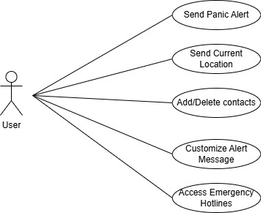
USE CASE DIAGRAM

Slide 11
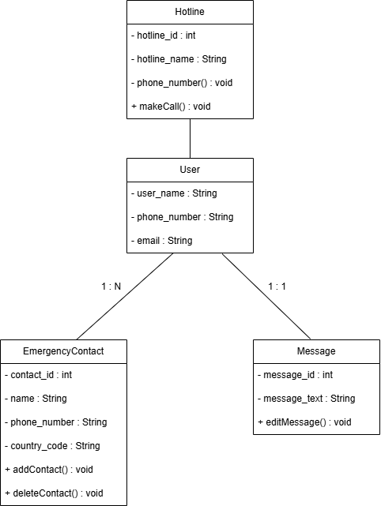
CLASS DIAGRAM

Slide 12
ENTITY RELATIONSHIP DIAGRAM

Slide 13

SEQUENCE DIAGRAM
User
Emergency contact
Message
Hotline
Add Emergency
contacts
Confirm details
Send message
Forward Calling

Slide 14
Test Cases
Test Case Id | Test Case Description | Input | Expected Output | Actual Output | STATUS
1
2
3
4
5
6

