Slide 1
Digital Infrastructure for Moving Objects — DIMO
Building an open connected vehicle ecosystem

Slide 2

Connect your car with DIMO
Download DIMO Mobile
Connect your car to the DIMO network
Stream data and earn $DIMO tokens
Access anonymized data for battery performance, automated driving systems, traffic, and weather
Develop applications for ridesharing, smart insurance, and more
Photo by Pexels

Slide 3
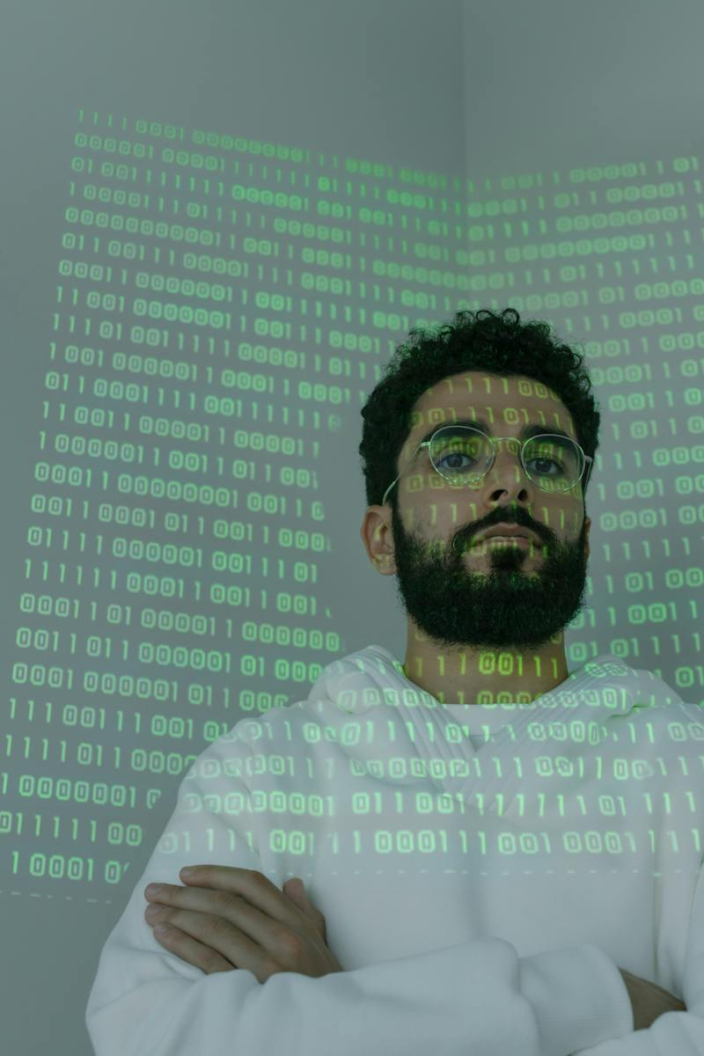
Web3: Real world transformation
Connecting physical and digital worlds
Web3 is not just about the metaverse
Efforts should be focused on improving the real world
Build a world that is more "Solarpunk" than Bladerunner
Connect digital and physical world through open cyber-physical systems
Photo by Pexels

Slide 4
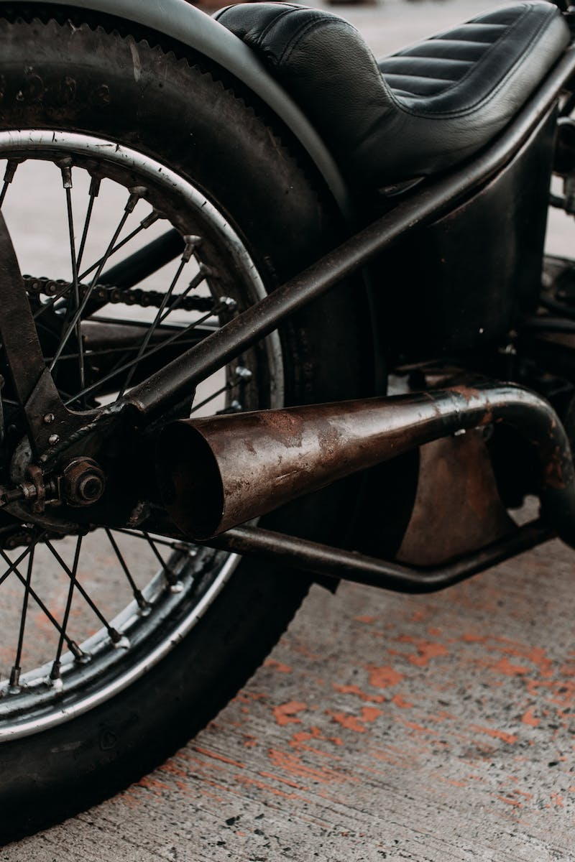
The Trusted Machine Age
Shared goals & guiding principles
Users own & delegate access to connected devices
Network participants own meaningful stakes in platforms
Developers can build apps and services based on merit
Privacy and regulatory oversight can coexist under transparent rules
Photo by Pexels

Slide 5

Introducing DIMO: IoT data and connectivity protocol
Enabling data providers and application development
Securely connect your car and become a data provider
Join the DIMO open data marketplace and application development environment
New features and applications for drivers, fleets, and enterprises
Supply and demand of the web3 ecosystem
Photo by Pexels

Slide 6
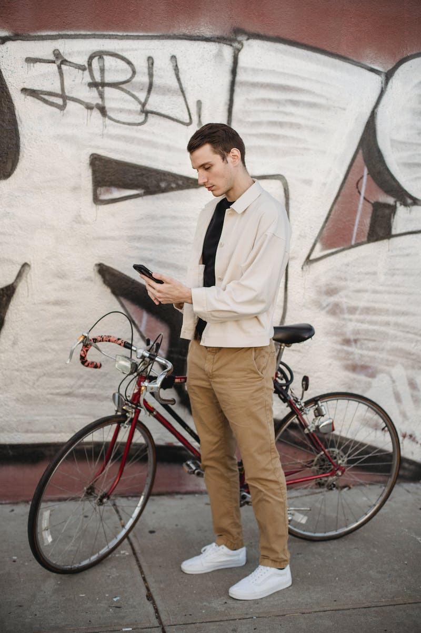
Building an open connected vehicle ecosystem
Deploying key building blocks on DIMO
Distribute $DIMO tokens for valuable services
Empower vehicle owners to securely connect their cars
Super-scale data collection, storage, and analysis
Build next-gen consumer products and enterprise services
Photo by Pexels

Slide 7

Unlocking $1T+ of new value
Improvements in customer experience and more
Potential to unlock value through customer experience improvements
R&D, coordination cost savings, risk management, and safety
Using $DIMO token to bootstrap the network
Platform for customer-centric applications and services
Photo by Pexels

