Slide 1
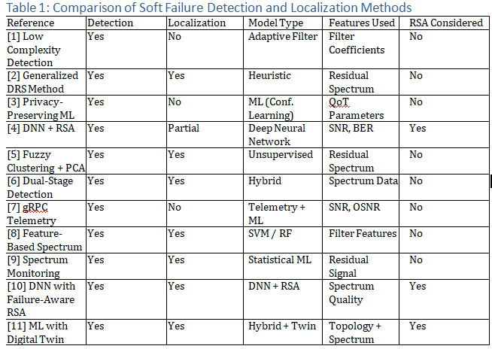

Slide 2
METHODOLOGY
SOFT FAILURE PREDICTION
SOFT FAILURE LOCALIZATION
QOT CHECK
ROUTING AND SPECTRUM

Slide 3
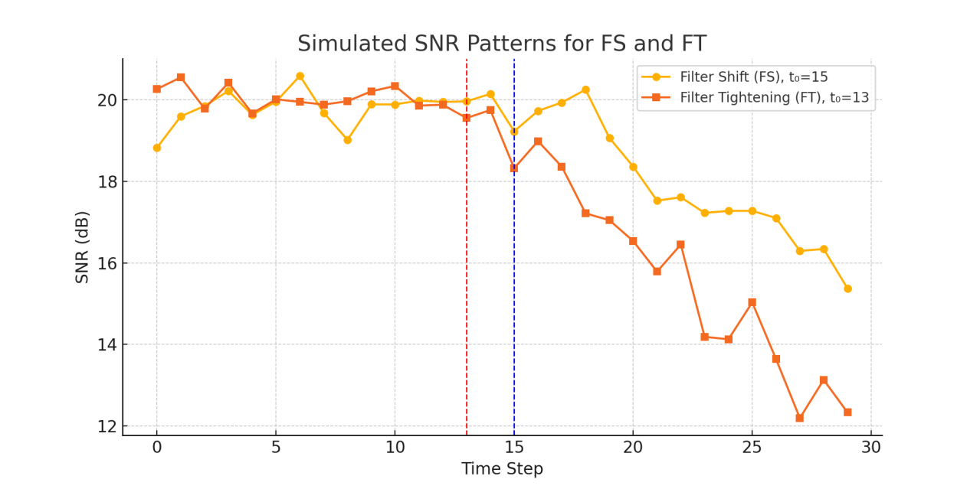
DATASET GENERATION
Normal Dataset Generation: SNR_normal(t) = S0 + N(0, σ2) where S0 ∈ [15, 25] dB
Filter Shifting (FS): SNR_FS(t) = S0 - α·(t - to) + N(0, σ2), for t ≥ to
Where:
α = 0.3 dB/time step (FS degradation factor)
to ∈ [10, 20] is the failure onset point
σ2 models environmental randomness (σ ≈ 0.5)
Filter Tightening (FT):SNR_FT(t) = S0 - β·(t - to) + N(0, σ2), for t ≥ to
Where:
β = 0.5 dB/time step (FT degradation factor)
to ∈ [10, 20] randomly selected onset time

Slide 4
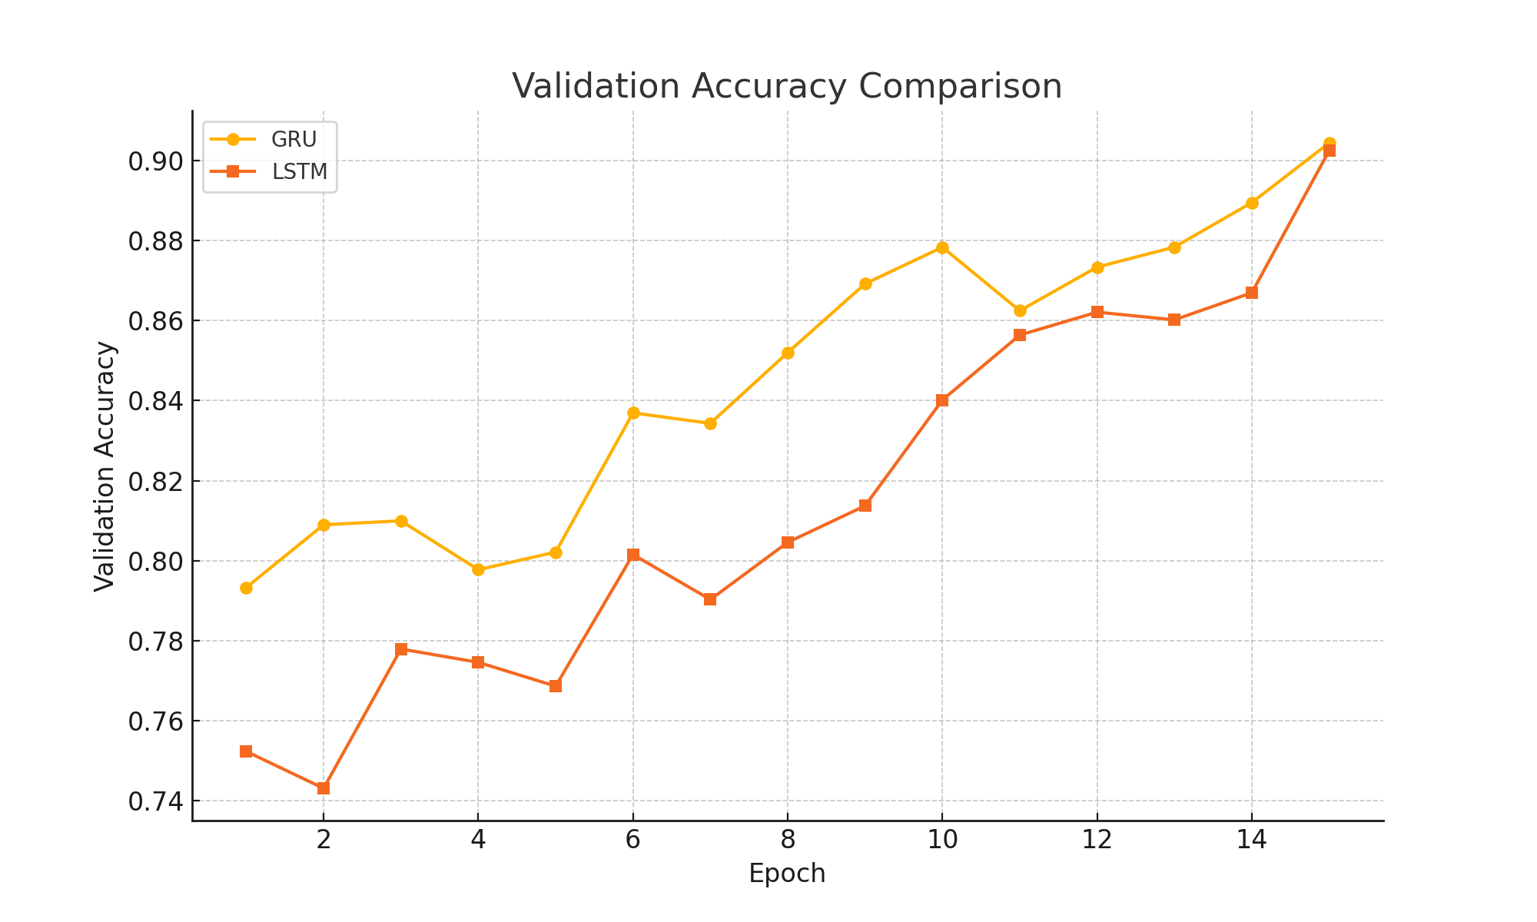
RESULT AND DISCUSSION
Figure 6: Validation Accuracy Comparison between GRU and LSTM Models

Slide 5
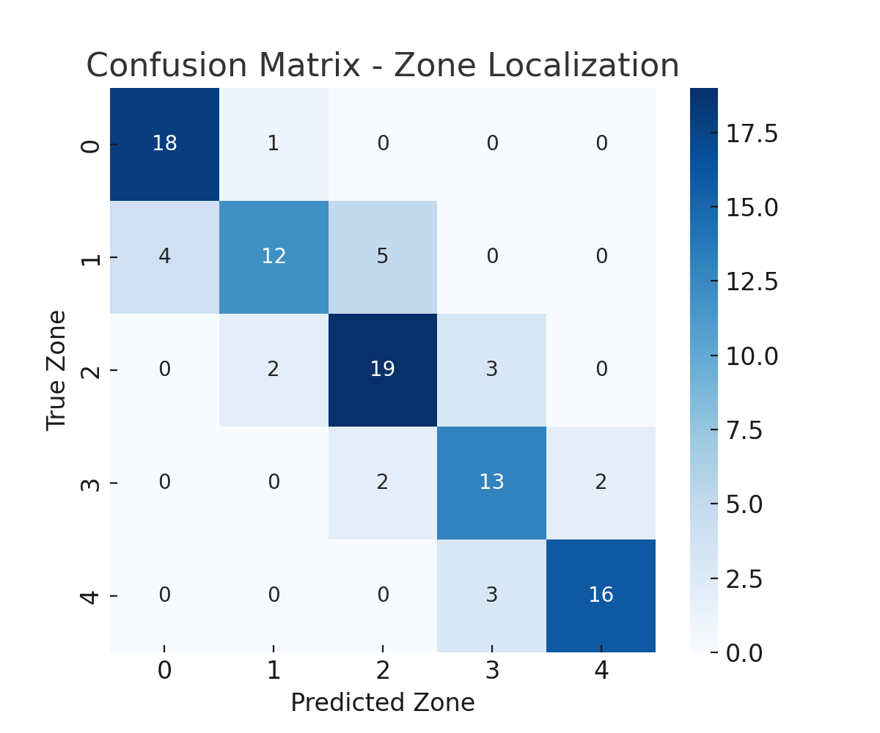
CONFUSION MATRIX
Figure 8: Confusion Matrix of Zone-Based Localization Model]

Slide 6
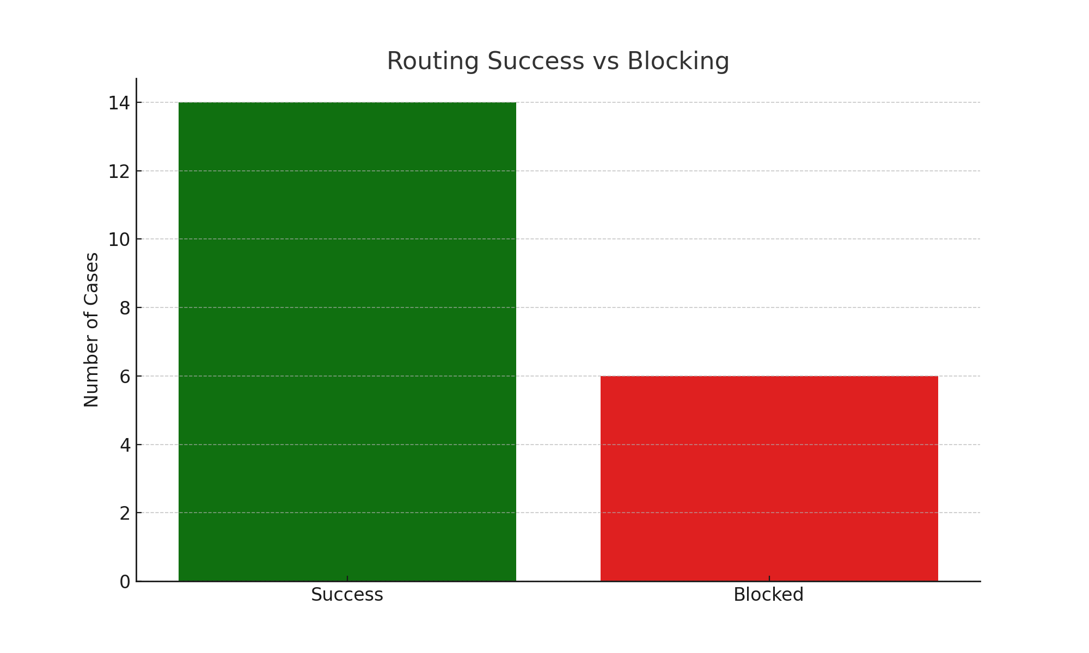
ROUTING SUCCESS
[Figure 9: Routing Success vs Blocked Attempts (Bar Chart)]

Slide 7
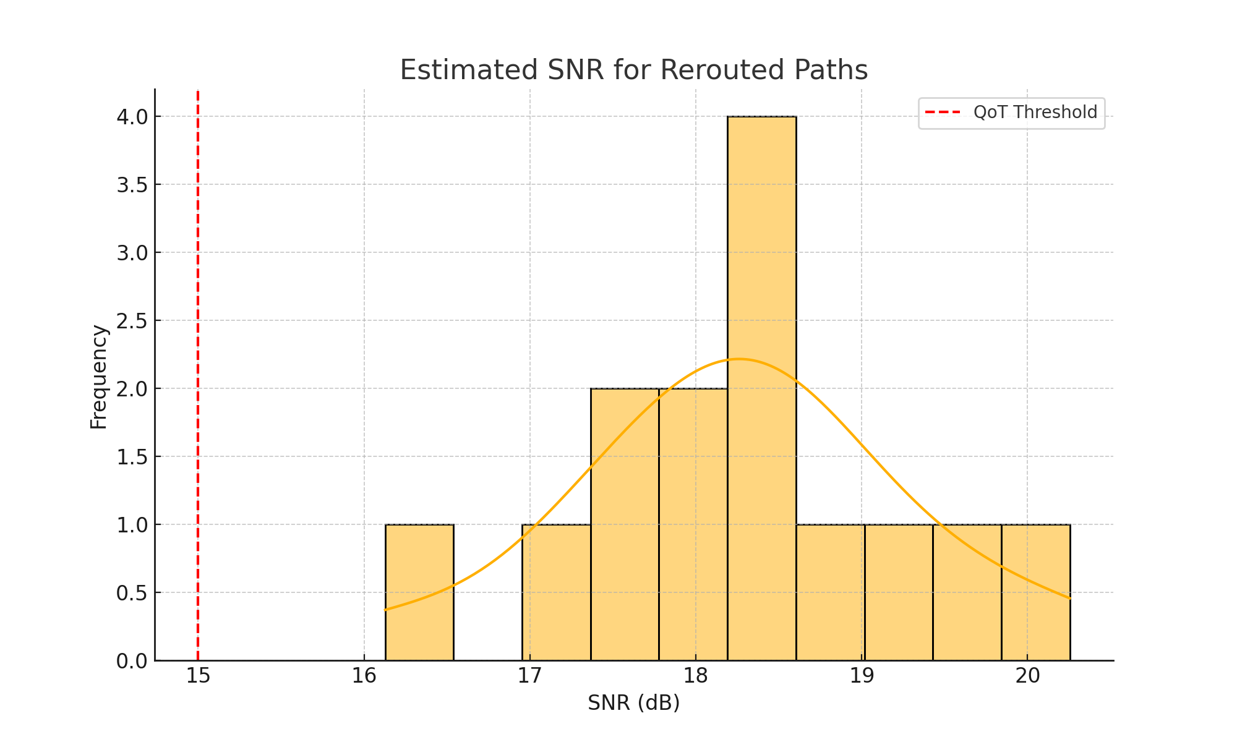
xcz
Figure 10: Histogram of Estimated QoT (SNR) for Rerouted Paths

Slide 8
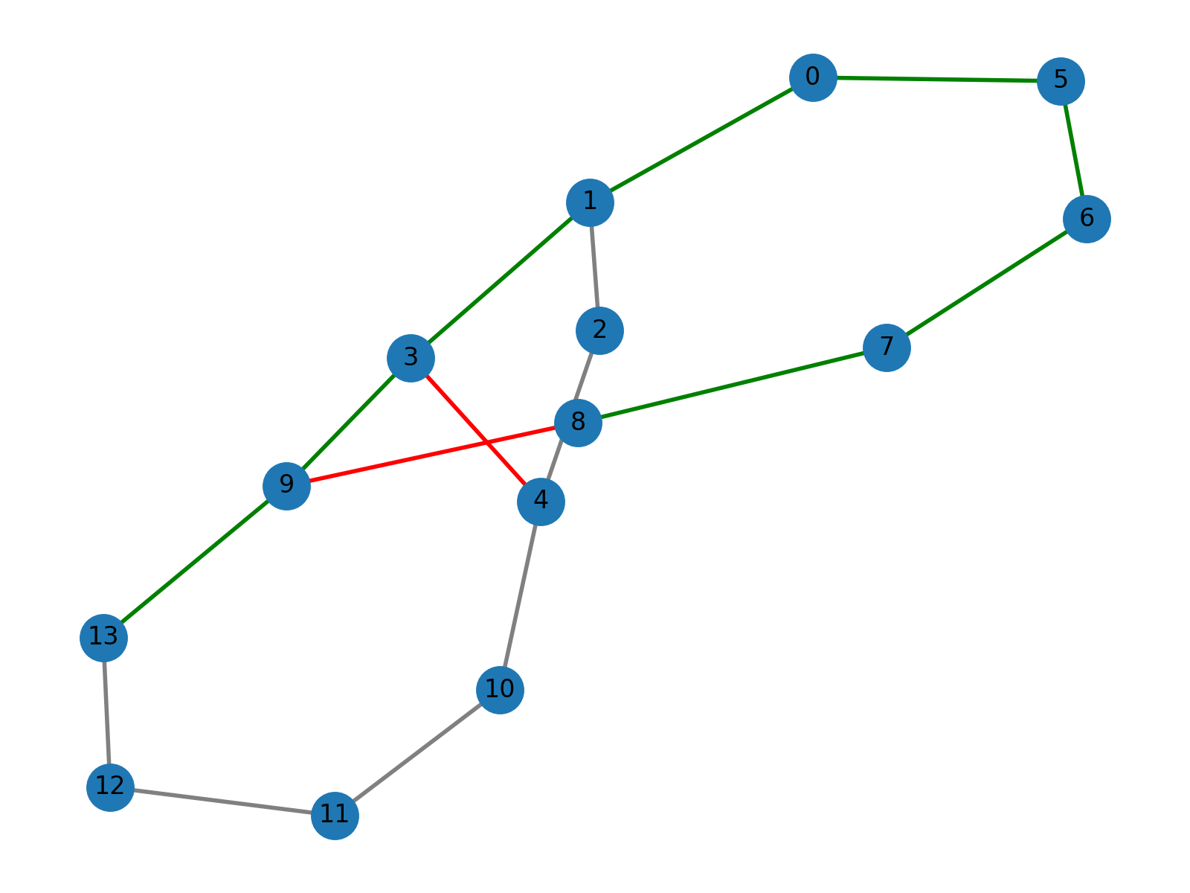
Figure 11: Network Topology with Failed and Rerouted Paths]

Slide 9
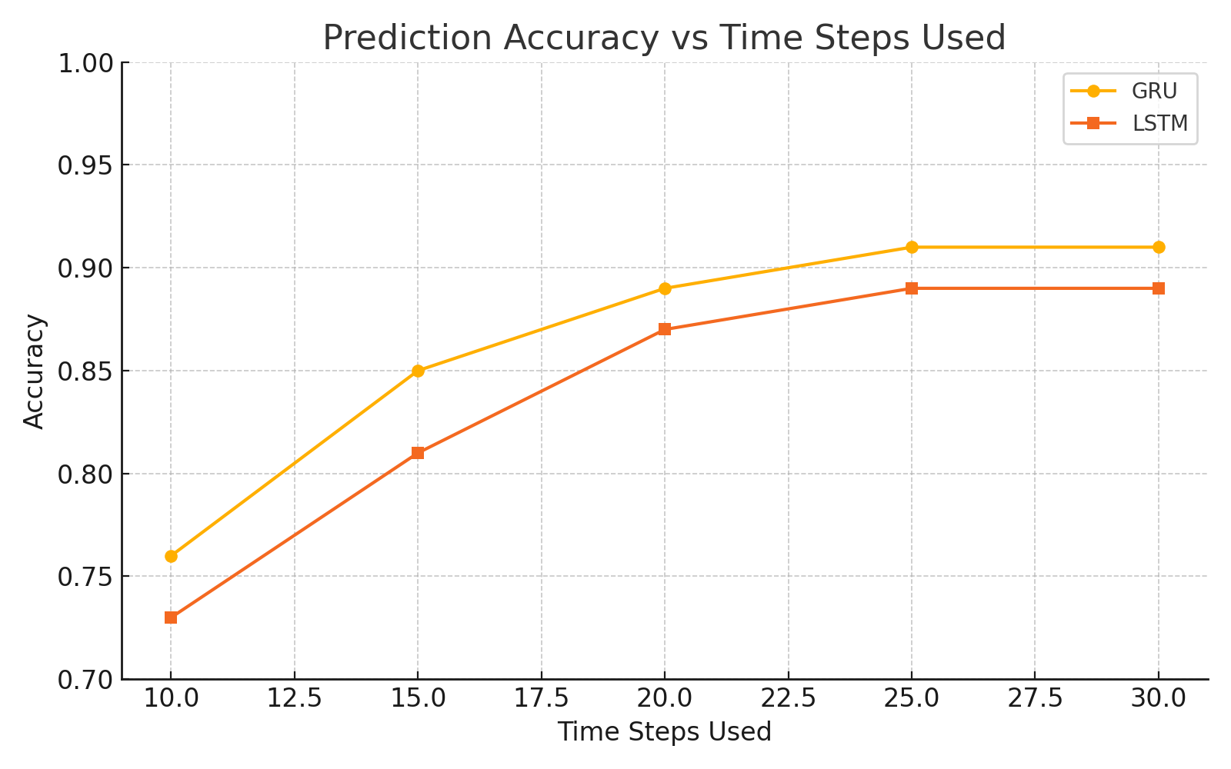
Figure 12: prediction Accuracy vs Time Steps Used

Slide 10
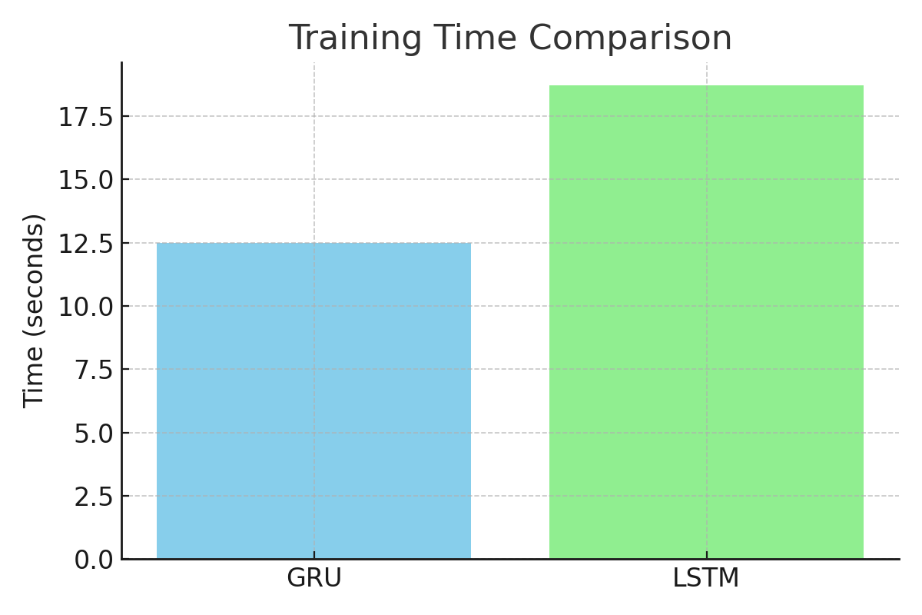
Figure 7: Training Time Comparison of GRU vs LSTM.

Slide 11
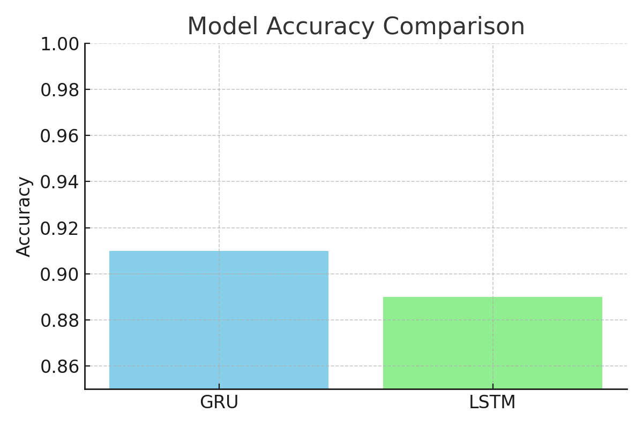
Figure 7: Accuracy Comparison of GRU vs LSTM.

