Slide 1

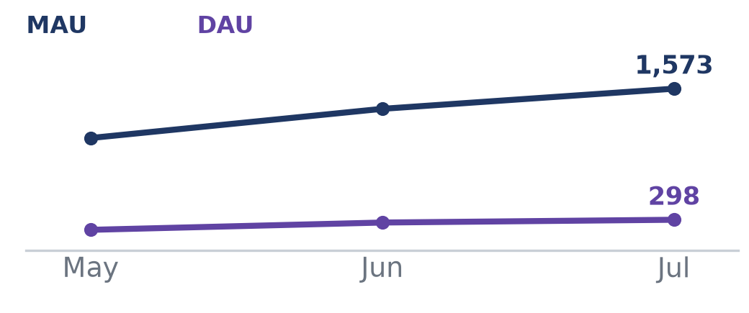
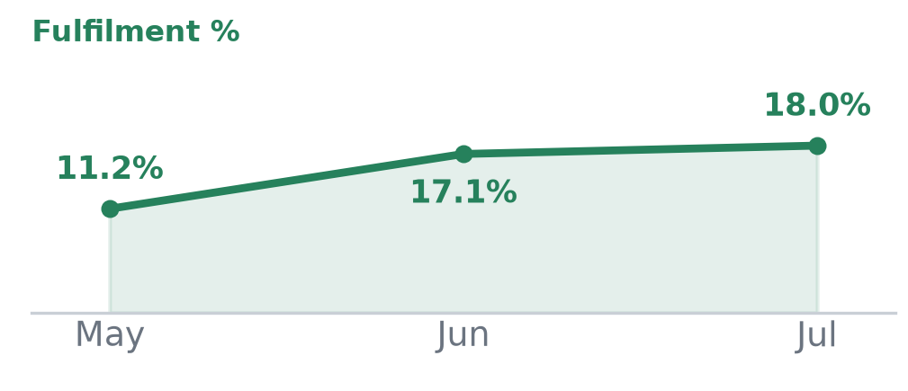
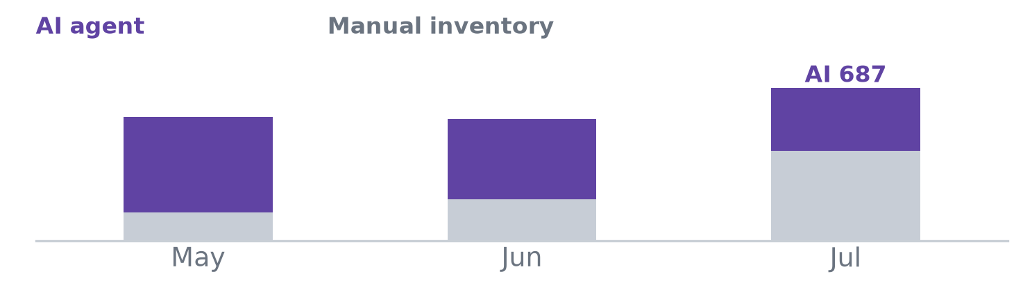
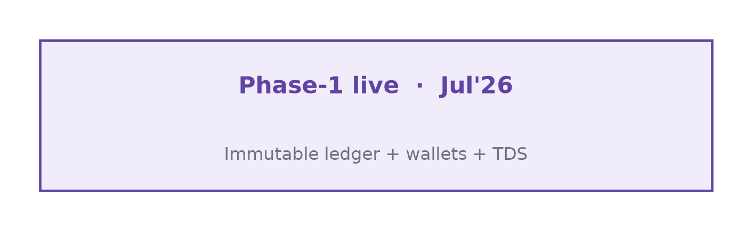
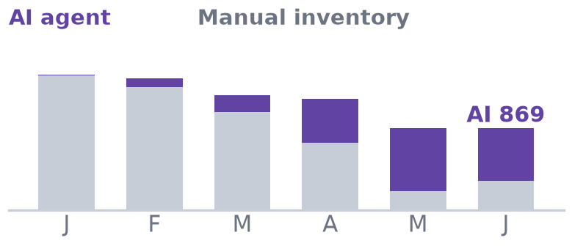
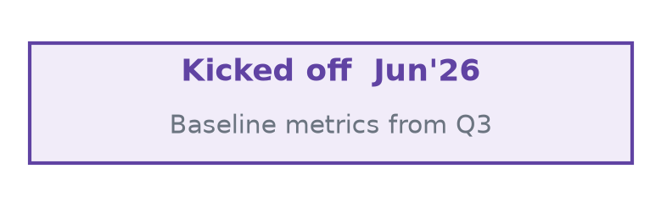
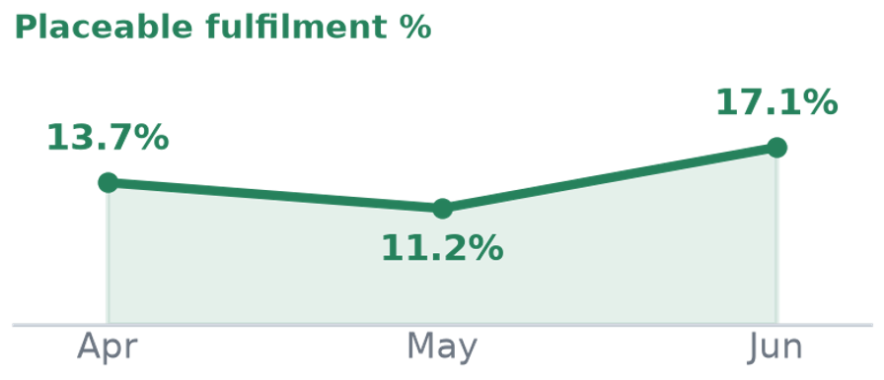
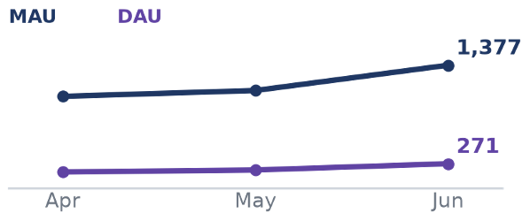
Product & Tech Updates — Carrier Matching
Steady Momentum; Pedal on Inventory Quality and Demand Fulfilment
Project Goal
PROGRESS (thru Jul'26)
TREND (May–Jul'26)
NEXT FOCUS (Aug–Sept)
Drive FO App to 1,000 DAU
• POD details + payment status & timelines in app
• Proactive POD dispute/deduction alerts + re-upload
• DAU 271 → 298 (+10%); MAU 1,377 → 1,573 (+14%)
› Trip Statement — 3-yr ledger tab in FO App
› TDS rate visibility + self-serve declaration
› Ticketing for FOs not on app (WhatsApp/IVR)
Improve demand fulfilment to 25%
• Near-match logic + match quality on demand list
• Supplier availability: lane-specific vs unavailable
• Agents onboarded (Clerk) for lane assignment
› Auto CRM alerts — bids / matches / approvals
› Sort demand by Demand Actionability Score
› Agentic AI calling for fulfilment agents
Increase inventory by 50% (1,500/mo)
• Automated AI calling for live & potential inventory (multi-lang)
• WhatsApp fallback + callback; cooldown filtering
• AI drives ~65% of inventory
› Inventory creation on network lanes → 1,500/mo
› Improve inventory quality & conversion
• Automated advance payments for Gold/Silver FOs (validation → approval → auto-release)
• WhatsApp-disconnect auto-reminders for CRM users
• Vahan verification & journey updates in LSP WhatsApp
~20% reduction in
City Team resource cost
› Runner App — POD collection + OCR audit
› LSP App — self-serve trip/tracking/POD + tickets
› Automate compliance document generation
Cost to serve reduction by 50%
Ledger automation for compliance
› Auto-calc & reverse TDS; advance-pay auto-release (60%)
› Payment fraud checks + LSP exposure limits
› Self-serve balance payment for FOs
• Immutable trip-level ledger — Net Payable/Receivable (live)
• FO/LSP wallets + overpayment settlement; automated TDS
• Ledger Phase-1 foundation (journal + payouts) live
@FreightTiger confidential
Notes:
Bolder heading and tile effect

Slide 2
Next Focus — Aug–Sept'26 Roadmap
15 initiatives across Finance/Ledger, Risk, Fulfilment, FO/LSP Experience & Ops — bucketed with measurable outcomes
Finance Automation & Ledger
Ledger Automation in CRM
100% trips carry immutable payment record; overpayment auto-settled to wallets
Auto-calculate TDS
100% trips system-calculated; ~0 error rate; 60 hrs/mo ops saved
Automated Advance Payment (Gold/Silver FOs)
60% auto-released; disbursal TAT → 2 hrs
Automate compliance document generation
100% auto-generated; 60 hrs/mo saved
Balance payment automation
60% self-initiated by FO; fewer ops touchpoints
Fulfilment & Demand Intelligence
Auto CRM alerts
bids received / inventory matched / approval assigned — faster time-to-action
Sort demand by Demand Actionability Score
more agent time on placeable loads; faster placement
Agentic AI calling for fulfilment agents
calls automated at scale; cost/call ↓; conversion ↑
Risk, Fraud & Exposure Control
Payment fraud checks (FO / user / bank-detail change)
100% payments fraud-screened; releases blocked pre-disbursal
Configurable LSP exposure limit + auto-disable
breaches auto-caught & actioned; lower bad-debt risk
POD Collection & Audit
Runner App/Mobile page
Hard-POD TAT ↓ ≥20%; OCR-audited PODs; faster dispute resolution
FO App Transparency & Self-Serve
Trip Statement — 3-yr ledger tab in FO App
statement views ↑; fewer payment-status tickets
TDS rate visibility + self-serve declaration
% FOs self-serving TDS ↑; fewer TDS tickets
LSP Experience & Visibility
LSP App
self-serve trip/tracking/POD status + ticketing; fewer inbound status calls
Support & Ops Automation
Ticketing for FOs not on the app
WhatsApp/IVR/agent — broader off-app support coverage
@FreightTiger confidential

