Slide 1

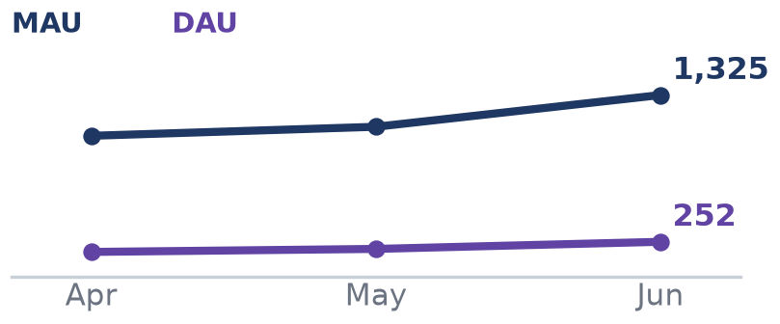
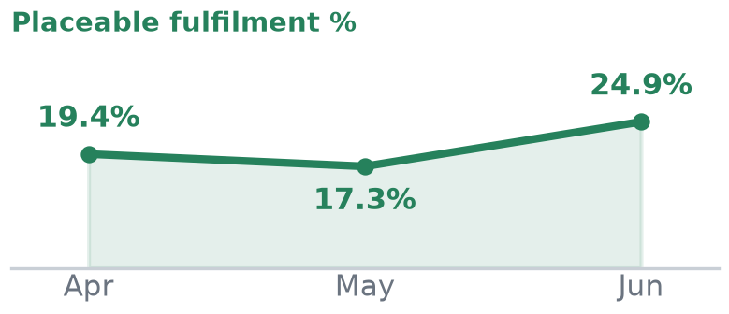
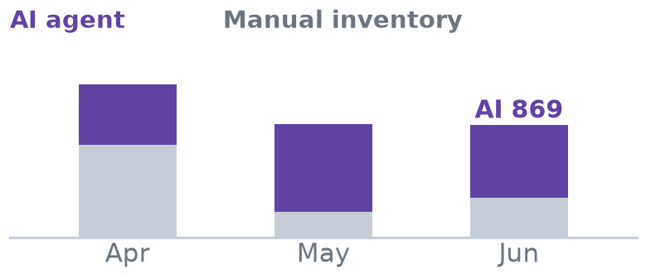
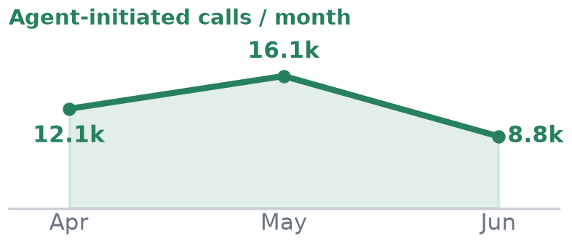
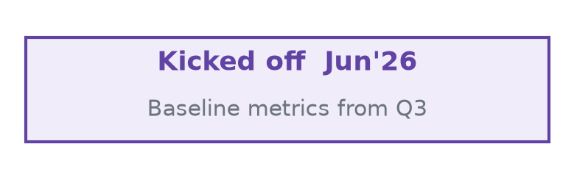
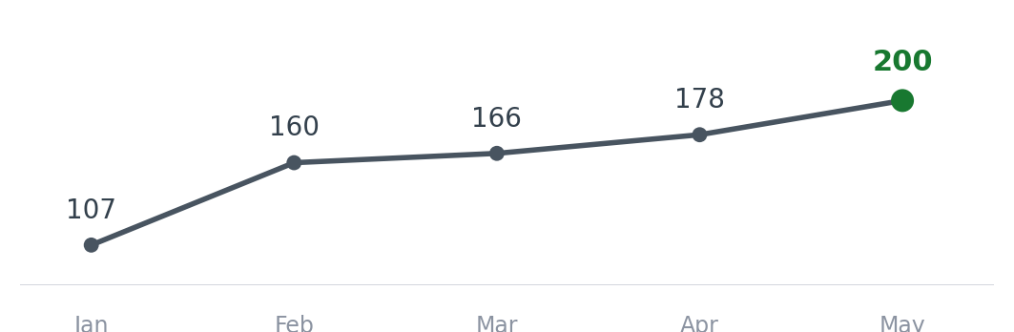
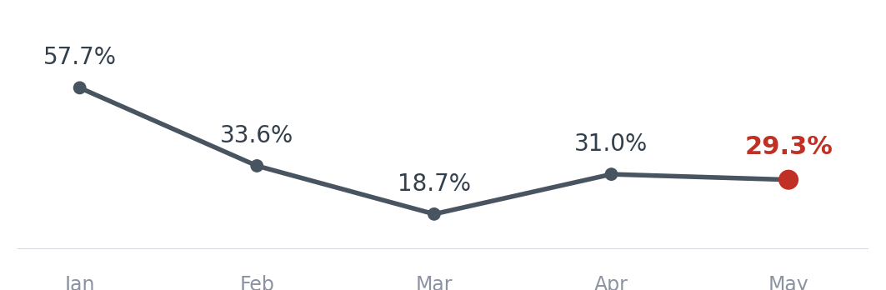
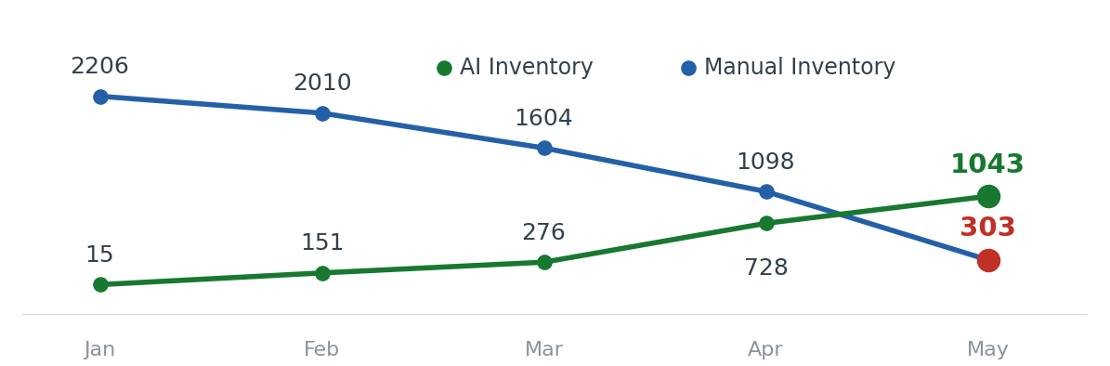
Product & Tech Updates — Carrier Matching
Apr–Jun'26 · Q2 Board Review + Monthly TML Review | Steady momentum; pedal on inventory quality & demand fulfilment
PROJECT / GOAL
APR–JUN DELIVERY
TREND (Apr–Jun'26)
NEXT FOCUS (Jul–Aug)
Drive FO App to 2,000 DAU
Better load experience & payment visibility
• My Bids + bid-status alerts; advance-pay banner
• Full POD details, status & dispute alerts
• Exact loading address post-win; demand alerts
• DAU 178 → 252 (+42%); MAU → 1,325; Installs → 1,935
› Drive toward 2,000 DAU
› Lift WAU → DAU daily habit & retention
› Deepen payment visibility + load discovery
Improve demand fulfilment to 40%
Matching, bid ranges & real-time visibility
• Smarter matching: origin + normalised veh-type
• Split availability lane-wise; enrich suppliers
• Duplicate-demand guard; agent onboarding
• Bids 477 → 725 (+52%); fulfilment 17.3 → 24.9%
› Lift placement on inventory & FO bids
› Convert bids → trips (Jun dipped to 10)
› Push placeable fulfilment toward 40%
Increase inventory 50% (1,500/mo)
Via automated agentic calling
• Agentic AI inventory calling — multi-lingual
• GPS potential-inv detection; alt O/D capture
• WhatsApp fallback + callback; Live Eval Agent
• AI drives ~65% of inventory (869 of 1,341)
› Inventory quality — best-time-to-call, power-lane proximity, FO filtering
› Rebuild placeable conversion
› Scale agent inventory to 1,500/mo
Cost to serve reduction by 70%
Automate ops processes
• Automated Vahan verification via ULIP
• Auto WhatsApp trip-link + loading-memo to LSP
• System STA auto-calc; adv-pay %; OCR approval
• ~10 hrs/day CT saved; ~15% cost reduction
› FO document collection via app payment incentives
› AI CT for SIM-consent automation
› Transit-delay detection
Ledger automation for compliance
Trip & party-level ledger
• Ledger design finalised — build-vs-buy decision
• Phased plan; trip & party-level ledger design
› Build trip-level & party-level ledgers
› Wallet-based auto-reconciliation across trips
@FreightTiger confidential
Notes:
Bolder heading and tile effect

Slide 2
Customer Integrations
In progress integrations and their current statuses
Product/Tech team to update
Customer | Stage | ETA | MRR (INR Lacs) | Comments
Novoco | Live | May 4 | 8 | -
Pidilite Phase 1 | Live | May 7 | - | Existing customer, no additional MRR
MSP | Live | Apr 25 May 22 | 0.5 | -
Pittie Group | Dev in progress | TBD | 3 | Client development is in progress. Awaiting development completion timelines from the client to finalize the go-live date.
TCPL | Dev in progress | May 15 June 15 | 3.5 | Timeline shifted due to expanded scope
Diageo Phase 1 | UAT | Jun 29 | 5 | UAT in progress
Tata Bluescope | Partially Live | NA | 2 | Live with 8 locations. 1 plant go live pending
Kajaria Ceramics | Kick Off | TBD | 2.7 | The project kick-off initiated on 5th June,
JSW Steel plant addition | Kick Off | TBD | 1 | New Plants addition via Integration we got approval from JSW Management Kickoff call with JSW IT is scheduled
BASF | Dev in progress | Aug 18 | 5 | Solutioning and dev running in parallel
@FreightTiger confidential

Slide 3
Key Challenges — Scaling the Initiatives
System-generated supply is actioned last — CRM inventory, FO App bids & bot demands need priority & SLA decisions from leadership
CHALLENGE
CONTEXT
KEY QUESTIONS FOR LEADERSHIP
1 CRM inventory prioritisation
How should CRM-generated inventory be prioritised?
~1,300 CRM inventories/month (incl. ~800 Power-Lane), but conversions stay under 50/month. The fulfilment team clears its own + central-team inventory first; by the time it reaches system-generated CRM inventory, the load is usually already placed externally (CRM inventory is collected in the morning).
› Should CRM inventory get equal priority in the workflow, not the last source?
› What SLA / process ensures it is actioned before the demand is fulfilled elsewhere?
2 FO App bids not acted upon
Why are FO App bids not being acted upon?
We receive 30–55 FO App bids/day, but only 1–2 are converted — and 0 conversions in the last week. As with CRM inventory, the team focuses on manual + central inventory first; by the time app bids are reviewed, the demands have often already been fulfilled.
› Should FO App bids have a defined response SLA / priority, so they are reviewed before demand is fulfilled through other channels?
3 Bot-created demand actionability
Why is there low actionability on bot-created demands?
On power lanes, manually-created demands convert at 18% vs only 3% for bot-created demands. Bot-created demand is clearly not getting priority, while the team continues to focus on manually-created demands.
› Should bot-created demands sit in the primary fulfilment queue, not a secondary source?
› What business-process changes ensure bot demands are acted on before they go stale?
@FreightTiger confidential

Slide 4
3-Month Execution Plan — Carrier Matching
Scale revenue to ₹1.2 Cr/month by Sept · cut cost base 50% | Q2 exit: DAU → 500 · conversion → 20% · MS+FinOps −30% (25% / 50% = FY27)
Ledger
Fulfilment %
DAU
Reduce Ops Bandwidth
Network-lane conversion: May 11.2% → Jun 17.1% → Q2 exit 20%
JULY 12 stories
AUGUST 11 stories
SEPTEMBER 6 stories
Ledger · 5 stories ✓ Shipped
Stand up the trip-level payment ledger — immutable Net Payable/Receivable record, wallet-based overpayment settlement, and automated TDS (capture, calculate & reverse).
Ledger · 4 stories ◐ In build
Take Ledger Phase-1 to production and bring finance into the FO App — 3-yr trip statement, trip-level TDS rate, and self-serve TDS declaration.
Ledger · 1 story ○ Planned
Add configurable LSP exposure limits with auto-disable on breach.
Fulfilment % · 3 stories ◐ Part shipped
Act on demand faster — lane-based agent auto-assignment, Demand-Bot context building, and near-match inventory with match-quality on the demand list.
Fulfilment % · 5 stories ○ Planned
Prioritise placeable demand — auto CRM alerts, Demand-Actionability-Score sorting, vehicle heat-map, auto tracking-master updates, and in-CRM calling with callbacks.
Fulfilment % · 2 stories ○ Planned
Scale fulfilment — agentic-AI calling for agents and a live LSP / PSA-CSM / city target dashboard.
DAU · 1 story ◐ In build
Let FOs reach the PSA directly for placement from the app (PSA number in-app).
DAU · 1 story ○ Planned
Extend ticketing to FOs not on the app via WhatsApp / IVR / agent.
DAU · 1 story ○ Planned
Capture trip charges directly in the FO App with an approval flow.
Reduce Ops Bandwidth · 3 stories ◐ Part shipped
Automate ops — advance payments for Gold/Silver FOs, pre-transit SIM-consent collection, and transit-delay detection & escalation.
Reduce Ops Bandwidth · 1 story ○ Planned
Auto-share the loading location to drivers over call + WhatsApp.
Reduce Ops Bandwidth · 2 stories ○ Planned
Automate compliance-document generation and POD audit via OCR.
Notes for leadership Q2 exit targets: DAU → 500 · network-lane conversion → 20% · MS+FinOps bandwidth −30% (25% / 50% are FY27 annual targets).
Network-lane conversion (Q1 FY27): May 11.2% → Jun 17.1% — entering Q2 at ~17%, the plan above targets a 20% exit.
Status per Linear (Aug'26): ✓ Shipped ◐ In build / part shipped ○ Planned
@FreightTiger confidential

