Slide 1

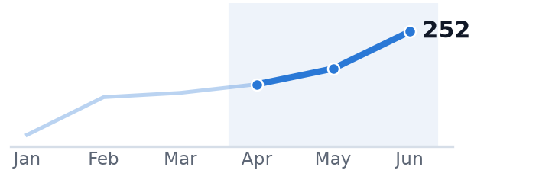
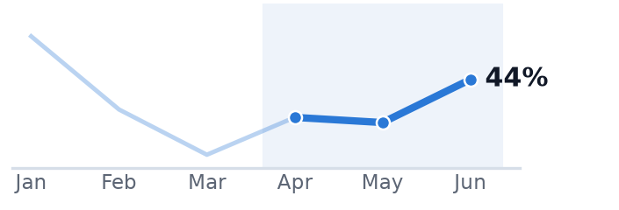
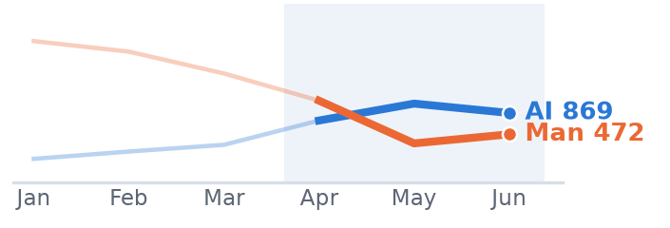
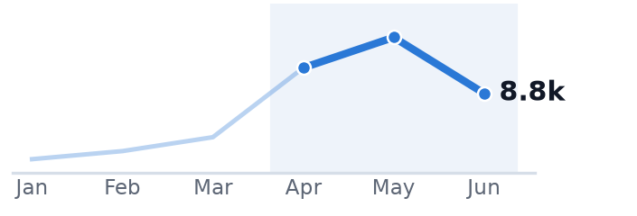
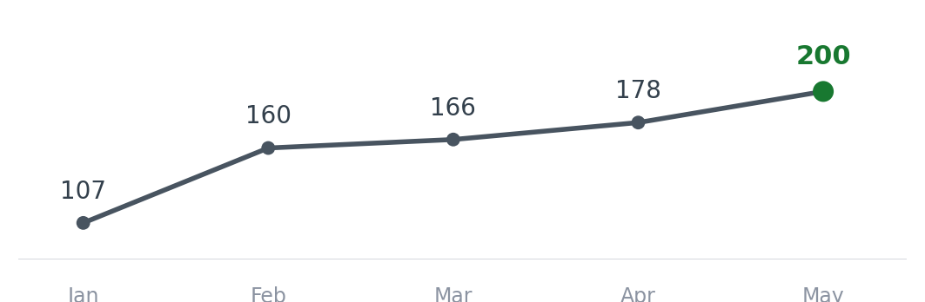
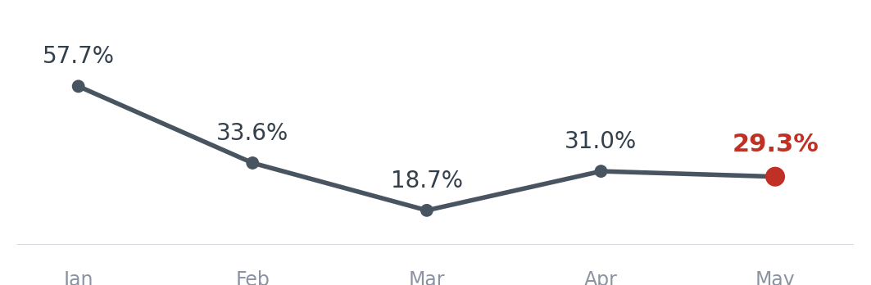
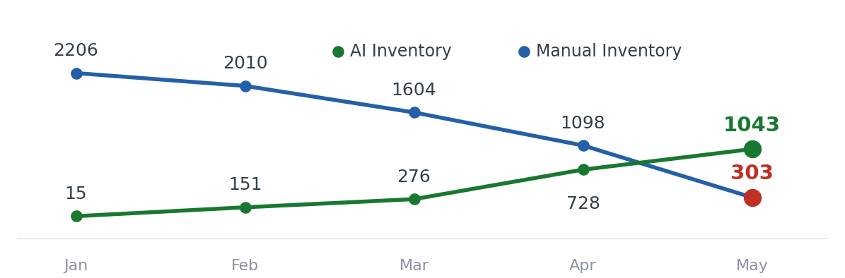
Product & Tech Updates — Carrier Matching
Apr–Jun'26 Board & Monthly Review · Steady momentum; pedal on inventory & demand fulfilment
PROJECT
DELIVERED · APR–JUN'26
METRICS & TREND (JAN–JUN'26)
NEXT FOCUS · JUL–AUG
Drive FO App to 2,000 DAU
Better load experience & payment visibility
• Load discovery & experience revamp
• In-app payment visibility
• Bid & trip status surfacing
DAU 178→252 (+42%)
Installs 1,449→1,935
MAU 1,027→1,325
• Payment status timeline in FO App (POD→UTR)
• Push DAU toward 2,000
• Lift WAU (582→747), cut uninstalls
Improve demand fulfilment to 50%
Matching, bid ranges & real-time visibility
• Suggested bid ranges
• Real-time matching visibility
• FO–demand matching tuning
Placeable fulfil 31→43.5%
Bids 670→725
Unique FOs 211→267
• Sustain 50% placeable-fulfilment target
• Bid ranges & matching visibility
• Rebuild bid consistency across lanes
Increase inventory 50% (1,500/mo)
Via automated agentic calling
• Agentic calling for inventory (AI bot)
• Call → inventory automation
• Manual-ops reduction
AI inv 728→1,043
Manual 1,098→472
Agent calls → 16k
• Inventory quality: best-time-to-call, power-lane, FO filtering
• Lift placeable conversion (23.9→11.4%)
• Grow net inventory to 1,500/mo
Cost to serve reduction 70%
Automate ops processes
• Automated Vahan verification (LSP WhatsApp)
• Automated journey/transit updates
~10 hrs/day CT effort saved
~15% CT resource-cost cut
Agent calls 12k→16k (peak)
• FO doc collection via app incentives
• AI City-Team for SIM-consent automation
• Transit-delay detection
Ledger automation for compliance
Trip & party-level ledger · NEW (Jun)
• Trip & party-level ledger — kickoff
• Build trip-level & party-level ledgers
• Wallet-based auto-reconciliation across trips
New · Jun'26
Trend from monthly metrics (Jan–Jun'26); Apr–Jun highlighted. Feature names indicative — confirm against Linear delivered stories / roadmap.
@FreightTiger confidential
Notes:
Bolder heading and tile effect

Slide 2
Customer Integrations
In progress integrations and their current statuses
Product/Tech team to update
Customer | Stage | ETA | MRR (INR Lacs) | Comments
Novoco | Live | May 4 | 8 | -
Pidilite Phase 1 | Live | May 7 | - | Existing customer, no additional MRR
MSP | Live | Apr 25 May 22 | 0.5 | -
Pittie Group | Dev in progress | TBD | 3 | Client development is in progress. Awaiting development completion timelines from the client to finalize the go-live date.
TCPL | Dev in progress | May 15 June 15 | 3.5 | Timeline shifted due to expanded scope
Diageo Phase 1 | UAT | Jun 29 | 5 | UAT in progress
Tata Bluescope | Partially Live | NA | 2 | Live with 8 locations. 1 plant go live pending
Kajaria Ceramics | Kick Off | TBD | 2.7 | The project kick-off initiated on 5th June,
JSW Steel plant addition | Kick Off | TBD | 1 | New Plants addition via Integration we got approval from JSW Management Kickoff call with JSW IT is scheduled
BASF | Dev in progress | Aug 18 | 5 | Solutioning and dev running in parallel
@FreightTiger confidential

