Slide 1
Basic Simulation Modeling
Chapter 1

Slide 2
1.1 The Nature of Simulation
Simulation
Using computer techniques to simulate a real-world facility or process (the system)
Model
Mathematical or logical representation of system behavior
Model is evaluated numerically in a simulation

Slide 3
1.2 Systems, Models, and Simulation
Types of systems
Discrete
State variables change at separated points in time
Continuous
State variables change continuously with time

Slide 4
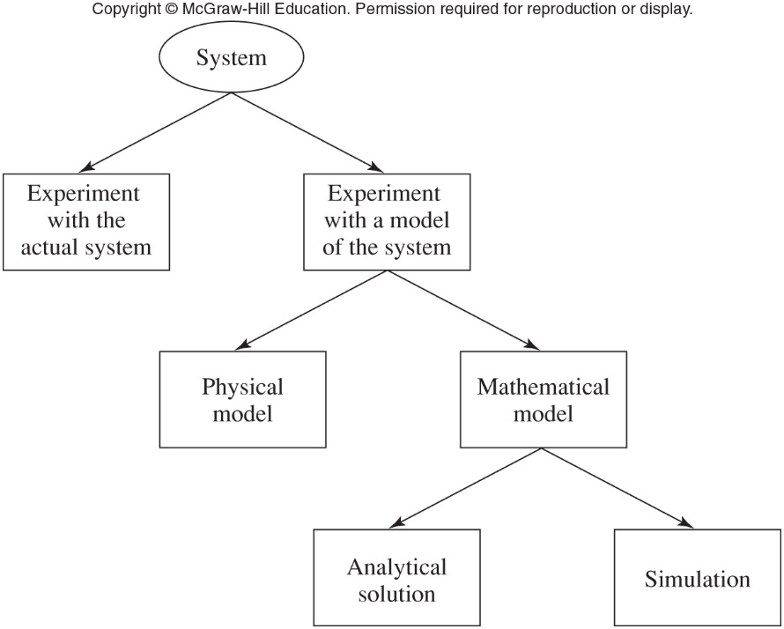
Systems, Models, and Simulation
Figure 1.1 Ways to study a system

Slide 5
1.3 Discrete-Event Simulation
Event
An instantaneous occurrence that may change the system’s state
Simulation clock
Variable that gives the current value of simulated time
Methods for advancing the simulation clock
Next-event time advance
Fixed-increment time advance

Slide 6
Discrete-Event Simulation
Next-event time advance
Clock initialized to zero
Times of events are determined
Clock advanced to time of first event
State of system updated
Clock advanced to time of next event
State of system updated
Continues until stopping condition satisfied

Slide 7
Discrete-Event Simulation
Fixed-increment time advance
Does not skip over inactive periods
Can use up a lot of computer time

Slide 8
1.4 Simulation of a Single-Server Queuing System
Example system: a one-operator barbershop
Interarrival times A₁, A₂…A_{n} are independent, identically distributed random variables
Customer service times are S₁, S₂…
Estimate three quantities
Expected average delay of customers in queue
Expected average number of customers in queue
Expected utilization of the server

Slide 9
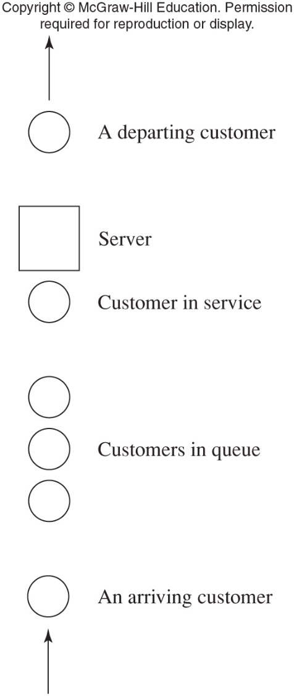
Simulation of a Single-Server Queuing System
Figure 1.4 A single-server queuing system

Slide 10
Simulation of a Single-Server Queuing System
Events for the barbershop example
Arrival time of a customer
Departure time of a customer
State variables
Status of the server
Number of customers in the queue
Arrival time of each customer currently in queue
Time of most recent event

Slide 11
Simulation of a Single-Server Queuing System
Initialization
State of the system at t = 0
Sequence of events
t = 0.4 arrival of customer 1
t = 1.6 arrival of customer 2
t = 2.1 arrival of customer 3
t = 2.4 departure of customer 1

Slide 12
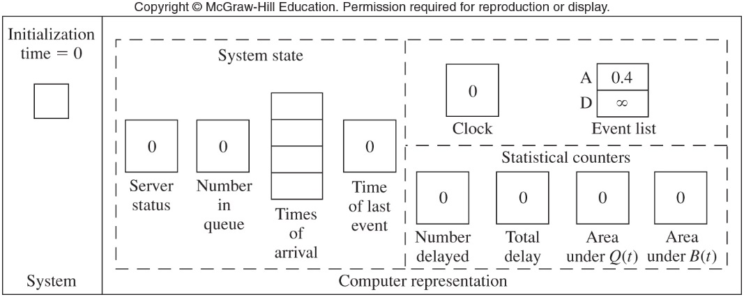
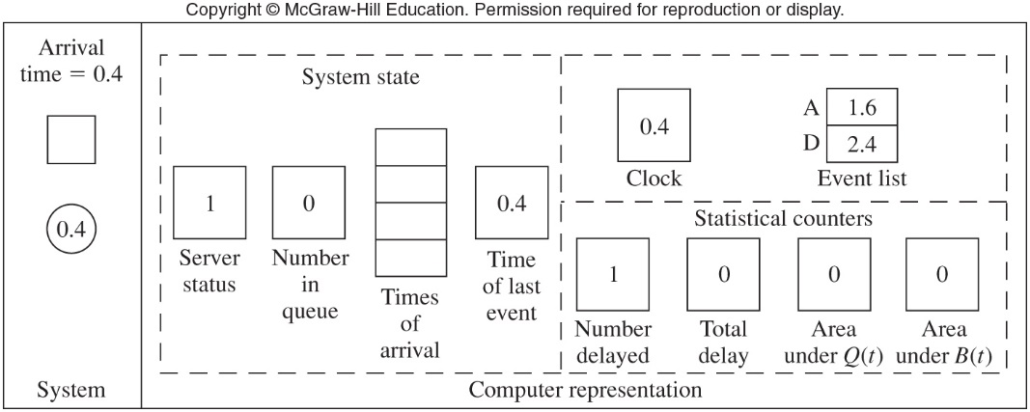
Figure 1.7 (a-b) Snapshots of the system and its computer representation at times t=0 and t=0.4

Slide 13
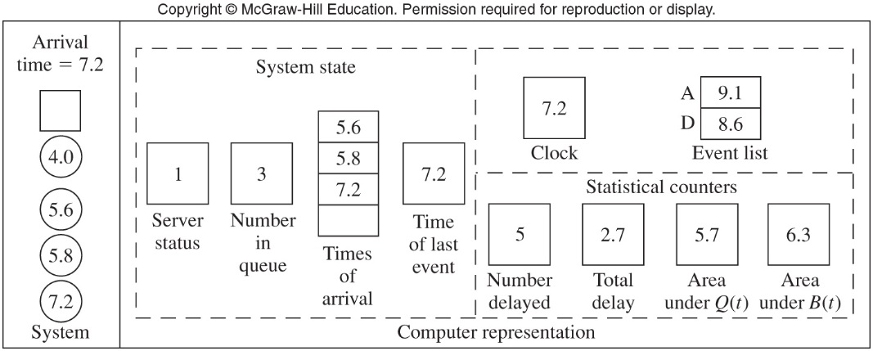
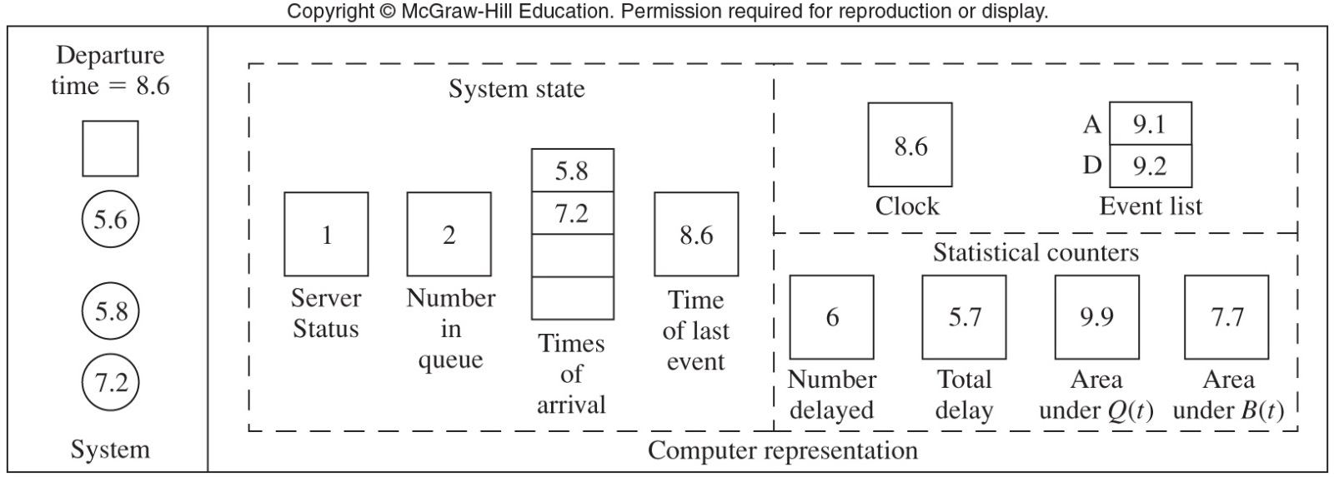
Figure 1.7 (m-n) Snapshots of the system and its computer representation at times t=7.2 and t=8.6

Slide 14
1.4 Simulation of a Single-Server Queuing System
Writing a simulation program
Our example: C, a general purpose language
Program modules
Initialization
Timing
Arrive
Depart
Report

Slide 15
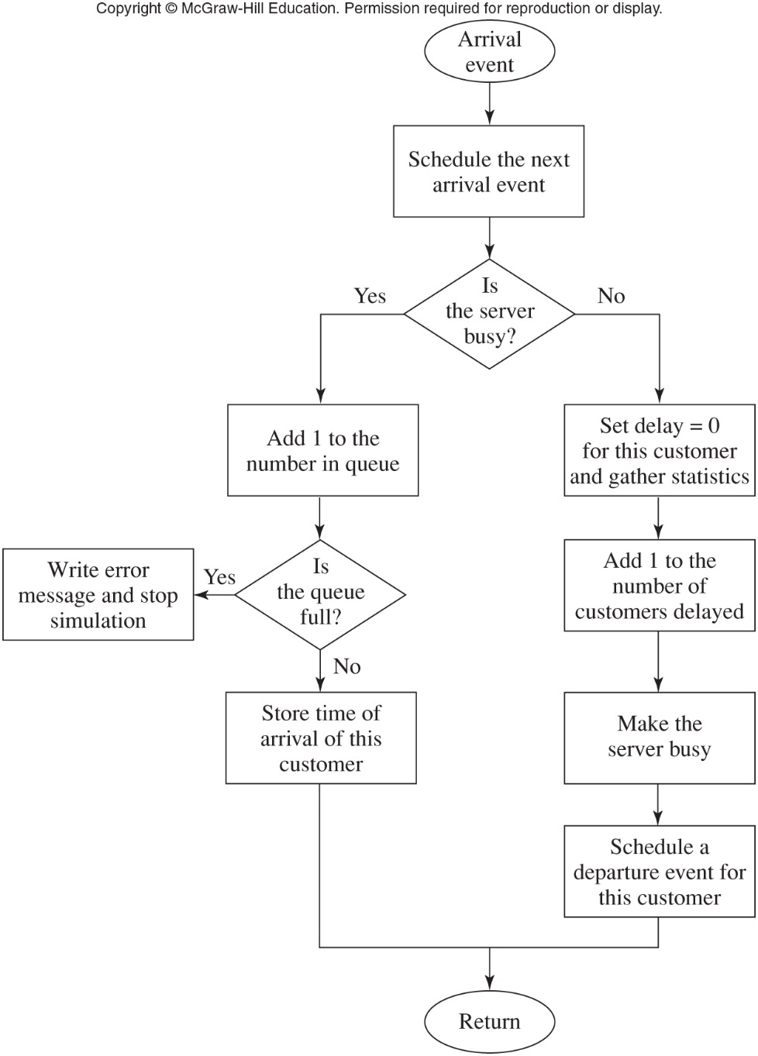
Figure 1.8 Flowchart for arrival routine – queuing model

Slide 16
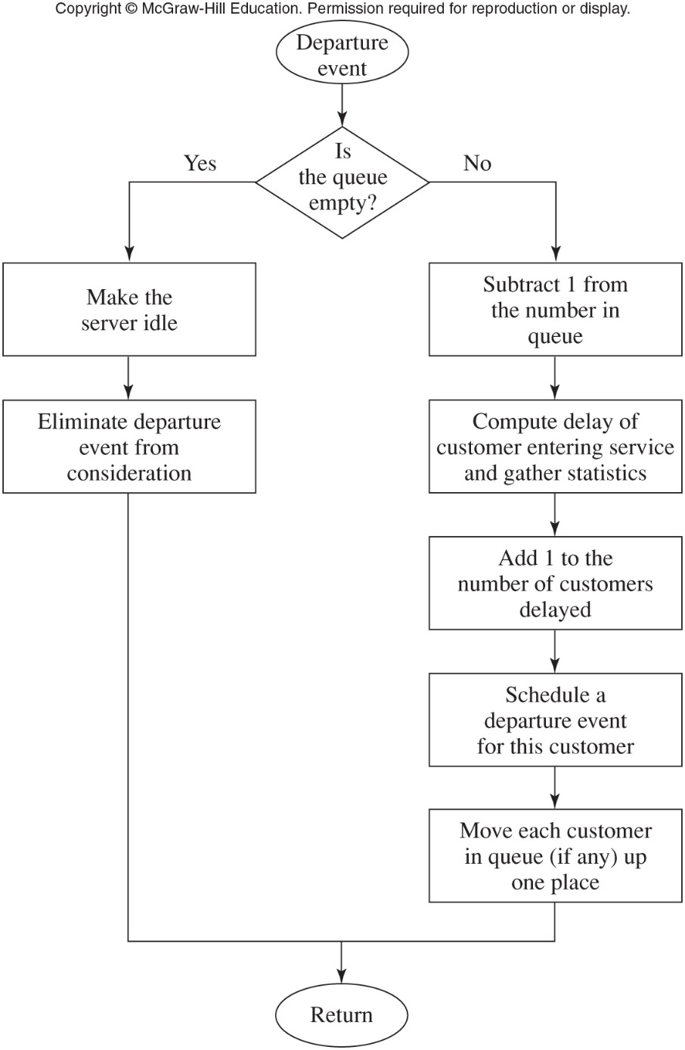
Figure 1.9 Flowchart for departure routine – queuing model

Slide 17
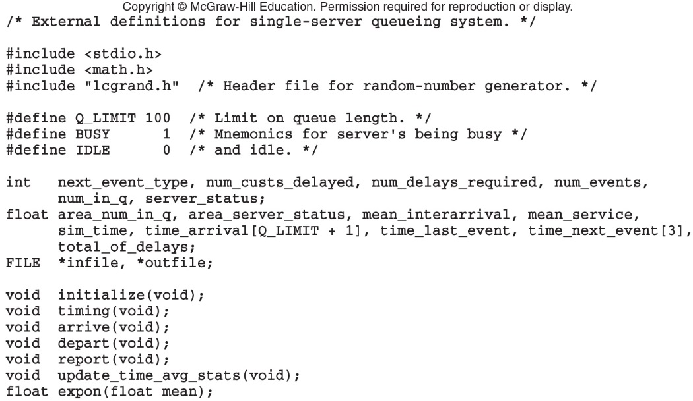
Simulation of a Single-Server Queuing System
Figure 1.10 C code for the external definitions, queuing model

Slide 18
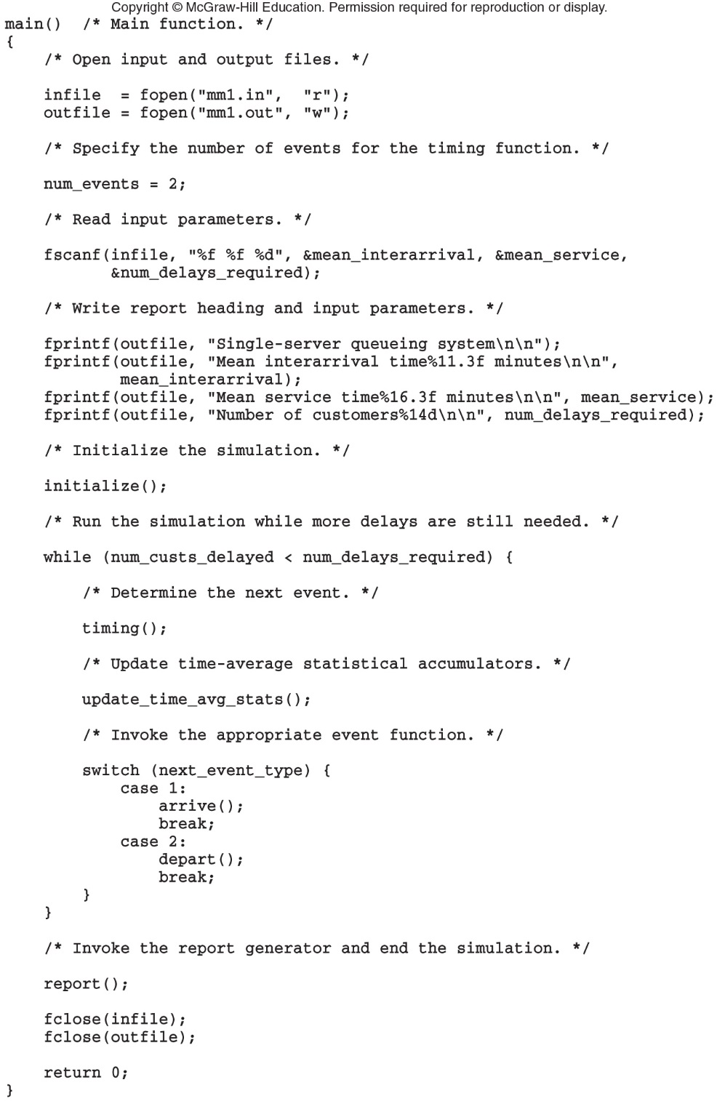
Figure 1.11 C code for the main function, queuing model (continues)

Slide 19
Figure 1.11 C code for the main function, queuing model (cont’d.)

Slide 20
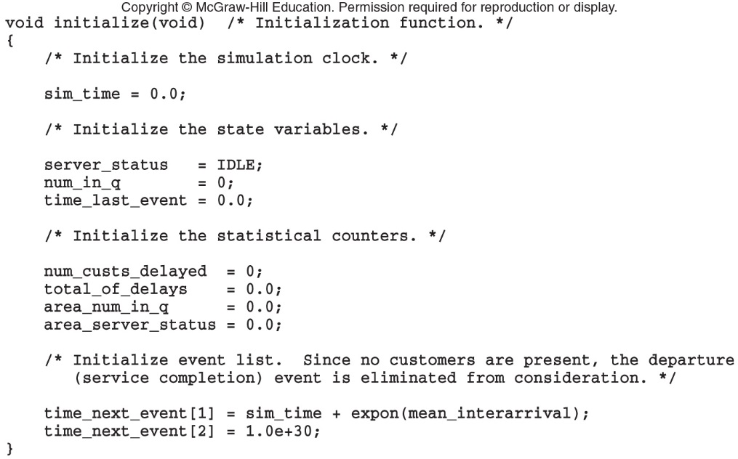
Simulation of a Single-Server Queuing System
Figure 1.12 C code for function initialize, queuing model

Slide 21
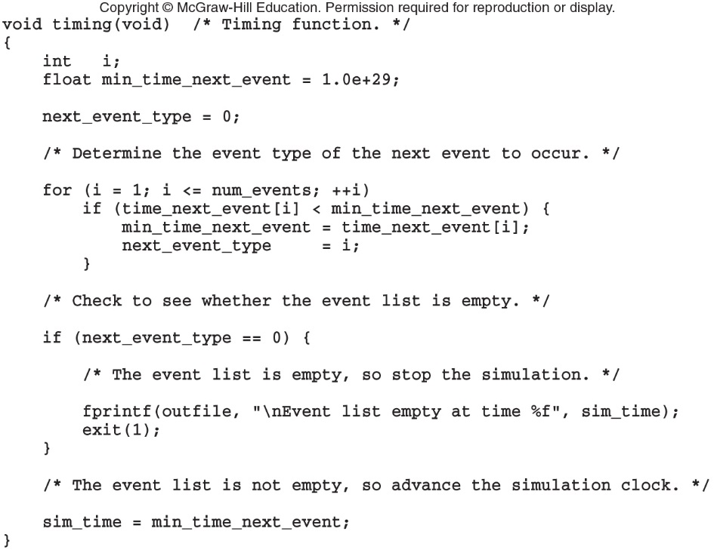
Simulation of a Single-Server Queuing System
Figure 1.13 C code for function timing, queuing model

Slide 22
Simulation of a Single-Server Queuing System
Discussion of simulation output
Numbers will vary each time the simulation is run
Not explicit answers but estimates of quantities
Results are functions of the input parameters, and they way system is initialized
Might want to study steady state characteristics of the system
Alternative stopping rules could have been defined

Slide 23
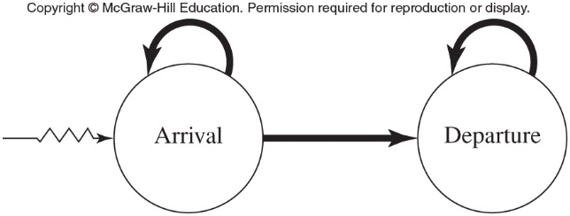
Simulation of a Single-Server Queuing System
Figure 1.25 Event graph, queuing model

Slide 24
1.5 Simulation of an Inventory System
Problem: compare various ordering policies for an inventory system
Given: initial inventory level, demands, times between demands
Costs: setup cost, incremental cost, holding and shortage costs
State variables: inventory level, amount of an outstanding order from company to supplier, and time of last event

Slide 25
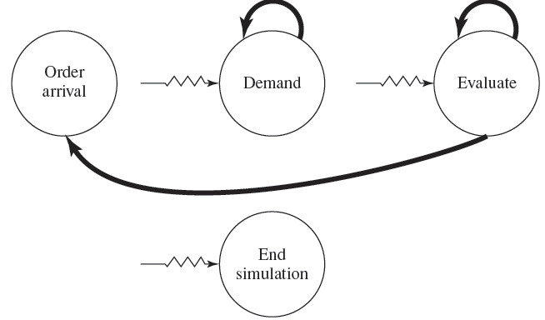
Simulation of an Inventory System
Figure 1.29 Event graph, inventory model

Slide 26
1.6 Parallel/Distributed Simulation and the High Level Architecture
Parallel-discrete event simulation
Execution of the simulation using multiple processors
Reduces execution time
Done by dividing model into several logical processes (LPs)
Critical issue: determining LPs happen in proper sequence

Slide 27
Parallel/Distributed Simulation and the High Level Architecture
Types of synchronization in parallel simulation
Conservative
Avoid any violations of local causality constraint
Optimistic
Time-warp mechanism: best known optimistic approach
Distributed simulation
HLA federation

Slide 28
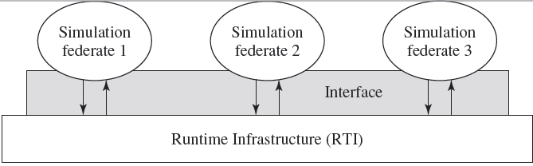
Parallel/Distributed Simulation and the High Level Architecture
Figure 1.45 Functional view of an HLA federation

Slide 29
1.7 Steps in a Sound Simulation Study
Formulate the problem and plan the study
Collect data and define a model
Ensure the assumptions are valid
Construct a computer program and verify
Make the pilot runs
Is the programmed model valid?
Design the experiments

Slide 30
Steps in a Sound Simulation Study
Make the production runs
Analyze the output data
Document, present, and use the results

Slide 31
1.8 Advantages, Disadvantages, and Pitfalls of Simulation
Most complex, real-world systems cannot be accurately described by an analytical mathematical model
Numerical simulation is the only investigation possible
Simulation allow for the:
Evaluation of alternative designs
Study of a system with a long time frame

Slide 32
Advantages, Disadvantages, and Pitfalls of Simulation
Simulation models can be expensive and time-consuming to develop
Large amounts of data can lead to “overconfidence” in the result
What are some causes of failure?
Lack of well-defined objectives
Inappropriate level of detail in the model
Crucial to involve the right people in the simulation study

