Slide 1
CPU
CENTRAL PROCESSING UNIT

Slide 2
INTRODUCTION OF CPU
The Central Processing Unit (CPU), often referred to as the "brain" of a computer, is a critical component responsible for executing instructions and performing calculations in a computer system. It plays a fundamental role in the operation of a computer and is a key element in determining a computer's overall performance.

Slide 3
HISTORY OF CPU
The history of the Central Processing Unit (CPU) is a fascinating journey that spans over several decades. The evolution of the CPU has been marked by significant advancements in technology, leading to increasingly powerful and efficient processors. Here is a brief history of the CPU:
1940s - First Electronic Digital Computers
1950s - Transition to Transistors
1960s - Integrated Circuits (ICs)
1970s – Microprocessors
1980s - Personal Computers (PCs)
1990s - Advancements in Performance
2000s - Multi-Core Processors
2020s - Advances in AI and High-Performance Computing

Slide 4
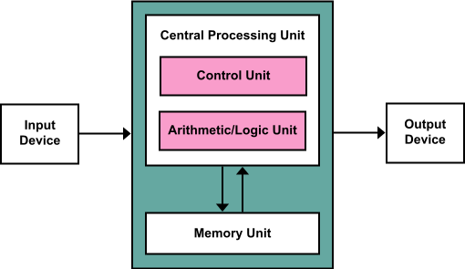
BLOCK DIGRAM OF CPU
(central processing unit)

Slide 5
COMPONENTS OF CPU
The Central Processing Unit (CPU) is a complex electronic component that performs the primary processing tasks within a computer system. It consists of several key components that work together to execute instructions and manipulate data. The main components of a CPU include:
CONTROL UNIT(CU)
ARTHEMATIC AND LOGIC UNIT(ALU)
REGISTERS

Slide 6
CONTROL UNIT(CU)
The Control Unit is responsible for coordinating and managing the various components of the CPU. It fetches instructions from memory, decodes them, and controls the flow of data within the CPU.

Slide 7
ARTHEMATIC AND LOGIC UNIT(ALU)
The ALU is responsible for performing arithmetic operations addition, subtraction, multiplication, division) and logical operations (AND, OR, NOT) on data. It's the component that actually carries out the calculations.

Slide 8
REGISTERS
Registers are small, high-speed memory locations within the CPU used for temporarily holding data, instructions, and addresses. Some of the essential registers include:
Program Counter (PC): Stores the memory address of the next instruction to be executed.
Instruction Register (IR): Holds the currently executing instruction.
Memory Address Register (MAR): Contains the memory address for read or write operations.
Memory Buffer Register (MBR): Temporarily holds data being transferred to or from memory.

Slide 9
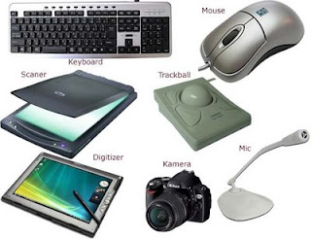
INPUT DEVICE
An input device is a hardware component or peripheral that allows users to enter data, commands, or information into a computer or electronic system. Input devices enable interaction between the user and the computer, facilitating the input of various types of data.

Slide 10
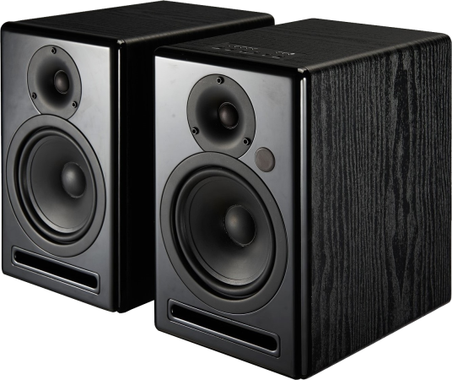
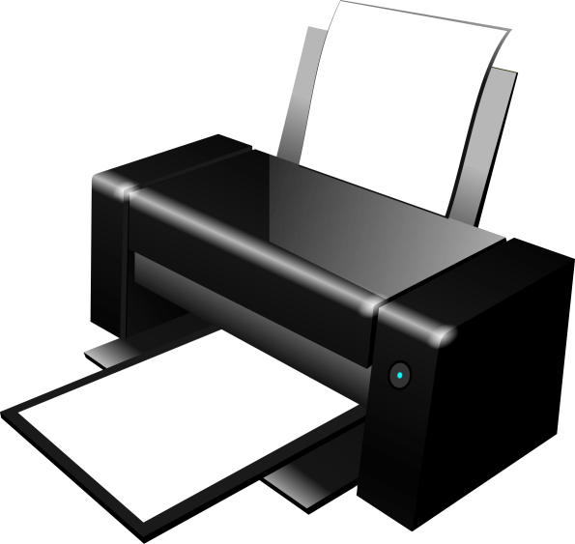
OUTPUT DEVICE
An output device is a hardware component or peripheral that displays or produces information from a computer or electronic system. Output devices allow the computer to convey processed data, results, or information to the user in a human-readable or perceivable form.

Slide 11
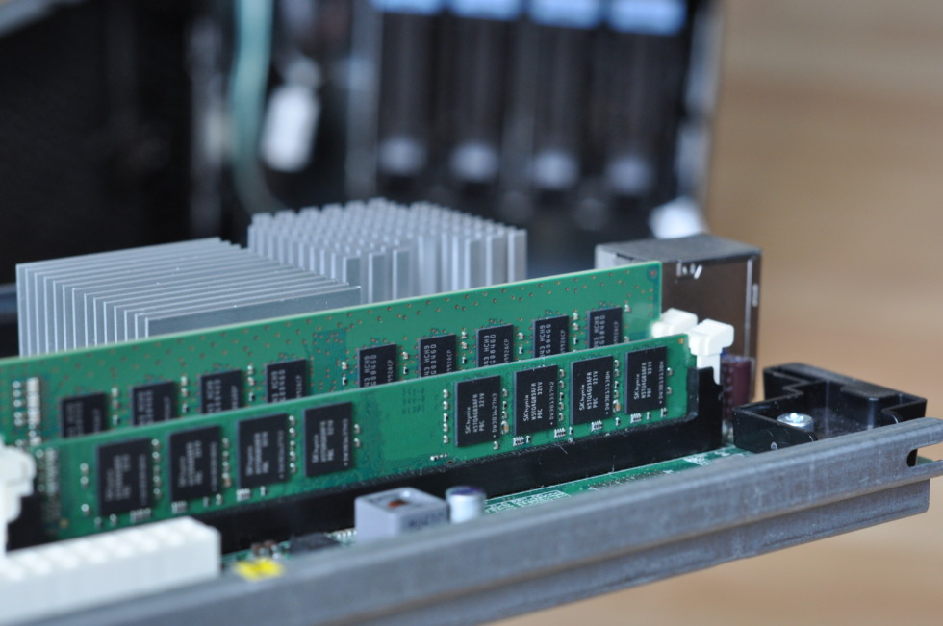
PRIMARY MEMORY
Primary memory, often referred to as RAM (Random Access Memory), is a critical component in a computer system. It serves as the computer's main working memory and plays a fundamental role in the execution of programs and the management of data

Slide 12
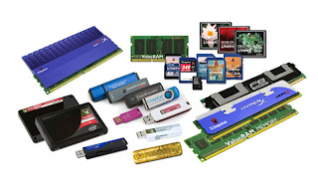
SECONDARY MEMORY
Secondary memory, often referred to as "storage" in the context of a computer system, is a crucial component responsible for long-term data retention and mass storage of programs, files, and data. Unlike primary memory (RAM), which is volatile and temporary, secondary memory is non-volatile and retains data even when the computer is powered off.

Slide 13
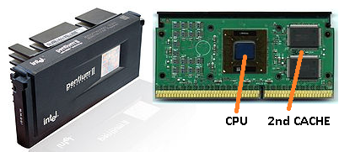
CACHE MEMORY
Cache memory, often referred to simply as "cache," is a type of high-speed volatile computer memory that provides high-speed data access to a processor and stores frequently used computer programs, applications, and data. Caches are used to reduce data latency and improve overall computer performance

Slide 14
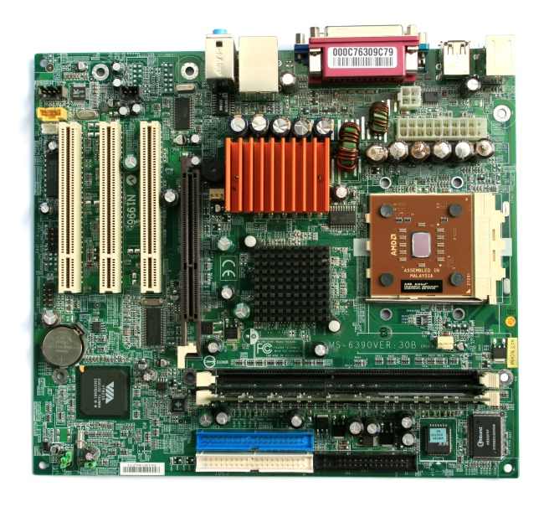
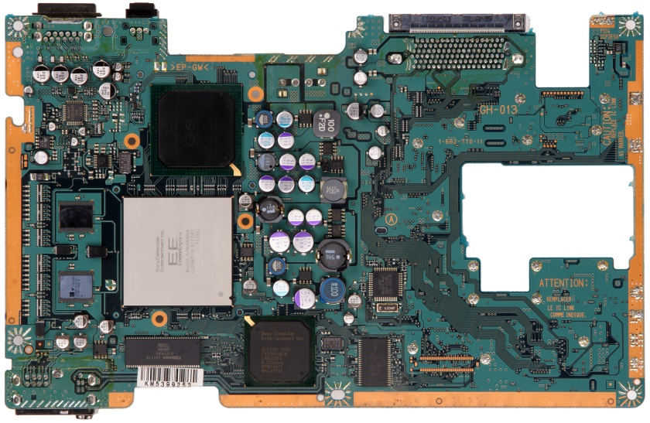
MOTHRBOARD
A motherboard, also known as a mainboard or system board, is a critical component in a computer system. It serves as the central hub that connects and facilitates communication between various hardware components, enabling the computer to function as a cohesive unit. The motherboard houses the CPU, memory, expansion slots, connectors, and more.

