Slide 1
Agenda
In this session, you will learn about:
What is cluster analysis?
Why clustering?
How can we cluster?
Motivation for partitional clustering
K-Means algorithm
Summary

Slide 2
Background
There are three methods to establish a classifier
Model a classification rule directly
Examples: k-NN, decision trees, perceptron, SVM
Model the probability of class memberships given input data
Example: logistic regression, perceptron with the cross-entropy cost
Make a probabilistic model of data within each class
Examples: Naïve Bayes, model based classifiers
1 and 2 are examples of discriminative or conditional classification
2 and 3 are both examples of probabilistic classification
3 is an example of generative classification
Notes:
Discriminative or Conditional classification
2, 3 are probabilistic classification

Slide 3
What is Cluster Analysis?
Finding groups of objects such that
the objects in a group will be similar (or related) to one another
and different from (or unrelated to) the objects in other groups
Inter-cluster distances are maximized
Intra-cluster distances are minimized
Notes:
For example different clip arts in this power-point slide are grouped into a single cluster. Each cluster for each figure.

Slide 4
Notion of a Cluster can be Ambiguous
How many clusters?
Six Clusters
Two Clusters
Four Clusters

Slide 5
What is Clustering?
Attach label to each observation or data points in a set
You can say this “unsupervised classification”
Clustering is alternatively called as “grouping”
Intuitively, if you would want to assign same label to a data points that are “close” to each other
Thus, clustering algorithms rely on a distance metric between data points
Sometimes, it is said that the for clustering, the distance metric is more important than the clustering algorithm

Slide 6
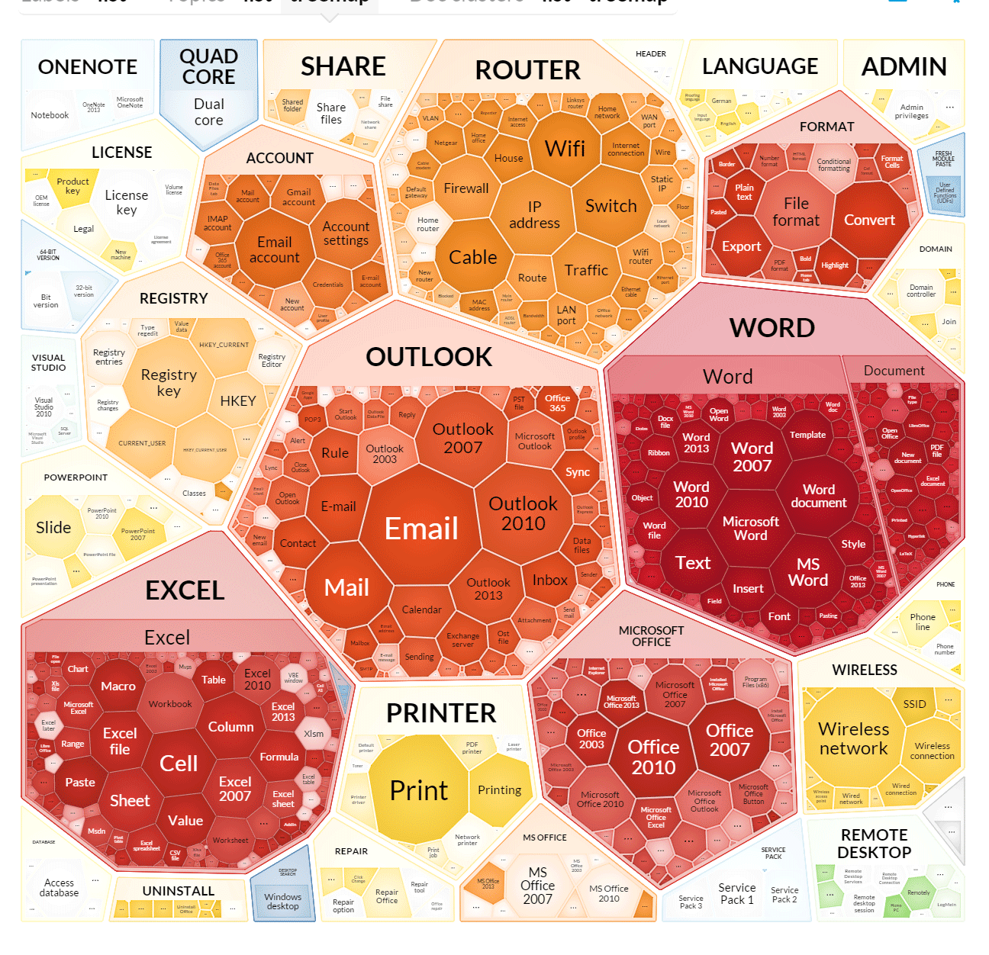
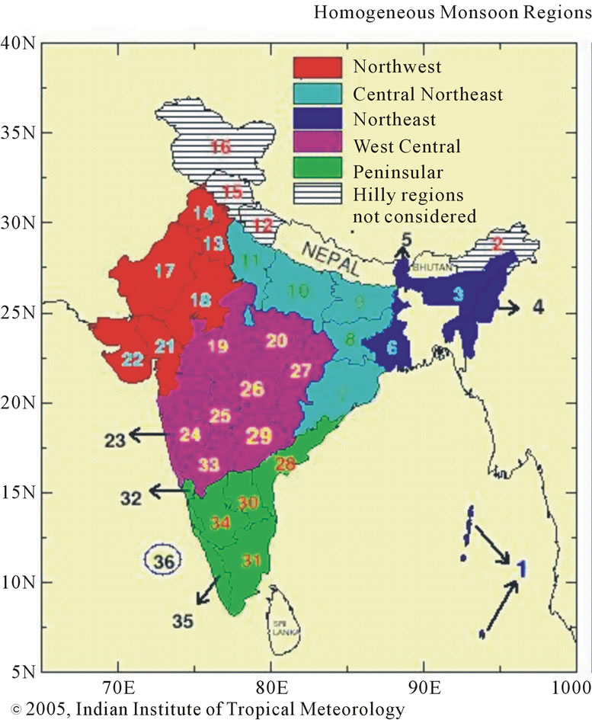
Why Clustering?
Understanding
Group related documents for browsing,
Group genes and proteins that have similar functionality, or
Group stocks with similar price fluctuations
Summarization
Reduce the size of large data sets
Feature selection pool
Data compression

Slide 7
What is NOT Cluster Analysis?
Supervised Classification
Have class label information
Simple Segmentation
Dividing students into different registration groups alphabetically, by last name
Results of a Query
Groupings are a result of an external specification
Graph Partitioning
Some mutual relevance and synergy, but areas are not identical

Slide 8
Types of Clustering
Clustering
Partitional
Hierarchical
Nested
A clustering is a set of clusters
Partitional Clustering
A division data objects into non-overlapping subsets (clusters) such that each data object is in exactly one subset
Hierarchical clustering
A set of nested clusters organized as a hierarchical tree
Nested Clustering
Mix of partitional and Hierarchical clustering

Slide 9
Partitional Clustering
A Partitional Clustering
Original Points

Slide 10
Hierarchical Clustering
Traditional Hierarchical Clustering
Traditional Dendrogram
Non-traditional Hierarchical Clustering
Non-traditional Dendrogram

Slide 11
Notion of “Closeness” Based on Distance Metric
We intuitively relate objects based on the notion of the “distance metric” and then group/cluster these objects by comparing the distance.
Shops close to my house: metric is “physical distance”
Group of people based on their mother tongue
metric is “language they speak”
All dialects of particular language are ignored
Group of people such as poor and Billionaire
Metric is the wealth they amassed
Notes:
We will formalize this notion of “distance metric” mathematically as a foundation for our clustering algorithm based on this notion.
Then we will try to use this metric to partition our data into clusters

Slide 12

Metric: Mathematically speaking
A metric or distance function is a function that defines a distance between each pair of elements of a set.
A metric on a set X is a function
$$d:X ×X→\left[0,∞\right),$$
and for all $x,y,z ∈X$ following conditions are satisfied
$d\left(x,y\right)≥0$ non-negativity or separation axiom
$d\left(x,y\right)=0 ⟺x=y$ identity of indiscernible
$d\left(x,y\right)=d\left(y,x\right)$ symmetry
$d\left(x,z\right)≤d\left(x,z\right)+d\left(y,z\right)$ triangle inequality
where $\left[0,∞\right)$ is the set of non-negative real numbers
Notes:
where $\left[0,∞\right)$ is the set of non-negative real numbers
Can you give example where symmetry (3) condition is not satisfied by our usual notion of the “distance metric”?
Quasimetrics are common in real life. For example, given a set X of mountain villages, the typical walking times between elements of X form a quasimetric because travel up hill takes longer than travel down hill. Another example is a taxicab geometry topology having one-way streets, where a path from point A to point B comprises a different set of streets than a path from B to A. Nevertheless, this notion is rarely used in mathematics, and its name is not entirely standardized.^{[5]}

Slide 13
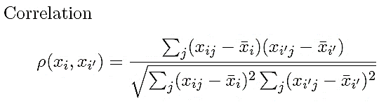
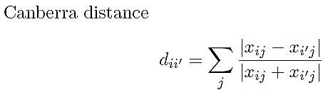
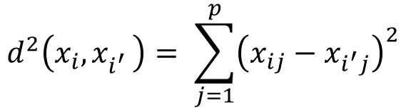
Distances: Quantitative Variables
Some Examples
Data point:
$$d^{2}\left(x_{i}, x_{i^{′}}^{}\right)= \sum_{j=1}^{p}{{\left(x_{ij}−x_{i^{′}j}\right)}^{2}}$$
Notes:
Notations:
$x_{i}$: ith feature vector
$x_{ij}$: jth coordinate of feature vector $x_{i}$
$\overline{x_{i} }$: mean of the vector $x_{i}$
$$\left|\right| :L_{1}norm of the vector , or absolute values of the number$$

Slide 14
Clustering Strategy using Distance Metric
We want to partition the data into non-overlapping clusters.
So we need to define boundaries of these clusters.
So within the cluster (“Intra-Cluster”) all data points have “similar” measure with respect to distance metric we used.
And “Inter-cluster” distance is at least equal to largest distance between a data point in the cluster and its center.
For example: Two clusters for the shop near my house and my friends house.
This philosophy is implemented in “K-Means Clustering Algorithm”

Slide 15
K-means Overview
Partitional clustering approach
Each cluster is associated with a centroid (center point)
Each point is assigned to the cluster with the closest centroid
Number of clusters, K, must be specified
The basic algorithm is very simple

Slide 16
Algorithm: k-means
Decide on a value for k (number of classes).
Initialize the k cluster centers (randomly, if necessary).
Decide the class memberships of the M objects by assigning them to the nearest cluster center.
Re-estimate the k cluster centers.
If none of the M objects changed membership in the last iteration, exit. Otherwise go to 3.

Slide 17
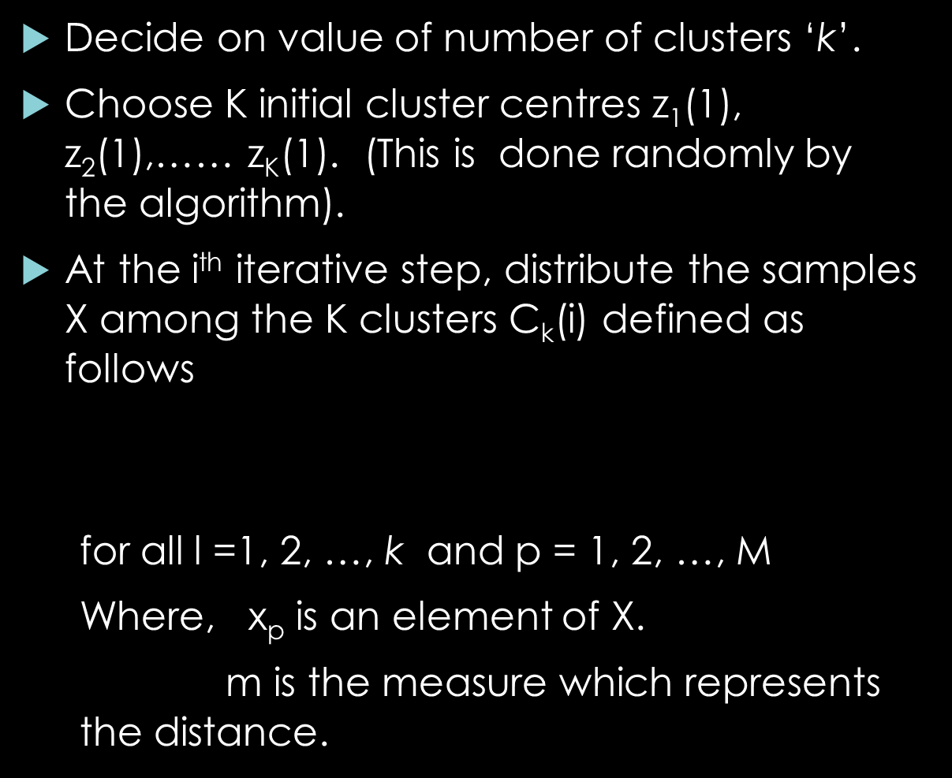
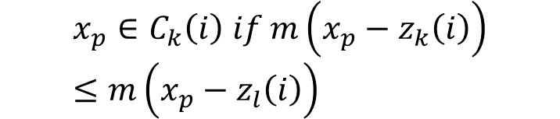
Mathematically, Algorithm: k-means – (1/2)
Decide on value of number of clusters ‘k’.
Choose K initial cluster centres z₁(1), z₂(1),…… z_{K}(1). (This is done randomly by the algorithm).
At the i^{th} iterative step, distribute the samples X among the K clusters C_{k}(i) defined as follows
for all l =1, 2, …, k and p = 1, 2, …, M
Where, x_{p} is an element of X.
m is the measure which represents the distance.
$$x_{p}∈C_{k}\left(i\right) if m\left(x_{p}−z_{k}\left(i\right)\right)≤m\left(x_{p}−z_{l}\left(i\right)\right)$$

Slide 18
Mathematically, Algorithm: k-means – (2/2)
Compute the new cluster centres z_{k}
If none of the M objects changed membership in the last iteration, exit. Otherwise go to step 3.

Slide 19
Flow Chart: K-means Algorithm
Select random
centres
z₁, z₂, ….z_{K}
Points move
For each x_{p} in X,
x_{p} is in C_{K} if it is closer to
z_{K} than to the other centers
STOP
Yes
No
Update z₁, z₂, ….z_{K}
to be the centres of C₁, C₂, ….,C_{K}

Slide 20
K-means Clustering – Details
K-means will converge for common similarity measures mentioned above.
Most of the convergence happens in the first few iterations.
Often the stopping condition is changed to ‘Until relatively few points change clusters’
Complexity is O( n * K * I * d )
n = number of points, K = number of clusters, I = number of iterations, d = number of attributes

Slide 21
Evaluating K-means Clusters
Most Common Measure is Sum of Squared Error (SSE)
For each point, the error is the distance to the nearest cluster
To get SSE, we square these errors and sum them.
x is a data point in cluster C_{i} and z_{i} is the representative point for cluster C_{i}
can show that m_{i} corresponds to the center (mean) of the cluster
Given two clusters, we can choose the one with the smallest error
One easy way to reduce SSE is to increase K, the number of clusters
A good clustering with smaller K can have a lower SSE than a poor clustering with higher K
Notes:
Nomenclature
SSE: Sum of the Square Error
d(x,y): distance metric for points x,y
$Z_{i}$ : Centroid/Cluster centre for cluster i
x : data point
K: Number of clusters

Slide 22
Example: Real life application of K-means clustering
Application of K-means Clustering
Colour Quantization
Colour quantization is the process of reducing the number of distinct colours in an image.
The intent is to preserve the colour appearance of the image as much as possible, while reducing the number of colours, whether for memory limitations or compression.
Is best used when building Content-Based Image Retrieval (CBIR) systems.
See MIT Photobook, Visual Search,
We will see how K-means clustering is used for image compression.

Slide 23
Colour Quantization Problem
Let us say we have an image that is stored with 24 bits/pixel and can have up to 16 million colours.
We have a colour screen with 8 bits/pixel that can display only 256 colours.
We want to ﬁnd the best 256 colours among all 16 million colours such that the image using only the 256 colours in the palette looks as close as possible to the original image.
We have colour quantization where we map from high to lower resolution.
of course we can always quantize uniformly, but this wastes the colour map by assigning entries to colours not existing in the image, or would not assign extra entries to colours frequently used in the image.
For example, if the image is a seascape, we expect to see many shades of blue and maybe no red. So the distribution of the colour map entries should reﬂect the original density.

Slide 24
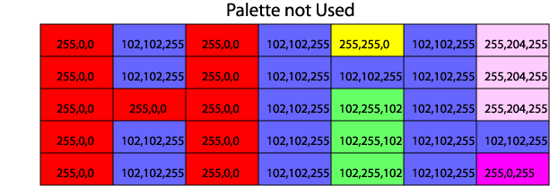
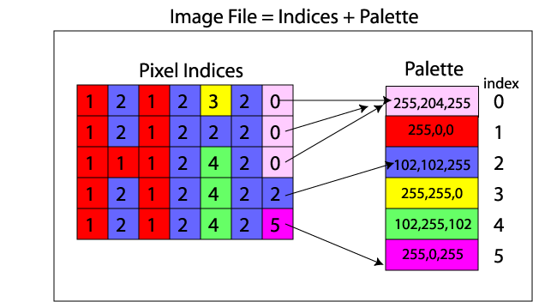
True - Colour vs. Index - Colour Images
True-colour Image
Index-colour Image
Each pixel is represented by a vector of 3 components [R, G, B]
For eg: 7 X 5 pixel image
File size = 7*5*3 bytes=105bytes
Each pixel is represented by an index into a colour map
For eg: 7 X 5 pixel image
File size = 6*3 bytes (pallet) + (7*5*1 bytes) (colour) = 53 bytes
Image Source: http://incompliancemag.com/article/automotive-emc-case-study-hmi-graphics-influence-on-radiated-emissions/

Slide 25
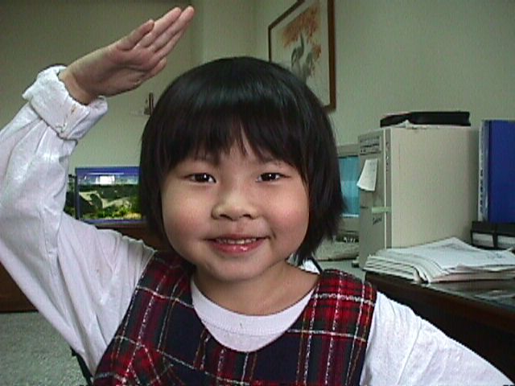
Example: Image Compression
Date: 1998/04/05
Dimension: 480x640
Raw data size: 480*640*3 bytes = 900KB
File size: 49.1KB
Compression ratio = 900/49.1 = 18.33
Source: “K-means Clustering”, PowerPoint presentation, J.-S. Roger Jang , CSIE Dept., National Taiwan Univ., Taiwan,http://mirlab.org/jang

Slide 26
Application: Image Compression
Goal
Convert a pixel image from true colours to indexed colours with minimum distortion.
Steps
Collect data from a true-colour image
Perform K-means clustering to obtain cluster centers as the indexed colours
Compute the compression rate
Notes:
$ρ:$ $compression ratio$
m: number of pixels in image along x-axis
n: number of pixels in image along y-axis

Slide 27
Example: Image Compression (1/3)
Some quantities of the k-means clustering
Number of pixels, n = 480x640 = 307200
These are number of vectors to be clustered
Each pixel is represented by a vector
Dimension, d = 3 (R, G, B)
Number of colours in the palette, m = 256 (no. of clusters)
Indexing of pixels for an 2*3*3 image
13 | 15 | 17
14 | 16 | 18
7 | 9 | 11
8 | 10 | 12
1 | 3 | 5
2 | 4 | 6

Slide 28
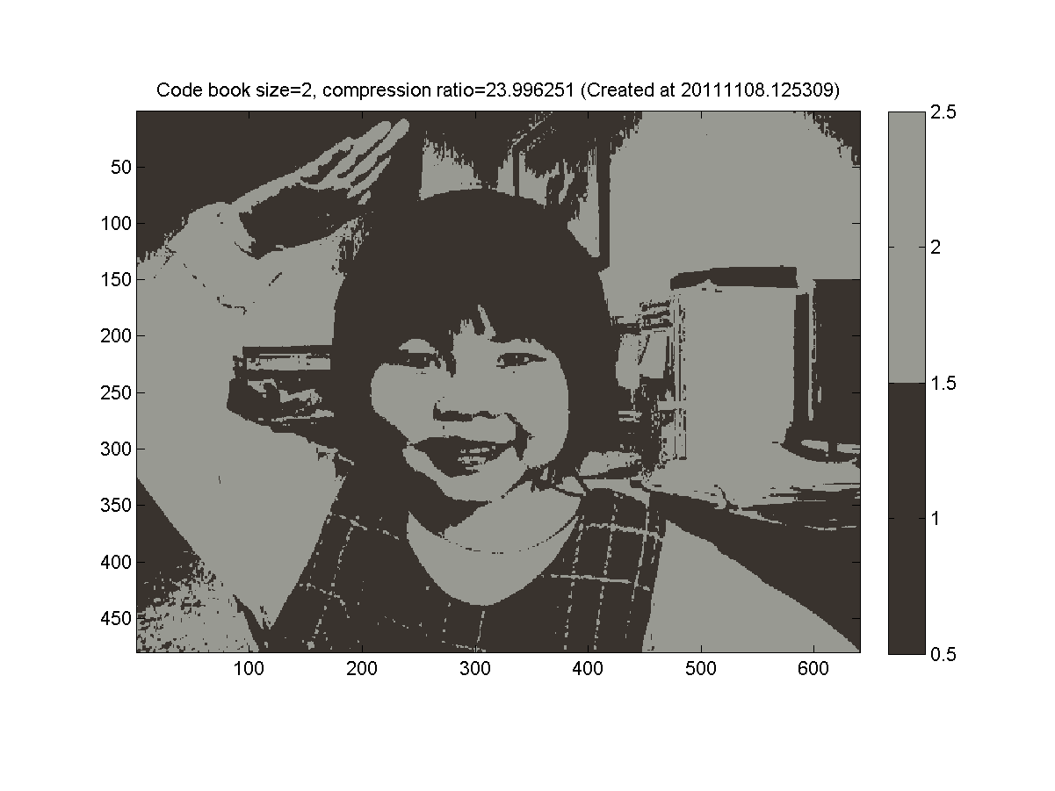
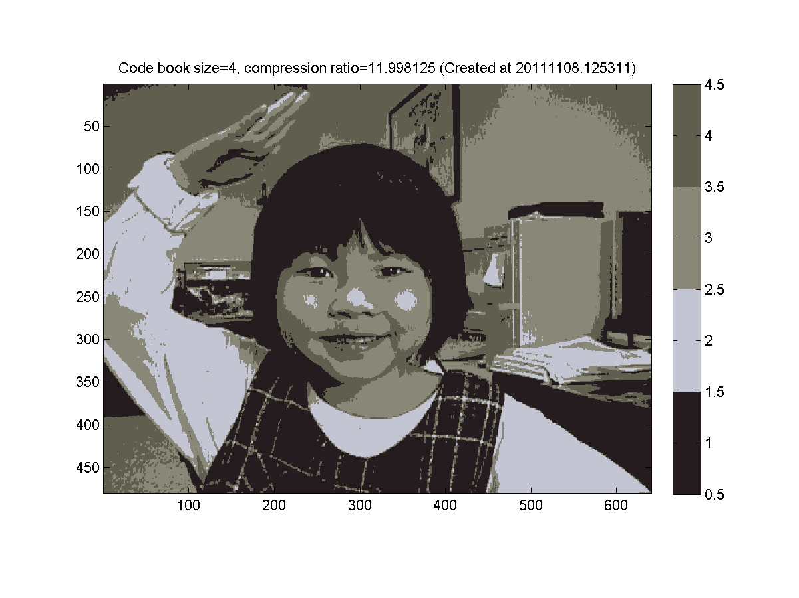
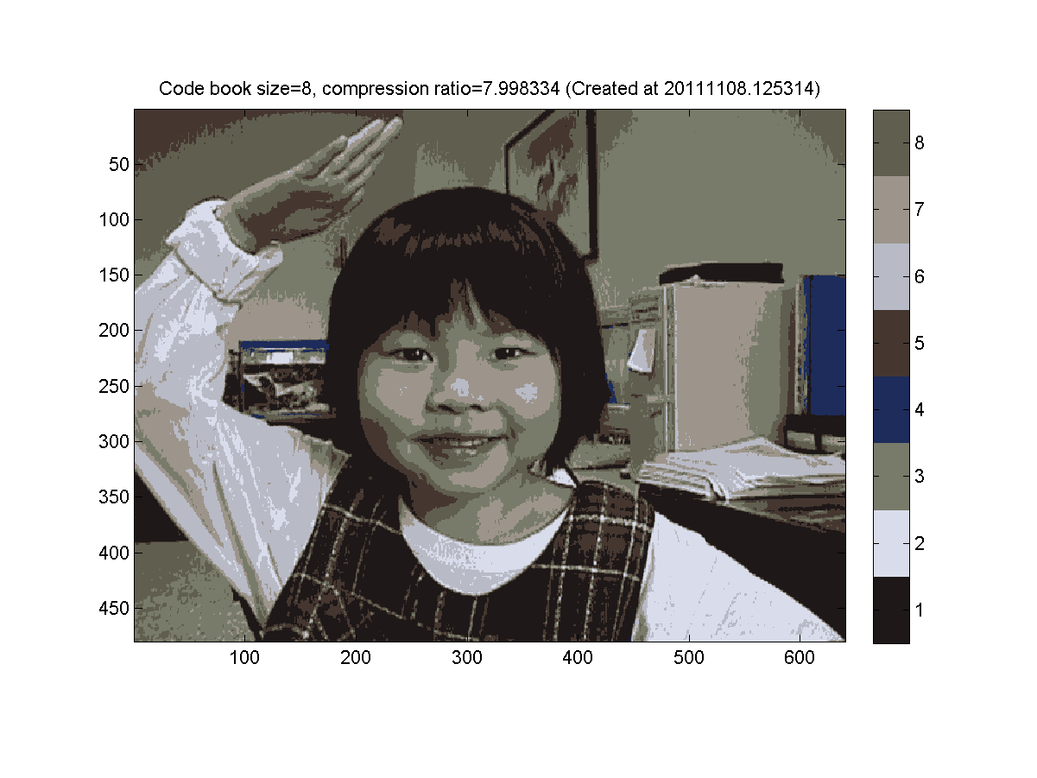
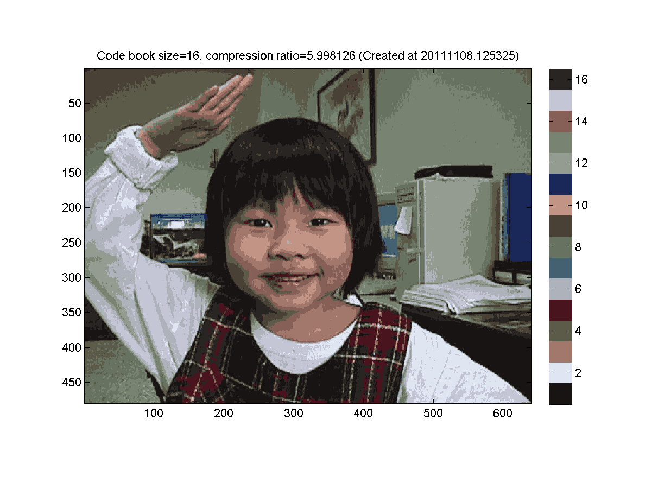
Example: Image Compression (2/3)
K=2
K=4
K=8
K=16

Slide 29
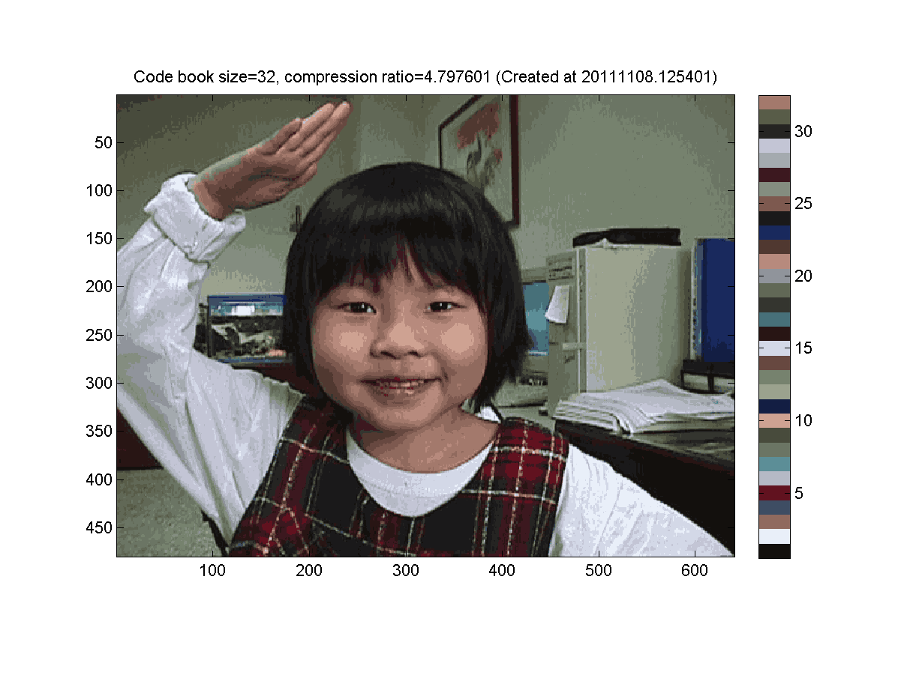
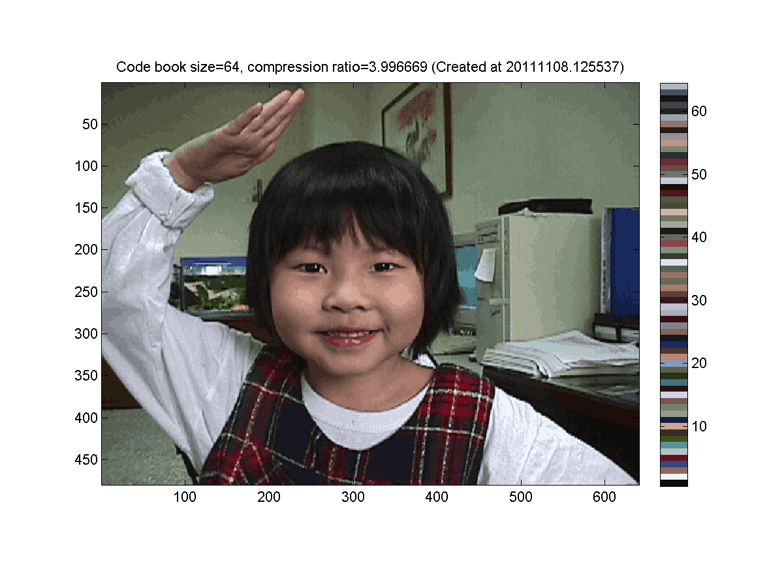
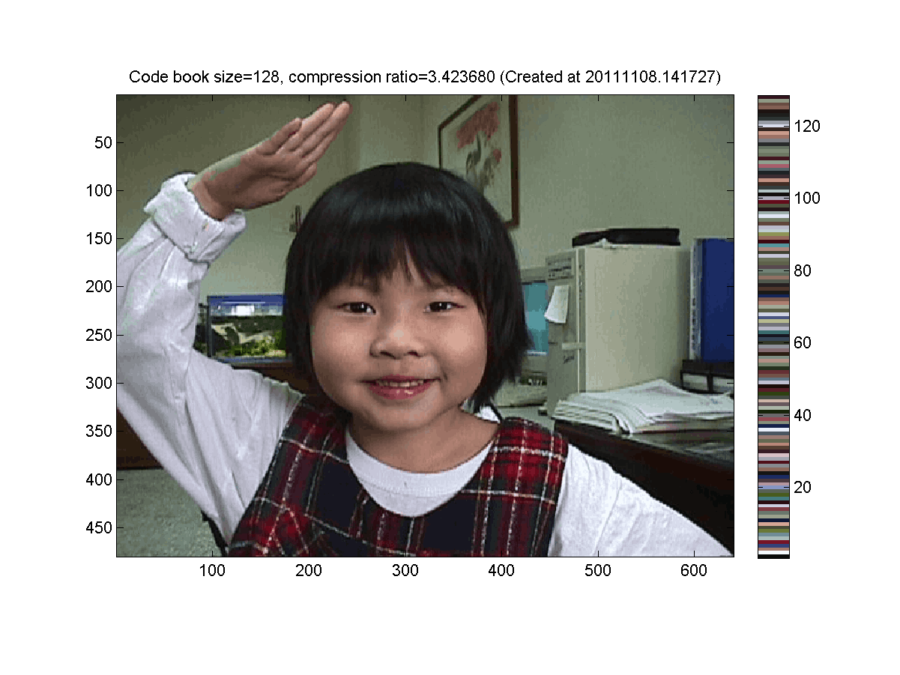
Example: Image Compression (3/3)
K=32
K=64
K=128
K=256

Slide 30
MATLAB Code
X = imread('annie19980405.jpg');
image(X)
[m, n, p]=size(X);
index=reshape(1:m*n*p, m*n, 3)';
data=double(X(index));
maxI=6;
for i=1:maxI
centerNum=2^i;
fprintf('i=%d/%d: no. of centers=%d\n', i, maxI, centerNum);
center=kMeansClustering(data, centerNum);
distMat=distPairwise(center, data);
[minValue, minIndex]=min(distMat);
X2=reshape(minIndex, m, n);
map=center'/255;
figure; image(X2); colourmap(map); colourbar; axis image;
end

Slide 31
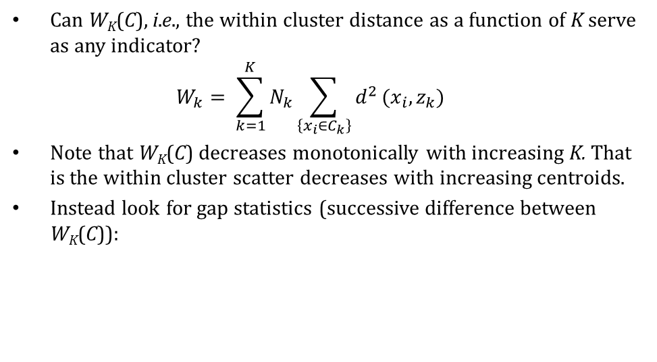
Choice of K?
Can W_{K}(C), i.e., the within cluster distance as a function of K serve as any indicator?
$$W_{k}= \sum_{k=1}^{K}{N_{k}}\sum_{\left\{x_{i}∈C_{k}\right\}}{d^{2}}(x_{i}, z_{k})$$
Note that W_{K}(C) decreases monotonically with increasing K. That is the within cluster scatter decreases with increasing centroids.
Instead look for gap statistics (successive difference between W_{K}(C)):
Notes:
$$W_{k}= \sum_{k=1}^{K}{N_{k}}\sum_{\left\{x_{i}∈C_{k}\right\}}{d^{2}}(x_{i}, z_{k})$$

Slide 32
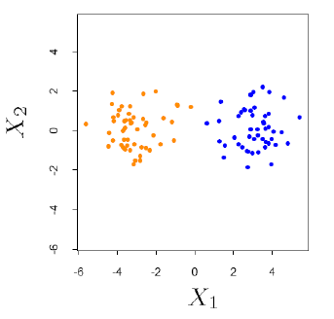
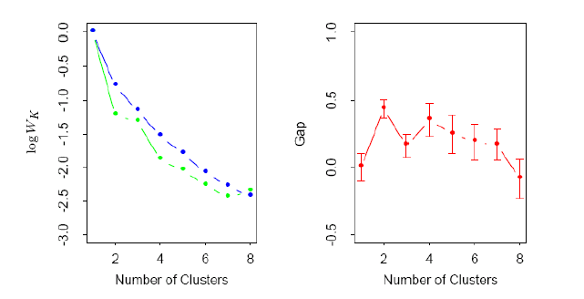
Choice of K…
Data points simulated
from two pdfs
Log(W_{K}) curve
Gap curve
This is essentially a visual heuristic

Slide 33

Demo Python Code

Slide 34
Demo Python Code
from sklearn.cluster import KMeans
import numpy as np
X = np.array([[1, 2], [1, 4], [1, 0],
[4, 2], [4, 4], [4, 0]])
kmeans = KMeans(n_clusters=2, random_state=0).fit(X)
kmeans.labels_array([0, 0, 0, 1, 1, 1], dtype=int32)
kmeans.predict([[0, 0], [4, 4]])
array([0, 1], dtype=int32)
kmeans.cluster_centers_array([[ 1., 2.],
[ 4., 2.]])

Slide 35
K-means: Limitations
K is a user input;
alternatively BIC (Bayesian information criterion) or
MDL (minimum description length) can be used to estimate K
K-means converges, but it finds a local minimum of the cost function.
It is an approximation to an NP-hard combinatorial optimization problem
Works only for numerical observations
Outliers can considerable trouble to K-means
K-means has problems when clusters are of differing
Sizes,
Densities
Non-globular shapes

Slide 36
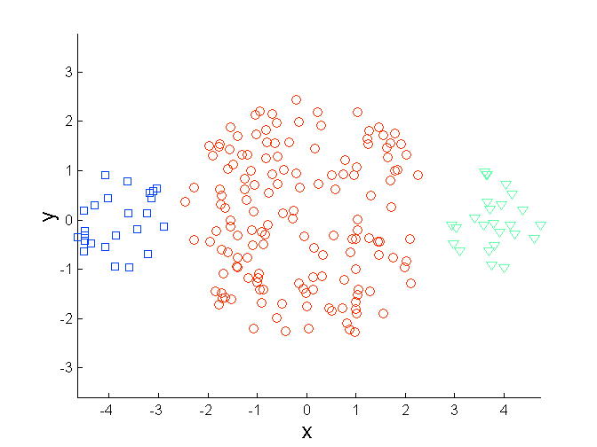
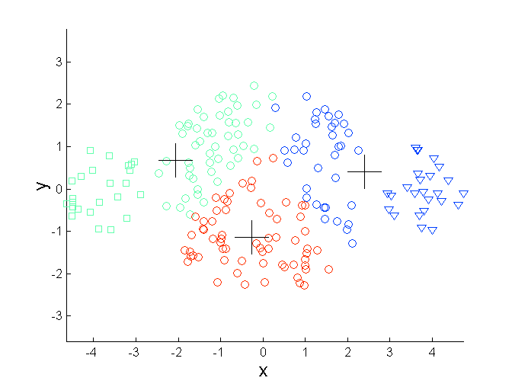
Limitations of K-means: Differing Sizes
Original Points
K-means (3 Clusters)

Slide 37
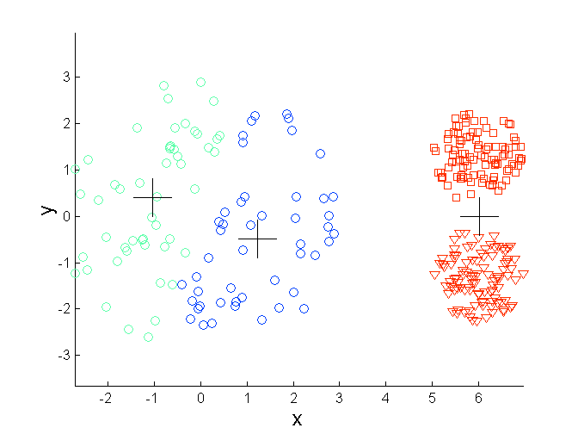
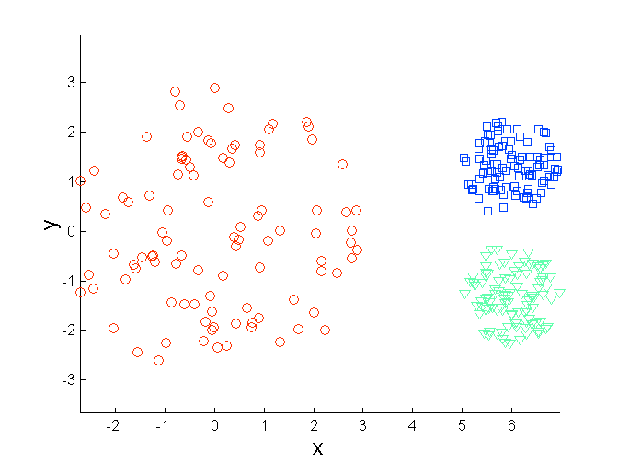
Limitations of K-means: Differing Density
Original Points
K-means (3 Clusters)

Slide 38
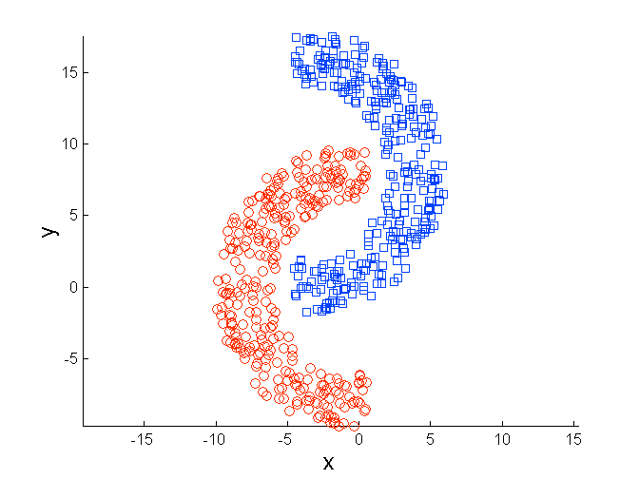
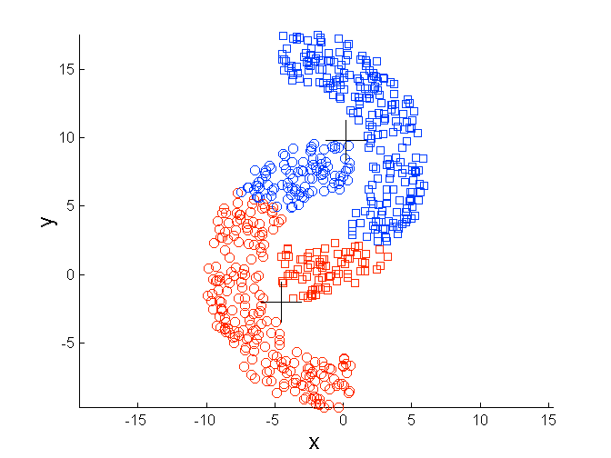
Limitations of K-means: Non-globular Shapes
Original Points
K-means (2 Clusters)

Slide 39
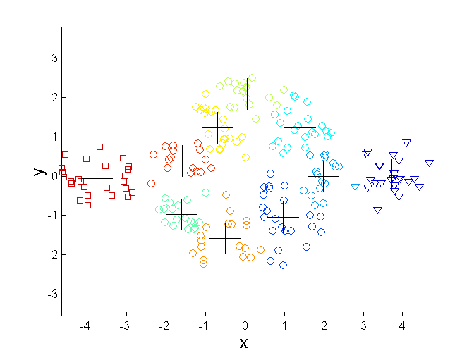
Overcoming K-means Limitations (1/3)
Original Points
K-means Clusters
One solution is to use many clusters.
Find parts of clusters, but need to put together.

Slide 40
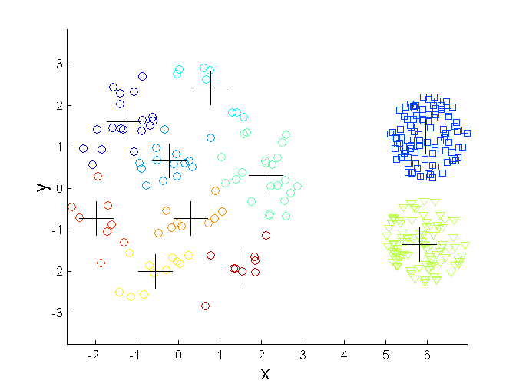
Overcoming K-means Limitations (2/3)
Original Points: Mix of globular and spread densities
K-means Clusters

Slide 41
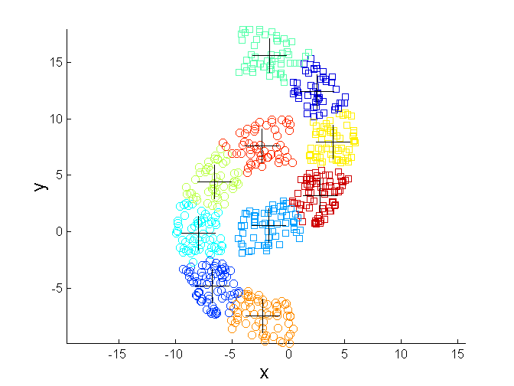
Overcoming K-means Limitations (3/3)
Original Points
K-means Clusters

Slide 42
K-Means Clustering: Epilougue
Despite certain limitations, the k-means algorithm is a major workhorse in clustering analysis:
It works well on many realistic data sets,
Is relatively fast, easy to implement, and easy to understand.
Many clustering algorithms that improve on or generalize k-means, such as k-medians, k-medoids, k-means++, and the EM algorithm for Gaussian mixtures, all reflect the same fundamental insight, that points in a cluster ought to be close to the center of that cluster.

Slide 43
Summary
We discussed concept of clustering and intuitive idea of closeness based on the distance metric.
We studied K-means algorithm in details.
Application of K-means algorithm for image compression was illustrated.
Certain limitations of K-means were presented.
Other partitional clustering algorithms such as K-median,K-medoids, Fuzzy K-means were discussed

Slide 44
Acknowledgement
Contents of this presentation are prepared from variety of sources. The list is not exhaustive but indicates major sources.
We thank these authors to make this content available.
“Some Techniques to Couple Models and Data”, Parte Y, Ph.D. Thesis, Institute de Mathématique de Toulouse, France, 2009
“Cluster Analysis: Basic Concepts and Algorithms”, Tan, P and Steinbach M and Kumar V, Chapter 8 , “Introduction to Data Mining” , Addison Welsley, 2006,Addison-Wesley Companion Book Site
“Clustering”, N. Ray, power point presentation , for course “Introduction to Machine Learning”, Computing Science 466 / 551, Fall Semester, 2009, University of Alberta, Canada.
“Tutorial On Fuzzy Clustering”, Jan Jantzen J, power point presentation, Technical University of Denmark

