Slide 1
BLUESTOCK FINTECH · CAPSTONE PROJECT
Mutual Fund Analytics Platform
End-to-End Data Engineering, ETL Pipeline & Interactive Dashboard
Prepared by Devendra Gautam · Individual Capstone · August 2026

Slide 2
01 · CONTEXT
2
Problem & Objective
The Problem
Key Project Objectives
India's mutual fund industry manages Rs. 81 lakh crore across 1,908 schemes and 26.12 crore folios — but NAV, AUM, SIP and holdings data live in fragmented, differently-formatted sources with no unified analytics layer.
1
Automated ETL pipeline from raw AMFI data
2
Normalised 7-table SQL star schema
3
19-chart EDA notebook with real findings
The Objective
Build a full-stack platform that ingests public AMFI/mfapi.in data, transforms it through a reproducible ETL pipeline, stores it in a relational star schema, and surfaces risk-adjusted fund insights via an interactive dashboard.
4
Sharpe / Sortino / Alpha / Beta / VaR metrics
5
4-page interactive Power BI dashboard
6
Investor behaviour & risk analytics
Educational capstone — real AMFI-sourced fund data, simulated investor transactions.

Slide 3
02 · FOUNDATION
3
Data Sources & Datasets
40
46K+
32.8K
10
Real fund schemes, 10 AMCs
Daily NAV observations
Investor transactions
Source datasets provided
Source | Data Type | Frequency
AMFI India | NAV, AUM, folio, SIP | Daily / Monthly
mfapi.in REST API | Historical NAV (JSON, no auth) | Daily
NSE / BSE | Benchmark index prices | Daily
AMFI Monthly Notes | Industry SIP & flow data | Monthly
Source
Data Type
Frequency
Real-World Anchors Embedded
SBI MF AUM (Dec-25): Rs. 12.50 lakh crore
SIP inflow (Dec-25): Rs. 31,002 crore ATH
Total MF folios (Dec-25): 26.12 crore
Industry AUM (Dec-25): Rs. 81 lakh crore
All fund identifiers, NAV anchors and AUM figures sourced from public AMFI / mfapi.in data.

Slide 4
03 · ENGINEERING
4
System Architecture & ETL Pipeline
EXTRACT
TRANSFORM
LOAD
ANALYSE
VISUALISE
10 CSVs + live mfapi.in
NAV pulls (6 schemes)
▶
Clean, forward-fill,
validate, standardise
▶
7-table SQLite
star schema
▶
Pandas / NumPy / SciPy
risk & return metrics
▶
4-page Power BI
dashboard
Star Schema — 7 Tables
Why a star schema?
dim_fund
Dimension
40 rows
Dimension tables (dim_fund, dim_date) describe slow-changing attributes. Fact tables record events — NAV, transactions, performance — each linked via amfi_code. This mirrors production BI pipelines at firms like Zerodha and Groww, and lets Power BI auto-build relationships and cross-filter cleanly across every dashboard page.
dim_date
Dimension
~1,612 rows
fact_nav
Fact
46,000 rows
fact_transactions
Fact
32,778 rows
fact_performance / fact_aum / fact_sip_industry
Fact
40 / 90 / 48 rows
Pipeline scripts: data_ingestion.py → data_cleaning.py → load_to_db.py (see GitHub repo).

Slide 5
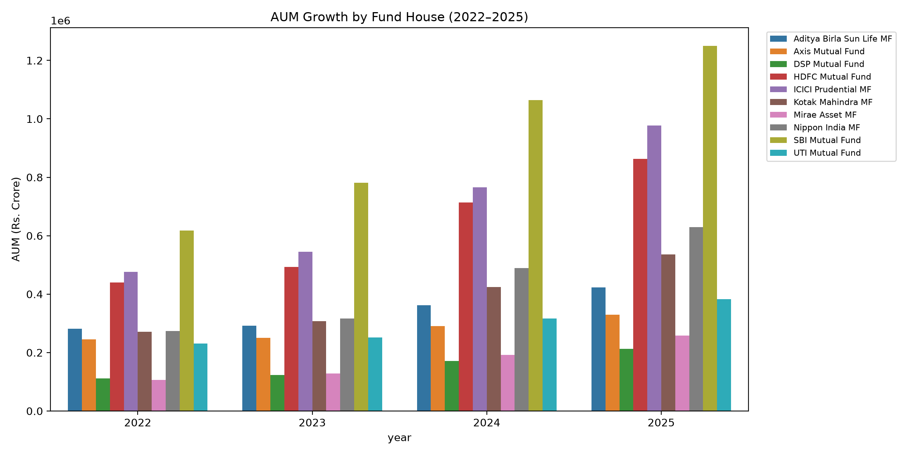
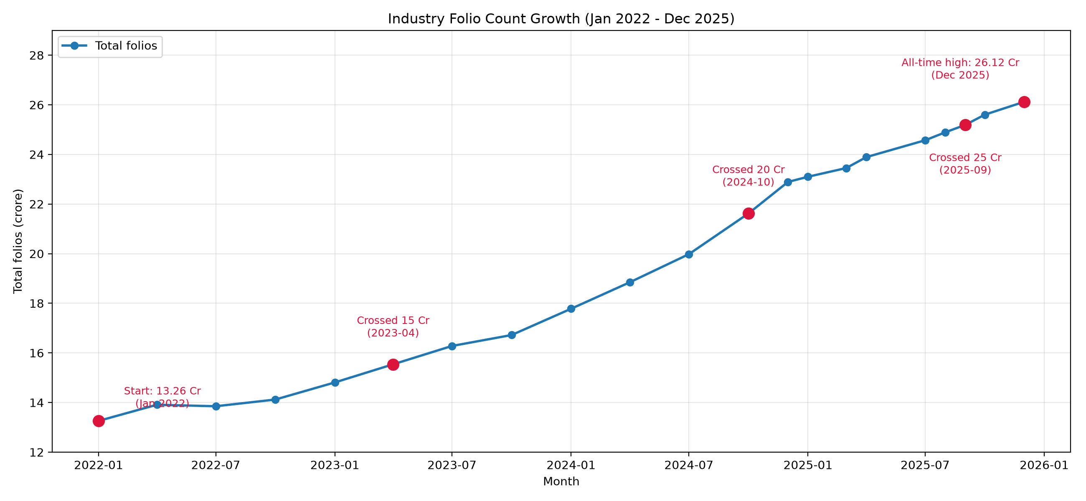
04 · EXPLORATION
5
EDA Highlights — Industry Growth
What the data shows
SBI Mutual Fund leads AUM every single year, 2022–2025 — consistent with its real-world #1 position.
Industry folio count nearly doubled: 13.26 Cr → 26.12 Cr (Jan-22 to Dec-25).
AUM growth is accelerating, not linear — the 2024–25 jump is the steepest in the sample.
Full detail: notebooks/EDA_Analysis.ipynb (19 charts).

Slide 6
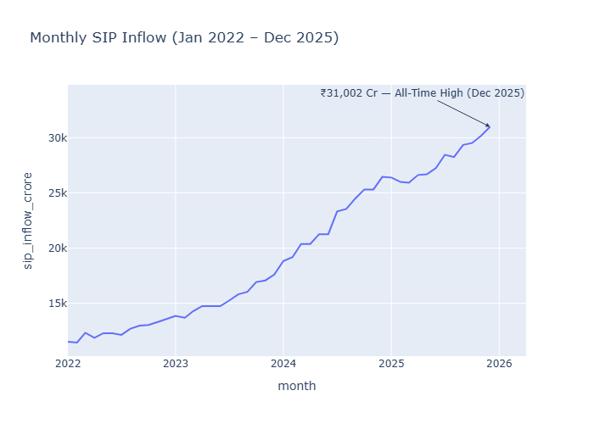
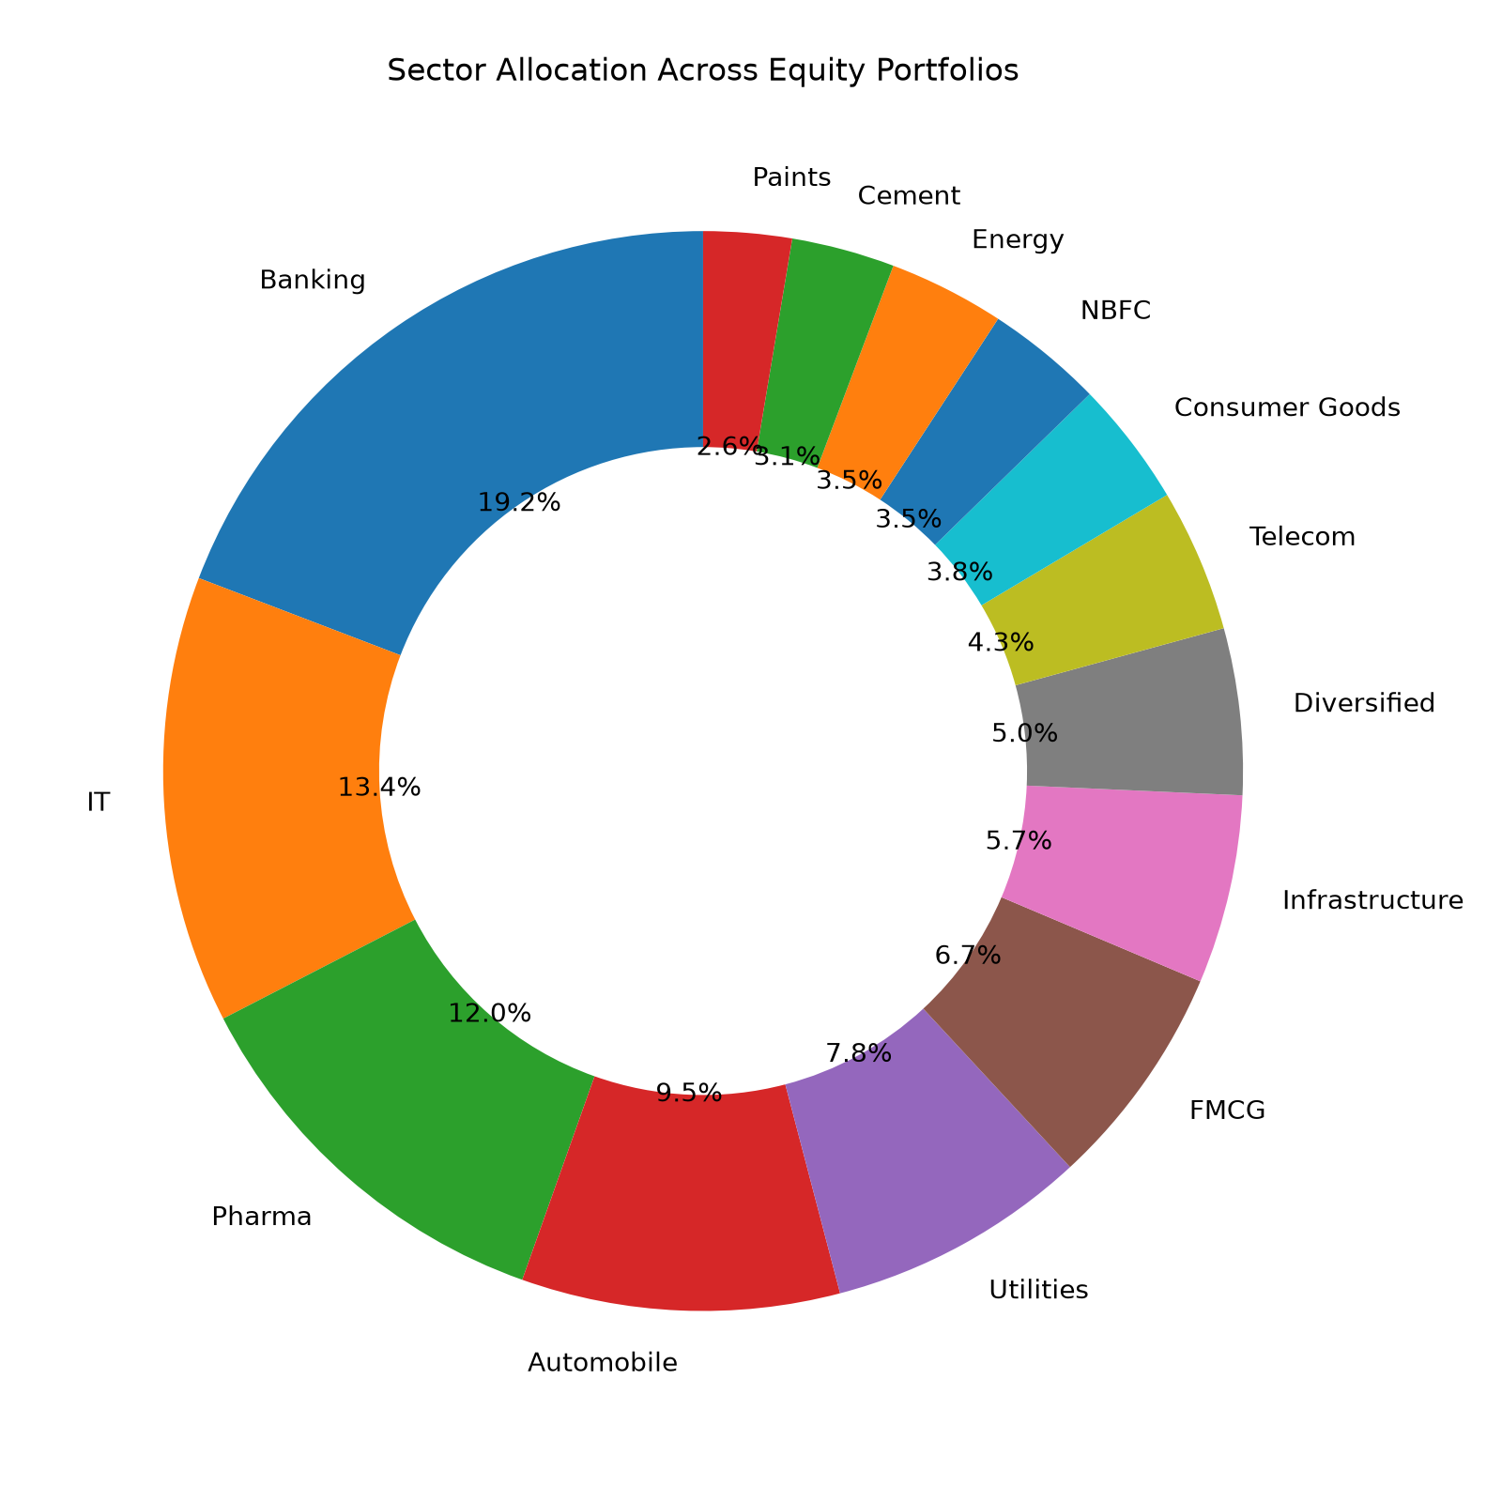
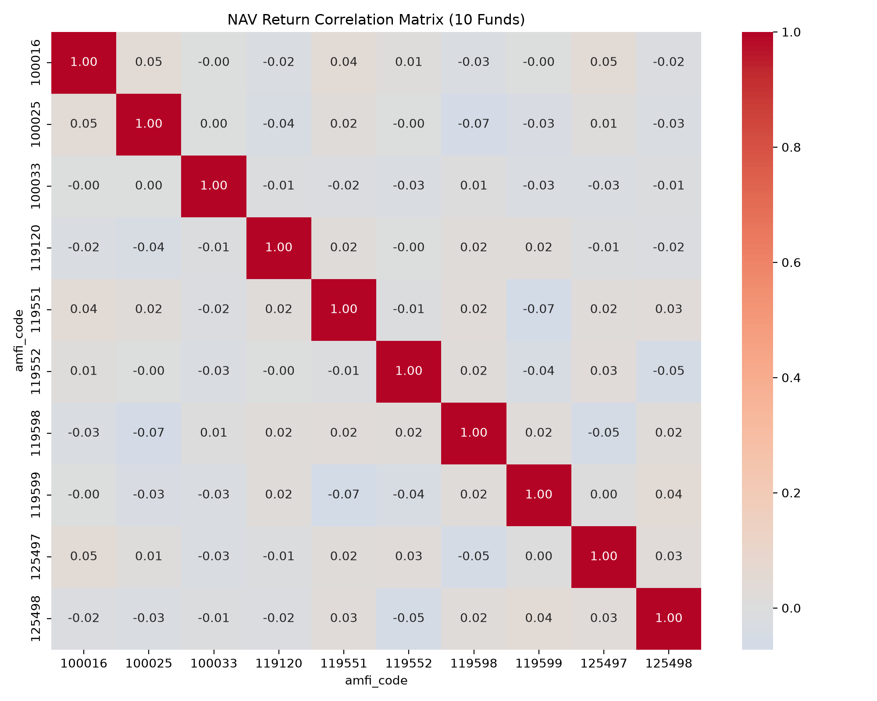
04 · EXPLORATION
6
EDA Highlights — Flows & Structure
What the data shows
Monthly SIP inflow grew near-linearly, peaking at the real Rs. 31,002 Cr all-time high (Dec-25).
Equity holdings concentrate in a handful of sectors — Banking, IT and Pharma dominate.
Fund return correlations are surprisingly low (–0.07 to +0.07) — returns look largely idiosyncratic, not one shared market factor.
Full detail: notebooks/EDA_Analysis.ipynb (19 charts).

Slide 7
05 · PERFORMANCE
7
Fund Scorecard — Methodology & Leaders
Composite Score (0–100)
Top 5 Funds by Scorecard
3-Year Return — 30%
1
Mirae Asset Large Cap Fund
Sharpe Ratio — 25%
Score: 86.25
Alpha vs Nifty 100 — 20%
2
ICICI Pru Midcap Fund
Score: 82.25
Expense Ratio (inv.) — 15%
3
Kotak Flexicap Fund
Max Drawdown (inv.) — 10%
Score: 82.00
4
HDFC Mid-Cap Opportunities Fund
Ranking funds by raw Sharpe ratio alone favours ultra-low-volatility Liquid funds (Sharpe up to 7.68) over genuinely strong equity performers. The composite scorecard corrects for this by blending return, risk-adjusted performance, cost and drawdown.
Score: 80.75
5
ICICI Pru Bluechip Fund (Direct)
Score: 80.00
Formulas: CAGR, Sharpe (Rf=6.5%), Sortino, OLS Alpha/Beta vs Nifty 100, Max Drawdown — see Final_Report.pdf §7.1.

Slide 8
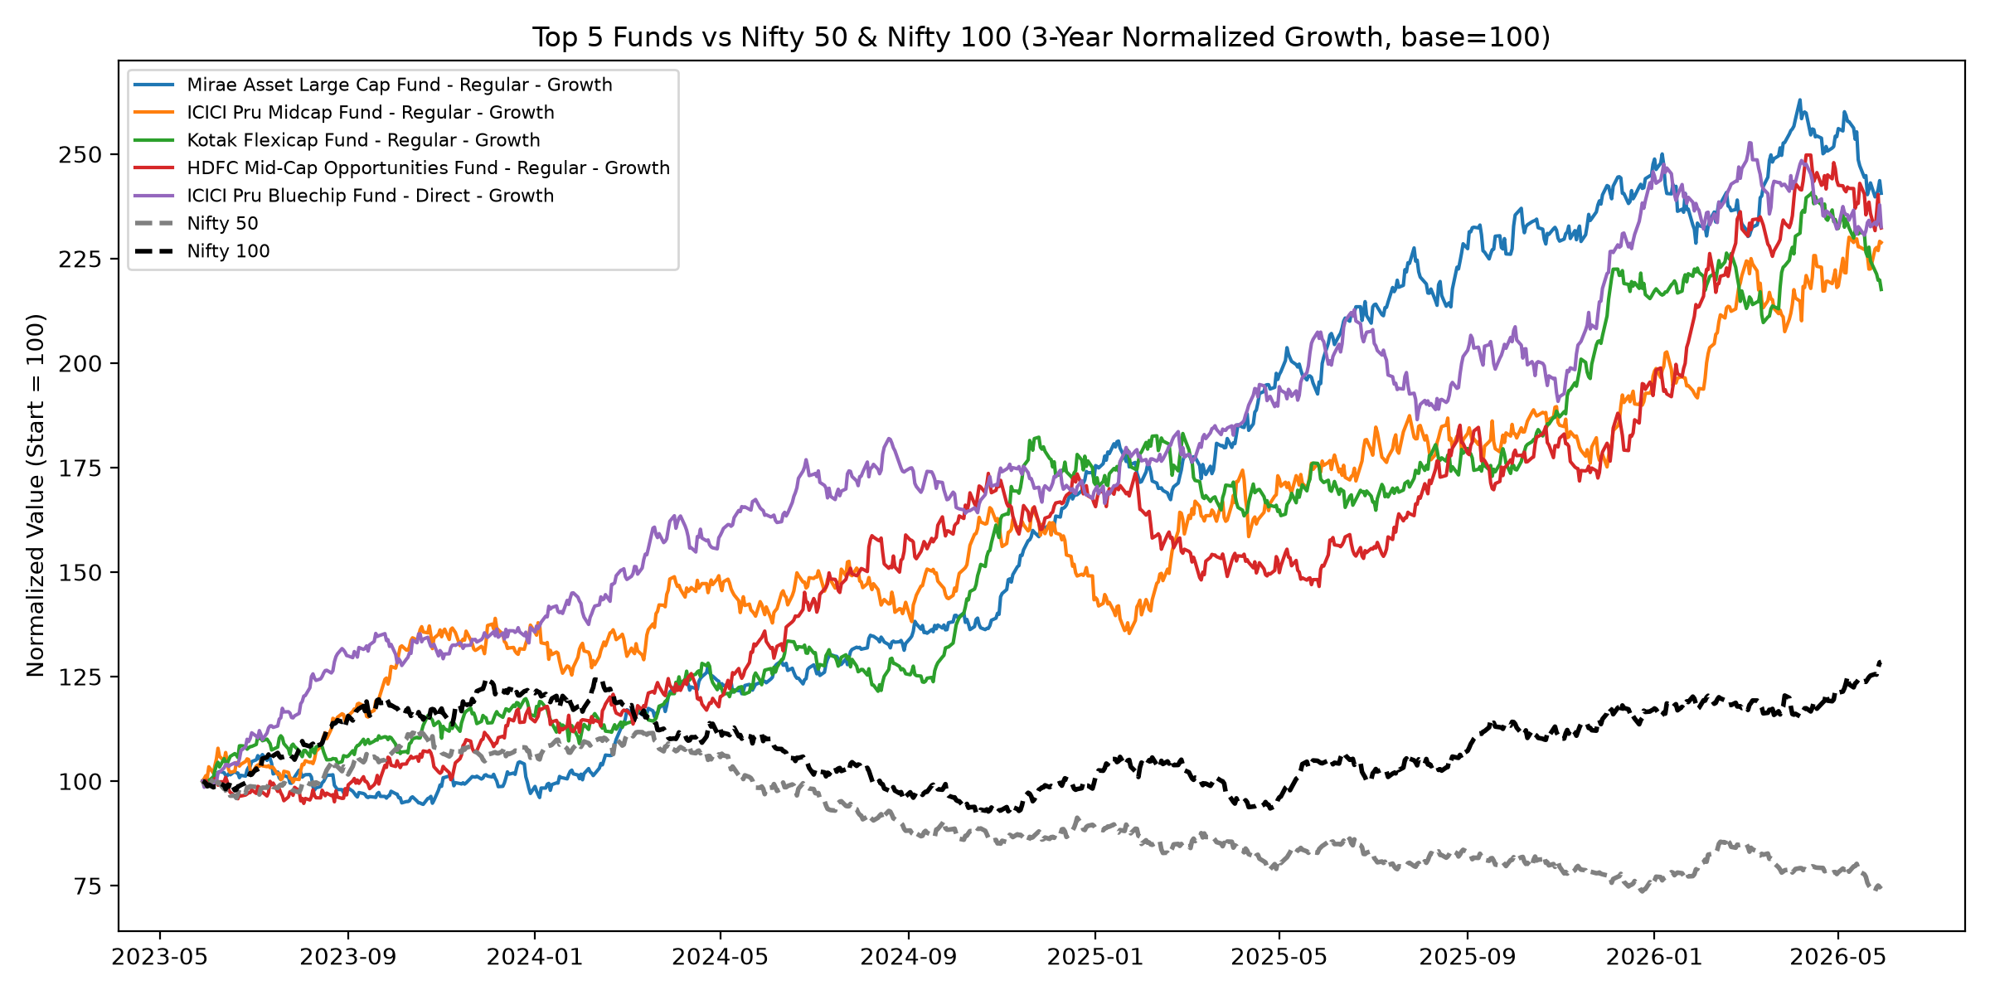
05 · PERFORMANCE
8
Top Funds vs Benchmark
Reading the chart
All series indexed to 100 at the start of the 3-year window. Every one of the top-5 scorecard funds meaningfully outpaces Nifty 100 over the full period — validating the composite scoring approach, not just cherry-picking high-Sharpe outliers.
+86.25
7.68
6.5%
Top scorecard fund
Highest raw Sharpe (Liquid)
Risk-free rate used (Rf)
Source: notebooks/Performance_Analytics.ipynb → data/processed/fund_scorecard.csv

Slide 9
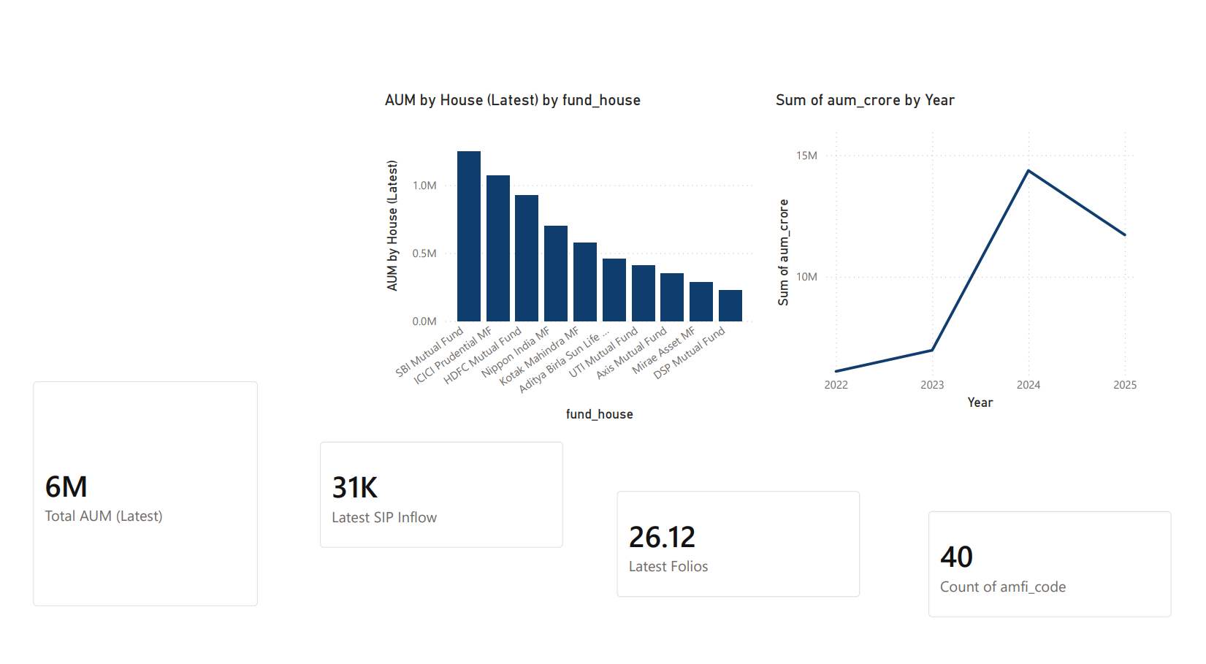
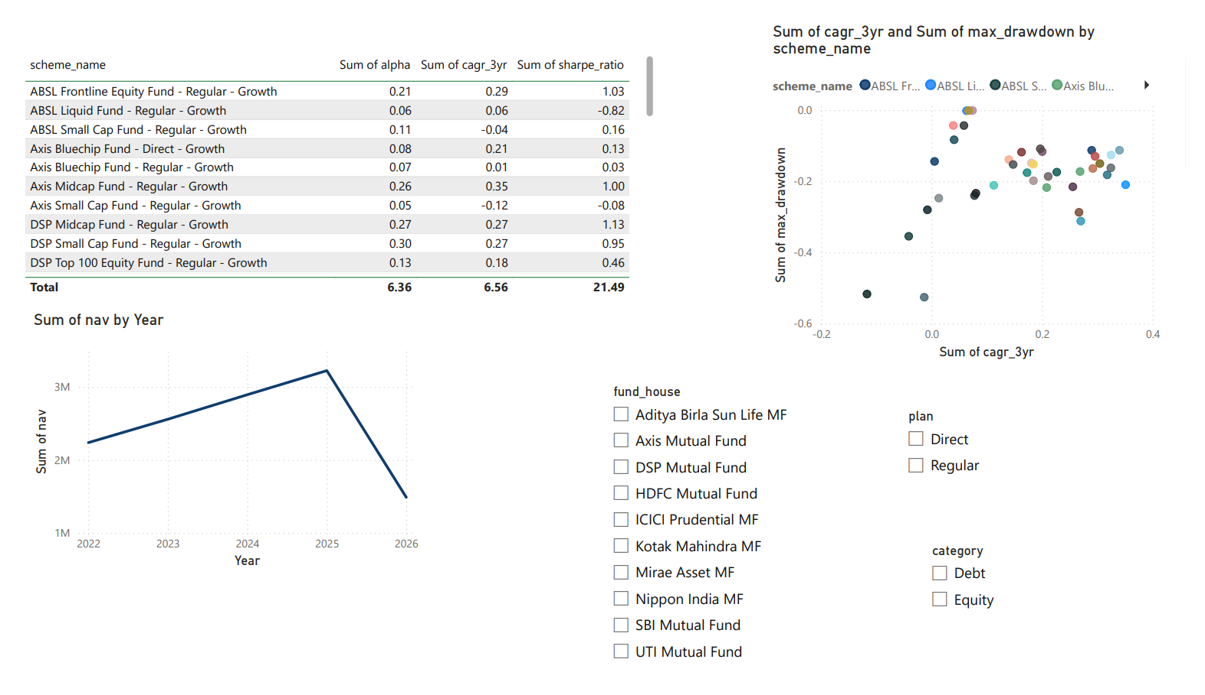
06 · DASHBOARD
9
Interactive Dashboard — Industry & Performance
Page 1 — Industry Overview
Page 2 — Fund Performance
KPI cards pinned to the latest period, AUM trend, AUM-by-AMC bar chart.
Sortable scorecard, return-vs-drawdown scatter, NAV trend, 3 slicers.
Power BI Desktop · bluestock_mf_dashboard.pbix · 4 pages, cross-filtering slicers on every page

Slide 10
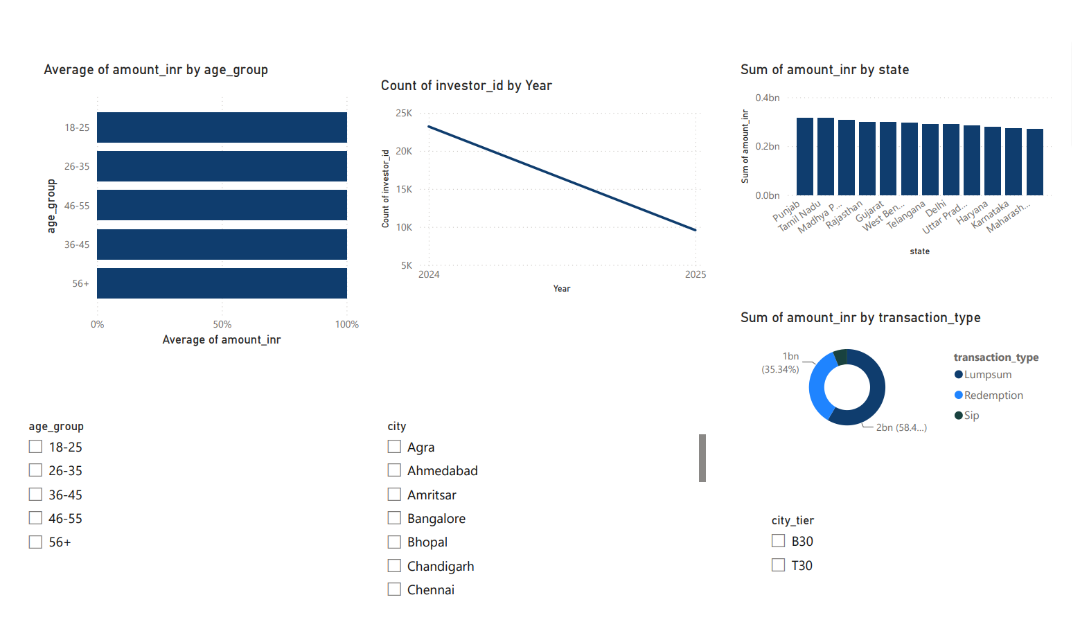
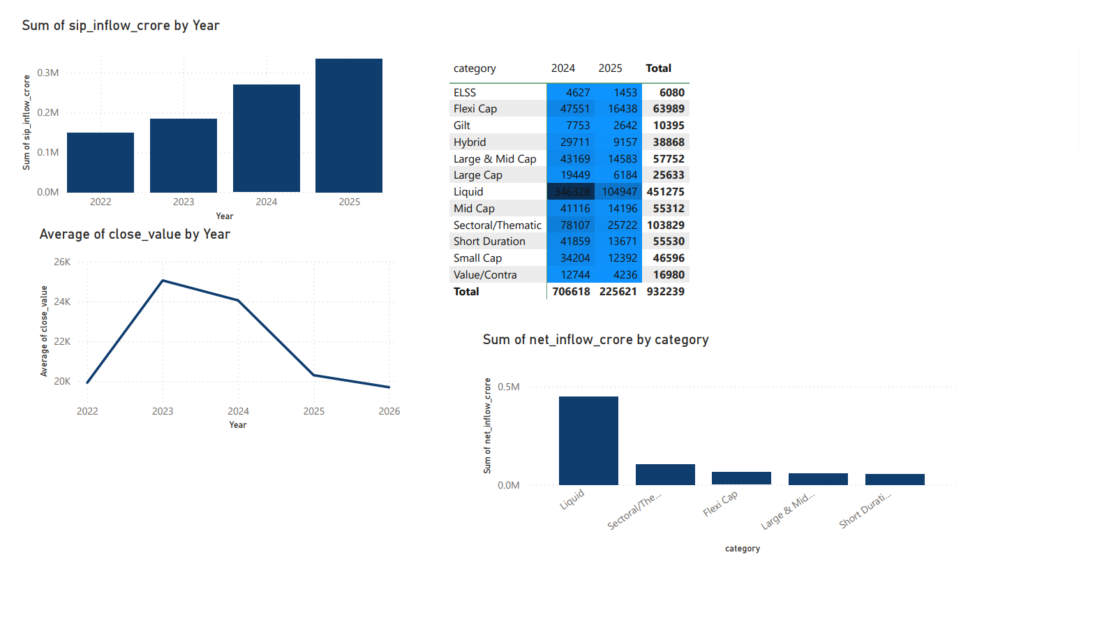
06 · DASHBOARD
10
Interactive Dashboard — Investors & Markets
Page 3 — Investor Analytics
Page 4 — SIP & Market Trends
Transactions by state, SIP/Lumpsum/Redemption split, age-group SIP behaviour.
SIP inflow vs Nifty 50, category-inflow heatmap, Top-5 categories by net inflow.
Known limitation: SIP inflow vs Nifty 50 is shown as two time-aligned charts rather than one true dual-axis visual — a cross-table relationship was built but the combo chart did not filter correctly. See Final_Report.pdf §10.

Slide 11
07 · SYNTHESIS
11
Key Findings
1
2
3
SIP continuity is a real problem
Small Cap carries the tail risk
Sharpe alone misleads fund choice
97.8% of long-term SIP investors (6+ SIPs) show gaps >35 days between payments — most “regular” investors aren't actually regular.
SBI, Axis and ABSL Small Cap funds post the worst VaR/CVaR — daily losses beyond -2.6% at the 95% confidence level.
Liquid funds top the Sharpe leaderboard purely from low volatility — the composite scorecard corrects for this.
4
5
6
2024 was the pivotal onboarding year
Concentration risk hides in category labels
SBI leads AUM every year
4,624 investors joined in 2024 vs just 138 in 2025 — the platform's growth is heavily front-loaded.
Axis Bluechip (HHI ≈ 2,968) is far more sector-concentrated than category peers — not visible without HHI analysis.
Consistent #1 by AUM across 2022–2025, matching its real-world position as India's largest AMC.

Slide 12
BLUESTOCK FINTECH · CAPSTONE PROJECT
Thank You
Full code, notebooks, SQL, dashboard and report on GitHub — tagged v1.0
github.com/Devendragautam/bluestock-mf-capstone
Devendra Gautam · bluestock-mf-capstone · August 2026

