Slide 1


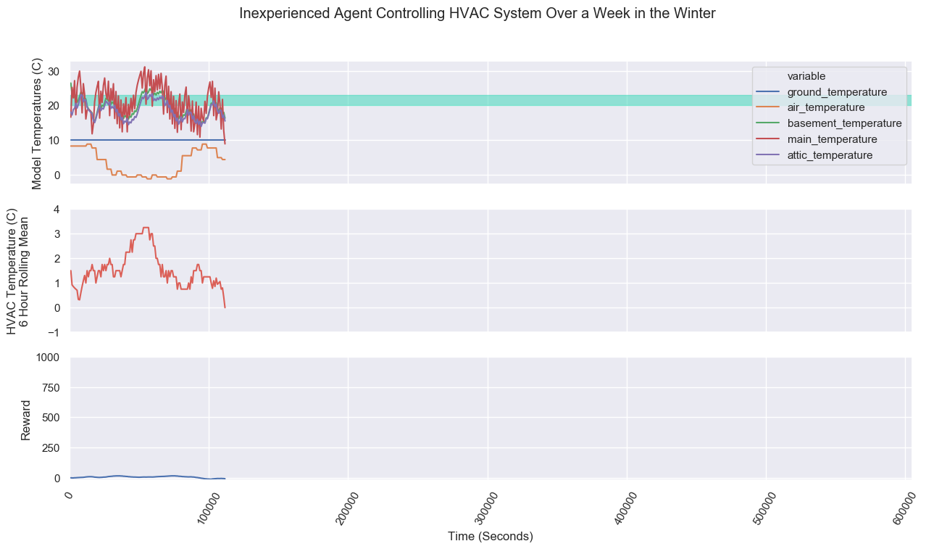
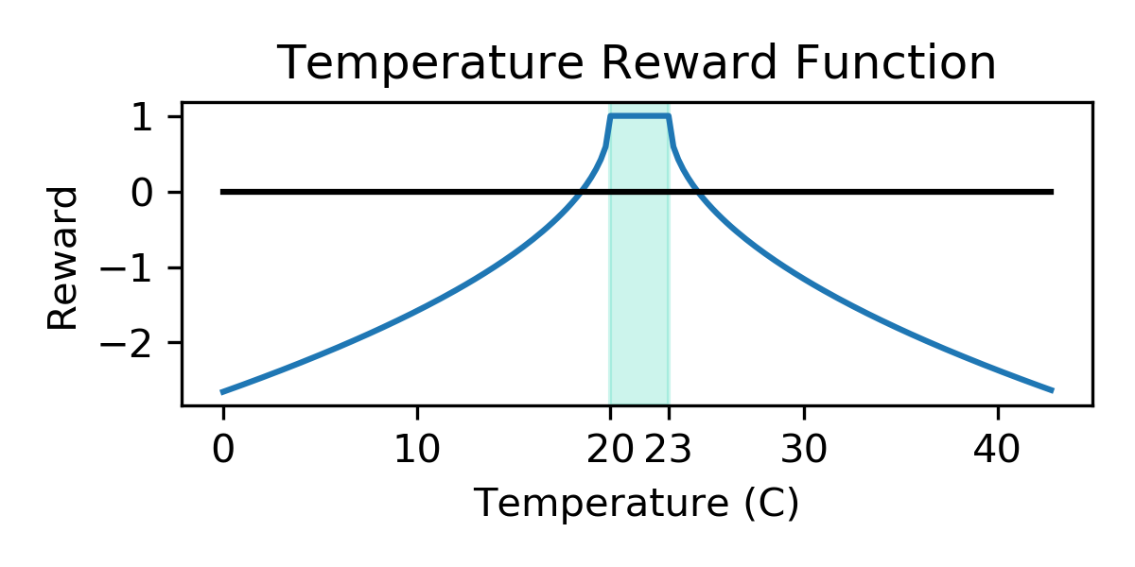
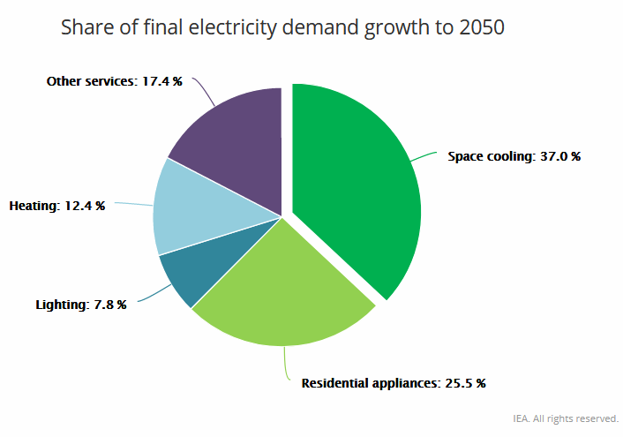
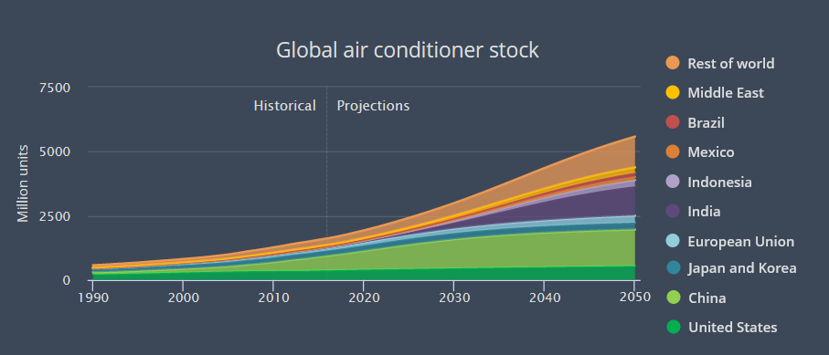
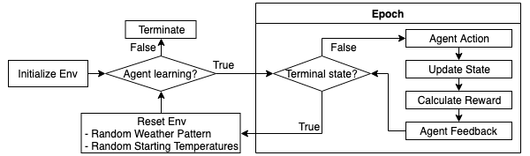
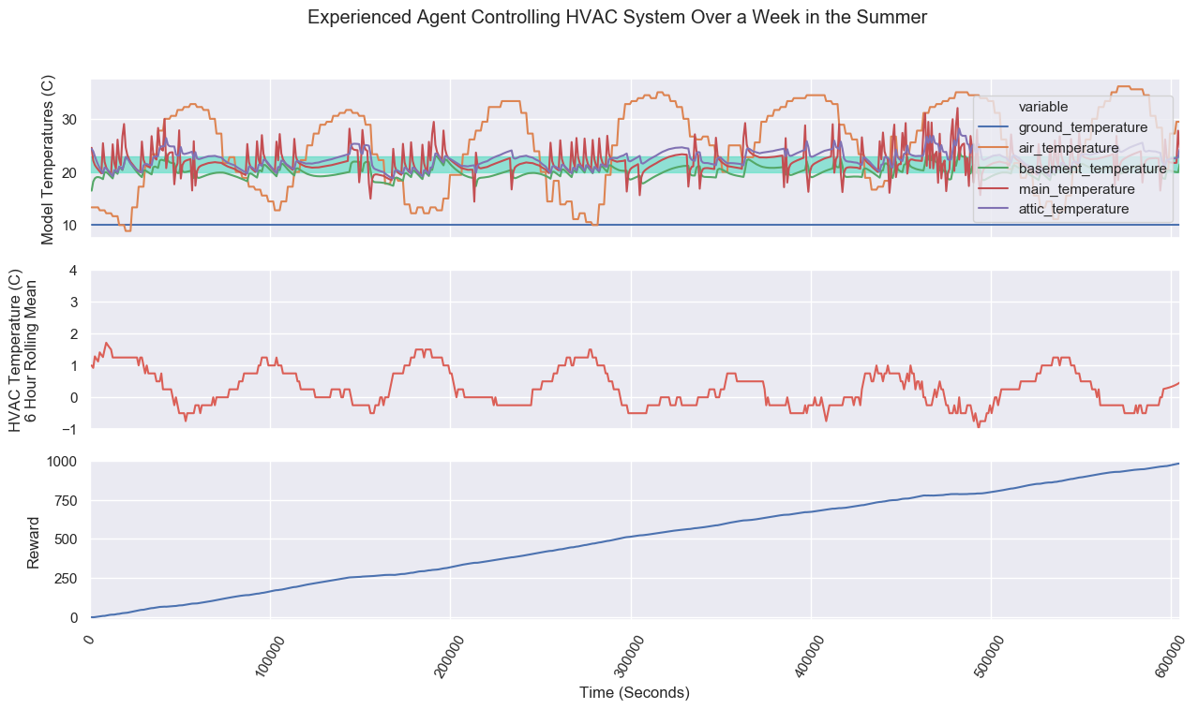
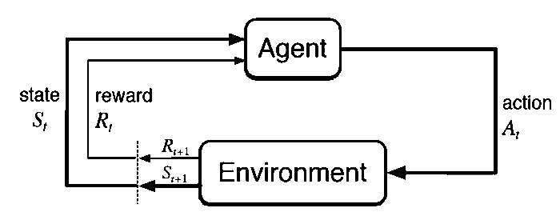
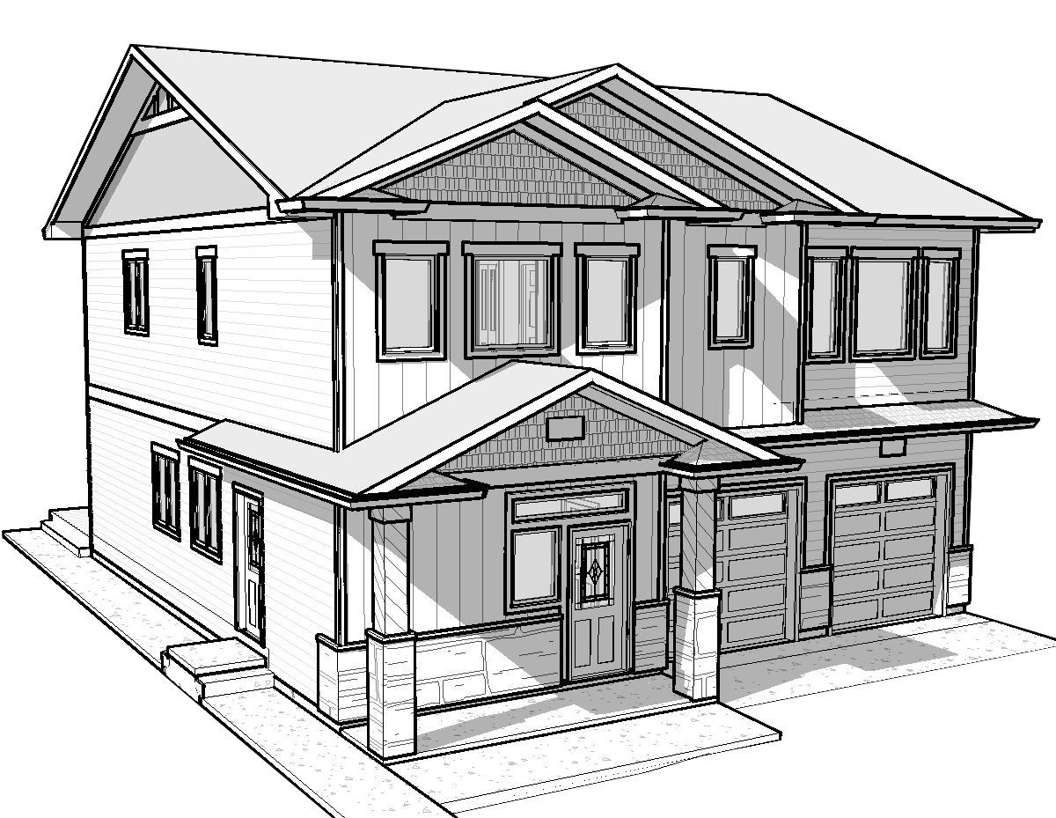
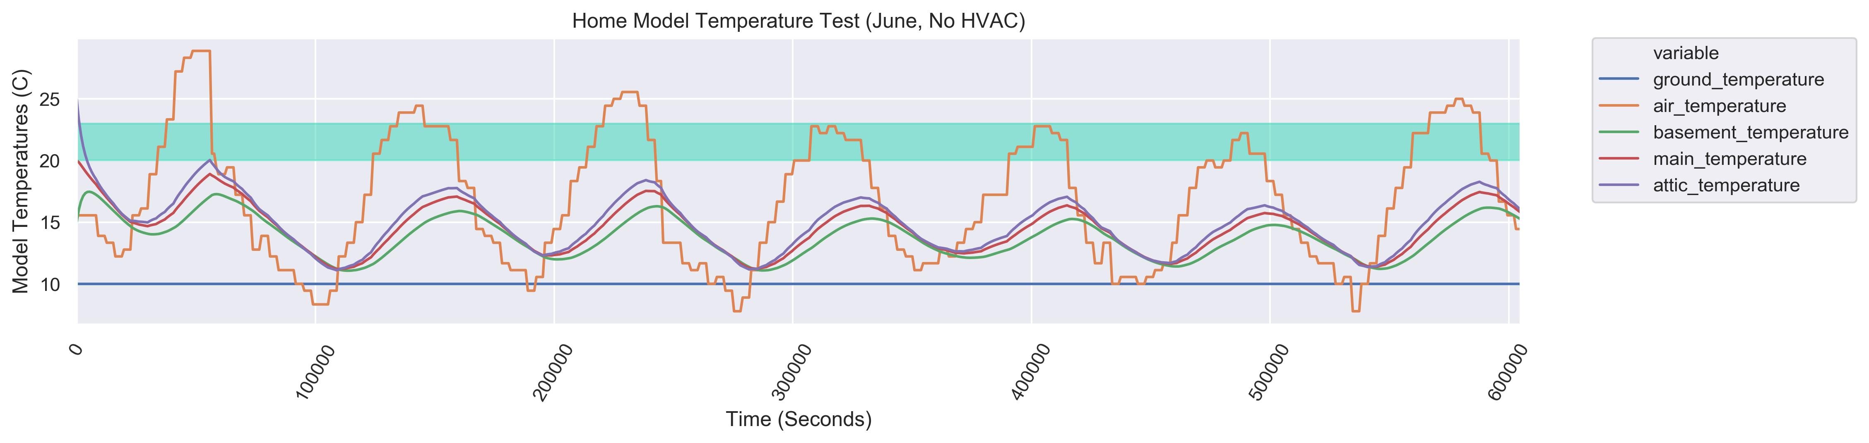
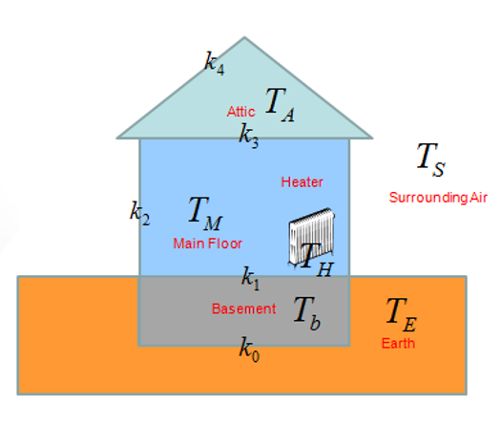
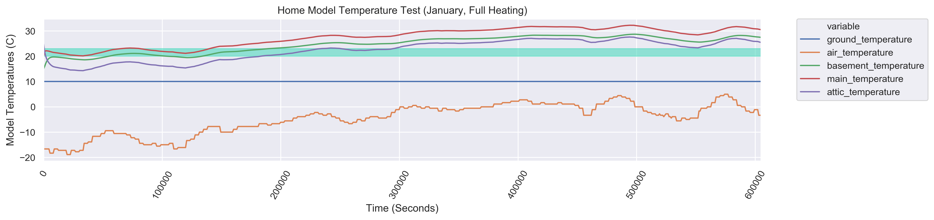
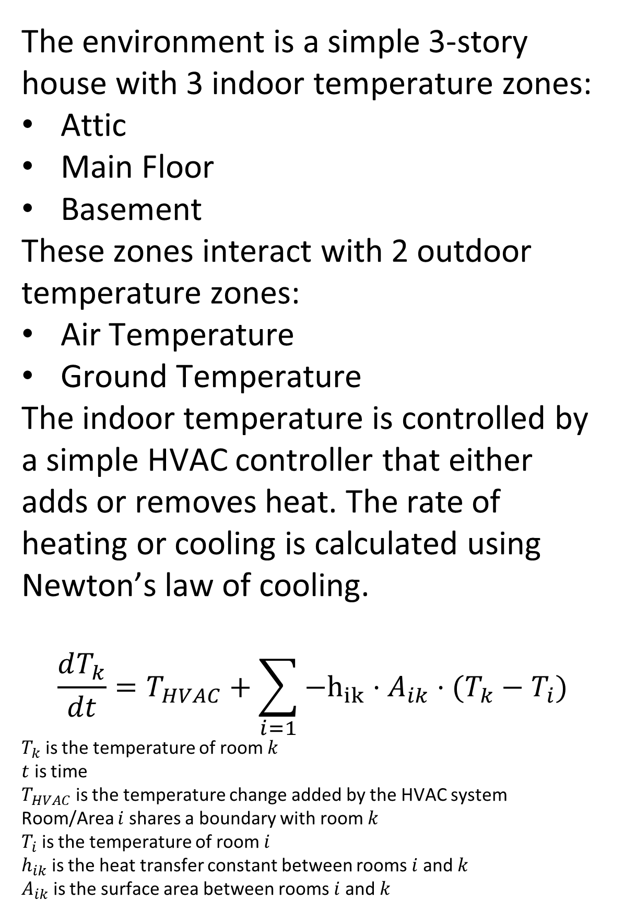
HVAC Optimization Using Reinforcement Learning
Jordan Devenport
Machine Intelligence in Clean Energy — Fall 2019
ABSTRACT
Method - Learning Agent
Results - Learning Agent
Smart HVAC systems are increasing in importance as the climate changes. In the next 30 years, the demand for air conditioning is expected to increase three-fold as the Earth warms and warm countries develop. This project uses reinforcement learning to optimize a smart thermostat.
The reinforcement learning agent is given a state (observation) and reward and learns to act so that its overall reward is maximized.
State/Observation Space
Current temperatures of observable spaces
Current state of HVAC system
Action Space
Cooler On
Inaction (No cost)
Heater On
Reward
A value calculated from the following
Attic Temperature
Main Temperature
Basement Temperature
Action cost
The agent uses Deep Q-Learning to learn the reward function and converge on a solution.
PROBLEM DESCRIPTION
Quick facts about HVAC usage:
About 20% of all energy in the US is used by HVAC systems. [1]
As the climate changes due to human influence, the demand for HVAC systems will continually increase.
“Without action to address energy efficiency, energy demand for space cooling will more than triple by 2050 – consuming as much electricity as all of China and India today [2]
One of the easiest methods of mitigating energy waste is through smart HVAC controls.
[2]
The temperature reward function. Notice how it gives a reward of +1 when the system is at room temperature (20-23 C)
[2]
At the beginning of the learning process the agent fails to correctly heat and cool the home. When the home gets too warm (above 33 C) or too cold (below 10 C) the episode terminates and the agent tries again. In this case note how the agent makes poor heating choices and the episode terminates with negligible reward.
METHOD
This project uses reinforcement learning. In reinforcement learning, an agent performs actions on an environment and makes decisions based on environment state and what it has learned. The agent learns based on feedback from a reward function. The reward function is important to optimize the agent’s behavior.
(Above) The learning algorithm. Note that in order to train the agent to react well to an arbitrary state, the agent is trained on many different weather patterns.
Method - Environment
RESULTS
The environment is a simple 3-story house with 3 indoor temperature zones:
Attic
Main Floor
Basement
These zones interact with 2 outdoor temperature zones:
Air Temperature
Ground Temperature
The indoor temperature is controlled by a simple HVAC controller that either adds or removes heat. The rate of heating or cooling is calculated using Newton’s law of cooling.
$$\frac{dT_{k}}{dt}=T_{HVAC}+\sum_{i=1}{−h_{ik}⋅A_{ik}⋅(T_{k}−T_{i})}$$
$T_{k}$ is the temperature of room $k$
$t$ is time
$T_{HVAC}$ is the temperature change added by the HVAC system
Room/Area $i$ shares a boundary with room $k$
$T_{i}$ is the temperature of room $i$
$h_{ik}$ is the heat transfer constant between rooms $i$ and $k$
$A_{ik}$ is the surface area between rooms $i$ and $k$
Results - Environment
A large part of this project was developing an environment that works. These graphs show how the environment functions without any intelligent input. It was important to create these sanity checks before implementing a learning agent.
After many epochs, the agent learns to keep the home at a comfortable temperature in any weather by responding to the reward function which is based on environment state and action cost. Note in this case how the total reward steadily increases over the entire epoch. The epoch terminates after reaching the goal time period of one week.
CONCLUSION
A simulation of the home without heating or cooling in June
As the effects of climate change loom every closer, it will be increasingly important to develop smart HVAC controls. Reinforcement learning can play an invaluable role in developing smart controls.
REFERENCES
[1] Wei, Tianshu et al. “Deep reinforcement learning for building HVAC control.” 2017 54th ACM/EDAC/IEEE Design Automation Conference (DAC) (2017): 1-6.
[2] IEA: The Future of Cooling - https://www.iea.org/futureofcooling/
[3] Differential Equations: Cooling -http://www.sharetechnote.com/html/DE_Modeling_Example_Cooling.html
Above: A simple diagram of the home environment with labeled variables for Newton’s law of cooling equations.
A simulation of the home with constant heating in January

