Slide 1
IBM University
Engagement Project
Submission
AI Placement Prep Agent
Your personalized roadmap to placement success — powered by AI, tailored to your profile, and ready for campus drives.
Powered by IBM watsonx Orchestrate
Student: Devesh Umesh Vishwasrao
IBM University Engagement Project | Slide 1

Slide 2

Project Title –
AI Placement Prep Agent
Domain of
Project –
Education / Career Development
Student Name | Recent Passport Photo | Email ID | Mobile number [WhatsApp]
Devesh Umesh Vishwasrao |  | vishwasraodevesh20@gmail.com | 9359446185
IBM University Engagement Project | Slide 2

Slide 3
Problem Statement : AI Placement Prep Agent
The Challenge
Students often prepare for campus placements using scattered resources and generic study plans. They may not know which technical topics deserve the most attention, which interview questions match a target role, or how to turn their current skills and available preparation time into a focused roadmap.
The Objective
• Generate a personalized week-by-week placement preparation roadmap.
• Provide role-specific technical and HR mock interview questions.
• Identify skill gaps against recruiter expectations and prioritize topics.
• Provide an exportable preparation plan that can be used offline.
IBM University Engagement Project | Slide 3

Slide 4
Proposed Solution: AI-Powered Placement Prep Agent
The proposed solution is an AI-powered placement preparation agent that takes a student's profile as input and turns it into an actionable preparation plan. The live website embeds an IBM watsonx Orchestrate agent for interactive conversations and personalized outputs.
Input | Agent Analysis | Personalized Output
Branch / year Target role Skills Weak topics Preparation time | Processes profile Maps needs to role expectations Prioritizes preparation | Roadmap Mock questions Skill gaps PDF prep plan
Three-step process
• Share your profile
• Agent analyses it
• Get your personalized roadmap
IBM University Engagement Project | Slide 4

Slide 5
Technology Used
IBM watsonx Orchestrate – powers the embedded AI agent and orchestration workflow.
IBM Cloud – deployment environment used by the embedded watsonx Orchestrate agent.
Web application – responsive HTML/CSS/JavaScript interface for the PlacementPrep AI site.
AI Agent embedding – the live agent is integrated into the website as an interactive chat experience.
PDF output – the agent can provide a downloadable personalized preparation roadmap.
IBM Bob platform – For designing and orchestrating multi-agent workflows visually
IBM University Engagement Project | Slide 5

Slide 6
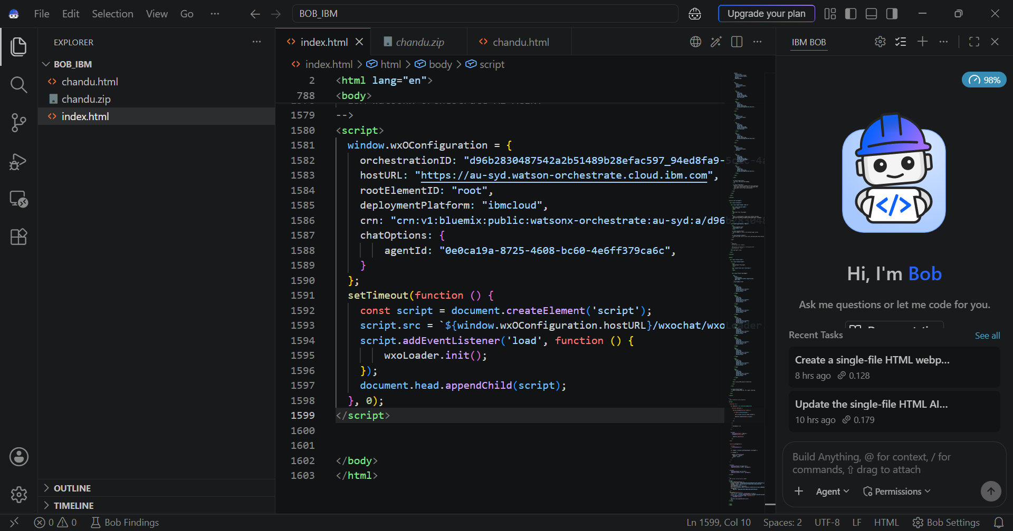
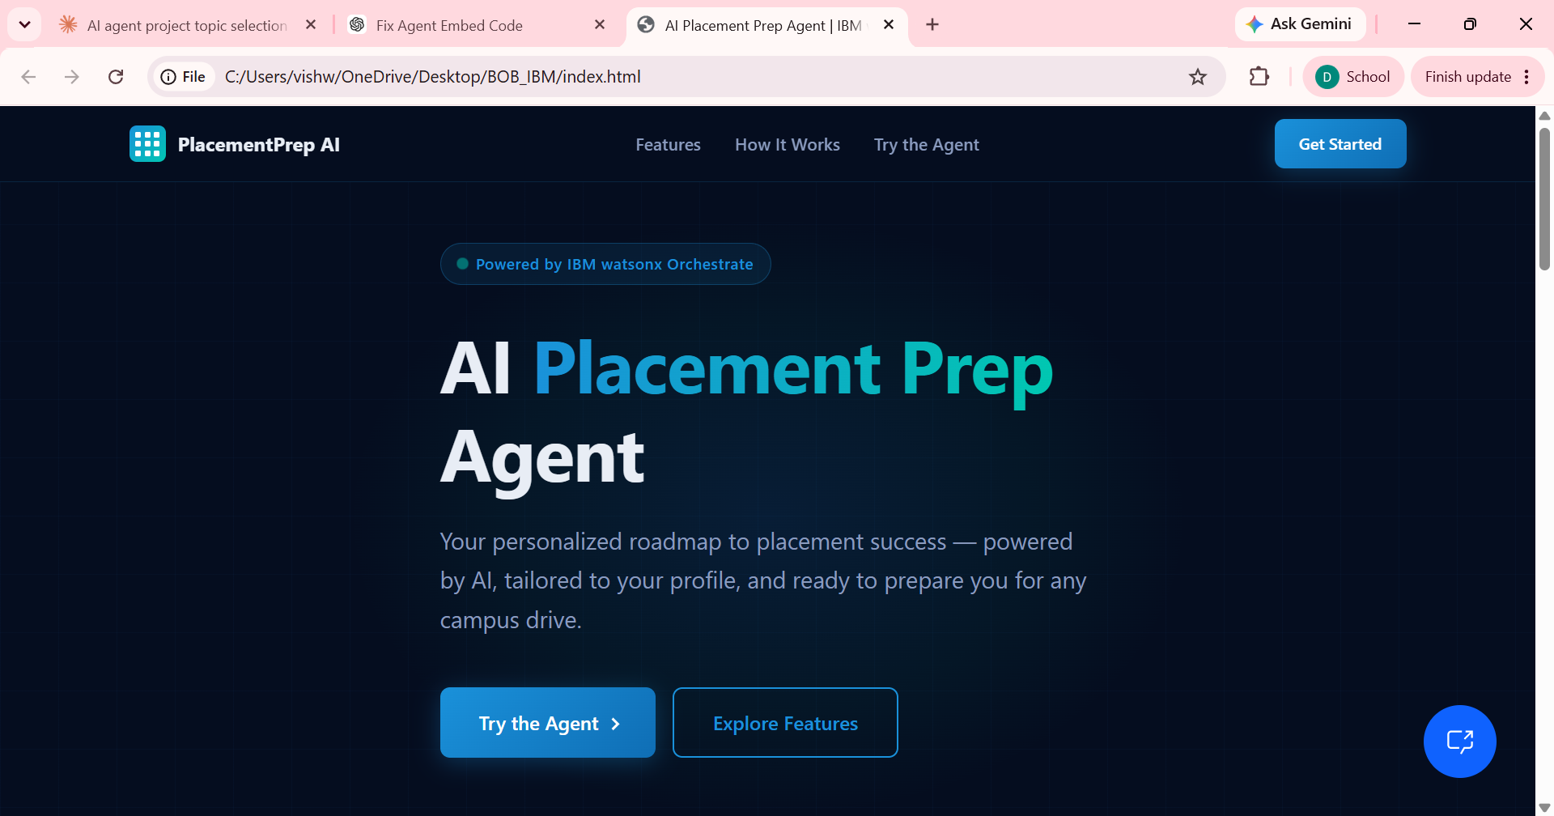
IBM BOB / Project Screenshots
Project interface and live-agent integration
IBM University Engagement Project | Slide 6

Slide 7
Role of Agentic AI in the Solution
Role of Agentic AI in Placement Prep Agent
Agentic AI enables the system to behave as an interactive preparation assistant rather than a static information page. The agent accepts a student's profile, analyzes the stated target role and skill gaps, and returns a focused preparation roadmap.
• Context-aware: uses the profile details shared by the student.
• Goal-driven: focuses the response on placement readiness and the target role.
• Adaptive: can respond to follow-up questions and refine the preparation guidance.
• Action-oriented: produces concrete topics, interview questions and a structured roadmap.
• Interactive: available directly inside the project website through the embedded agent.
IBM University Engagement Project | Slide 7

Slide 8
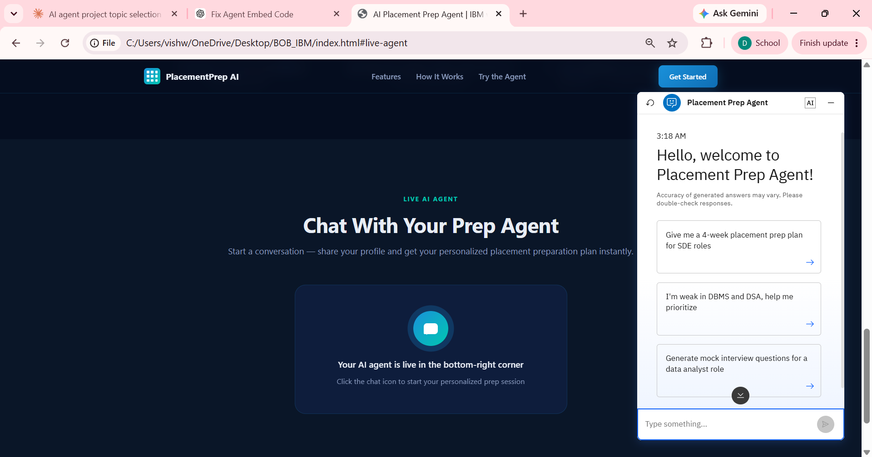
Project Output Screenshot – Profile Intake
Actual agent conversation: the agent asks for profile information needed to personalize the roadmap.
IBM University Engagement Project | Slide 8

Slide 9
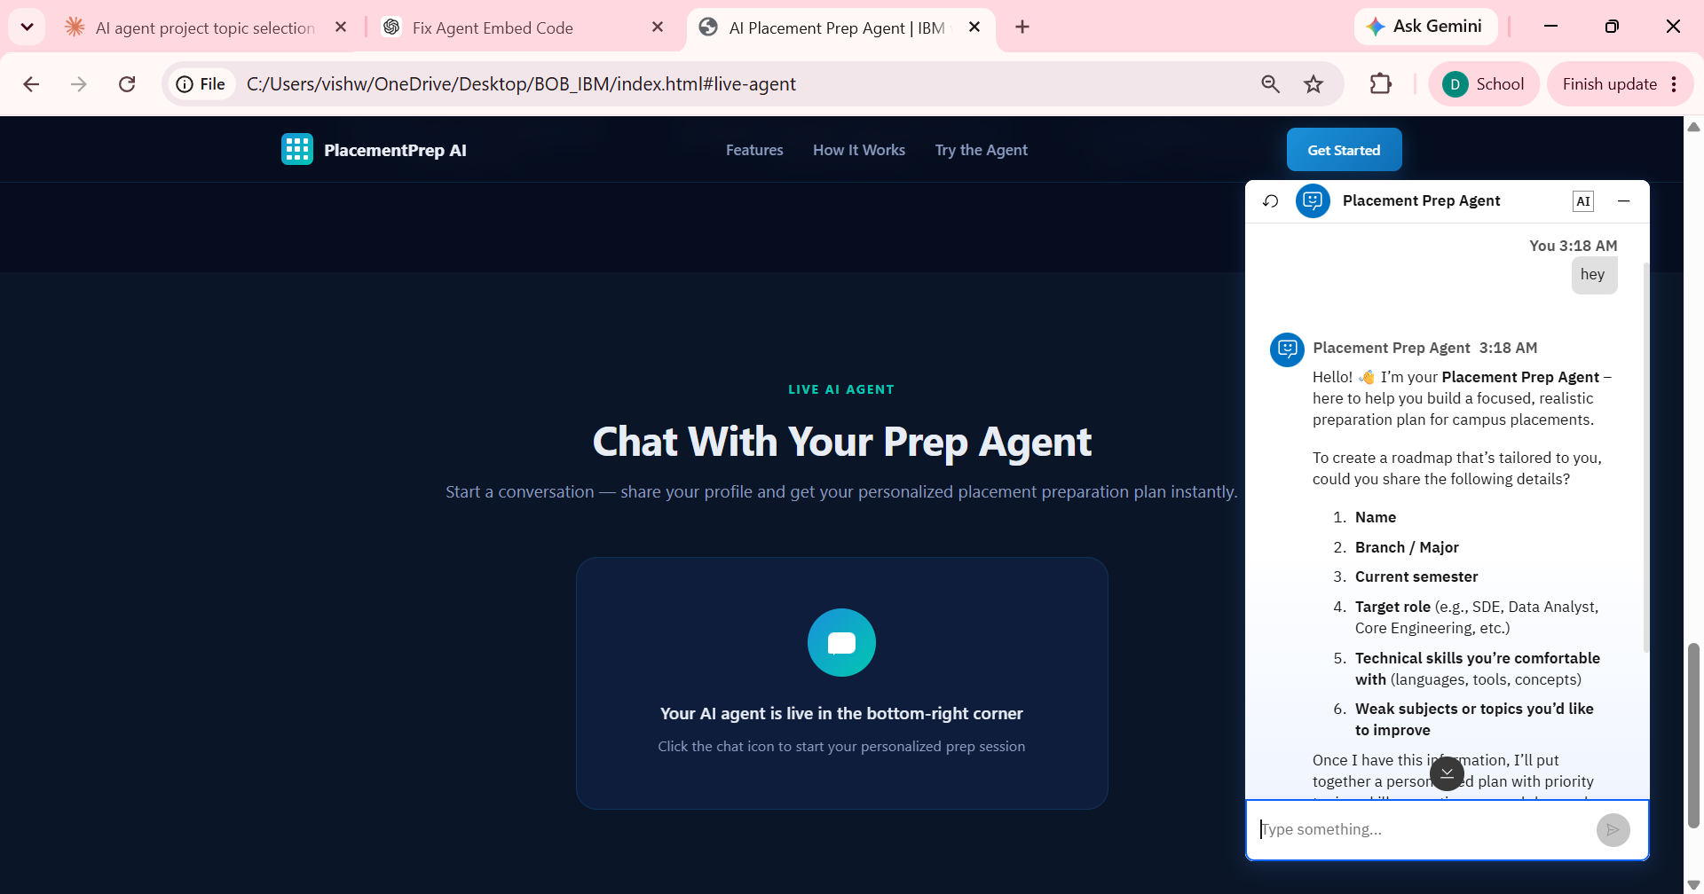
Project Output Screenshot – Personalized Roadmap
Actual agent output showing a personalized placement-prep response.
IBM University Engagement Project | Slide 9

Slide 10
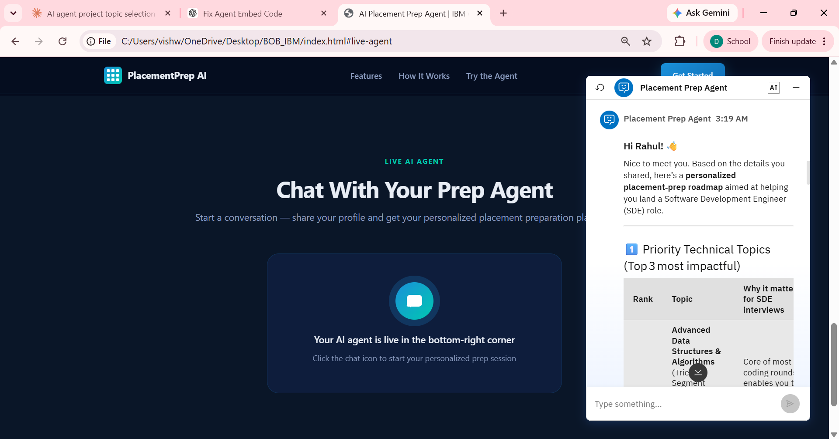
Project Output Screenshot – Priority Topics / Roadmap
Actual agent output showing prioritized technical topics and placement-preparation guidance.
IBM University Engagement Project | Slide 10

Slide 11
Novelty and Uniqueness
• Personalization – the preparation plan is based on the student's own branch, target role, skills and available time.
• Role-specific preparation – technical and HR questions are tailored to the selected target role.
• Skill-gap focus – the agent highlights the topics that need the most attention.
• Actionable output – the result is a practical roadmap rather than only general placement advice.
• Live agent experience – students can interact with the assistant directly on the project website.
• Exportable preparation plan – the solution supports a downloadable PDF roadmap for offline study.
IBM University Engagement Project | Slide 11

Slide 12
GitHub Link
Public GitHub repository link
https://github.com/Devesh-Vishwasrao-20/ai-placement-prep-agent
IBM University Engagement Project | Slide 12

Slide 13
Future Scope
Resume-Based Personalization Integrate resume/CV analysis to automatically identify skills, projects, and areas for improvement.
Real-Time Job Matching Connect the agent with job and placement opportunities to recommend suitable roles based on the student's profile.
Adaptive Learning & Progress Tracking Track preparation progress and dynamically update the roadmap based on performance in quizzes and mock interviews
Advanced Mock Interview System Add voice-based mock interviews with AI evaluation of technical answers, communication, confidence, and response quality.
IBM University Engagement Project | Slide 13

Slide 14
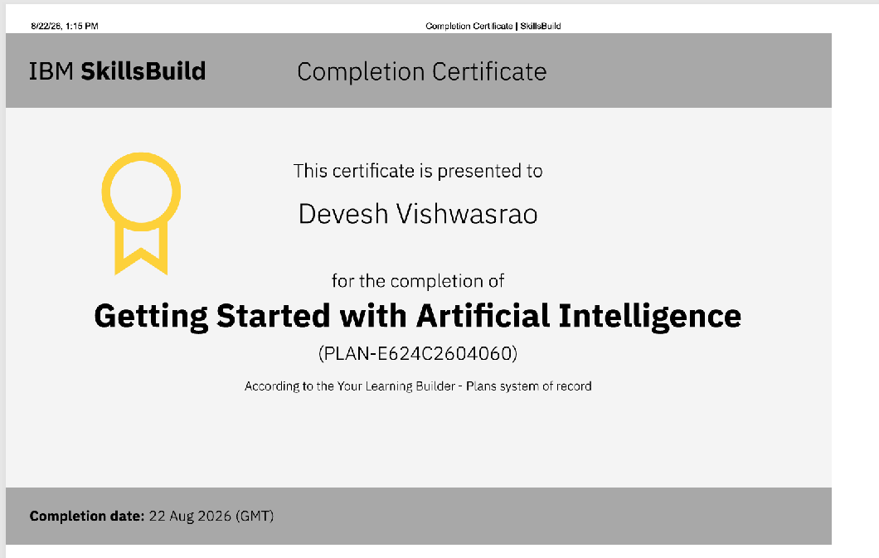
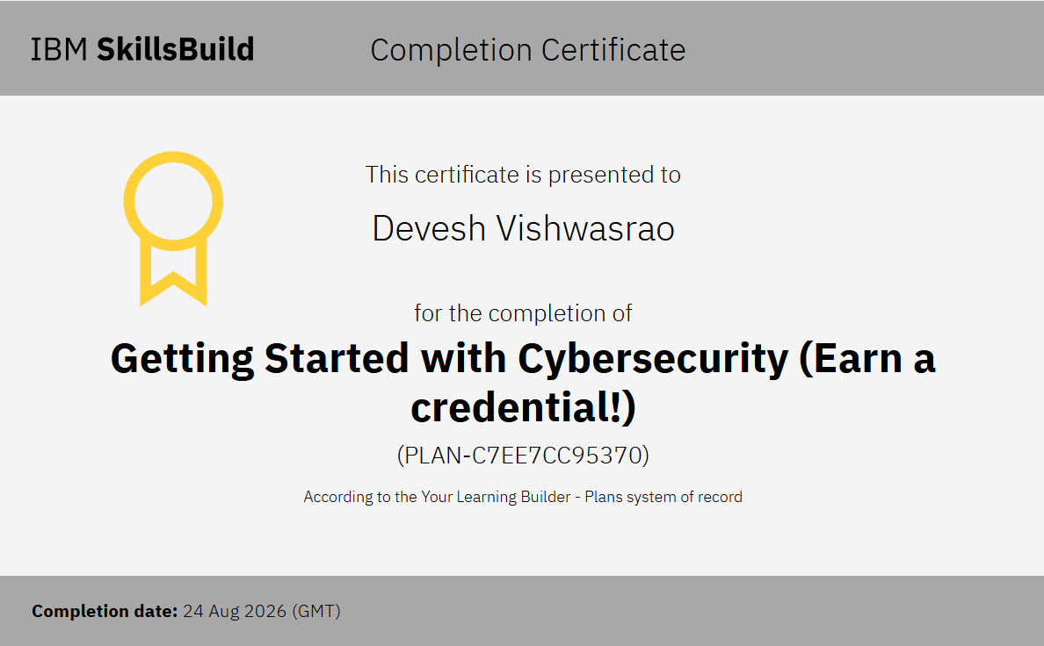
Certificates Earned
IBM University Engagement Project | Slide 14

Slide 15
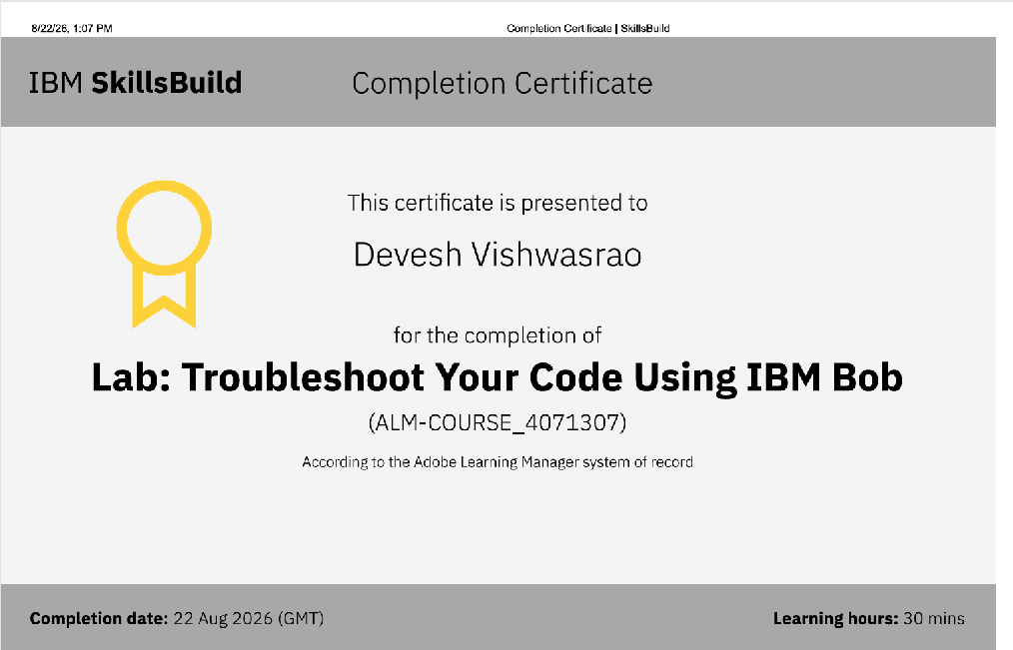
Certificates Earned / Additional Evidence
IBM University Engagement Project | Slide 15

