Slide 1
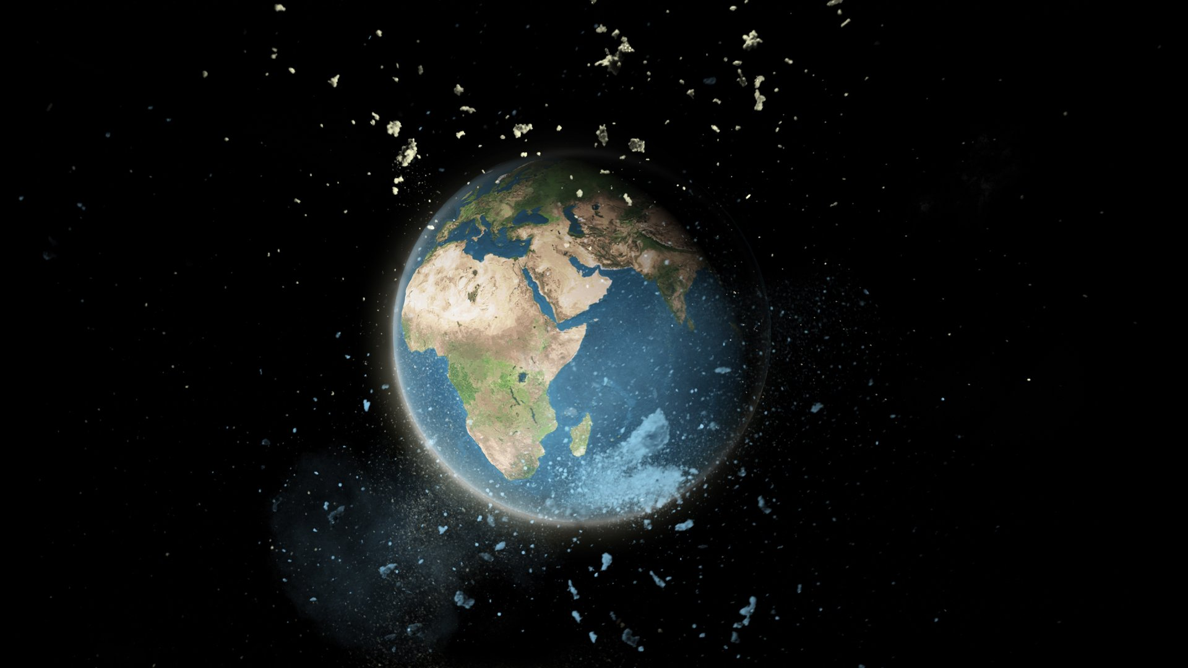
Machine Learning Frontiers: Identifying the Progenitors of Space Debris and Orbital Pollution
Devesh Ojha|T00733907
Mohd Asaf Shaikh|T00728877

Slide 2

OBJECTIVE
To develop and refine a machine learning-based classification model capable of accurately identifying and categorizing space objects into four distinct categories: Debris, Rocket Bodies, Payloads, and TBA (To be Acknowledge).

Slide 3
STEPS FOR THE DATA ANALYSIS
Data Collection & Understanding
Data Cleaning & Preprocessing
Exploratory Data Analysis
Model Selection and Development
Data collection and understanding entails analyzing this data to uncover insights and ensure quality, setting the stage for effective model development. Here, the data has been extracted from Kaggle: https://www.kaggle.com/datasets/kandhalkhandeka/satellites-and-debris-in-earths-orbit
Data Cleaning and Preprocessing involves statistical analysis and visualization techniques to uncover patterns, trends, and anomalies.
Lastly, This involve choosing suitable machine learning algorithms and refining them through training and tuning to address specific problems effectively.
This step is used to explore your data visually and statistically to identify patterns and grasp important features, informing the direction of future modeling efforts.

Slide 4
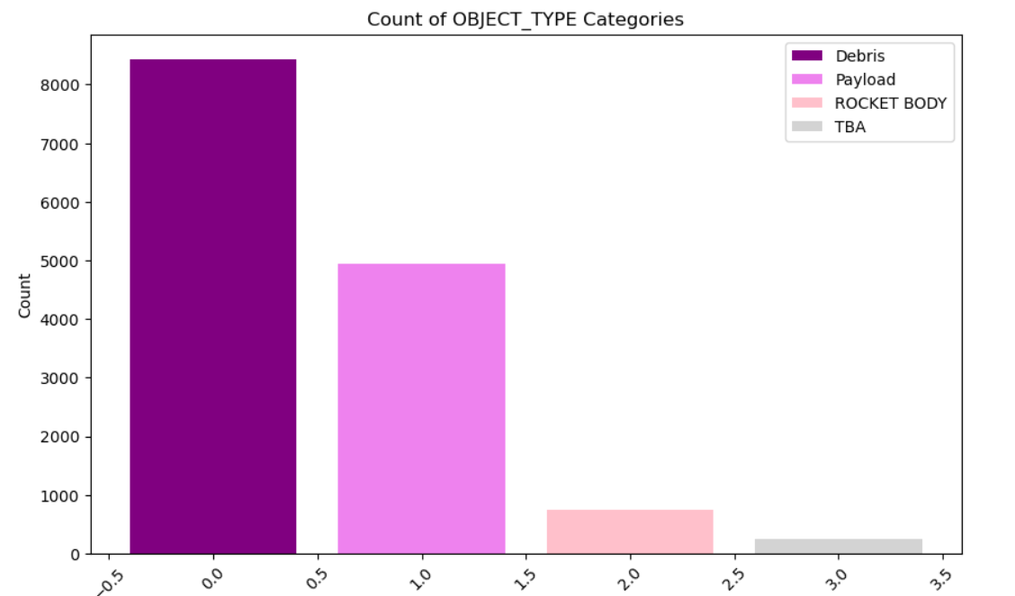
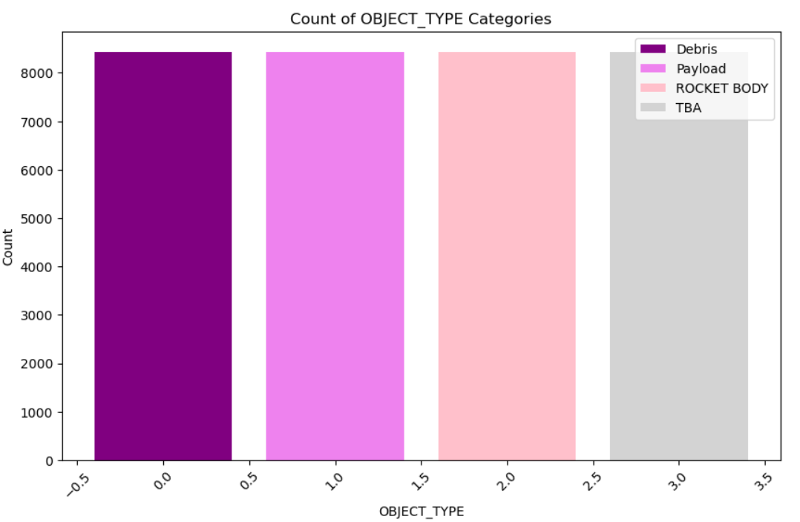
Data preprocessing
Label Encoder :- Label encoding is used to convert categorical text data into numerical form, allowing machine learning algorithms to process and understand it .
Smote :- This is used to address class imbalance in datasets by synthetically generating new examples of the minority class.
Before Upscaling
After Upscaling

Slide 5
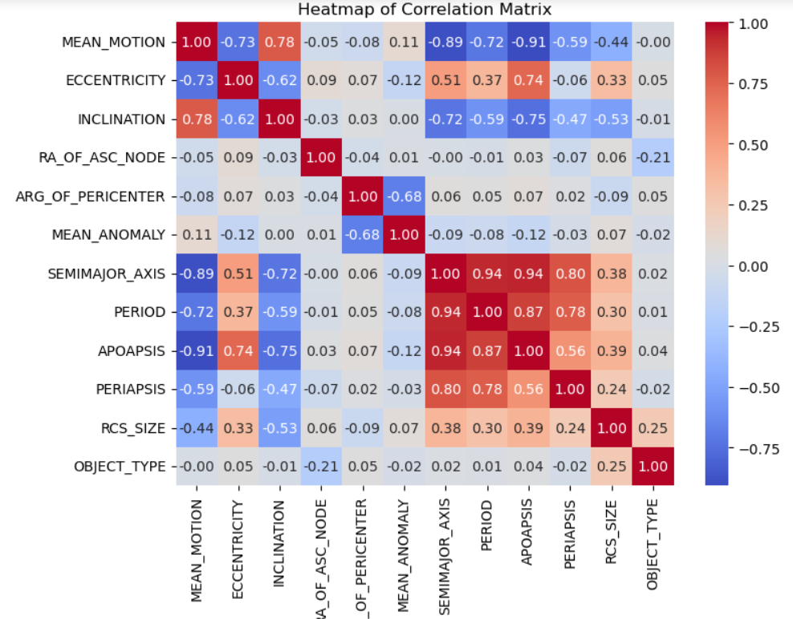
Exploratory data analysis: CORRELATION MATRIX

Slide 6
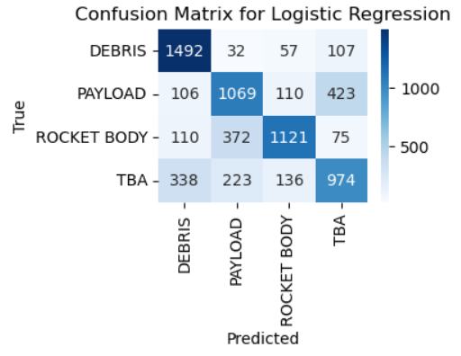
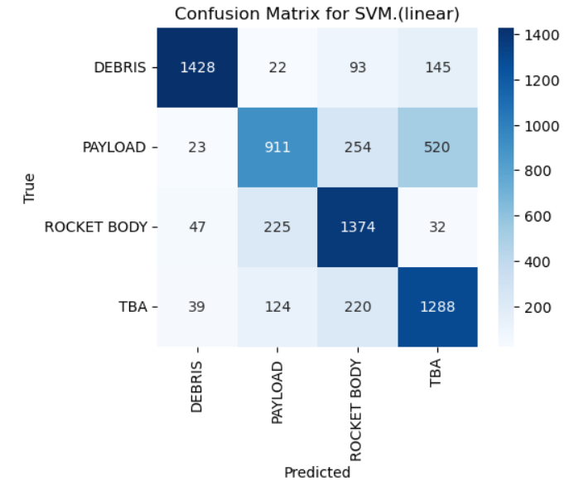
Exploratory data analysis: Model selection
Logistic Regression
Accuracy :- 69%
After Fine Tuning Accuracy :- 69.3%
SVM(Support Vector Machine)-Linear
Accuracy :- 74.1%
After Fine Tuning Accuracy :- 74.6%

Slide 7
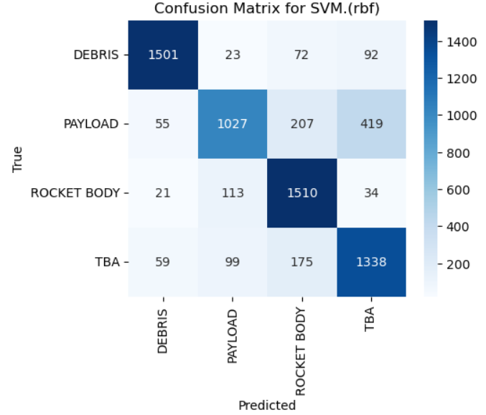
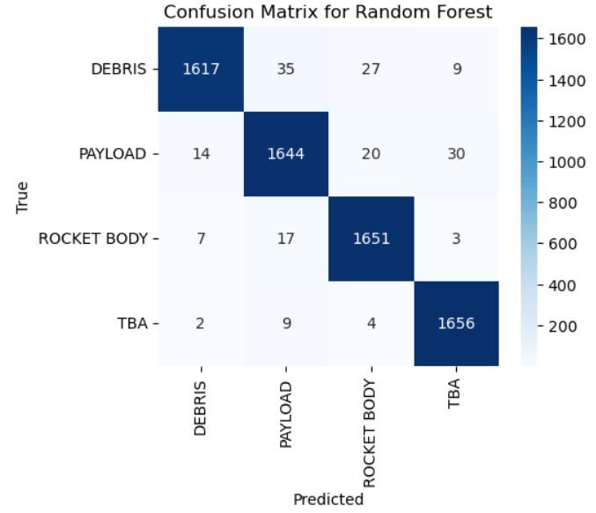
Exploratory data analysis: model selection
SVM(Support Vector Machine)-RBF
Accuracy :- 79.7%
After Fine Tuning Accuracy :- 92.7%
Random Forest Classifier
Accuracy :- 97.3%
After Fine Tuning Accuracy :- 97.3%

Slide 8
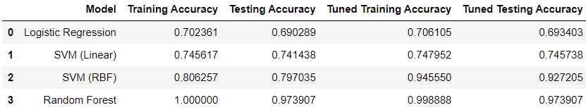
Model evaluation
Model fit(Without Fine Tuning) :- For every classifier the training and testing value are high and close to each other, So they Neither overfit or underfit. It suggest the good balance between the Bias and Variance.
Model fit(With Fine Tuning) :- After Fine tuning every Model, All the models indicates a will fitting because of good balance between Bias and Variance after seeing the training and testing accuracy.
Best Model :- The Best Model is the Random forest Model with the highest Accuracy.

Slide 9

Future Scope

Slide 10
Thank You

