Slide 1
Supermarket Sales Dashboard Summary
Designed for Business Stakeholders
Tool Used: Python (Simulated Power BI/Tableau Style)

Slide 2
Objective
- Provide business insights using sales data
- Visualize key metrics like sales, income, and trends
- Enable better decision making through interactive visuals

Slide 3
Dataset Summary
- 1000 transactions from a supermarket chain
- Attributes include: Date, Branch, Product line, Total, Tax, COGS, Income
- Covers 3 cities and multiple payment modes

Slide 4
Key Performance Indicators (KPIs)
- Total Sales
- Gross Income
- Sales by Product Line
- Payment Distribution
- Monthly Sales Trend

Slide 5
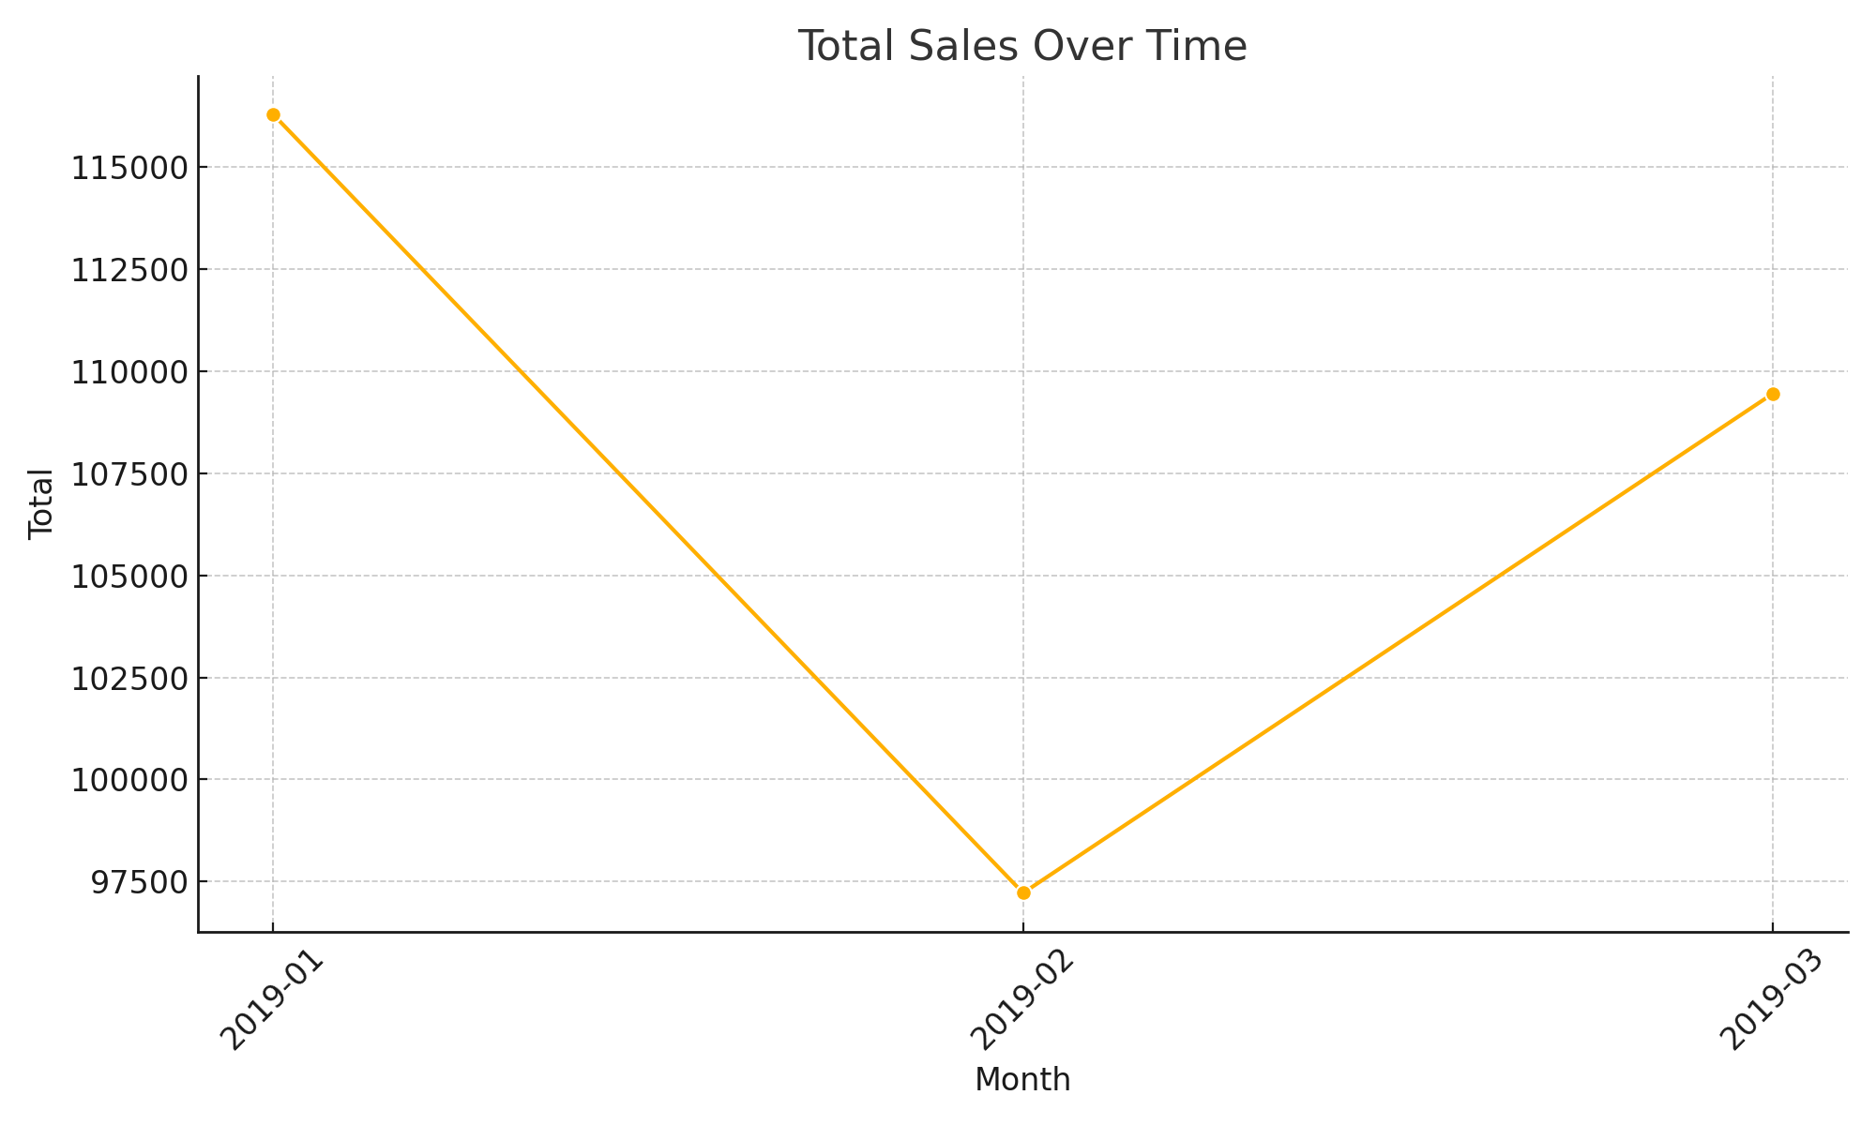
Total Sales Over Time

Slide 6
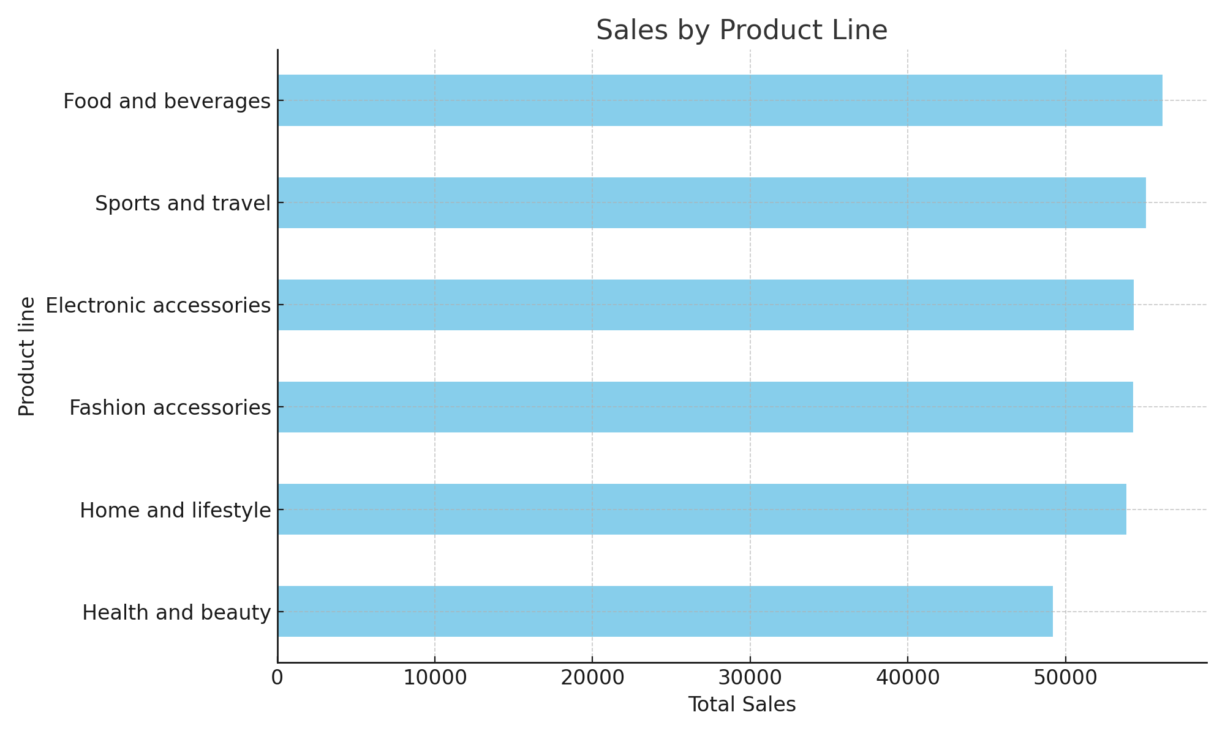
Sales by Product Line

Slide 7
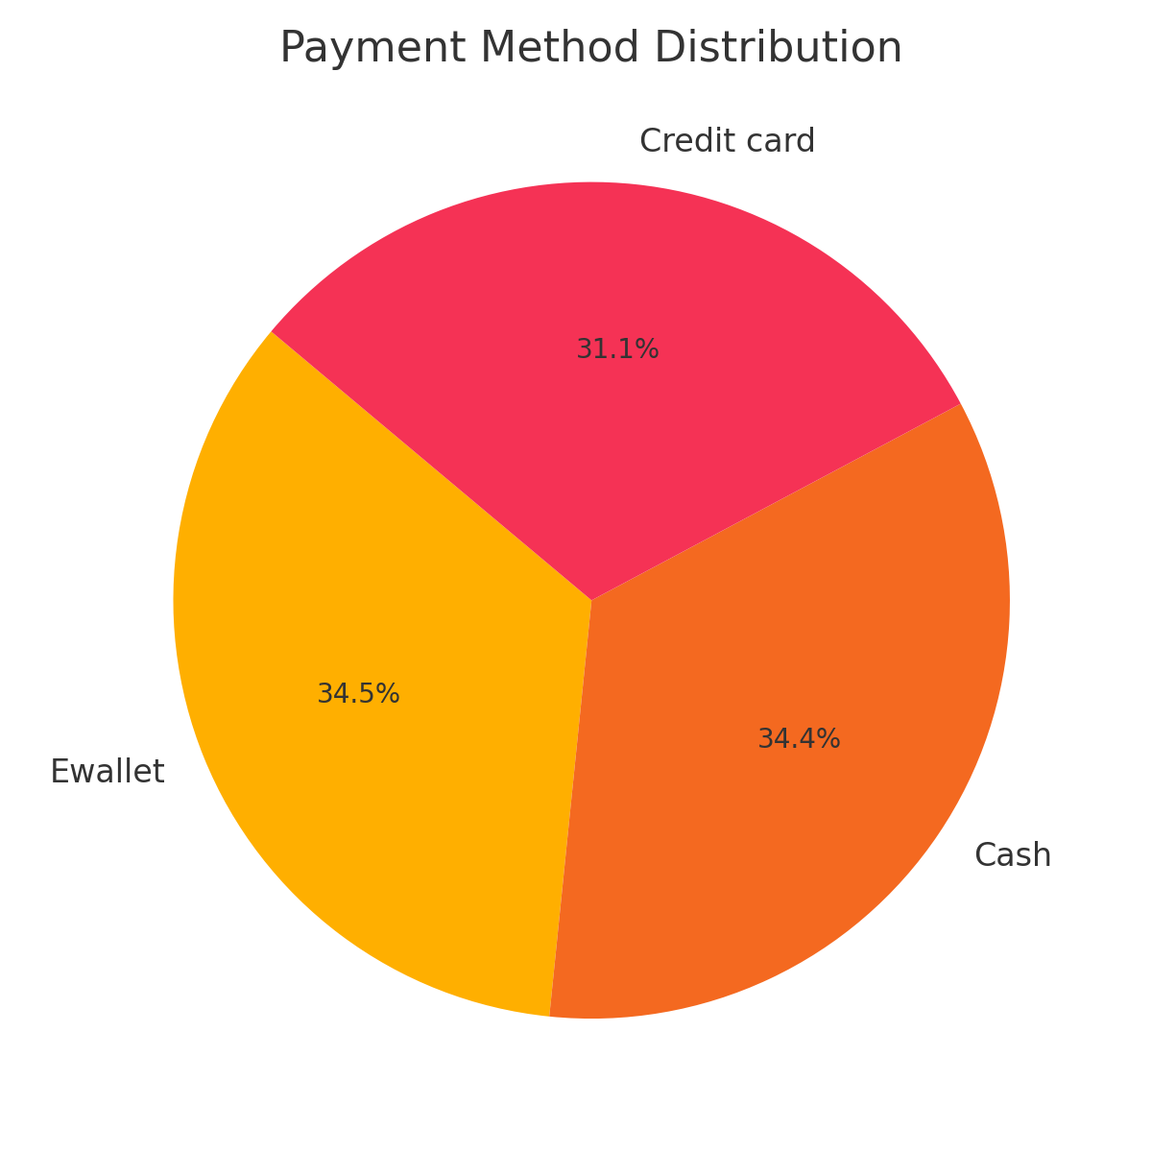
Payment Method Distribution

Slide 8
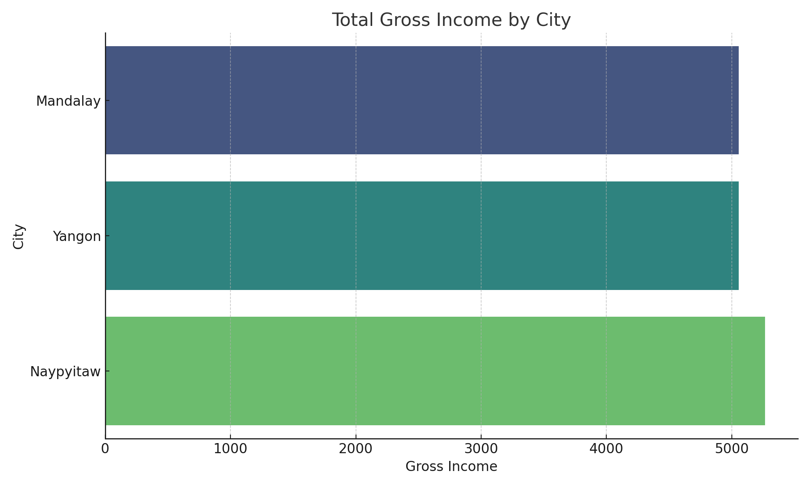
Gross Income by City

Slide 9
Insights & Takeaways
- Highest sales seen in specific product lines like 'Food and beverages'
- Most customers used Ewallet or Cash
- Gross income is highest in Yangon
- Monthly trends show seasonality in sales

Slide 10
Future Enhancements
- Integrate real-time sales updates
- Add customer segmentation
- Enable interactive filters by branch/product/date

