Slide 1

Excel
GET JOB READY BY INDUSTRY
Manu Gupta

Slide 2
Table of Contents
Business Problem
Base knowledge
Quizes
Case Solution

Slide 3
Case Study- Airlines Flight Delays and Cancellation

Slide 4
Business Problem
We have sample data for Transportation Bureau that tracks the performance of domestic flights in United States. Analytical Problem: We need to analyze following :
Identify the Flights that are running on Time, Delayed, Cancelled
Identify the reason for Cancellation of Flights
Domestic Flights overall Performance

Slide 5
Business Problem
Basic definitions and terminologies in the sample data-
Airline – Airline Identifier
Flight Number – Flight Identifier
Tail Number – Aircraft identifier ()
Wheel OFF – The time point that the aircraft wheels leave the ground
Wheel ON – The time point that the aircraft wheels touch the ground
Scheduled Time – Planned time amount needed for Flight trip
Taxi Out – The time duration elapsed between departure from origin airport gate and wheel off
Taxi In – The time duration elapsed between wheel-on and gate arrival at the destination airport
Air Time – The time duration between Wheel OFF and Wheel On time
Elapsed Time – Air Time + Taxi IN + Taxi Out
Arrival Time – Wheel ON + Taxi IN
AIR Time – The time duration between the wheels OFF and Wheels ON time

Slide 6
Base knowledge

Slide 7
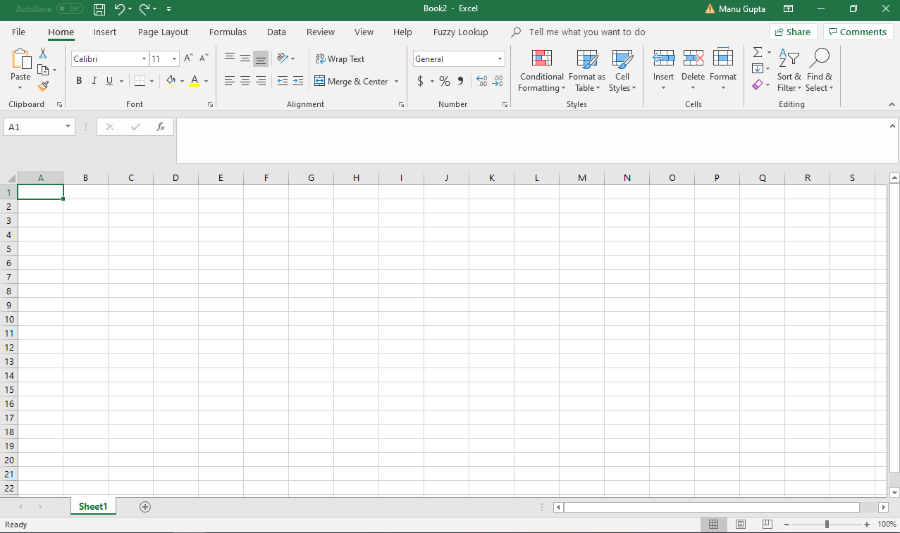
Getting Started with Excel
Excel is one of the most powerful and very widely used software of Microsoft.
People across the globe use Excel in all the industries be it Teaching, Medical Science, Corporate, Analytics etc. in some shape and form.
Refer below the basic snapshot of how a Blank/ new Excel document looks.

Slide 8
Getting Started with Excel
In the last slide, we saw there are lot many options in the top section of the document. We will discuss mostly all of them in the subsequent slides.
Columns
Rows

Slide 9
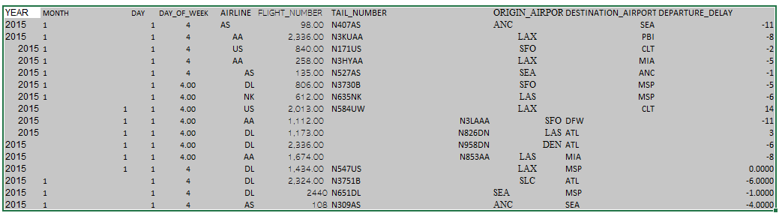
Getting Started with Excel - Formatting
Lets look at some basic Formatting options that we have in Excel.
Formatting is one the key step that every should be well versed with while working on Excel as any information that is represented has to be clean. No user would like to read an unformatted Excel as it is very difficult to read and interpret the information.
Lets look a the below snapshot of an Excel document and try to understand what exactly Formatting in Excel mean

Slide 10
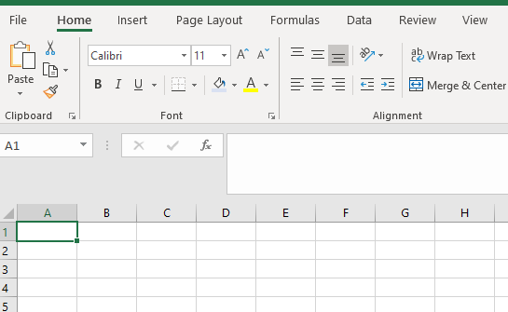
Getting Started with Excel - Formatting
Lets understand what all options can be used to achieve the actual formatting we need to do to make the last slide look clean and readable
Font Type and Size
Bold, Italics, Underline
Cell Border
Cell Color and Font Color
Font alignment in the cell

Slide 11
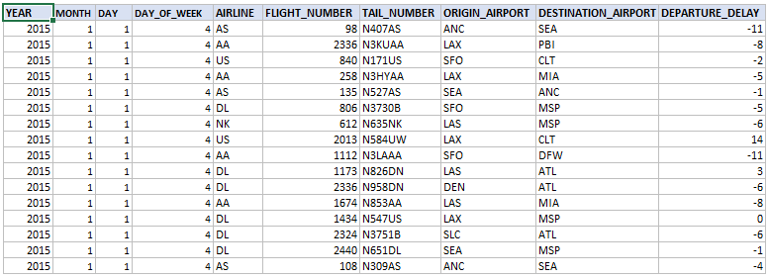
Getting Started with Excel - Formatting
Below is the snapshot of the same Excel – but well Formatted. Let’s quickly see what all steps were taken to make the document look clean and readable.
Alignment (text and Number)
Font Type and Font Size consistency
Number Formatting
Table Header formatting to identify what each column correspond to
Borders
Column Width
Let’s switch to Excel document for demo

Slide 12
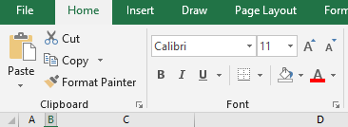
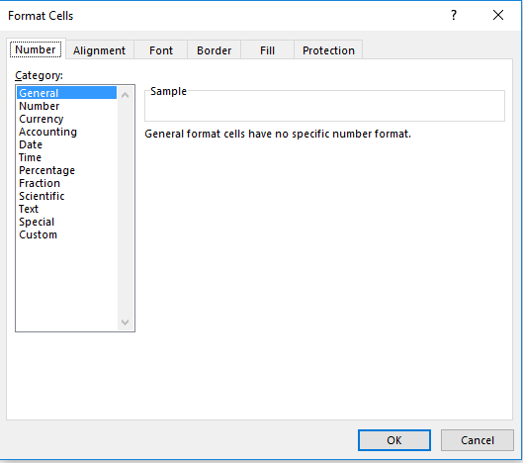
Getting Started with Excel - Formatting
Another approach to do all the formatting – Click on the icon beside Font section as highlighted. Pop up window appears as shown below
Font: This is used to control the font style, size , color and add effects like strikethrough or allow to add superscript or subscript
Border: This is used to add borders around the selected range of value/values and control the line style and color
Number: This allows to format the numerical cell values in different formats as per the requirement
Protection: This is used to hide or protect the cell
Alignment: This is used to align the values both in horizontal and vertical directions or to rotate the text
Fill: This is used to add effects of pattern, color, gradient, or pictures in the selected range

Slide 13
Quiz 1
How should Numbers and Font be aligned?
A
No specific alignment is needed
B
Left and Right
C
Right and Left
D
Center Align
A
B
C
D

Slide 14
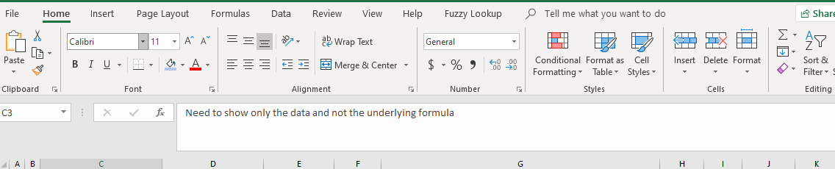
Filters
Filtering the data means extracting the data for a particular scenario. The method of applying the Filters in Excel reduces the time to identify the exact case and also is accurate.
Lets see how data can be filtered in Excel.
Filters can be applied both on Text and Numbers. There are multiple options to filter like –
Text Filters – Equals, Does nor Equal, Begins/ Ends with, Contains, Does not Contains, Custom Filter
Number Filters – Equals, Does nor Equal,>=,<=, Top 10, Above/Below Avg., Custom Filter
Let’s switch to Excel document for demo

Slide 15
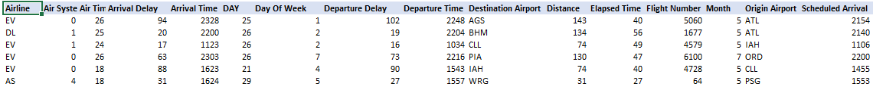
Filters
From the Filter icon shown in the last slide, filter icons ae shown in the respective table. Select the first cell of the table as highlighted below and then click the Filter icon as shown in the last slide.
On selecting the filter option, the filter icons appear in the table as shown below. Select the drop down and apply the required filter.
Let’s switch to Excel document for demo

Slide 16
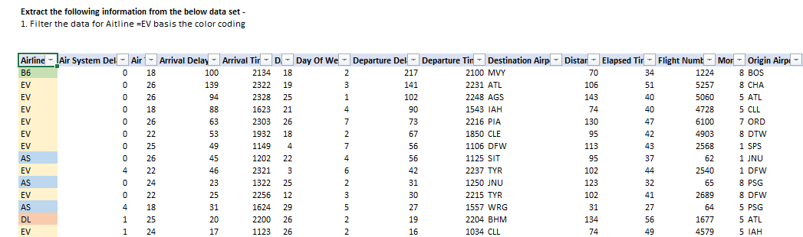
Filters
Filtering the data is not limited to Text/ Numbers. It can be done basis the Cell Colors. Lets do a simple Exercise to filter data based on cell colors
Let’s switch to Excel document for demo

Slide 17
Sorting
Sorting means to arrange the data in a particular order. Sorting is generally done on Number variables to arrange them in Ascending/ Descending order. But the sorting is not limited to numbers as Text/ strings can also be sorted
Sorting data in Excel is very common and very widely used concept. Lets see how do we sort the data in Excel.
Refer the icon to Sort the data

Slide 18
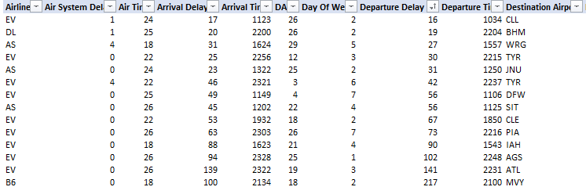
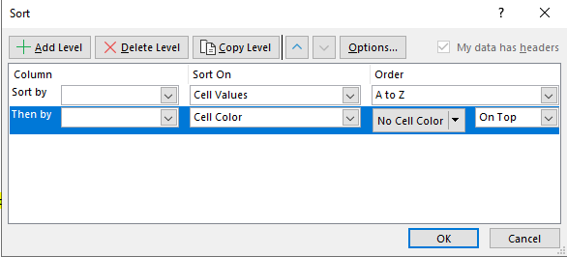
Sorting
Lets sort the data shown in the below snapshot -
There are 3 options to sort –
Sort Ascending
Sort Descending
Custom Sort
Let’s switch to Excel document for demo

Slide 19
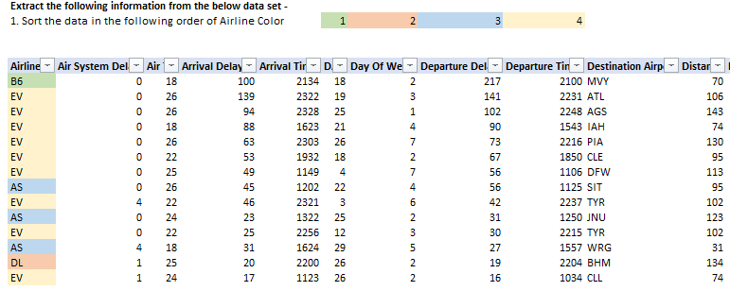
Sorting
In Custom Sort – we can sort the data based on color coding as well. Lets work on an example -
Let’s switch to Excel document for demo

Slide 20
Quiz 2
Filtering can be done on
A
Text
B
Numbers
C
Color
D
All
A
B
C
D

Slide 21
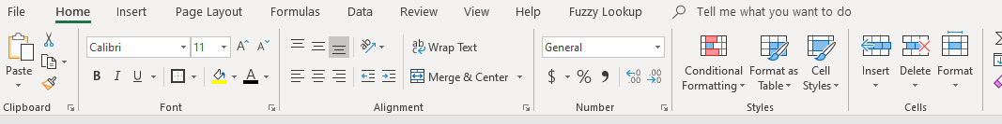
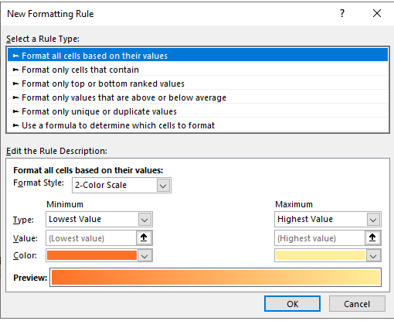
Conditional Formatting
Conditional formatting – this is a special formatting option where formatting can be done basis the conditions.
For e.g. Highlight the cells in Red with values >100 or Highlights cells with Blank values etc.
Refer the below image to see the option to do the conditional formatting
Let’s switch to Excel document for demo

Slide 22
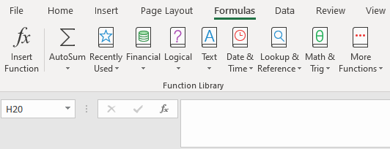
Basic Formula
Excel supports a large number of Functions. There are many types of functions –
Aggregate Functions
Financial Functions
Logical Functions
Text Functions
Date and Time Functions
Lookup and Reference
Mathematical Functions
Statistical Functions
Formula – can be accessed from Formula Tab as shown in the image above. The formula can be used in any cell or in the Formula Bar.
Let’s switch to Excel document for demo

Slide 23
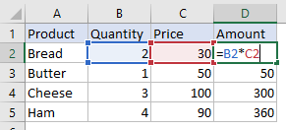
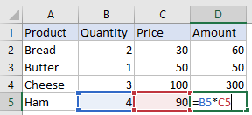
Cell Reference
By default, Excel uses relative references. Lets understand this via an example.
Refer the above two tables:
Amount – Quantity * Price
On writing the formula once in the cell i.e. B2*C2 , Excel automatically calculates the output. This is referred as cell referencing. Now any change in the Quantity or Price need to be updated in the respective cells and the formula remains unchanged.
Excel automatically calculates the Amount by the Formula mentioned.
In the same way, there is no need to write the formula again in the cells below. The formula need to be pasted in the cells below. The row number gets changed automatically and the columns remain same.
Let’s switch to Excel document for demo

Slide 24
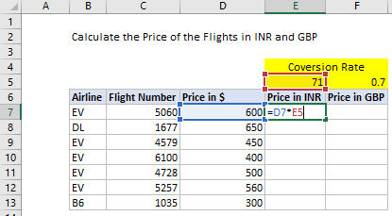
Cell Reference
However, there is a special case as well for this. At times, direct formula cannot be dragged down.
There is a concept of Fixing the cells. This is done using $ symbol.
The row and column can be fixed selectively as per requirement. Let’s see an example –

Slide 25
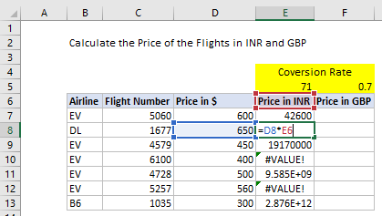
Cell Reference
In the below example, let’s see why is Fixed Cell Reference used.
Calculate the price in INR - (Price in $ ) x (71)
In the below snapshot, used the simple calculation as seen in the earlier example.
Copy and paste the same formula in the subsequent cells. The error in few of the cells in visible clearly.
Lets see what is the reason for the error. D8 x E6 is throwing an error.

Slide 26
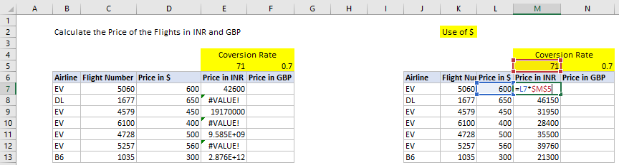
Cell Reference
In the below example, let’s see why is Fixed Cell Reference used.
5. In order to fix this issue, Fixed references are used. In order to fix a cell/ range, $ symbol is used.
6. In the below screenshot, we need to fix “71” i.e. cell M5
7. Refer the second table in the image below. M5 has $ sign. After writing the formula, just Press F4 and $ symbol appears and this denotes that the cell is fixed.
8. Now, drag the same formula down in other cells and desired result would be achieved.
Let’s switch to Excel document for demo

Slide 27
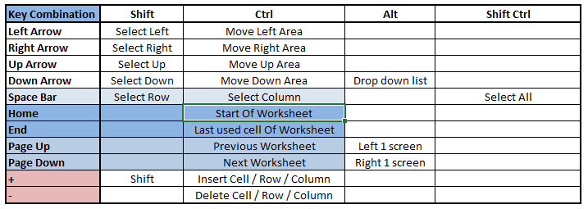
Shortcuts
Now that we have learnt the basic concepts, lets look at some of the basic shortcuts.
Lets look at the method of learning the shortcuts.
Press ALT and then all the shortcuts for different menu gets activated.
Select the appropriate Option and then see if any more subsequent shortcut need to be selected to achieve the desired result
Let’s switch to Excel document for demo

Slide 28
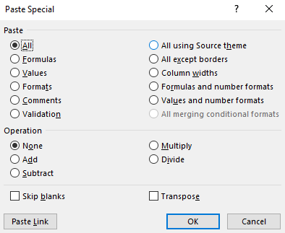
Paste Special
Paste special is a very common and important feature in Excel that is very frequently used. This is followed by “Copy” operation.
After the cell (s) are copied, there is are lot many options that Excel provides to paste.
The snapshot below shows all the capabilities that Excel has for paste Special. The shortcut to access this is ALT + H + V + S
Lets look at couple of examples -
Let’s switch to Excel document for demo

Slide 29
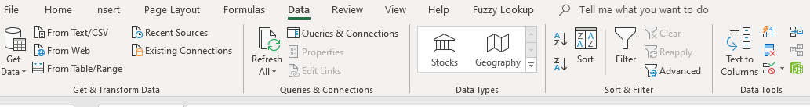
Text to Columns
Text to columns feature is used to segregate the data into multiple columns. The initial data should be separated by any delimiter. Generally, we came across comma as a delimiter as csv is a comma delimited file. There are many other widely used delimiters for e.g. Pipe, Tab, Space, comma, semi colon etc.
Lets look how we do this in Excel.
Let’s switch to Excel document for demo

Slide 30
Quiz 3
Which operator is used to fix the cells in Excel?
A
#
B
%
C
$
D
&
A
B
C
D

Slide 31
Advanced Functions
VLOOKUP is an Excel function to lookup and retrieve data from a specific column in table.
This function supports approximate and exact matching, and wildcards (* ?) for partial matches.
The "V" stands for "vertical".
Lookup values must appear in the first column of the table, with lookup columns to the right.
Syntax:
=VLOOKUP(value, Table, Col_Index,[Range_Lookup])
Arguments:
Value – The value to look for in the first column of table
Table – The table from which to retrieve a value
Col_Index –The column in the table from which to retrieve a value
Range_Lookup – [Optional] TRUE=approximate Match ; FALSE= Exact Match
Let’s understand this function by taking an example.
Similar to VLOOKUP there is another function – HLOOKUP
The only difference is instead of Vertical lookup, this function is used for Horizontal Lookup
Let’s switch to Excel document for demo

Slide 32
Advanced Functions
COUNTIF is an excel function that is used to count cells that meet single criteria
Syntax:
=COUNTIF (Range, Criteria)
Arguments:
Range – The range of cells to count
Criteria – The criteria that controls which cells to be counted
Let’s understand this function by taking an example.
Let’s switch to Excel document for demo

Slide 33
Advanced Functions
COUNTIFS is an excel function that is used to count cells that meet one or more criteria
Syntax:
=COUNTIF (Range1, Criteria1, [Range2], [Criteria2],….)
Arguments:
Range1 – The first range to evaluate
Criteria1 – The criteria to use on Range1
Range2 – [Optional] The second range to evaluate
Criteria2 – [Optional] The criteria to use on Range2
Each additional range must have the same number of rows and columns as range1, but ranges do not need to be adjacent. If you supply ranges with a mismatch, you'll get a #VALUE error.
Non-numeric criteria needs to be enclosed in double quotes but numeric criteria does not. For example: 100, "100", ">32", "jim", or A1 (where A1 contains a number).
The wildcard characters ? and * can be used in criteria. A question mark matches any one character and an asterisk matches any sequence of characters.
To find a literal question mark or asterisk, use a tilde (~) in front question mark or asterisk (i.e. ~?, ~*).
Let’s switch to Excel document for demo

Slide 34
Quiz 4
What are the parameters of VLOOKUP?
A
Look up value, Table Range
B
Table Range, Col_index, Range_Lookup
C
Look up value, Table Range, Col_index, Range_Lookup
D
Look up value, Table Range, Col_index
A
B
C
D

Slide 35
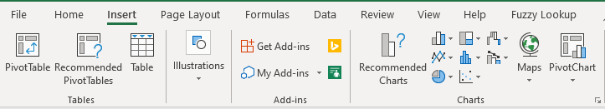
Pivot Table
Pivot Tables in Excel is the most widely used feature. This is used to do all advanced calculations and analysis. In the field of data analytics, use of Pivot Tables is must.
Lets see, how do we create a Pivot Table and its key capabilities.
How to create a Pivot Table:
Select the data on which Pivot Table need to be created.
Go to Insert → Pivot Table

Slide 36
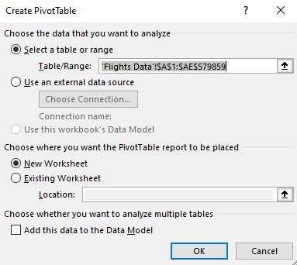
Pivot Table
3. Pop up appears as shown below.
4. Specify the data range if not specified earlier
5. Chose New/ Existing Worksheet to create the Pivot Table
6. Add this data to the Data Model – will cover in subsequent slides

Slide 37
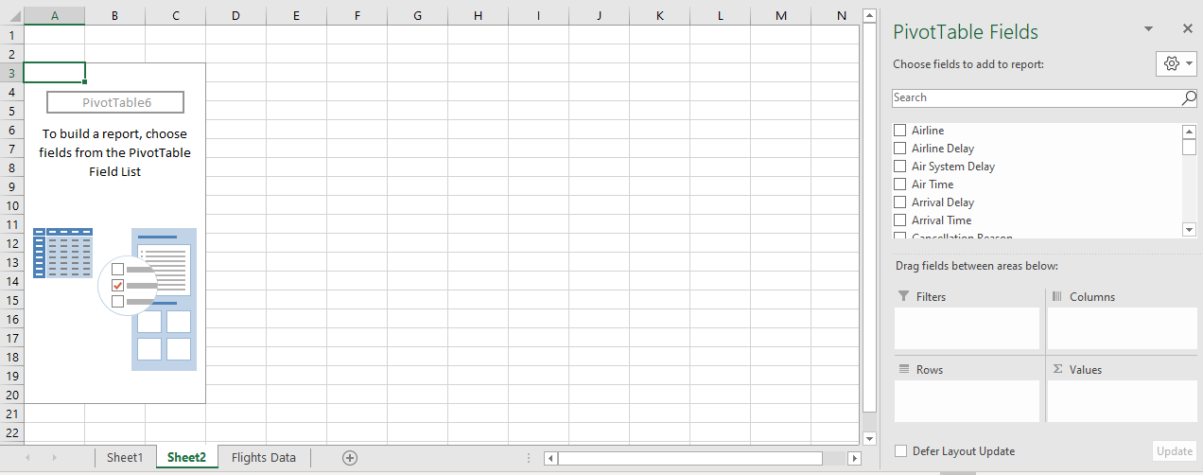
Pivot Table
Below screen appears in clicking Ok.
Data variables
Filter Pane
Columns
Rows
Values

Slide 38
Pivot Table
In the last screen, there are two key areas-
Pivot Table fields – This section outlines all the data variables. Search is also available in case user need to search a particular data variable
There are 4 components –
Filters – Dragging a data variable in this section create a Filter for that variable in the Pivot table
Columns - Dragging a data variable in this section creates Columns with the values of the variable
Rows - Dragging a data variable in this section creates Rows with the values of the variable
Values – This is the aggregation section and Measure need to be dropped here. All type of basic aggregations can be done in this section i.e. Sum, Count, Average, Max, Min etc.
3. Lets use all the above options and create a pivot table.
Let’s switch to Excel document for demo

Slide 39
Pivot Table
There is no direct function for COUNTD. Using Pivots, COUNTD can be done. In order to achieve this, make sure that the below highlighted check box is checked while inserting a Pivot Table on the selected data range.
Lets see another example and see how COUNTD is done using Pivot Table.
Let’s switch to Excel document for demo

Slide 40
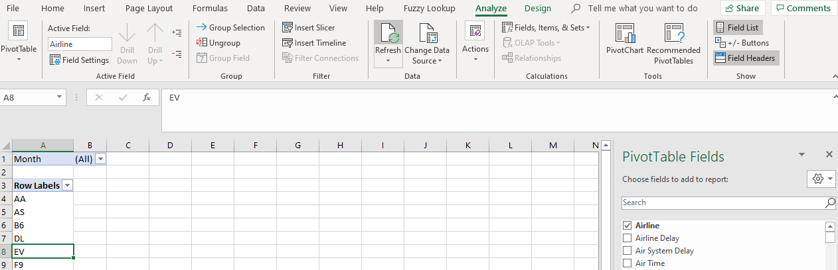
Pivot Table
In order to calculate a Calculated Field that is not present in the data fields, use the option as highlighted in the snapshot below.
Lets calculate Elapsed time for the flights mentioned in the table.
Let’s switch to Excel document for demo

Slide 41
Quiz 5
How to calculate COUNTD in Pivots
A
Excel in built Function
B
Function appears post adding data to data model
C
Pivot Function
D
HLOOKUP
A
B
C
D

Slide 42
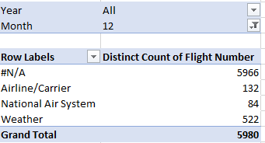
Pivot Table Charts
Now, lets extend the learning of pivot table to create charts. We will learn how to create Charts on Pivot Tables.
Lets create a Pivot Table first for the below analysis.
Once the Pivot table is created, we will see how to create chart using pivot table.
Identify the reason and # Flights that has resulted in cancellation of flights
Let’s switch to Excel document for demo

Slide 43
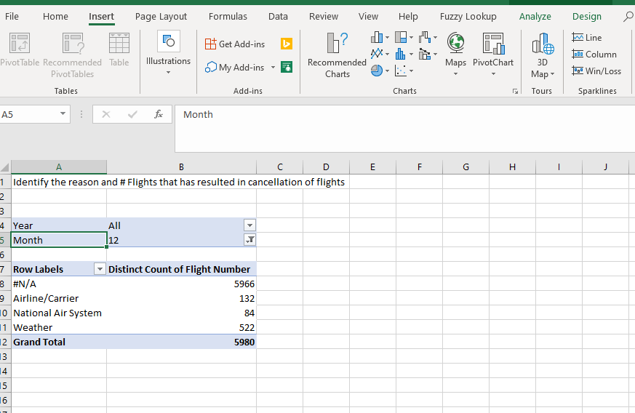
Pivot Table Charts
Select the pivot table and click on Insert.
Form the below snapshot, click on insert Pivot Chart.
Let’s switch to Excel document for demo

Slide 44
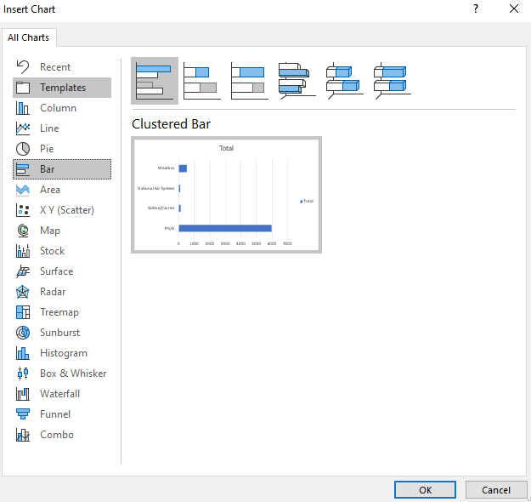
Pivot Table Charts
On inserting the Pivot Chart, below pop up appears. Select the required chart.
Let’s switch to Excel document for demo

Slide 45
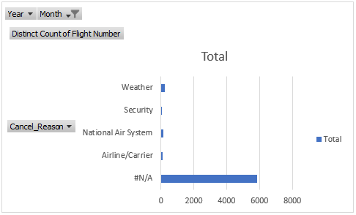
Pivot Table Charts
1. On the left panel, different chart types are displayed.
2. In the center, preview of the selected chart is shown.
3. On the top, we can see, if for the selected chart, further chat sub type is available.
On selecting the bar chart, we see the below chart.
Let’s switch to Excel document for demo

Slide 46
Pivot Table Charts
Lets identify all the options that we have on the chart –
Year, Month, Cancel_Reason – These are the Filters that help us slice and dice the chart. We can exclude/ include any data point that we want for analysis.
For e.g. – We want to exclude the Cancel_Reason as
“#N/A” – then select the Cancel-Reason dropdown
and we can exclude this from the filter and Chart is
Updated with only the valid reasons for cancellation.
Right click the chart for other basic formatting options.
Let’s switch to Excel document for demo

Slide 47
Pivot Table Charts
Lets create a Month on Month chart to Count the following Flights –
Cancelled Flights
Delayed due to Security Delay
Delayed due to Arrival Delay
Delayed due to Air System Delay
Delayed due to Airline Delay
Let’s switch to Excel document for demo

Slide 48
Quiz 6
What is the shortcut for Paste Special
A
ALT+ H +V+S
B
CTRL + V
C
CTRL + D
D
CTRL +H+V+S
A
B
C
D

Slide 49
References
The best reference in Excel is press F1 and type what exactly you want to search/ need help.
There is lot of content available freely over the internet. Refer the below URLs to seek an answer to the your queries.
https://www.w3resource.com/excel/
https://chandoo.org/wp/excel-basics/
https://blog.hubspot.com/marketing/how-to-use-excel-tips
Let’s switch to Excel document for demo

