Slide 1
.
2
Thank You
3

Slide 2
Experiment Setup
Every one of the 10 activation functions {ACTIVATIONS = ['ReLU', 'sigmoid', 'tanh', 'leaky_ReLU', 'softmax', 'linear', 'ELU', 'SELU', 'GELU', 'swish']} is trained from the same seed, on the same data, with the same hyperparameters, with nn(n_layers=1), matching the original shallow-network comparison.
f(x) = sin(x) + 0.5·cos(2x)
f(x,y) = sin(x)·cos(y)
1D Task — Curve Fitting
2D Task — Surface Fitting
Domain: x ∈ [−2π, 2π], 100 points
Domain: x, y ∈ [−3, 3], 15×15 grid (225 pts)
Model: nn(input=1, hidden=64, n_layers=1)
Model: nn(input=2, hidden=64, n_layers=1)
Training: 1500 epochs, SGD
Training: 600 epochs, SGD
Learning rate: 0.001
Learning rate: 0.001
1

Slide 3
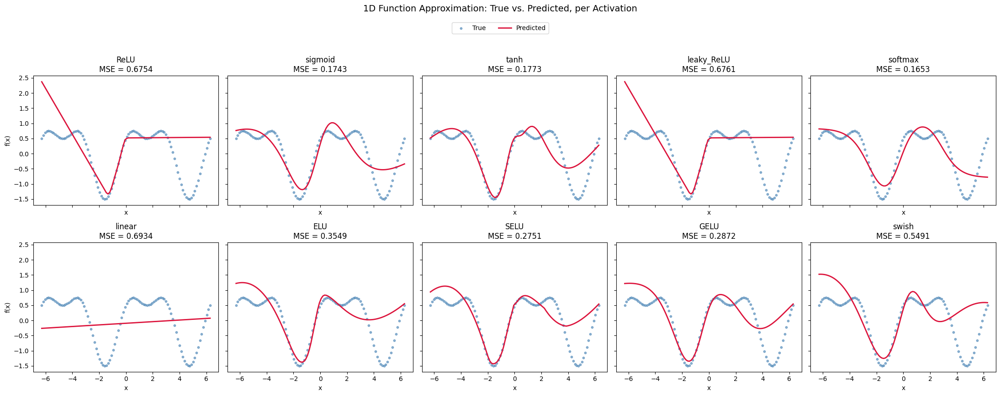
1D Function Approximation: Predicted vs. True
f(x) = sin(x) + 0.5·cos(2x), fit by each activation function
Best fit: softmax (MSE 0.165), sigmoid (0.174), tanh (0.177) • Worst: linear (0.693) — no nonlinearity to bend the fit
2

Slide 4
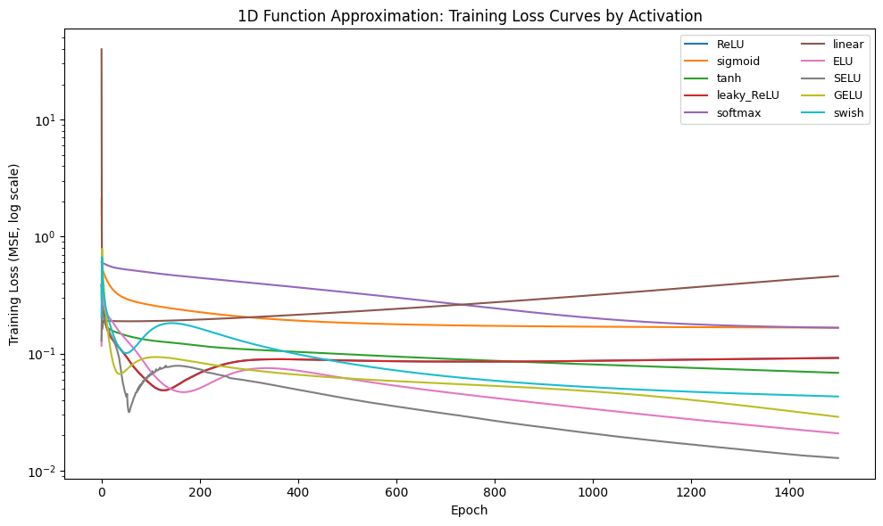
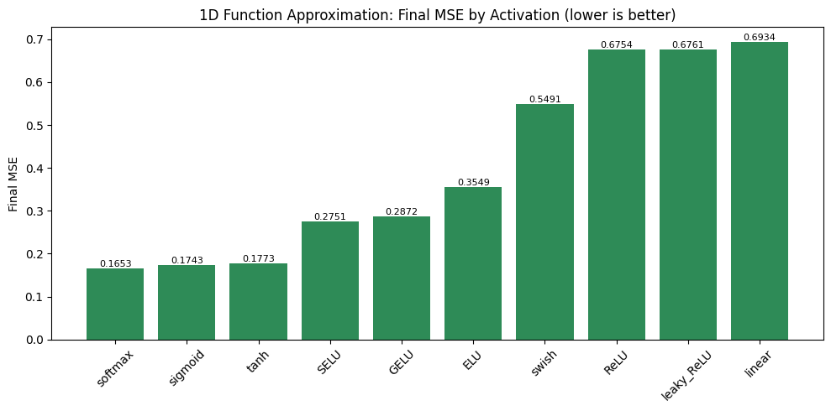
1D Task: Training Dynamics
Final MSE, ranked best → worst
Loss curves (log scale)
None of the 10 activations diverged (no NaNs) under these settings. Smooth, saturating/self-normalizing activations (softmax, sigmoid, tanh) converge to the lowest loss here; ReLU-family activations (ReLU, leaky_ReLU) converge steadily but plateau higher, and the purely linear network cannot represent curvature at all and stalls with the highest error.
3

Slide 5
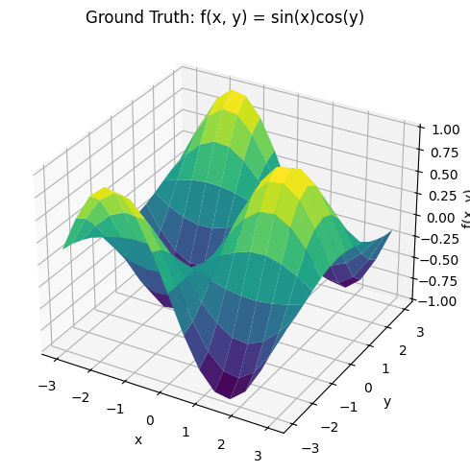
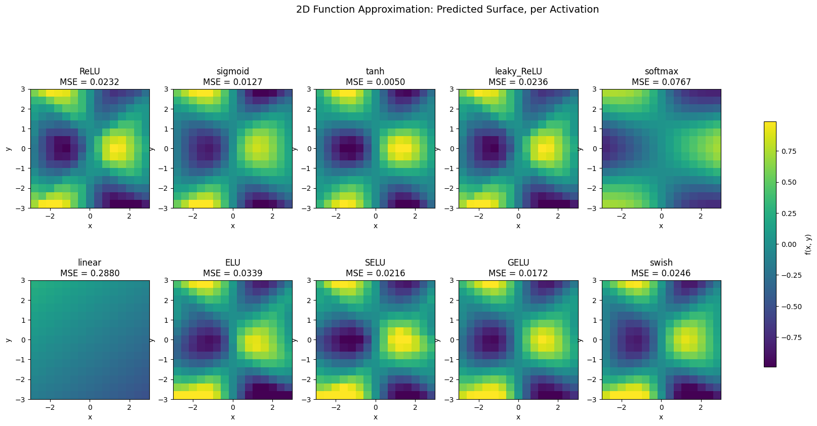
2D Function Approximation: Predicted Surfaces
f(x,y) = sin(x)·cos(y)
Ground truth
Best fit: tanh (MSE 0.005), sigmoid (0.013), GELU (0.017) • Worst: linear (0.288)
4

Slide 6
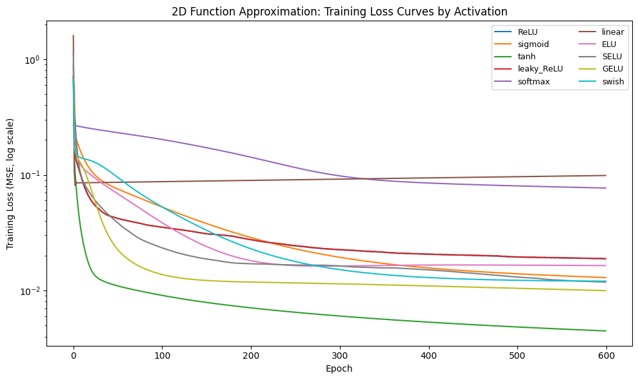
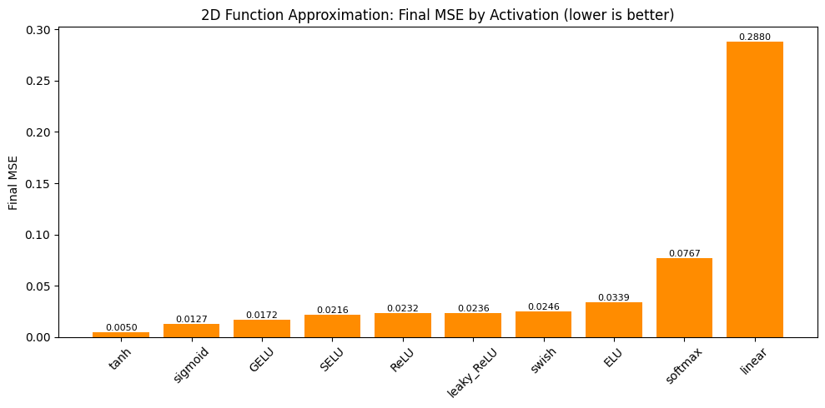
2D Task: Training Dynamics
Final MSE, ranked best → worst
Loss curves (log scale)
tanh's smooth, zero-centered output makes it the strongest fit for this smoother 2D surface. softmax drops from 1st place (1D) to 9th (2D) forcing hidden activations to sum to one discards magnitude information that matters more as the target gets more complex, showing that the best activation is task-dependent.
5

Slide 7
Summary: 1D vs. 2D Performance by Activation
1D: sin(x) + 0.5·cos(2x)
2D: sin(x)·cos(y)
Activation | MSE | Rank
softmax | 0.165 | 1
sigmoid | 0.174 | 2
tanh | 0.177 | 3
SELU | 0.275 | 4
GELU | 0.287 | 5
ELU | 0.355 | 6
swish | 0.549 | 7
ReLU | 0.675 | 8
leaky_ReLU | 0.676 | 9
linear | 0.693 | 10
Activation | MSE | Rank
tanh | 0.005 | 1
sigmoid | 0.013 | 2
GELU | 0.017 | 3
SELU | 0.022 | 4
ReLU | 0.023 | 5
leaky_ReLU | 0.024 | 6
swish | 0.025 | 7
ELU | 0.034 | 8
softmax | 0.077 | 9
linear | 0.288 | 10
6

Slide 8
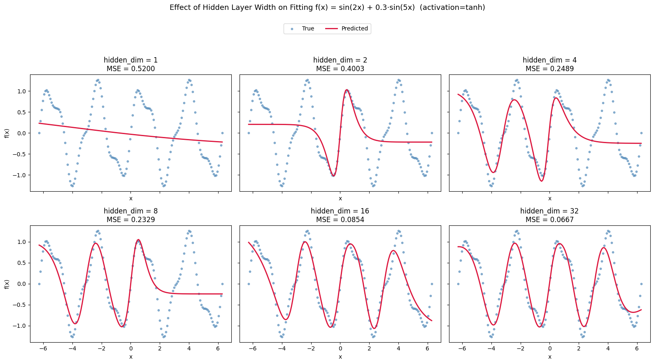
Does Adding Neurons Improve Nonlinearity Fit?
Fixed n_layers=1, activation=tanh only hidden_dim (width) changes. Target: f(x) = sin(2x) + 0.3·sin(5x), a higher-frequency curve than the earlier 1D task, chosen to make the width effect obvious.
7

Slide 9
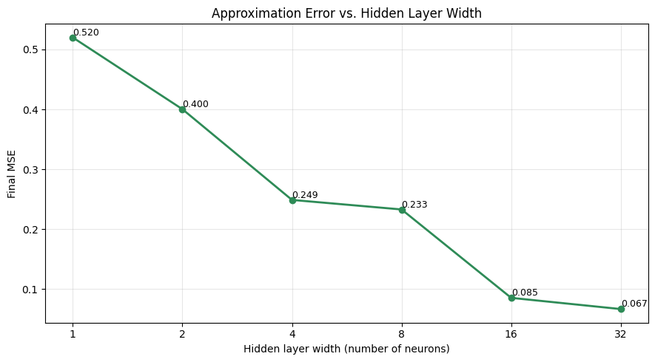
Width Study: Error vs. Hidden Layer Size
1
Error drops sharply at first
1 neuron can only bend the curve once (MSE 0.52); by 8 neurons the network already tracks the slow oscillation (MSE 0.23).
2
Then returns diminish
16→32 neurons only takes MSE from 0.085 to 0.067 most of the representational gain is already captured.
3
Wider needs more training, not just more capacity
Beyond ~32 neurons (with this fixed epoch budget & plain SGD), wider layers can score worse simply because they haven't finished converging yet.
8

Slide 10
.
2
Thank You
3

