Slide 1

Theme: Inventory Management
Team: Devesh

Slide 2



Business Challenge
In the Inventory Management segment, major challenges one is facing are :
Automation in Stock Reconciliation is absent, resulting a toll on manual efforts and sometimes a block in customer service procedure.
Real Time Tracking/location of a jewellery item in the stores or at inventory storehouse is not present
Smart count of inventory availability at any time is a need

Slide 3

To solve the given business challenge I present

Slide 4
CaratMap is Near Field Communication(NFC) based mobile application which tracks real time location of each individual asset present in physical store.
A 2D- real time map of store is generated with the help of a network of NFC tags throughout the store and on the items as well.
Sales representative in store can search an item via bar code scanner(present in app) or by typing name or can search in catalogue embed In app.
Our app will tell the exact location of item i.e. Tray Number, Block Number and also the row of tray.
Also if an item is missing from the store, our product can send the alert. In other words it will add automation in the process of stock reconciliation.
(Demo video link is given in the second last slide, demonstrating whole process in real time) for easy understanding

Slide 5
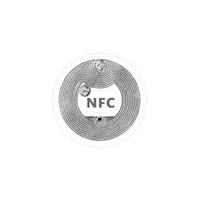


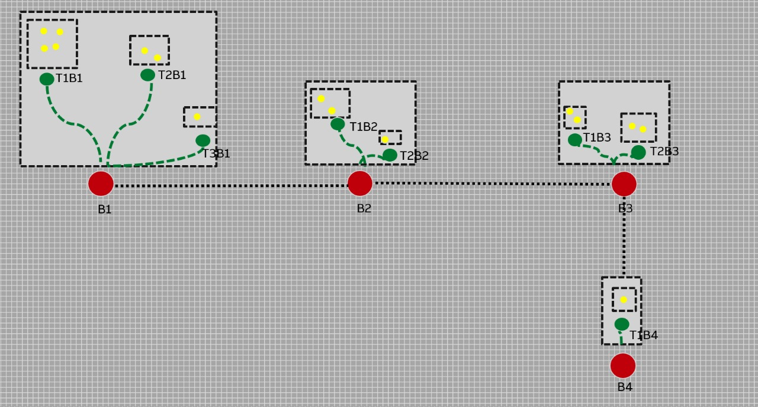
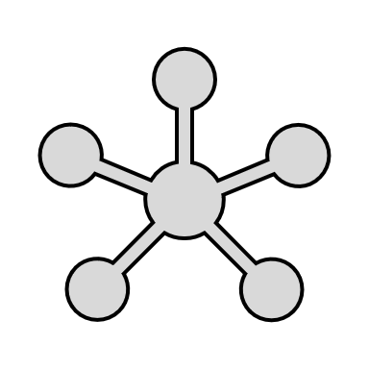
Methodology (Demo video link is given in the second last slide, demonstrating whole process in real time)
Initially each Jewellery item would be associated with a bar code
Each bar-code will be connected to a NFC tag, means each item’s information is now stored in this tag.
Different types of NFC would be there. Some stores information of a whole shelf(block), some of trays and rest are sticked on jewellery items and the tags which are place on path.
Items in tray
Trays in shelves
Different shelves/block containing trays
Once all the items are tagged with NFC tags, lane of NFC tags would be created, resulting in communication throughout the network.
A real-time time 2D with search functionality will be ready, helping in counting, tracking, availability of inventory.

Slide 6
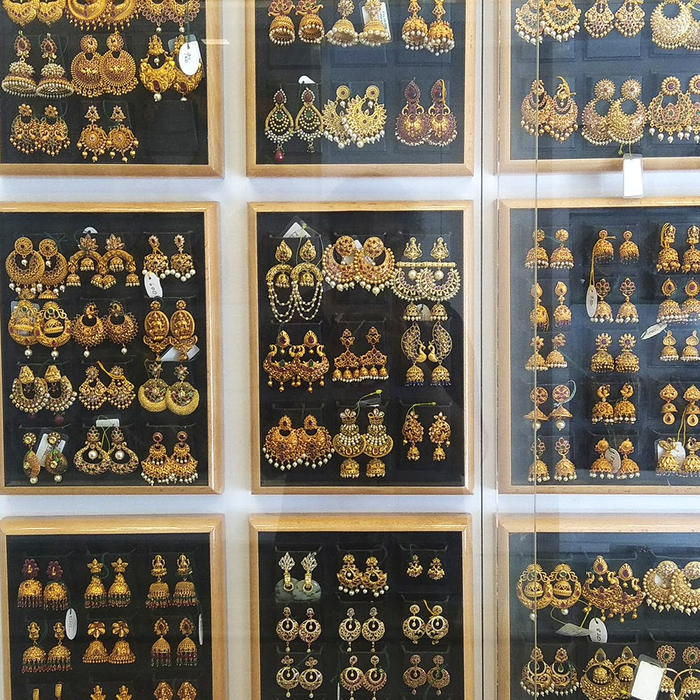
Tag placing in real scenario
Each tag stores information, we are converting this information into map. Each NFC tag is always in Active state in presence of another tag thus maintaining path to transfer insformation.
Grey tags are Path tags responsible for passing message from App till the required item.
Red& Green tag stores which all items they include. Similar like a tree structure node and children.
Yellow tag identifies a particular item.
Real Example:
Lets say sales representative wants red circle item.
1.He will search the item by typing name or scanning bar code from our app.
2.Click on locate tag by tapping it on nearest grey tag.
3. Now code will check which red tag contains desired tag and we will get shelf/rack number.
4. In our case Red tag no.. Tray 4 ( example) will be our output. We will get complete tray / shelf number on app .
Tray 4

Slide 7
How would the communication throughout network will look like
Color Code:
Tags laying out as path of communication
A block or rack containing Trays
Tags storing info for a rack/block
Red tag checking if it contains an item
Tags storing info for a tray
Tags storing info for a individual item
Each path tag stores info, and follow Djikstra’s algo to reach final child i.e. any item.
A tray containing few items
Store Layout with NFC Tags

Slide 8
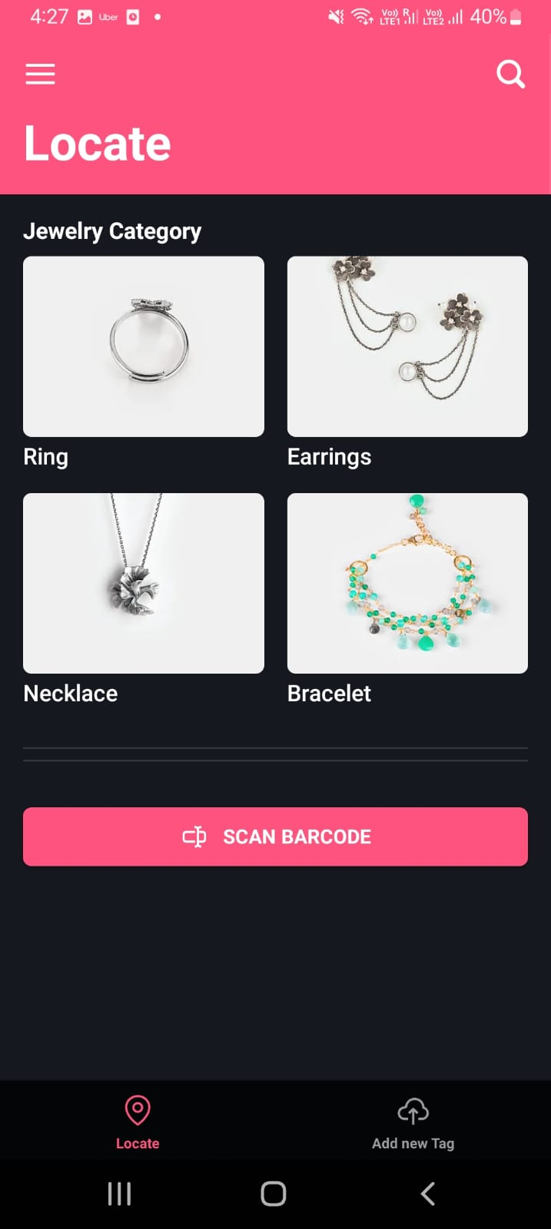
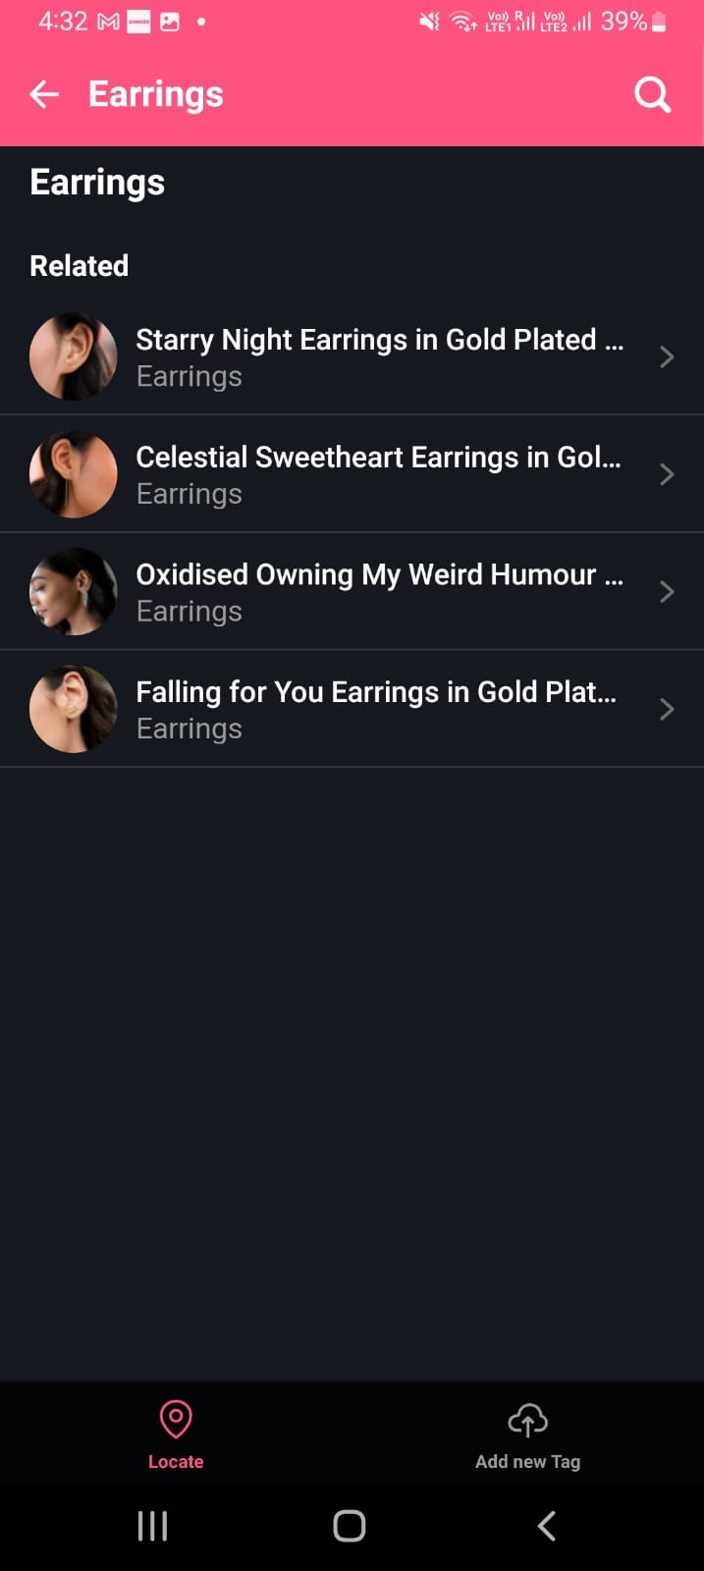
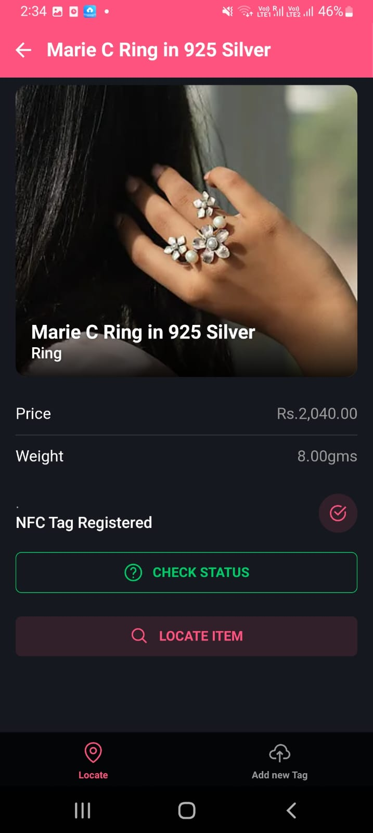
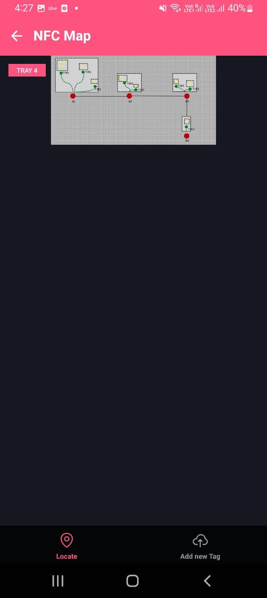
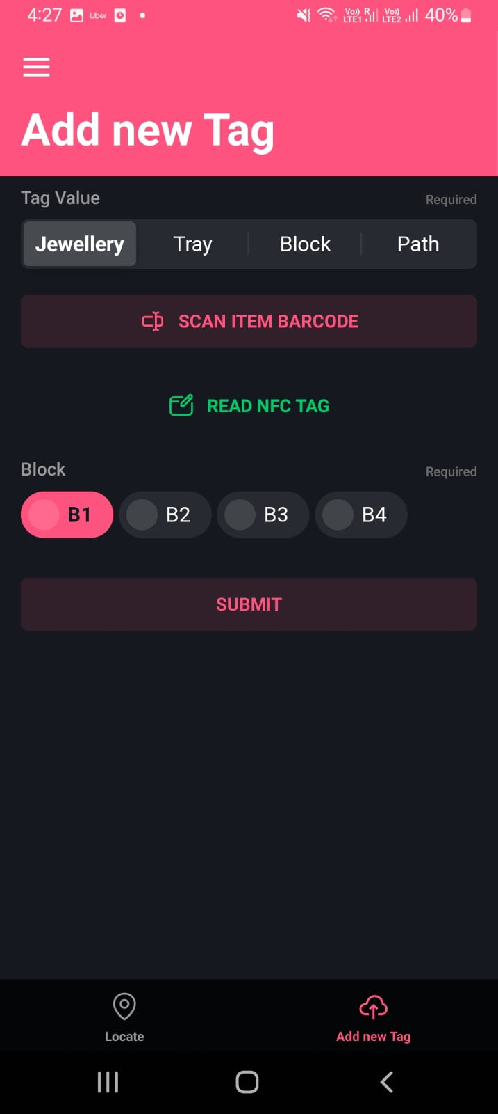
Screenshots
One can scan the bar code of item or search in different categories to locate
Search an item in different Categories Section
Check status whether item is in store network along with the location in store
Realtime 2d map with item location like Tray no.
Read a new NFC tag as one of the types i.e. jewellery, tray, block or path

Slide 9
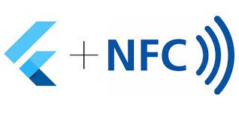


Architecture cum Techstack
The communication throughout the network containing location, direction of a tag is converted to code using Android Libraries, thus giving Numerical Values Information
Unity is used to convert numerical distances into a 2d map with icons.
Flutter Framework along with NFC (read+write) library is used to create UI and accessing NFC tags

Slide 10
Future Scaling Prospects
When it comes to scaling the POC, granularity in location will increase. For POC, I am narrowing it down to shelf number and tray number but in future we can also track the rows of tray.
Keeping time constraints in mind I restrict my self from going into that granularity.
Complexity of map will increase and that is when NFC smooth communication comes into picture, no matter how complex the network is smooth communication between tags is guaranteed.
POC is showing for one store location, each store has to gone though a NFC setup.
Few points on why NFC technology for this theme.
Major advantage ROI is great, NFC tag I am using for POC is of Rs.10 with communicating withing range of 5cm. For scaling we can have better range NFC tags thus resulting in less number if stickers in store.
We have to create a path of NFC tags on wall, just like we have for electricity. It is not typical as it seems, just peel the back of tag and stick on surface.
Keeping the effort required for tagging each item with NFC and laying layout in each store is one time. The return is something that can make the experience exponential in Omni-Channel .

Slide 11
Demo Video Link

Slide 12
Thank You

