Slide 1
Image Document Optimization- SBI
Powered By - Microsoft Corporation Pvt Ltd.
TEAM- DEVESH

Slide 2

Problem Being Solved
Officially Valid Documents –such as Aadhaar card, Driving License, Voter Identity card, PAN card and other application forms which are a part of daily official operations are stored as images/PDF.
A Huge volume of documents need to be maintained, re-used, preserved for operational activities during the Loan & Deposit Account lifecycle. Optimization is required for these documents to help efficiently store / retrieve the documents.

Slide 3
Our Solution
Main objective of our solution is to reduce the noise around the image as well as improving the orientation of the image along with reducing the size. For this we are using Autoencoders functionality of image processing.
Autoencoders consists of an encoder network, which takes the feature data and encodes it to fit into the latent space. This encoded data (i.e., code) is used by the decoder to convert back to the feature data. In an encoder, what the model learns is how to encode the data efficiently so that the decoder can convert it back to the original. Therefore, the essential part of autoencoder training is to generate an optimized latent space.

Slide 4
Features of our solution
Reducing size of images without losing any quality.
Reducing size of overall storage blob.
Automatically detection of Orientation.
Automatically analyzing the boundaries of required text, hence reducing noise(white space )around the document.

Slide 5
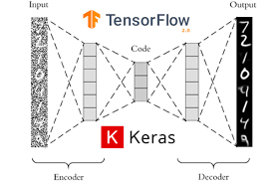
ARCHITECTURE

Slide 6




TECHSTACK

Slide 7

Submitted By : DEVESH
Email : devesh.xin@gmail.com
Mobile No: 8433448479

