Slide 1

by CoinSwitch
Team- Devesh

Slide 2



Lawsuit Filed against Ride sharing apps for Data Stealing

Slide 3
Present Problem OR Beginning of Future “Data Rampant”
Applications like Uber provide a matching service and apparently they so-called decentralize it. This is P2P technology at its finest. Or is it? Several scandals have emerged out of Uber’s corporate culture as of late. Uber has become notorious both for its business practices and for what it incentivizes and allows its drivers to do.
Despite these concerns, Uber has grown at an exponential rate over the past few years and is showing revenue numbers in the billions. It provides a useful service: people prefer using a location-aware app to hail a ride over calling a taxi, and it’s safe to say the demand for real-time ride-sharing isn’t going away anytime soon. But privacy invasion and the vast imbalance of power between a billion-dollar corporation and the drivers are the negatives of Uber that riders must accept when they use its service.

Slide 4

To solve the current problem we present:

Slide 5





Our Solution
We eliminate the existence of the middle agency, thereby completely removing the regulation of salaries of drivers by corporations. So, the earnings of the driver are solely dependent on the number of rides he/she makes.
All the data is stored on the peer-to-peer decentralized Polygon Matic Chain. This not only ensures complete security, but also a lightning-fast experience. Data privacy is maintained by the access specifiers of data members and methods defined in the smart contracts.
We are not only eliminating the middle man, the L2 solution by Polygon gives us a boost in transaction rate.
We have implemented a smart
contract addressing the issue of
storing critical data necessary at different stages of Taxi Hailing and making it verifiable by all
stakeholders.

Slide 6
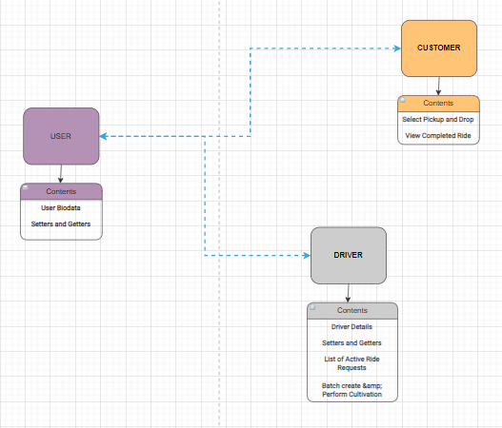
Application Workflow Diagram

Slide 7
Tech Stack
Solidity (Ethereum)
Metamask (Ethereum wallet)
Mumbai testnet( Polygon Networkwith Matic Faucet )
Remix IDE
Truffle
IPFS
Web3JS
React Native
Nodejs (Express)
Google Map Api
Firebase for Google Auth

Slide 8


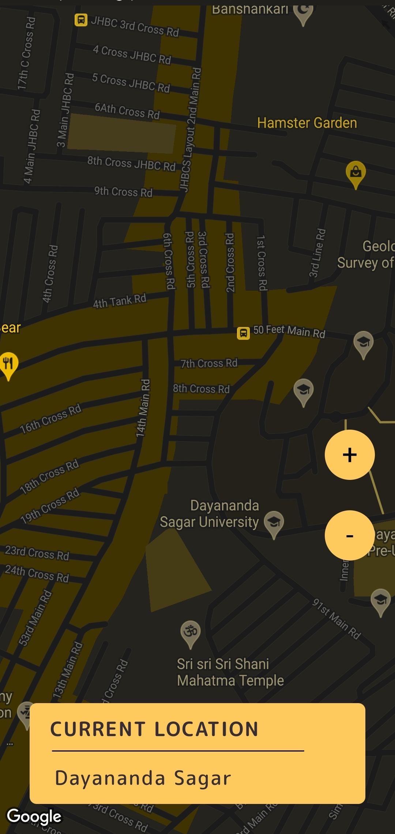
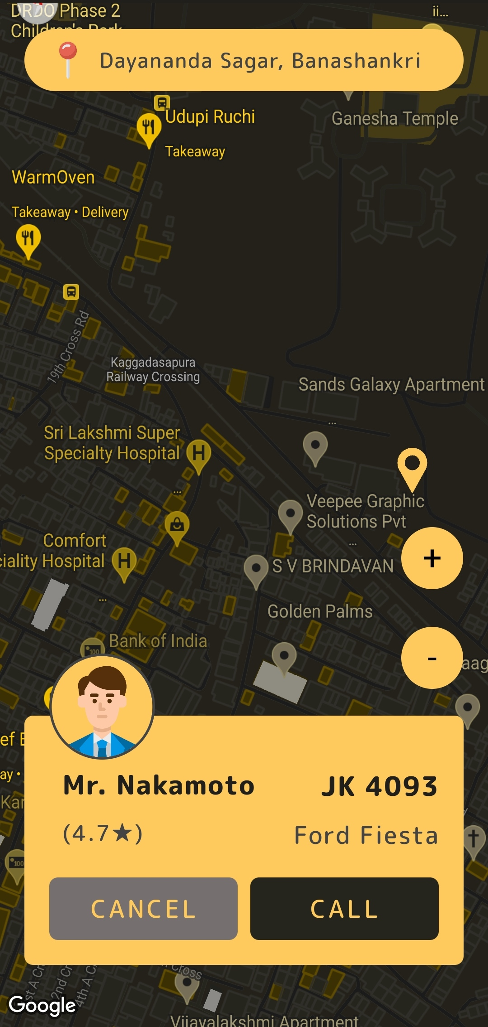
Screenshots

Slide 9
Demo Video
https://youtu.be/ZqIxDx2pxOM

