Slide 1
Video Analytics- SBI
Powered By - Microsoft Corporation Pvt Ltd.
TEAM- DEVESH

Slide 2

Problem Being Solved
Surveillance is being constantly carried out via Video Cameras at Branches, ATMs & Offices of the Bank. As a proactive measure and to protect against unscrupulous elements, the video feed is constantly monitored by personnel at Command Centres / Control rooms.

Slide 3
Our Solution
We propose a light-weight model for anomaly detection, functional for a real-world surveillance network. We adopted a pretrained model and extracted frame-wise features, followed by a sequential learning mechanism for the precise recognition of anomalous activity.
We employed the residual attention-based long short-term memory (LSTM) concept, which can effectively learn temporal context information and precisely recognize anomalous activity. Moreover, using a residual attention-based LSTM saves more than 10% of learnable parameters as compared to the usual LSTM network size.

Slide 4
Features of our solution
Detecting Dangerous Objects like gun,knife
Analyzing Facial Expressions/Emotions
Automatic Signaling if camera feed interrupted
Built-in security guidelines

Slide 5
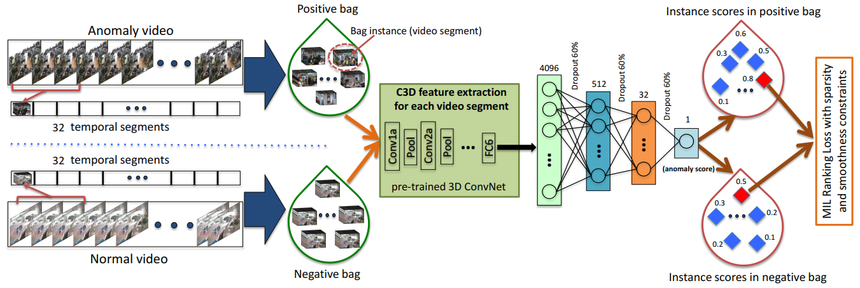
ARCHITECTURE

Slide 6




TECHSTACK

Slide 7

Submitted By : DEVESH
Email : devesh.xin@gmail.com
Mobile No: 8433448479

