Slide 1
VIDEO COMPRESSION- SBI
Powered By - Microsoft Corporation Pvt Ltd.
TEAM- DEVESH

Slide 2

Problem Being Solved
With the advent of Video Based Customer Identification Process (V-CIP), multiple use cases have emerged for customer onboarding & servicing requests of customers in a secure, paperless, cost-effective & friendly manner.
Storage / retrieval of these video files is a challenge especially given the expected tsunami of video files that are expected to be generated on extending more use-cases to our client base of over 45 crore customers.

Slide 3
Our Solution
We propose a video compression framework using conditional Generative Adversarial Networks (GANs). We rely on two encoders: one that deploys a standard video codec and another which generates low-level maps via a pipeline of down-sampling, a newly devised soft edge detector, and a novel lossless compression scheme. For decoding, we use a standard video decoder as well as a neural network based one, which is trained using a conditional GAN. Recent "deep" approaches to video compression require multiple videos to pre-train generative networks to conduct interpolation. In contrast to this prior work, our scheme trains a generative decoder on pairs of a very limited number of key frames taken from a single video and corresponding low-level maps. The trained decoder produces reconstructed frames relying on a guidance of low-level maps, without any interpolation.

Slide 4
Features of our solution
Semantic-fidelity oriented image and video compression
Rate-distortion (RD) optimization guided neural network training and adaptive switching for compression task.
Memory and computation efficient design for practical image and video codec.

Slide 5
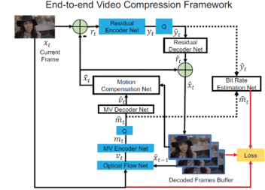
ARCHITECTURE

Slide 6




TECHSTACK

Slide 7

Submitted By : DEVESH
Email : devesh.xin@gmail.com
Mobile No: 8433448479

