Slide 1
Voice Biometrics- SBI
Powered By - Microsoft Corporation Pvt Ltd.
TEAM- DEVESH

Slide 2

Problem Being Solved
Customers interact with the Bank via various channels such as Contact Centre & Video based Customer Identification Process Calls. Authentication measures of Caller ID / PIN / Security Questions / Device Signatures are often inadequate and intrusive.
For this a Voice Authentication solution is required to address the issue and improving customer engagement.

Slide 3
Our Solution
Our Solution can help determine who is speaking in an audio clip. The service can verify and identify speakers by their unique voice characteristics, by using voice biometry.
You provide audio training data for a single speaker, which creates an enrollment profile based on the unique characteristics of the speaker's voice. You can then cross-check audio voice samples against this profile to verify that the speaker is the same person (speaker verification). You can also cross-check audio voice samples against a group of enrolled speaker profiles to see if it matches any profile in the group (speaker identification).

Slide 4
Features of our solution
Speaker verification can be either text-dependent or text-independent.
Text-dependent verification means that speakers need to choose the same passphrase to use during both enrollment and verification phases.
Text-independent verification means that speakers can speak in everyday language in the enrollment and verification phrases.

Slide 5
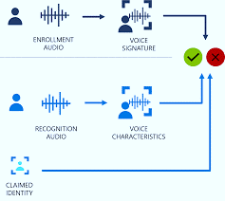
ARCHITECTURE

Slide 6



TECHSTACK

Slide 7

Submitted By : DEVESH
Email : devesh.xin@gmail.com
Mobile No: 8433448479

