Slide 1
Cloud-Based Knowledge Graph Framework for Automated Research Intelligence
Answering research questions from a knowledge graph, with citations
Dhruv Gupta (23BIT0350) | Parth Sharma (23BIT0211) | Devesh Agarwal (23BIT0201)
BITE412L Cloud Computing | Course Instructor: Dr. Priya V
School of Computer Science and Engineering, VIT Vellore
Notes:
Introduce the team and the project: we turn scientific papers into a knowledge graph on AWS, and answer questions only from facts in that graph, with citations.

Slide 2
Outline
Introduction and problem statement
Existing approaches and project objectives
Literature survey, research gap and novelty
Proposed system and cloud architecture
Datasets, NLP models and the knowledge graph
GraphRAG question answering
Results and dashboard demo
Security, testing and cost
Challenges, team contributions
Conclusion and future work
Notes:
The talk follows the report: the problem, what exists, what we built, how it works on AWS, the results, and what comes next.

Slide 3
Introduction and problem statement
Scale: scientific output grows every year; OpenAlex alone indexes over 300 million scholarly works.
Scattered knowledge: which methods solve which tasks, and on which datasets, is spread across the text of thousands of papers.
Keyword search: returns documents, not answers, and cannot follow links across papers.
Standalone LLMs: answer fluently but invent authors, venues and results, and cannot cite a source.
Problem: automatically turn scientific text into a queryable knowledge graph on the cloud, and answer questions from it with verifiable citations.
Notes:
Researchers and R&D teams cannot read everything. Search finds documents but does not connect facts across them. LLMs give answers that sound right but are often invented. Our problem statement is the last bullet.

Slide 4
Limitations of existing approaches
Capability | Keyword search | LLM on its own | This project (GraphRAG)
Answers questions in plain English | No | Yes | Yes
Connects facts across many papers | No | No | Yes
Cites the source of every statement | No | No | Yes
Grounded in verifiable data | Yes | No | Yes
Updates automatically as papers arrive | Yes | No | Yes
Each existing approach solves only part of the problem; our system combines grounding, multi-hop links and natural-language answers.
Notes:
Search is grounded but cannot answer or connect facts. An LLM can answer but is not grounded. GraphRAG answers in plain English, but only from facts retrieved from the graph, with citations.

Slide 5
Project objectives
# | Objective | Success criterion | Result
1 | Automated entity and relation extraction | F1 at least 0.60 | NER 0.618, RE 0.661
2 | Serverless, event-driven processing | At least 1,000 papers/hour | About 1,350 papers/hour, 0 failures
3 | Grounded answers with GraphRAG | Hallucination below 5% | 0% (62.5% without the graph)
4 | Scalable graph storage | Retrieval under 1 s | 0.535 s; 29,320 nodes
5 | Interactive, secure dashboard | All features work; 401 without login | All checks pass
6 | Monitoring and testing | Alarms, passing end-to-end test, $0 | 13/13 checks, $0 charged
All six objectives were met on the deployed system.
Notes:
Every objective had a measurable criterion set in advance. The right-hand column is what we measured on the deployed system.

Slide 6
Literature survey (15 papers)
Group | Papers | What they show | What they lack
Building knowledge graphs | P1, P2, P5, P11, P14 | KGs capture multi-hop relations; deep models extract knowledge from text | Manual ontologies, noisy general extractors
Reasoning and systems | P6, P7, P10, P12, P15 | Better completion, reasoning and distributed knowledge sharing | Offline or simulated; no cloud deployment
KG-grounded generation | P3, P4, P8, P9, P13 | Graphs reduce LLM hallucination; GraphRAG design space | No same-model comparison or deployed system
12 papers from IEEE, ACM, Springer, Elsevier and MDPI venues, plus 3 recent arXiv preprints; 11 published in 2024-2026.
Each member analysed five papers related to their part of the project.
Notes:
We grouped the 15 papers by what they do. One proposal paper was retracted and one could not be verified, so we replaced them with verified papers from IEEE TKDE and ACM TOIS.

Slide 7
Research gap and novelty
Research gap
Our novelty
No reviewed system combines automatic extraction of scientific entities and typed relations
with a graph that updates as new papers arrive,
cited answers tested against the same LLM without the graph,
and a secure, monitored, low-cost cloud deployment.
Algorithm: two SciBERT models (entities and relations) with canonicalisation.
Feature: plain-English answers with clickable citations, multi-hop Connect, Research 360.
Cloud: event-driven serverless pipeline on AWS; graph and LLM switchable by parameter.
Evidence: hallucination 0% vs 62.5% for the same LLM without the graph.
Notes:
Each paper covers one or two of these points; none combines all four. Our contribution is the integrated, measured, deployed system, not any single new component.

Slide 8
Proposed system
Extract: two fine-tuned SciBERT models on Amazon SageMaker find methods, tasks, datasets and metrics, and the relations between them.
Store: papers, authors, institutions and extracted entities go into a knowledge graph linked by typed edges.
Ask: GraphRAG retrieves the relevant facts; the LLM answers only from them and cites each source paper.
Automatic: a paper uploaded to Amazon S3 is processed without any manual step.
Users: researchers sign up and ask questions; project members can also upload papers.
Notes:
The system in three verbs: extract, store, ask. Everything is serverless, so it scales when papers arrive and costs nothing when idle.

Slide 9
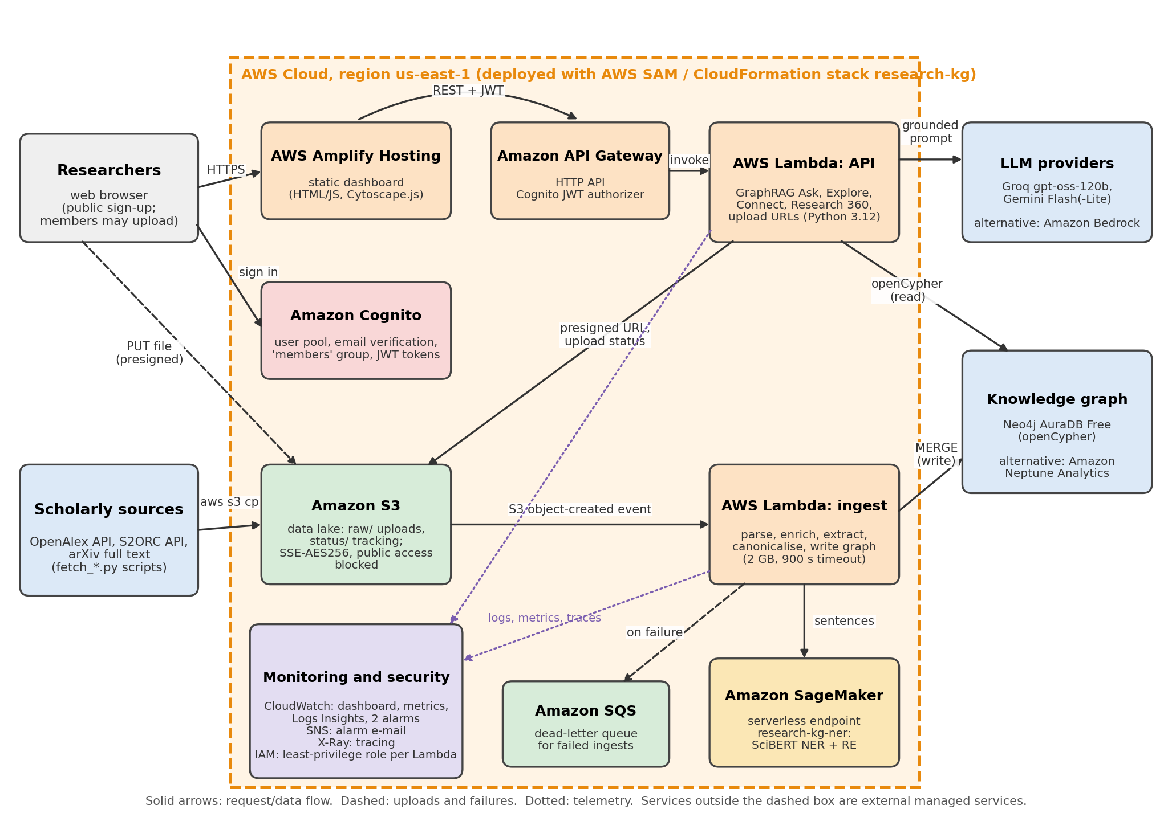
Cloud deployment architecture (AWS)
Dashboard on Amplify; sign-in with Cognito
API Gateway checks the JWT, then calls the API Lambda
S3 upload triggers the ingest Lambda, which calls SciBERT on SageMaker
Results are written to the knowledge graph
CloudWatch, X-Ray and SNS monitor both paths
Notes:
Walk through the diagram. Because the AWS Free plan blocks Neptune and Bedrock, the graph runs on Neo4j AuraDB and the LLM on Groq and Gemini; one deployment parameter switches back to the AWS services.

Slide 10
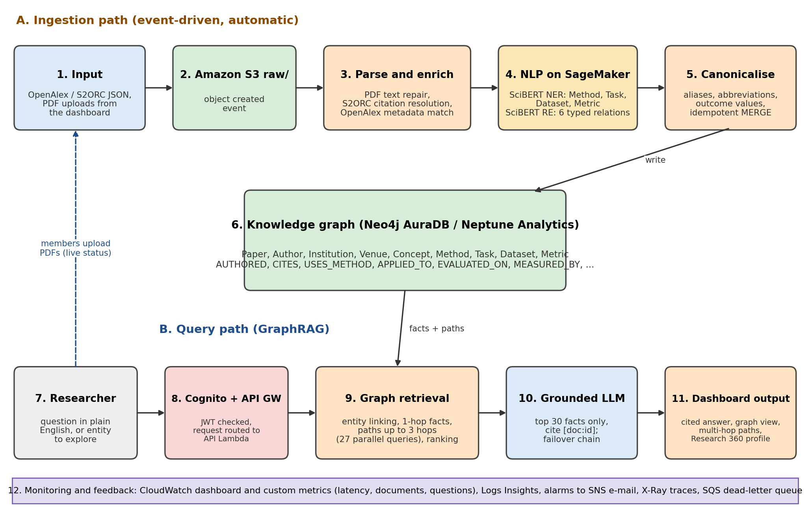
Complete system workflow
Path A: upload, S3 event, parse and enrich, SciBERT, write graph
Path B: question, Cognito and API Gateway, graph retrieval, grounded LLM, dashboard
Both paths share one knowledge graph
Members' uploads feed back into path A with live status
Notes:
Two paths share one graph. The top path builds the graph automatically; the bottom path answers questions from it.

Slide 11
AWS services used
Service | Purpose in the project | Status
Amazon S3 | Data lake for raw papers and upload status (encrypted, private) | Deployed
AWS Lambda | Ingest function (parse, extract, write) and API function (GraphRAG, Explore) | Deployed
Amazon SageMaker | Serverless endpoint serving the two SciBERT models | Deployed
Amazon API Gateway + Cognito | HTTP API with JWT sign-in; members group for uploads | Deployed
AWS Amplify | Hosts the web dashboard | Deployed
CloudWatch, X-Ray, SNS, SQS, IAM | Monitoring, alarms, tracing, dead-letter queue, least-privilege roles | Deployed
Neptune Analytics, Bedrock | Original graph and LLM design (blocked on the Free plan) | Configured
Notes:
All services are defined in one AWS SAM template and deploy with one command. Neptune and Bedrock are implemented as options and are used on a paid account.

Slide 12
Datasets
OpenAlex (OurResearch, CC0): over 300 million works; gives exact authors, institutions, venues and citations. Retracted works are filtered out.
S2ORC (Allen Institute for AI): over 12 million full-text papers; inline citation markers are resolved to the cited paper.
SciERC (Luan et al., 2018): 500 annotated abstracts with 6 entity types and 7 relation types; used to train and test both models.
Uploads: PDFs from the dashboard are repaired, matched to OpenAlex and processed like any other paper.
Storage: raw data is fetched by scripts and kept in S3, not in Git.
Notes:
OpenAlex gives clean metadata, S2ORC gives full text, SciERC is the labelled training data.

Slide 13
Ingestion pipeline
1. Upload: a PDF or JSON file lands in the S3 raw/ folder.
2. Trigger: the S3 event starts the ingest Lambda automatically.
3. Parse and enrich: repair PDF text, resolve citations, match the paper to OpenAlex.
4. Extract: SciBERT on SageMaker finds entities and relations in every sentence.
5. Write: names are cleaned up and merged into the graph; failures go to a dead-letter queue.
Measure | Result
Throughput | ~1,350 papers/hour
Final rebuild | 306 docs, 0 failures
One upload | ~49 s to the graph
Per document | 10.9 s median
Notes:
No manual step: an upload creates an S3 event and the paper appears in the graph within about a minute. The full graph was rebuilt in 13.5 minutes with 12 Lambdas in parallel and no failures.

Slide 14
Entity recognition with SciBERT
Fine-tuned allenai/scibert_scivocab_uncased for token classification
Overall F1 0.618; Methods 0.707
Trained on a laptop CPU (SageMaker training quota is 0), served on SageMaker
Papers with entities: 189/304 (rules) to 305/305
Paper-to-entity links: 377 to 6,063
Notes:
The first model finds entities. Its F1 is close to the published SciBERT result (about 0.65) even though we trained on a CPU. Compared with the rule-based baseline, every paper now has entities.

Slide 15
Relation extraction with SciBERT
Classifies each pair of entities as one of 7 relations or none
Typed entity markers show the model each entity's type
Reads the encoder at the entity start markers instead of [CLS]
Best epoch and threshold chosen on dev only
865 typed relations in the graph (APPLIED_TO, EVALUATED_ON, ...)
Notes:
The second model labels how two entities are related. Following the PURE approach, F1 rose from 0.423 to 0.661. The test set was never used for tuning.

Slide 16
The knowledge graph
Nodes: Paper, Author, Institution, Venue, Concept, Method, Task, Dataset, Metric.
Metadata edges: AUTHORED, AFFILIATED_WITH, PUBLISHED_IN, CITES, HAS_CONCEPT.
Extracted edges: USES_METHOD, APPLIED_TO, EVALUATED_ON, MEASURED_BY, COMPARED_WITH, IS_A, PART_OF.
Outcomes: reported values (e.g. F1 = 91.4%) are stored on the edges.
Queries: openCypher, so the same queries run on Neo4j AuraDB and Amazon Neptune Analytics.
Graph size | Count
Nodes | 29,320
Relationships | 42,015
Papers | 20,746
Authors | 1,674
Methods | 2,416
Tasks | 1,727
Datasets | 779
Notes:
This is the ontology. Most paper nodes are cited references; 306 documents were fully processed.

Slide 17
GraphRAG question answering
1. Entity linking: match words and phrases in the question to graph nodes.
2. Multi-hop expansion: collect neighbours and paths of up to 3 hops, with 27 graph queries in parallel.
3. Ranking: score each fact by match quality, relation type and the question's wording.
4. Grounded generation: the LLM gets only the top 30 facts and must cite [doc:id] for every statement.
5. Failover: Groq, then Gemini; if no LLM answers in 22 s, the cited facts are returned instead.
Notes:
Retrieval takes about half a second. The LLM is never asked to answer from memory, which is why it cannot invent facts. A question never fails, even if every LLM is slow.

Slide 18
Result: hallucination test
Same model (gpt-oss-120b), same 28 questions, with and without the graph
Without the graph: 62.5% confident wrong answers, no citations
With GraphRAG: every answerable question correct, 0% hallucination
Citation precision 98.3%
Both refused questions about made-up entities, so the gain comes from grounding
Notes:
This is the key result. For example, without the graph the model invented a survey's authors, venue and year. With the graph every answer was correct and cited.

Slide 19
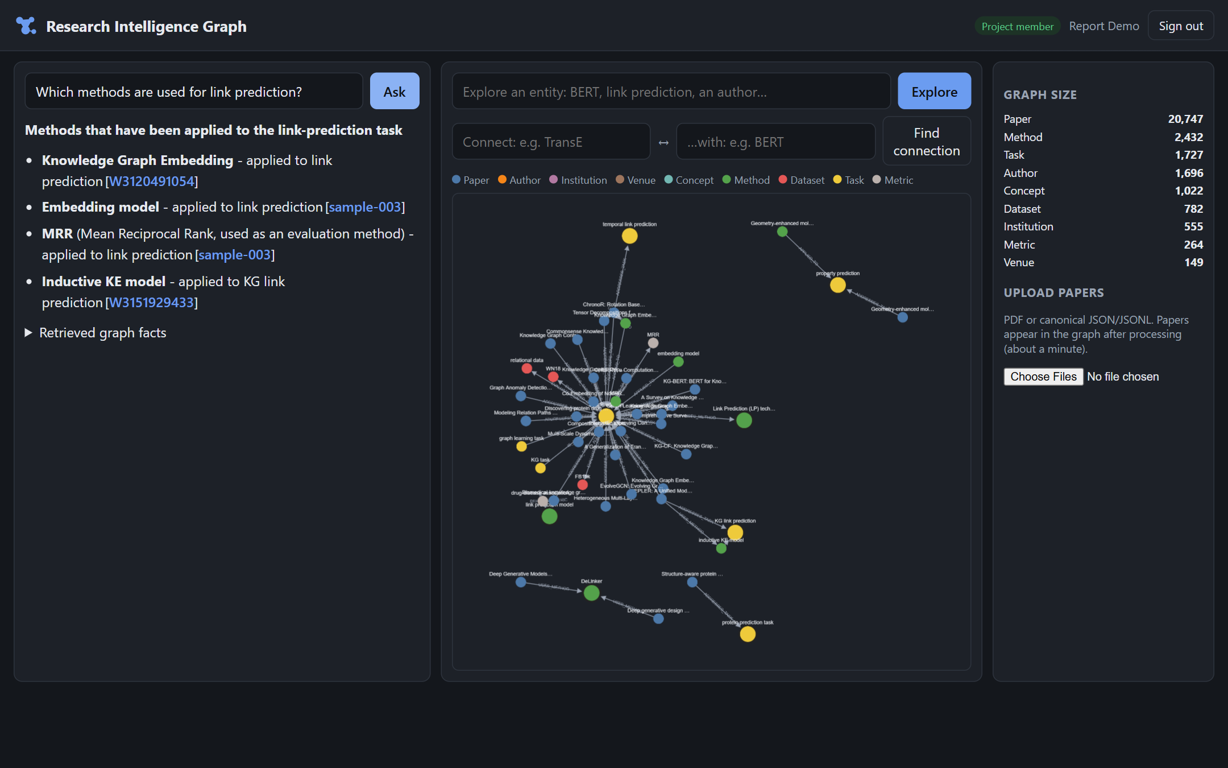
Dashboard: Ask
Question typed in plain English
Short answer; each line cites its source paper
Centre: the graph of retrieved facts
Right: live graph size and member upload
Notes:
Live demo point: ask which methods are used for link prediction and click a citation.

Slide 20
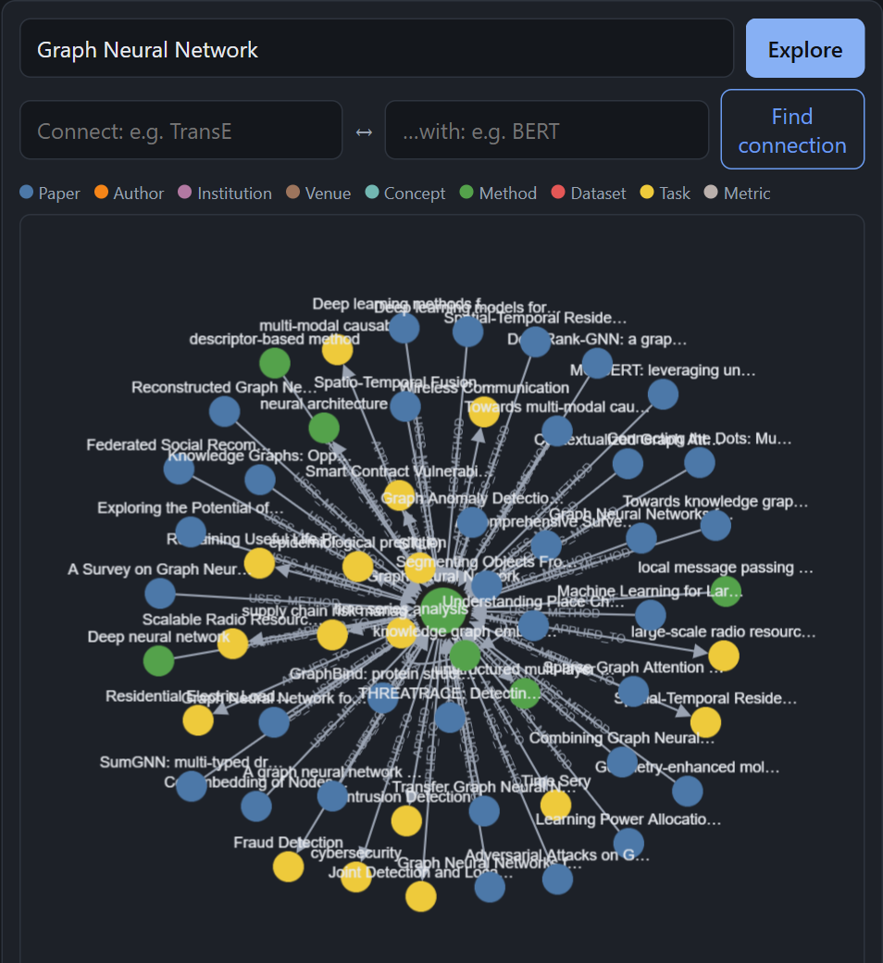
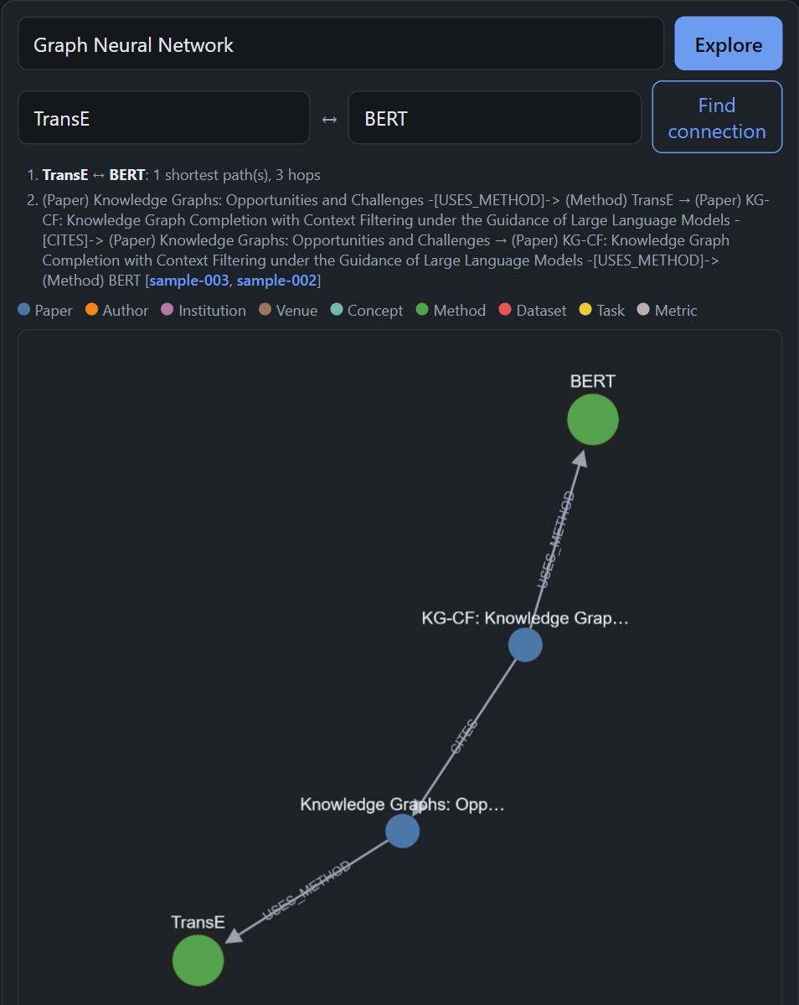
Dashboard: Explore and Connect
Explore: everything connected to an entity
Connect: shortest chain between two entities, e.g. TransE to BERT in 3 hops
Research 360: papers per year, collaborators, related methods
Notes:
Connect shows multi-hop discovery: a survey uses TransE, KG-CF cites that survey, and KG-CF uses BERT. Keyword search cannot find links like this.

Slide 21
Security and reliability
Authentication: Cognito sign-up with e-mail verification; every private API call needs a valid JWT.
Least privilege: each Lambda has its own IAM role, limited to one S3 prefix and one SageMaker endpoint.
Data protection: S3 encryption, public access blocked, short-lived presigned upload URLs; secrets never in Git.
Fault handling: retries, an SQS dead-letter queue (14 days), back-off on throttling, LLM failover.
Monitoring: CloudWatch dashboard, Logs Insights queries, two alarms e-mailed through SNS, X-Ray traces.
Notes:
Only signed-in users reach the API and only members can upload. Every failure is either retried, kept for later, or answered from cited facts.

Slide 22
Testing and performance
Test | Result
End-to-end test on the live system (sign-in, all routes, upload to graph) | 13 / 13 checks pass
Unit tests | 33 passing
Request without login | Rejected (401)
Graph retrieval latency | 0.535 s average
API server errors | 0 in 240 requests
Dashboard page load / accessibility scan | 0.24-0.66 s / 0 violations
Testing also found defects we fixed: repeated paths in Connect, duplicate nodes from parallel writes, placeholder sample data and a contrast issue.
Notes:
The end-to-end test creates a temporary user, calls every route, uploads a paper and follows it into the graph, then deletes the user.

Slide 23
Cost
Actual cost: $0 charged on the AWS Free plan.
Lambda, API Gateway, S3, Cognito, CloudWatch and Amplify stayed within the free tier.
SageMaker serverless inference used a few cents of credits; it costs nothing when idle.
Neo4j AuraDB Free, Groq and Gemini free tiers cost nothing.
Full AWS design (estimate) | USD / month
Neptune Analytics, 8 h/day | ~85
SageMaker, 2,000 papers | ~3
Bedrock, 1,000 questions | < 1
Other services | 0-2
Total | ~90
Notes:
Serverless means we pay only for use. On the full AWS design, the Neptune graph is the main cost because it bills per hour.

Slide 24
Challenges and solutions
Challenge | Solution
AWS Free plan blocks Neptune and Bedrock | Graph and LLM made deployment parameters; Neo4j AuraDB and Groq/Gemini with the same queries
SageMaker training quota is 0 | Trained SciBERT on a laptop CPU, served on a SageMaker serverless endpoint
Throttling during bulk ingestion | Endpoint concurrency 10 and exponential back-off; 12 parallel Lambdas, 0 failures
Slow multi-hop retrieval (about 6 s) | 27 parallel queries instead of 44 sequential: 0.535 s
Duplicate nodes and repeated paths | Uniqueness constraints and de-duplicated Connect results
Notes:
The biggest constraint was the AWS Free plan. Instead of dropping the AWS design, we made the graph and LLM provider configurable.

Slide 25
Team contributions
Member | Area | Main contributions
Dhruv Gupta 23BIT0350 | Knowledge graph and GraphRAG | Graph ontology and schema, multi-hop retrieval and ranking, grounded LLM layer, GraphRAG benchmarks, literature survey lead
Parth Sharma 23BIT0211 | Dashboard, API and AWS | Dashboard and API Lambda, SAM template, Cognito, IAM, CloudWatch, Amplify, end-to-end and UI/UX testing
Devesh Agarwal 23BIT0201 | Data and NLP extraction | OpenAlex and S2ORC pipelines, S3 data lake and ingest Lambda, SciBERT NER and RE models, SageMaker deployment
Shared: system architecture, integration testing, code reviews and the final report.
Notes:
Work was split equally by layer, and each member analysed five of the fifteen papers.

Slide 26
Conclusion and future work
Conclusion
Future work
Built a working, serverless system on AWS that turns papers into a knowledge graph
Answers questions with citations and 0% hallucination on our benchmark
All six objectives met on the deployed system, at $0
Run on Neptune Analytics and Bedrock and compare latency and cost
Ingest larger OpenAlex and S2ORC slices; OCR for scanned PDFs
GPU training and end-to-end relation evaluation
Secrets Manager, MFA and API rate limiting
User study with open-ended expert questions
Notes:
The system works end to end and its answers can be checked. Next steps are mostly about scale and the paid AWS services.

Slide 27
Thank you
Questions and live demo
Dashboard: https://main.d1gnkprv2sjfmv.amplifyapp.com
Repository: github.com/DeveshAg30/Cloud_Based_Knowledge_Graph_Framework_for_Automated_Research_Intelligence_Aws_Project_2026
Notes:
Before a live demo, resume the Neo4j AuraDB instance if it has paused and ask one question to warm up the functions.

