Slide 1

Shri Shankaracharya Technical Campus ,Bhilai
A
PROJECT PRESENTATION
ON
FULL STACK DEVELOPMENT
Submitted To
Prof.R.K Khare
Presented By
Devesh Gautam,Abhijeet Singh, C.Krishnaveni, B.V Himanshu
B.Tech CSE-D

Slide 2

Full Stack Web Development (Natours)
Devesh Gautam
C krishnaveni
Abhijeet singh
B v himanshu rao
Sem:8th sec: d
Roll: 303602219057, 303602219005, 303602219050, 303602219049

Slide 3
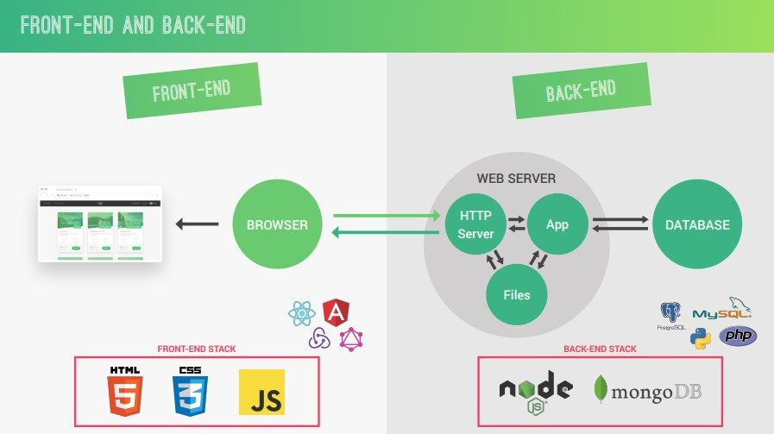

Slide 4
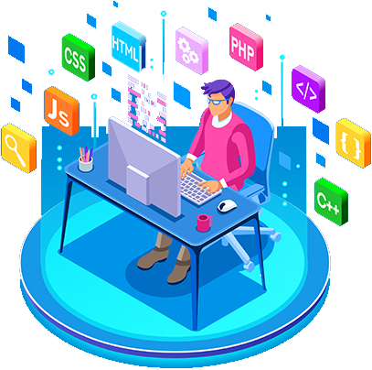
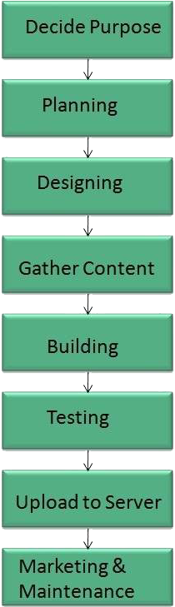
Process of Web Development
Decide Purpose
Planning
Designing
Gather Content
Building
Testing
Upload to Server
Marketing & Maintenance

Slide 5
Hardware Requirements
The hardware requirements for are:
Processor: Intel Core i3 (2nd generation) higher (or AMD equivalent).
Memory: 4 GB RAM DDR3
Display: Monitor
Network: Internet Connection

Slide 6
Software Requirements
The software requirements are:
Operating System : Microsoft Windows 7(or higher) or Mac OSX
Web Browser : Any Browser

Slide 7
Methodology
Model-View-Controller (MVC) architecture
MVC is an acronym for Model-View-Controller. It is a design pattern for software projects. It is used majorly by Node developers and by C#, Ruby, PHP framework users too. In MVC pattern, application and its development are divided into three interconnected parts. The advantage of this is it helps in focusing on a specific part of the application name, the ways information is presented to and accepted from, the user. It helps in allowing for efficient code reuse and the parallel development of the application.

Slide 8
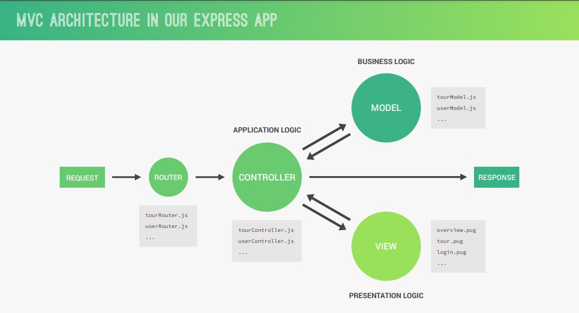

Slide 9
Technologies
used

Slide 10
Technology
01. MongoDB
02. Express.js
MongoDB serves as a database for the whole web App.
Express, is a back end web application framework for building RESTful APIs with Node.js.
03. PugJs
04. Node.js
05. Mongoose
Pug is a high-performance template engine heavily influenced by Haml and implemented with JavaScript for Node.js and browsers.
Node.js is an open source server environment. Node.js allows you to run JavaScript on the server.
Mongoose provides a straight-forward, schema-based solution to model your application data

Slide 11
Project Natours
Join with Nature with us

Slide 12
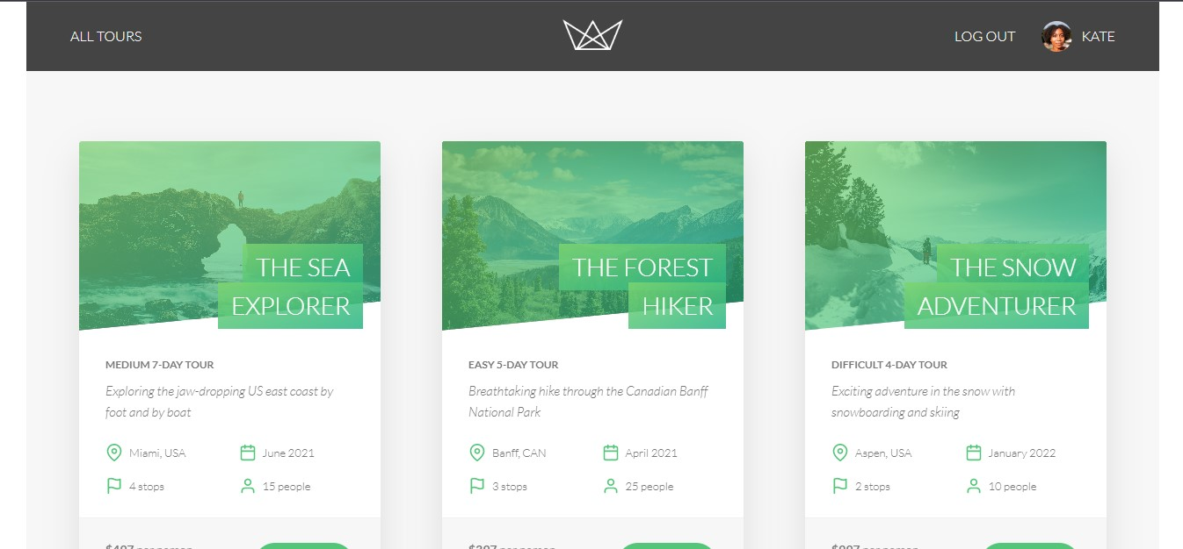
Project Description
This NodeJs application is Constructed with the help of a few frameworks like Express, Mongoose, and other dependencies. For the database we have MongoDB.
API follows The Representational State Transfer (REST) architectural style. The whole Back-End follows The Model-View-Controller(MVC) an architectural pattern.
12
Project Description
June 6, 2023

Slide 13
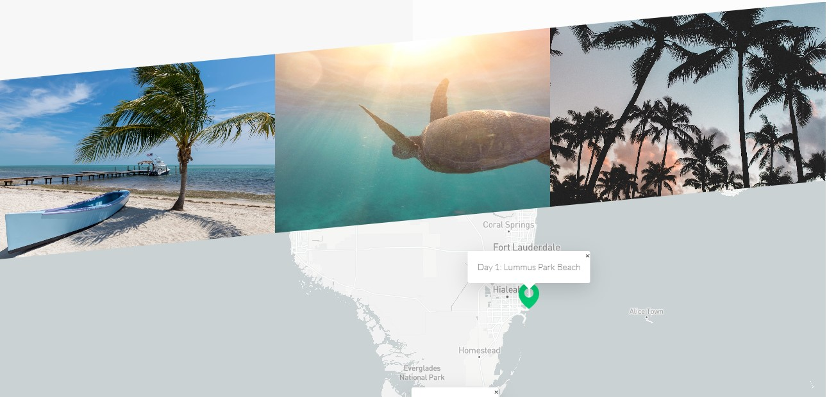
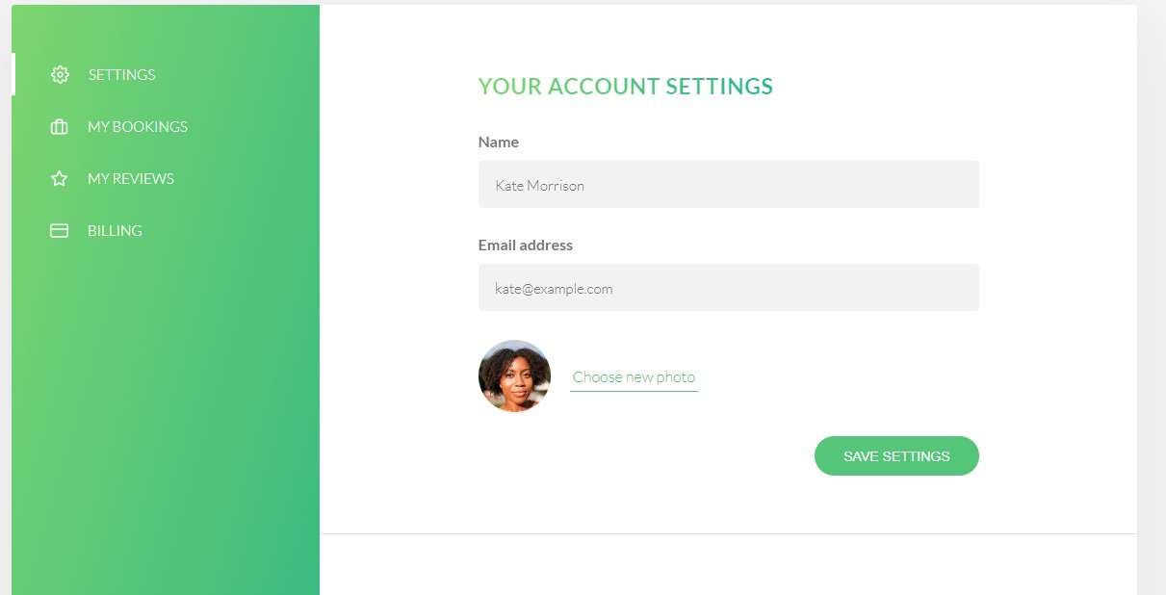
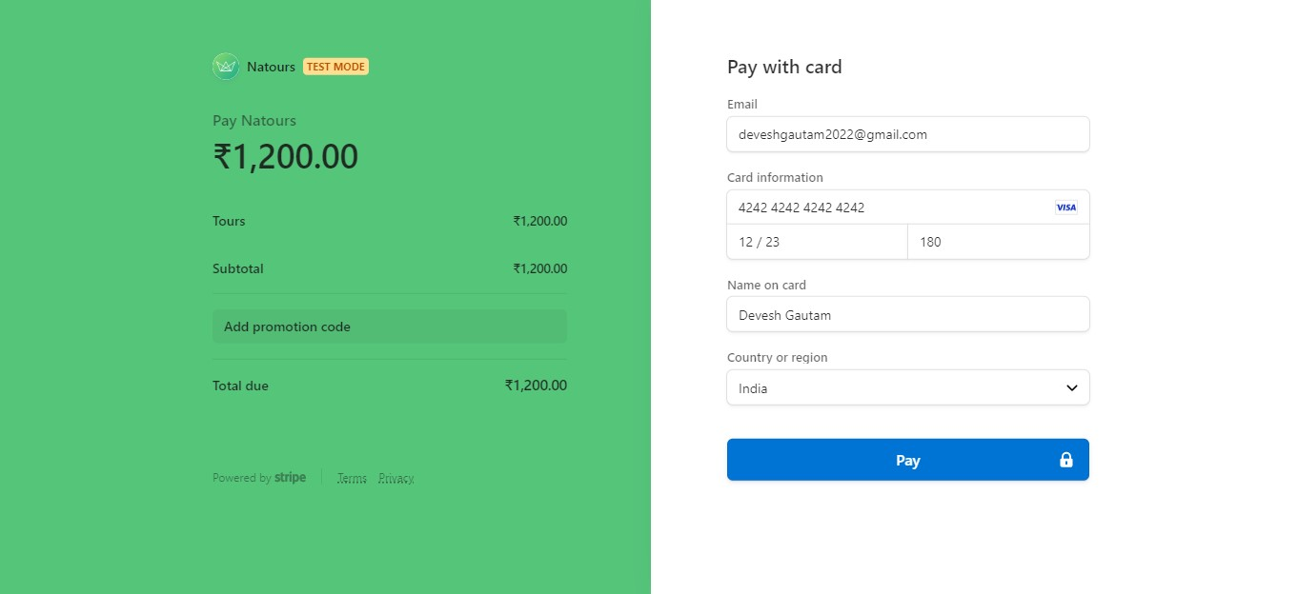
Project Snippet.

Slide 14
Conclusion And Scope for Future
Taking the business supervision online.
Expanding Reach.
Easy Maintenance.
Cross Platform App
Cloud Enabled
Query resolution

Slide 15
Thank you

