Slide 1
PHENYLPROPANOIDS

Slide 2
Definition: Phenylpropanoids represent a large group of natural products containing a phenyl ring attached to a three-carbon propane side chain(C₆-C₃) in their structure.
It represent a naturally occurring phenolic compounds essentially derived from the aromatic amino acids phenylalanine and tyrosine or in a certain specific instances the intermediate obtained from Shikimic acid biosynthesis pathway.
These compounds comprise of a phenyl ring to which is attached a 3C-side chain; and may also contain one or more C6-C3 residues.
The unique combination of the phenylpropane side chain(ie 3C-atom)evidently present in ‘Phenylpropanoids’ are absolutely devoid of nitrogen atom.
eg. Alkaloids, cyanogenetic glycosides, glucosinolates.

Slide 3
The phenylpropanoids are distinctly phenolic in character by virtue of the presence of one or several hydroxyl groups attached to the aromatic ring (C6-C6),they are more often known among the phytochemists as ‘plant phenolic’.
Biosynthesis: Derived from the aromatic amino acids phenylalanine and tyrosine or the intermediates of the shikimic acid biosynthetic pathway.
Categories: Simple Phenylpropanoids (phenylpropenes, phenylpropyl alcohols, phenylpropionaldehydes, phenylpropionic acids)

Slide 4
Classification
It may be classified on the basis of their basic chemical moieties
Hydroxycinnamic acid
Phenylpropenes
Coumarins
Abridged phenylpropanoids
Biphenylpropenoid derivatives
High molecular weight phenylpropanoids

Slide 5
Simple phenylpropanoids
Phenylpropenes
phenylpropyl alcohols
Phenylpropionaldehydes

Slide 6
Phenylpropanoid synthesis
Shikimic Acid Pathway

Slide 7
Shikimic Acid Pathway

Slide 8
Shikimic Acid Pathway

Slide 9
Shikimic Acid Pathway

Slide 10
Shikimic Acid Pathway

Slide 11
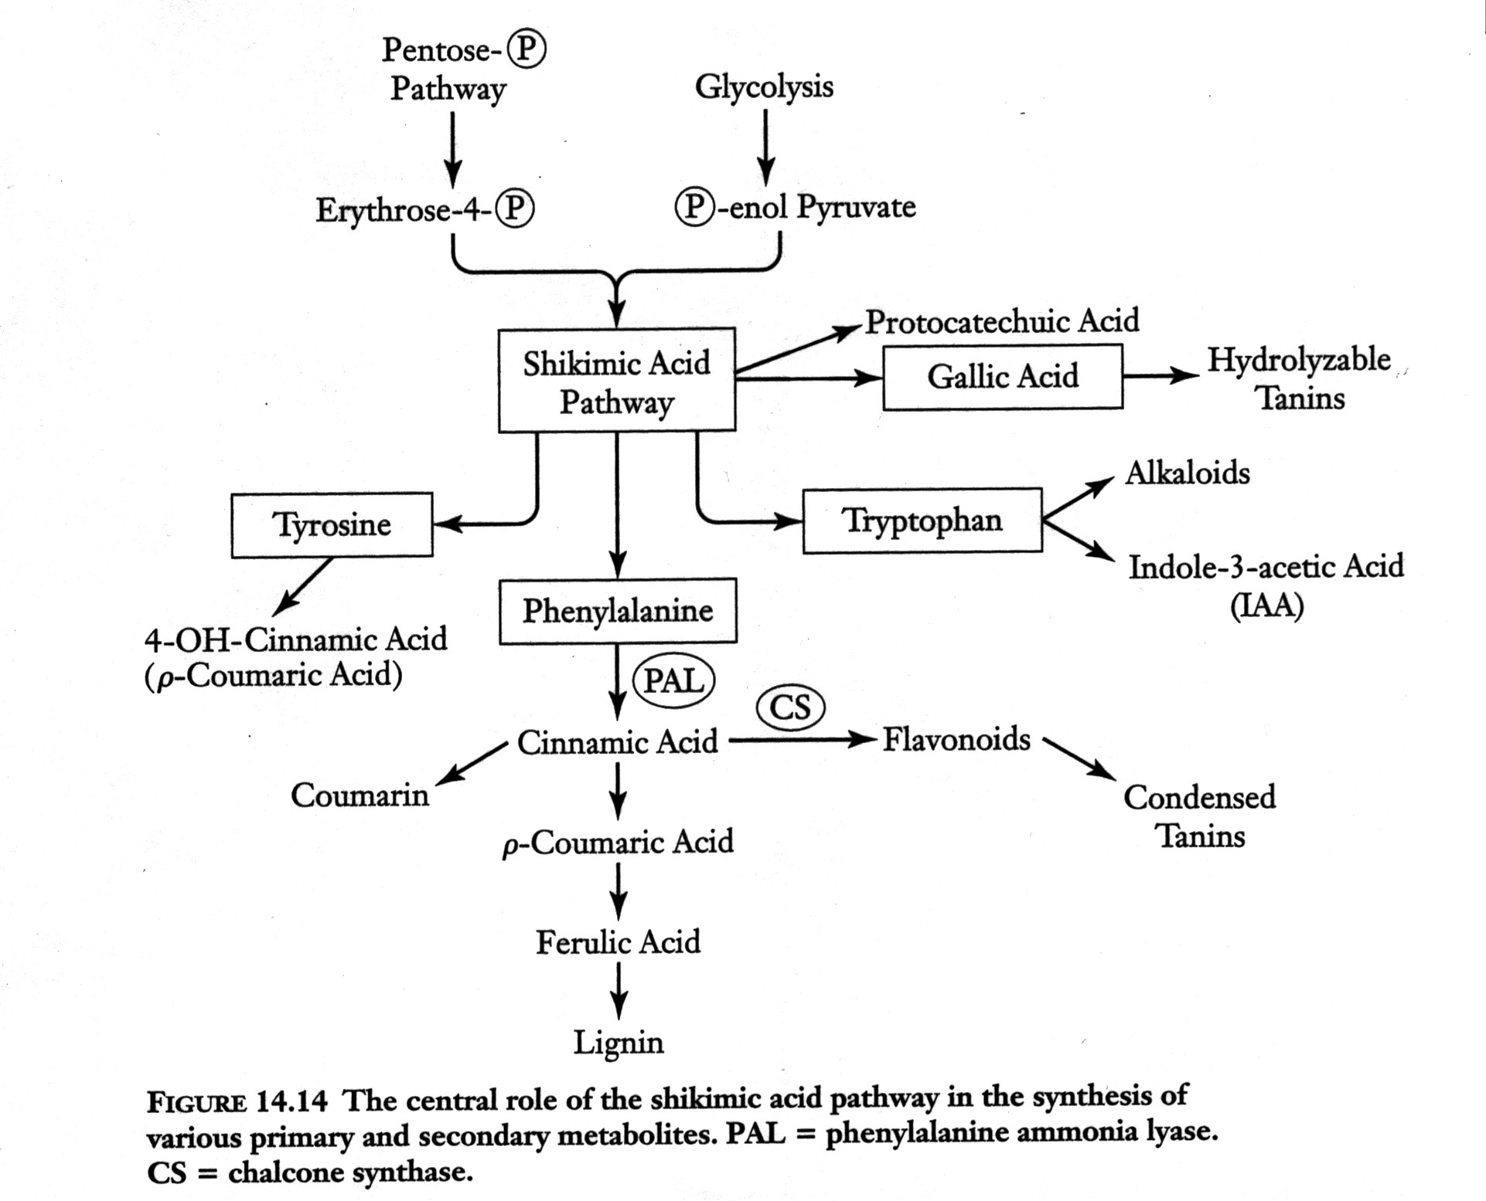

Slide 12
Phenylpropanoids:
Flavonoids – water soluble plant pigments
Anthocyanidins – improve microcirculation & nightvision
Coumarins - Anticoagulants
Lignans – Anti-cancer drugs
Tannins – in green tea, red raspberry & witch hazel

Slide 13
Coumarins-Structure and Classification:
Coumarins are lactones which are derived from p-hydroxycinnamic acids which undergo ortho hydroxylation then ring closure between the ortho hydroxyl group and the carboxylic group of the side chain, after a trans to cis isomerization of the side chain double bond.
Coumarins are widely distributed in higher plants, and commonly found in families such as the Umbelliferae (Apiaceae) and Rutaceae, both in the free form and as glycosides.

Slide 14
Coumarins:

Slide 15
Lignins
Most abundant natural aromatic organic polymers found in virtually all vascular plants.
Lignins together with cellulose and hemicellulose are the major cell wall components of the fibres of all wood and grass species in the plant kingdom.
Lignins are the sequestered in the secondary layer of the cell wall in close association with the cellulose matrix where in the phenolic hydroxyl moieties present in the lignins may be either hydrogen bonded or covalently bonded to hemicellulose.
It considered to be a sole factor for strengthening of the cell wall and consequently for its synthesis.
Also regarded as a decisive factor in the process of evolution

Slide 16
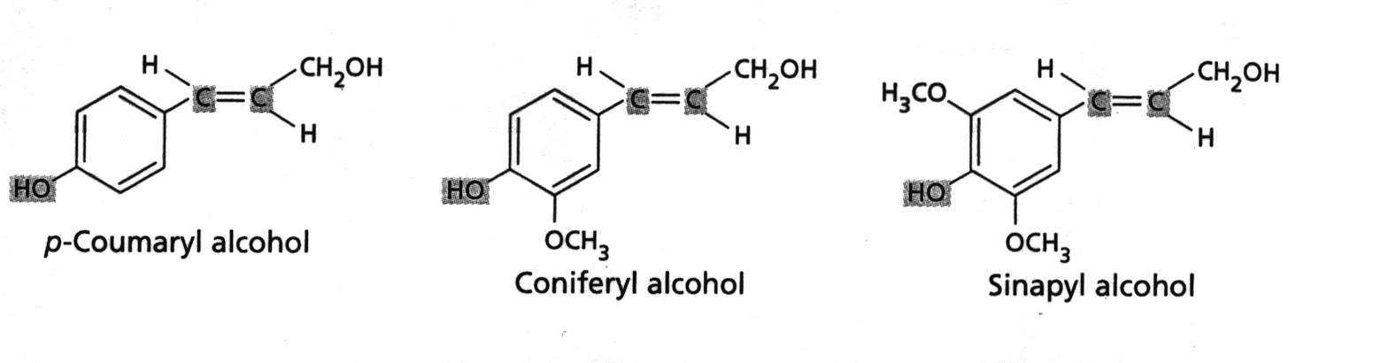
Lignin monomers
Polymer of three phenolic alochols
Different species have different ratios of these monomers
Lignin in beech has 100:70:7 of coniferyl: sinapyl: para-coumaryl

Slide 17
Composition-it usually composed of coniferyl, p-comaryl and sinapyl alcohols in varying proportion in a variety of plant species.
Uses
Use as a source of vanillin, syringic aldehyde and dimethyl sulphoxide.
Also employed as an extender for phenolic plastics.
Used to strengthen rubber for shoe soles.
Use an oil mud additive.
Use as a stabilizer for asphalt emulsions.
Employed to precipitate protein.

Slide 18
Lignin a complex phenolic
Primary metabolite - secondary cell wall component occurs in all vascular plants
Structural function
Also protective because deters herbivores due to its toughness
Blocks growth of many pathogens because only small group of fungi can degrade

Slide 19
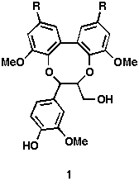
Shikimic Acid Lignins
A synthetic Lignan

Slide 20
LIGNANS
The product with lower molecular weight that are accomplished by the oxidative coupling of para-hydroxyphenylpropene units where in two units may be linked by an oxygen bridge
Lignans are typically found as dimeric phenylpropanoids derivatives and are found in woody tissues and resin of plants.
Most of lignans are free form, seldom as glycoside.
They have antitumor, antiviral, liver protective, etc. activities.
The two phenylpropanoid units mostly linked through the β-C atom of the C₃ side chains.
The terminology lignin or precisely Haworth lignin is generally applied to such compounds that are derived by coupling acid and / or alcohol exclusively; where as the compounds which are derived by coupling propenyl and/or allyl derivatives are known as Neolignans.

Slide 21
Biological source- it occurs widely and have been obtained from roots, heart wood, foliage, fruit and resinous exudates of plants.
They represent the dimer stage intermediate between the monomeric propyl phenol units and lignin.
α- lignin has been found in the roots and rhizomes of Podophyllum hexandrum Royle.
Lignans are formed by the reduction of ferulic acid to coniferyl alcohol as its first step and foremost step the oxidative dimerization of the coniferyl alcohol units and the establishment of linkage through the β-carbon atom of the C3 side chain.
eg. Etoposide, Teriposide.

Slide 22
Structure and Classification
Classification:
Simple Lignans
Monoepoxylignans
Lignanolides
Cyclolignans
Lignans
Cyclolignolides
Bisepoxylignans
Dibenzocyclooctene lignans
Biphenylene lignans
Other lignans

Slide 23
Flavonoids
One of the largest classes of phenolic
Carbon skeleton has 15 carbons with two benzene rings connected by a 3-C bridge
-C₃-

Slide 24
Flavonoids
Many have antimicrobial activity
anti-bacterial, anti-fungal, and anti-viral
Flavonoids in red wine responsible for the “French Paradox” - lower risk of heart attacks by inhibiting platelet aggregation and blood clots

Slide 25
Flavonoids
Flavonoids classified into different groups based on the degree of oxidation of the 3-C bridge
Anthocyanins
Flavones
Flavonols
Isoflavones
Majority of flavonoids exist as glycosides

Slide 26
Flavonoid Structure

Slide 27
Shikimic Acid Flavones

Slide 28
Flavones and Flavonols
Also flower pigments
Absorb UV not visible light - not visible to human eye but visible to many insects - maybe be attractants, nectar guides
Also present in leaves where they protect against UV-B damage
Appeared to be involved in legume roots in attracting N-fixing bacteria

Slide 29
Isoflavonoids
Some have strong insecticidal activity - rotenoids
Some have estrogenic/anti-estrogenic activity and cause infertility in mammals
Many are phytoalexins - antimicrobial compounds produced in response to bacteria and fungi

Slide 30
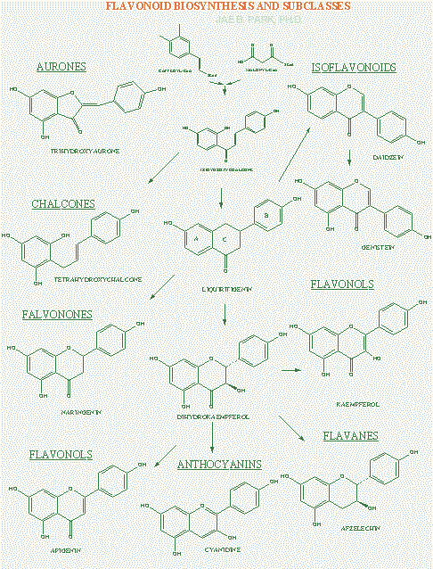

Slide 31
Flavonoid Facts
Flavonoids are found in higher vascular plants, particularly in the flower, leaves and bark. They are especially abundant in fruits, grains and nuts, particularly in the skins.
Beverages consisting of plant extracts (beer, tea, wine, fruit juice) are the principle source of dietary flavonoid intake. A glass of red wine has ~200 mg of flavonoids.
Typical flavonoid intake ranges from 50 to 800 mg/day, which is roughly 5, 50 and 100 times that of Vitamins C, and E, and carotenoids respectively.

Slide 32
What are flavonoids?
Flavonoids are the most abundant polyphenols in human diet, representing about 2/3 of all those ones ingested. Like other phytochemicals, they are the products of secondary metabolism of plants and, currently, it is not possible to determine precisely their number, even if over 4000 have been identified. In fruits and vegetables, they are usually found in the form of glycosides and sometimes as acylglycosides, while acylated, methylated and sulfate molecules are less frequent and in lower concentrations. They are water-soluble and accumulate in cell vacuoles.

Slide 33
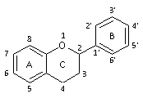
Chemical structure of flavonoids
Their basic structure is a skeleton of diphenylpropane, namely, two benzene rings (ring A and B, see figure) linked by a three carbon chain that forms a closed pyran ring (heterocyclic ring containing oxygen, the C ring) with benzenic A ring. Therefore, their structure is also referred to as C6-C3-C6. In most cases, B ring is attached to position 2 of C ring, but it can also bind in position 3 or 4; this, together with the structural features of the ring B and the patterns of glycosylation and hydroxylation of the three rings, makes the flavonoids one of the larger and more diversified groups of phytochemicals, so not only of polyphenols, in nature. Their biological activities, for example they are potent antioxidants, depend both on the structural characteristics and the pattern of glycosylation

Slide 34
They can be subdivided into different subgroups depending on the carbon of the C ring on which B ring is attached, and the degree of unsaturation and oxidation of the C ring. Flavonoids in which B ring is linked in position 3 of the ring C are called isoflavones; those in which B ring is linked in position 4, neoflavonoids, while those in which the B ring is linked in position 2 can be further subdivided into several subgroups on the basis of the structural features of the C ring. These subgroup are: flavones, flavonols, flavanones, flavanonols, flavanols or catechins and anthocyanins. Finally, flavonoids with open C ring are called chalcones.

Slide 35
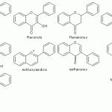
Classification of flavonoids

Slide 36
Flavones
They have a double bond between positions 2 and 3 and a ketone in position 4 of the C ring. Most flavones of vegetables and fruits has a hydroxyl group in position 5 of the A ring, while the hydroxylation in other positions, for the most part in position 7 of the A ring or 3′ and 4′ of the B ring may vary according to the taxonomic classification of the particular vegetable or fruit. Glycosylation occurs primarily on position 5 and 7, methylation and acylation on the hydroxyl groups of the B ring. Some flavones, such as nobiletin and tangeretin, are polymethoxylated.

Slide 37
Flavonols
Compared to flavones, they have a hydroxyl group in position 3 of the C ring, which may also be glycosylated. Again, like flavones, flavonols are very diverse in methylation and hydroxylation patterns as well, and, considering the different glycosylation patterns, they are perhaps the most common and largest subgroup of flavonoids in fruits and vegetables. For example, quercetin is present in many plant foods.

Slide 38
Flavanones
Flavanones, also called dihydroflavones, have the C ring saturated; therefore, unlike flavones, the double bond between positions 2 and 3 is saturated and this is the only structural difference between the two subgroups of flavonoids. The flavanones can be multi-hydroxylated, and several hydroxyl groups can be glycosylated and/or methylated. Some have unique patterns of substitution, for example, furanoflavanones, prenylated flavanones, pyranoflavanones or benzylated flavanones, giving a great number of substituted derivatives. Over the past 15 years, the number of flavanones discovered is significantly increased.

Slide 39
Flavanonols
Flavanonols, also called dihydroflavonols, are the 3-hydroxy derivatives of flavanones; they are an highly diversified and multisubstituted subgroup.
Isoflavones As anticipated, isoflavones are a subgroup of flavonoids in which the B ring is attached to position 3 of the C ring. They have structural similarities to estrogens, such as estradiol, and for this reason they are also called phytoestrogens.
Neoflavonoids They have the B ring attached to position 4 of the C ring.

Slide 40
Flavanols or flavan-3-ols or catechins Flavanols are also referred to flavan-3-ols as the hydroxyl group is almost always bound to position 3 of C ring; they are called catechins as well. Unlike many flavonoids, there is no double bond between positions 2 and 3. Another distinctive features, e.g. compared to flavanonols, with which they share a hydroxyl group in position 3, is the lack of a carbonyl group, that is, a keto group, in position 4. This particular chemical structure allows flavanols to have two chiral centers in the molecule, on positions 2 and 3, then four possible diastereoisomers. Epicatechin is the isomer with the cis configuration and catechin is the one with the trans configuration. Each of these configurations has two stereoisomers, namely, (+)-epicatechin and (-)-epicatechin, (+)-catechin and (-)-catechin. (+)-Catechin and (-)-epicatechin are the two isomers most often present in edible plants. Another important feature of flavanols, particularly of catechin and epicatechin, is the ability to form polymers, called proanthocyanidins or condensed tannins. The name “proanthocyanidins” is due to the fact that an acid-catalyzed cleavage produces anthocyanidins. Proanthocyanidins typically contain 2 to 60 monomers of flavanols. Monomeric and oligomeric flavanols (containing 2 to 7 monomers) are strong antioxidants.

Slide 41
Anthocyanidins Chemically, anthocyanidins are generally present as chloride salts. They are the only group of flavonoids that gives plants colours (all other flavonoids are colourless). Anthocyanins are glycosides of anthocyanidins. Sugar units are bound mostly to position 3 of the C ring and they are often conjugated with phenolic acids, such as ferulic acid. The color of the anthocyanins depends on the pH and also by methylation or acylation at the hydroxyl groups on the A and B rings.
Chalcones Chalcones and dihydrochalcones are flavonoids with open structure; they are classified as flavonoids because they have similar synthetic pathways.

Slide 42
Orange peel
Synonym-Citrus vulgaris,Citrus bigaradia,citrus aurantium
Biological source-The orange peel is the fresh or dried outer part of Citrus aurantium Linn.
Family-Rutaceae.
Phytoconstituents-Contains1-2.5% of volatile oil,principal component of volatile oil is 90% limonene,small amount of aldehydes citral,citronellal,hespiridine,isohespiridine,Vit C and pectin.
uses-
-Aromatic ,stomachic, carminative and flavouring agent.
-used in fish liver oil preparations and liver extract

Slide 43
Garcinia
Synonym-Kokum, Goa butter, mangosteen oil
Biological source- kokum is the fat obtained by expression from the seeds of Garcinia indica.
Family-Guttiferae.
Phytoconstituents-Contains 30% of fat. It consist of glyceride of stearic acid ( 55% ),oleic acids (40%),palmitic acid (2.5%),hydroxyl capric acid (10%)and linoleic acid (1.5%)
uses-
-Nutritive, demulcent, astringent, emollient.
-used as base in ointment,suppository,creams,lotions and make up foundation.

Slide 44
Liquorice
Synonym-Radix glycyrrhizae,sweet liquorice.
Biological source- It consist of peeled and unpeeled root and stolons of Glycyrrhiza glabra.
Family-Leguminosae.
Phytoconstituents-10% triterpenoidal saponins (sweet) “Glycyrrhizin”.K &Ca salts of glycyrrhizic acid with 2 molecules of D-glucuronic acid, flavonoids, bitter sub.
uses-
1) Flavoring agent, sweetener in Pharmaceutical preparation.
2) Demulcent and expectorant.
3) Treatment of peptic ulcer, and gastritis
4) Treatment of Rheumatoid arthritis and Inflammatory conditions as it has cortisone like action, even hemorrhoids.
5) Treatment of liver diseases and hepatoprotective, antiviral.

Slide 45
Soya bean
Synonym-large bean,yellow bean.miracle bean,golden bean,soja,soy.
Biological source- It consist of dried seeds of Glycine max L. (Merill).
Family-Fabaceae.
Phytoconstituents-protein and soybean oil content account for 56% of dry soybeans by weight (36% protein and 20% fat). The remainder consists of 30% carbohydrates, 9% water and 5% ash. Soybeans comprise approximately 8% seed coat or hull, 90% cotyledons and 2% hypocotyl axis or germ
uses-
1)

Slide 46
Buckwheat
Synonym-Beech tree, beech wheat.
Biological source- It consist of dried seeds of Fagopyrum esculentum
Family-Polygonaceae.
Phytoconstituents-Starch is 25% amylose and 75% amylopectin, Crude protein is 18%, Rich in iron (60–100 ppm), zinc (20–30 ppm) and selenium (20–50 ppb),[.
uses-
1use in foods to reduce plasma cholesterol, body fat, and cholesterol gallstones.
2 to treat high blood pressure
3 helpful in the management of diabetes
4 Is effective for treating dysentery and chronic diarrhea

Slide 47
Cranberry
Synonym-Cranberry, American cranberry, arandano Americano, arandano rtepador, grosse moosbeere, kranbeere, tsuru-kokemomo, vaccinium
Biological source- It consist of dried berris of Vaccinium macrocarpon Aiton.
Family-Ericaceae.
Phytoconstituents-
uses-
1) used as a traditional medicine for the treatment of bladder and kidney ailments
2) used as a fabric and food dye, and as a poultice to treat wounds and blood poisoning..
3) to reduce fever
4) Treatment of Rheumatoid arthritis and Inflammatory conditions as it has cortisone like action, even hemorrhoids.
5) Treatment of liver diseases and hepatoprotective, antiviral.

Slide 48
AMMI
Synonym-Ammi
Biological source-It consist of fruits of Ammi majus.
Family-Umbelliferae.
Phytoconstituents-Contains Xanthotoxin, Bergapten, isopimplin
Traditional uses-
-Increase the formation of melanin pigments in the skin.
-in the treatment of idiopathic vitiligo.

Slide 49
Psoralea(Bavchi)
Synonym-Hogweed, punarnava, ghetuli.
Biological source-It consist of dried ripe fruits of the plant known as Psoralea caryofolia.
Family-Leguminosae.
Phytoconstituents-Contains essential oil, resin, raffinose, coumarin, psoralen, isopsoralin, psoralidin and corylifolins.
Traditional uses-
-in treatment of leukoderma, leprosy, psoriasis, diuretic, anthelmintic, laxative.

Slide 50
Phyllanthus
Synonym-
Biological source-It consist of whole herb or aerial tenders Phylanthus amarus.
Family-Euphorbiaceae.
Phytoconstituents-
Traditional uses-
-in treatment of Hepatoprotective.
-In treatment of hepatitis B.
- Also used as liver tonic, hypoglycemic and antihypertensive.

Slide 51
Podophyllum
Synonym-Indian podophyllum, podophyllum radix, Himalayan May apple
Biological source-It consist of dried rhizomes and roots of Podophyllum hexandrum.
Family-Berberidaceae.
Phytoconstituents-Contains podophyllin, podophyllotaoxin, quercetin, kaempferol, essential oil, etoposide.
Traditional uses-
-Cytotoxic action.
-purgative.
- Also used as bile tonic.

