Slide 1
RESINS
All resins are practically insoluble in water.
These dissolve more or less completely in organic solvents, e.g. alcohol, oil of turpentine; those containing resin acids are usually proportionately soluble in alkalis.
A solution of a resin in a volatile solvent, when painted on a smooth surface should rapidly and completely dry to form a hard transparent film; to be suitable for varnish the film should not darken with age or become impaired upon exposure to light or moisture.

Slide 2
Formation of Resins
In many instances resin in plants is formed in special passages or tubes called resin ducts, which usually anastomose: thus a single incision may drain the resin from a considerable area of the plant.
The cells lining the duct possess a layer (called the resinogenous layer) of slimy matter bounded by a fine cuticle and, resin is secreted in this layer and excreted through the cuticle into the resin duct.

Slide 3
In some cases, e.g. copaiba, numerous resin ducts are present and although tapping is necessary to drain the ducts, the wound per se is in no way responsible for the production of the resin, which is thus termed a normal or physiologically- produced resin.
In other instances, e.g. turpentine, only a few resin ducts are normally present, but following injury to the cambium the new (secondary) wood subsequently formed contains a very large number of ducts, and the resin from these is called wound, traumatic, or pathologically-produced resin.

Slide 4
Resin may continue to flow for a considerable period from wounding, or in some cases it may be necessary to inflict wounds at frequent intervals.
Further, invasion of the wound by fungi and bacteria sometimes plays an important part in the composition of the resin exuded.
the simple wound resin of Styrax Benzoin differs materially from the resin exuded after fungal invasion of the wound.

Slide 5
Composition of Resins.
Resins are not single chemical compounds, but are usually mixtures of substances of different and complex chemical characters. The following are the three more important groups of compound present in resins;
Resin Esters These consist mostly of resin alcohols combined with aromatic acids, of which benzoic and cinnamic acids are of frequent occurrence; other aromatic acids are less frequently found, e.g. ferulic acid (in asafetida). There are two principal kinds of resin alcohols in combination with these acids.
(a) Resinols - These are colourless, and give a negative reaction when tested with iron salts. The resin in benzoin consists principally of the resinol, benzoresinol, combined with cinnamic and benzoic acids.

Slide 6
(b) Resinotannols –
These are phenolic compounds, and give blue, green or violet-coloured compounds with ferric chloride.
They are usually named from their source, e.g. the resinotannol in balsam of Tolu is called toluresinotannol, and it occurs combined with benzoic and cinnamic acids; that from Sumatra benzoin is called sumaresinotannol, and it is similarly combined.
Like other esters, the resin esters are saponified when boiled with alcoholic solution of potassium hydroxide, and the previously combined acid obtained as a water-soluble potassium salt.
From the latter the aromatic acid (practically insoluble in water) may be obtained by distillation of the reaction mixture (to remove the alcohol}, extraction of the residue with water , and acidification of the solution with a mineral acid, whereupon the aromatic acid is precipitated.

Slide 7
Composition of Resins.
2. Resin Acids.
These acids, also called resinolic acids, are of high molecular weight and very complex. They usually occur free, and preponderate in some resins, e.g. 90 per cent or more of colophony (American) consists of the resin acid called abietic acid.
3. Resenes.
The chemical nature of these compounds is unknown. They are very stable, being unaffected by most chemical reagents or by exposure to moisture and light-hence resins consisting principally of resenes yield good varnishes provided the film is hard and therefore resistant to mechanical injury. The resenes are usually named from their source, e.g. that of Sandarac is called Sandaracoresene. The resene containing resins are, of course, those chiefly used in the manufacture of varnishes. Sandarac is used in pharmacy for making pill varnish.

Slide 8
Occurrence in Plants
In the plants resins usually occur in different secretory zones or structures. A few typical examples of such plant sources along with their specific secretary structures are given below:
(i) Resin Cells : Ginger–Zingiber officinale (Zingiberaceae);
(ii) Schizogenous Ducts : Pine Wood–Pinus polustris Miller.
or Schizolysogenous Ducts or Cavities (Pinaceae)
(iii) Glandular Hairs : Cannabis–Cannabis sativa . (Moraceae)
in some exceptionally rare instances the resin occurs as a result of sucking the juice of the plant by scale insects and converting the sucked-juice into a resinous substance that ultimately covers the insect itself and twigs of the plant as well, - Laccifer lacca (Family: Coccidae)-Shellac.

Slide 9
Preparation of Resins
two categories of resinous products, namely:
(a) Natural Resins;
(b) PreparedResins,
Natural Resins:
usually formed as the exudates from various plants obtained either normally or as a result of pathogenic conditions (i.e., by causing artificial punctures), such as: mastic, sandarac.
obtained by causing deep incisions or cuts in the trunk of the plant, for instance: turpentine.
procured by hammering and scorching, such as: balsam of Peru.

Slide 10
Prepared Resins:
(i) The crude drug containing resins is powdered and extracted with ethanol several times till complete exhaustion takes place. The combined alcoholic extract is either, evaporated & poured slowly into cold distilled water.
The precipitated resin is collected, washed with cold water and dried carefully under shade or in a vacuum
Examples: Podophyllum; Scammony and Jalap.
(ii) In the case of alco-resins, organic solvents with lower boiling points are normally employed e.g., solvent ether (bp 37°C); acetone (bp 56.5°C), for their extraction. However, the volatile oil fraction can be removed conveniently through distillation under vacuo.
(iii) In the instance of gum-resins, the resin is aptly extracted with 95% (v/v) ethanol while leaving the insoluble gum residue in the flask (or soxhlet thimble).

Slide 11
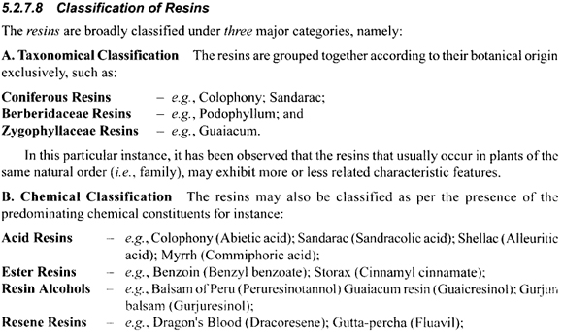

Slide 12
Resins consisting principally of Resin Acids.
Resin, Oleo-Resin or Gum-Resin and Resin Acids : Colophony, Copaiba, Myrrh .
Glyco-Resins.
This important and complex group comprises the glycosidal resins, which are so-called because when they are boiled with mineral acids hydrolysis takes place, with production of a sugar (usually dextrose) and a complex resin acid and simpler acids. Jalap resin and Ipomoea resin are examples of glyco-resins.

Slide 13
Balsams are the resinous mixtures that essentially contain large quantum of benoic acid, cinnamic acid or both, or esters of these organic aromatic acids.
Storax;
Peruvain Balsam;
Tolu Balsam;
Benzoin.

Slide 14
BENZOIN
Benzoin is a balsamic resin obtained from Styrax benzoin Dryander and other species of Styrax ( Styracece), and known in commerce as Sumatra Benzoin ( Styrax benzoin )and Siam Benzoin ( Styrax tonkinensis ).
Sumatra Benzoin yields not less than 75 per cent. of alcohol-soluble extractive and NMT 1 %. of acid-soluble ash.
Siam Benzoin yields not less than 90 per cent. of alcohol-soluble extractive, contains NMT 1 %. of foreign organic matter, and yields not more than 0.5 %. of acid-soluble ash.

Slide 15
BENZOIN
Styrax Benzoin, or Benjamin Tree, is a tall tree of quick growth, sending off many strong round branches, covered with a whitish downy bark.
The tree is a native of Sumatra, Java, Borneo, and other islands in the vicinity.
By wounding the bark near the origin of the lower branches, a juice exudes, which hardens upon exposure and forms the Sumatra Benzoin of Commerce.
The exudation is purely the result of pathological processes, the plant containing no resin receptacles.

Slide 16
BENZOIN
The trees, are wounded at six years, when the trunks are usually about seven or eight inches in diameter.
The operation is performed annually, and the product on each occasion from one tree never exceeds three pounds. The juice which first .flows is the purest, and affords the whitest and most fragrant benzoin.

Slide 17
COLLECTION & PREPARATION OF SUMATRA BENZOIN
Tapping
Further incisions are made at three months intervals – now the secretions are crystalline. About six months later the fresh tapping the product is scrapped off .
Second incision – 4 cm above after about a week hard secreations
First incision – sticky secretion – rejected

Slide 18
BENZOIN
Outer layer – finest quality ; Next Layer – intermediate quality; about a fortnight later the strip is scrapped again – lower quality –darker product.

Slide 19
SUMATRA BENZOIN
Brittle Mass with opaque whitish or reddish tears embedded in translucent reddish brown or greyish brown matrix.
Benzoin has a fragrant odor, with very little taste, but when chewed for some time leaves a sense of irritation in the mouth and fauces.
It breaks with a resinous fracture, and presents a mottled surface of white and brown or reddish-brown ; the white spots being smooth and shining, while the remainder, though sometimes shining and even translucent, is usually more or less rough and porous, and often exhibits impurities.
After long storage it becomes covered with a thin yellow transparent film which is due to oxidation of the resin.
In the inferior kinds the white spots are very few, or entirely wanting.

Slide 20
Constituents.
The chief constituents of benzoin are resin, benzoic and cinnamic acids and their esters. The resinous portion, which constitutes about three-fourths of the drug, is made up of esters of benzoresinol (siaresinol), constituting from 7 to 8 per cent. of the resin, and of an undetermined alcohol.
This latter has been stated to be sumaresinotannol. distinctive compound lubanyl benzoate. This occurs in crystalline masses melting at 72 C.

Slide 21
Constituents.
The total amount of free acids is from 15 to 17 per cent. In the Sumatra Benzoin cinnamic acid predominates, and in the Siam Benzoin benzoic acid is more abundant; Siam Benzoin contains no cinnamic acid
Other constituents include 9 or 10 % of esters of these acids, cinnamyl, cinnamate, phenylpropyl cinnamate, and traces of vanillin, benzaldehyde, styrol & styracin.

Slide 22
Chemical Tests
Benzoin on heating a small quantity with a little soda and water and warming the filtrate with potassium permanganate, when the odor of bitter almond will be developed.
The important analytical data to be considered in valuing benzoin are
the percentage soluble in 90 per cent. alcohol,
the quantity of aromatic acids present, both free and combined.

Slide 23
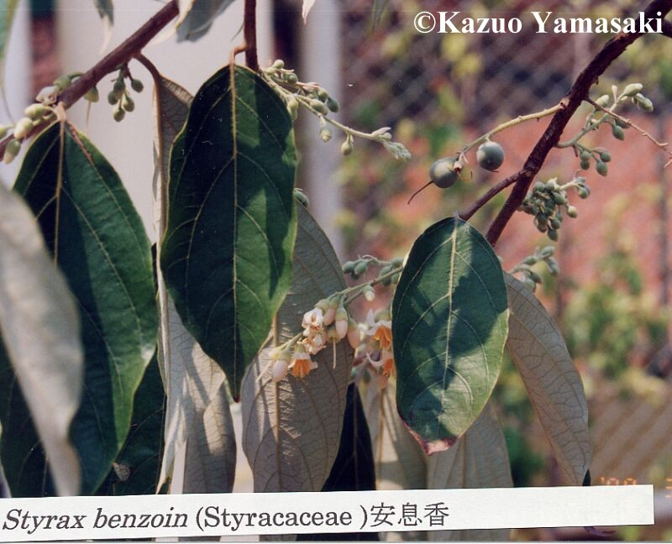
Styrax benzoin

Slide 24
TOLU BALSAM
Obtained from the trunk of Myroxylon balsamum ( Legiminosae ) ( Fabaceae )
Grow wild in Columbia &Venezuala , cultivated in Caribbean Islands.
Constituents
Benzoic acid – 6-8%, Cinnamic 10-15%, Benzyll benzoate, Mono and sesqueterpenoides
Uses – Antiseptic, Expectorant , combined with simple / Ipecac syrup.

Slide 25
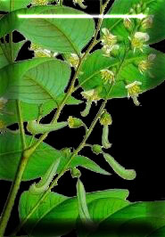
Balsam of Tolu
Myroxylon balsamum var, balsamum

Slide 26

Tolu balsam

Slide 27
PERU BALSAM
Obtained from the trunk of Myroxylon balsamum ( Legiminosae ) ( Fabaceae ) variety periera
Grow wild in Central America
Collection-
Trunk is beaten , stripped and in subsequent step scortched with torch to get the balsam. Exudation is soaked in rags followed by the extraction in boiling water. Insoluble balsam sinks to the bottom- decanted.
Constituents – Benzoic acid & Cinnamic acid 6-8%, Cinnamein 50-60%, vanillin , resinous fraction.
Green colour with FeCl₃ NLT 45 % &NMT 70% esters- Benzyl benzoate and Cinnamate

Slide 28
PERU BALSAM
Obtained from the trunk of Myroxylon balsamum ( Legiminosae ) ( Fabaceae ) variety periera
Grow wild in Central America
Collection-
Trunk is beaten , stripped and in subsequent step scortched with torch to get the balsam. Exudation is soaked in rags followed by the extraction in boiling water. Insoluble balsam sinks to the bottom- decanted.
Constituents – Benzoic acid & Cinnamic acid 6-8%, Cinnamein 50-60%, vanillin , resinous fraction.
Green colour with FeCl₃ NLT 45 % &NMT 70% esters- Benzyl benzoate and Cinnamate

Slide 29
COLOPHONY ( ROSIN )
Resin obtained from the trees of Pinus spp. – P. palustris and P. elliottii
Principal world producers – USA, Portugal , China Spain Greece , France, India.
Collection – Cup and Gutter Method – Blaze or groove is cut with suitable instrument . The groove is only few feet long and extends up to 4 m long. Metal or earthen cups are attached to the trunk with nails and one or two strips of galvanized iron are placed above each cup to direct the flow of the oleoresin.

Slide 30
COLOPHONY ( ROSIN )
The cups are collected at part. intervals and sent to the distillery. The tree can be tapped by the method for about 40 years commencing from the age of 20-30 years of the tree.
The flow of the oleo resin can be increased by the application of 50 % sulfuric acid solution to the cut surface – leads to collapsing of thin walled cell lining of the ducts,thus enlarging the channels
The resin is prepared by distilling out the v.oil in the distillery followed by chilling.

Slide 31
COLOPHONY ( ROSIN )
Constituents – Resin acids 90% , neutral inert sub . Resenes, and esters of fatty acids
Resin acids – diterpene acid , acid value = 150-180, During distillation ( + ) Pimaric acid is converted to ( - ) Pimaric acid = Abeitic acid
Uses – Preparation of Zinc Oxide and other adhesive plasters, ointments etc., Cosmetics .

Slide 32
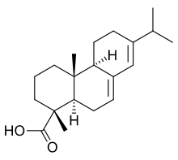
Chemical Tests:
Reaction with Acetic anhydride
and H₂ SO₄ VOILET COLOUR
Extraction of Colophony in DEE
followed by treatment with
Copper acetate
EMERALD GREEN COLOUR
OF DEE LAYER
ABEITIC ACID

Slide 33
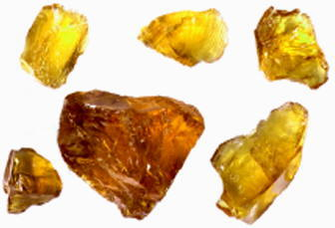
Colophony

Slide 34
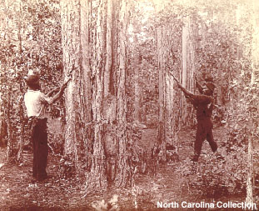
Workers slashing pine trees to drain rosin for distilling into turpentine, ca. 1900. U.S. Department of Agriculture, Forest Service photograph. Neg. 84-290

Slide 35
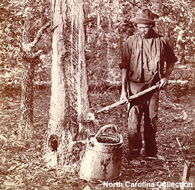

Slide 36
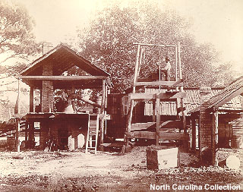

Slide 37
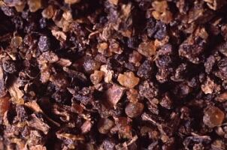

Slide 38
Myrrh
Oleo-gum resin obtained from the stem of Commifora molmol ( Burseraceae )
North East Africa and Arabia.
Known by ancients as bola / bol
India- Heerabol Myrrh-Mur-bitter
Collection –
The tree possess oleo resin canals in their phloem formed schizogenously and may unite afterwards with the other to form schizolysigenous cavities.
Much of the secretion is obtained by the sponteneous exudation from the cracks and fissures from the bark.

Slide 39
Myrrh
Also collected by giving incisions on the tree.
Characters – irregular tears or masses, weighing up to 250 gms, Surface reddish brown , brittle, aromatic odour bitter taste.
Constituents –
7-17 % v.oil, 25-40 % resin, 57-61 % gum, v. oil contains terpenes, sesquiterpenes, esters, cuminaldehyde, eugenol, easily resinifies and gives voilet colour with bromine.
Resin – large portion of resin is ether soluble contains α,β, γ-commiphoric acid, ether insoluble portion contains α,β-heerabomyrrholic acid. Gum is asociated with an oxidase enzyme.

Slide 40
Myrrh
Uses- Perfumery Industry, Local stimulant and antiseptic. Employed in medicine in the form of Mouth wash.

Slide 41
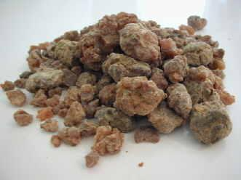
Myrrh

Slide 42
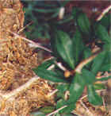
Myrrh

Slide 43
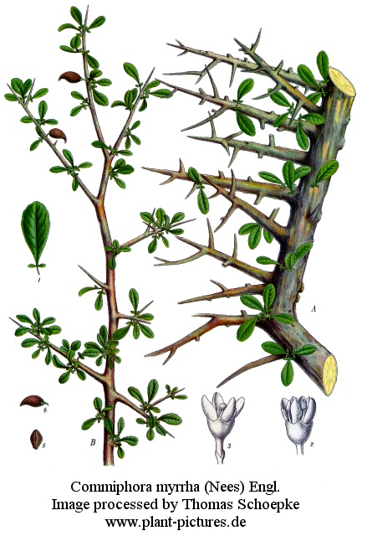
Myrrh

Slide 44
Guaiacum Resin
Obtained from heart wood of Guaiacum officianale , G. sanctum ( Zygophyllaceae )
Tropical regions of America, Venezuela , Columbia and West Indies. G. sanctum in Cuba , Bahamas and Florida
Large blocks / rounded tears . Surface of freshly fractured sample is brown and glassy. Powder is grayish and becomes green on exposure . Taste acrid, With FeCl₃ –blue colour. Mostl likely adulterant is colophony – detection through cupric acetate test.

Slide 45
Guaiacum Resin
Constituents – Lignans –Phenolic compounds having C₁₈ structure from two molecules of C₆ –C₃ , Guairetic acid ( Diaryl butane 10 % of the resin ).
Uses – Alcoholic solution for detection of blood stains, cyanogenetic glycosides, oxidase and peroxidase enzymes.

Slide 46
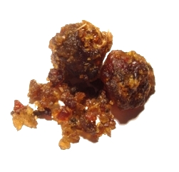
GUUGULE
Commiphora wightii (Guggal, Guggul or Mukul myrrh tree) is a flowering plant in the family. Burseraceae The guggul plant may be found from South Africa to Central Asia , but is most common in northern India
It is a small tree, reaching a maximum height of 4 m, with thin papery bark
Some plants bearing bisexual and male flowers, and others with female flowers. The individual flowers are red to pink, with four small petals.

Slide 47
Guggul has been a key component in ancient Indian Ayurvedic system of medicine. But has become so scarce because of its overuse in its two habitats in India where it is found — Gujarat and Rajasthan
Guggul produces a resinous sap known as gum guggul. The extract of this gum, called gugulipid, guggulipid or guglipid, has been used in Ayurvedic medicine.
The active ingredient in the extract is the steroid guggulsterone, which acts as an antagonist of the farnesoid X receptor, once believed to result in decreased cholesterol synthesis in the liver.

Slide 48
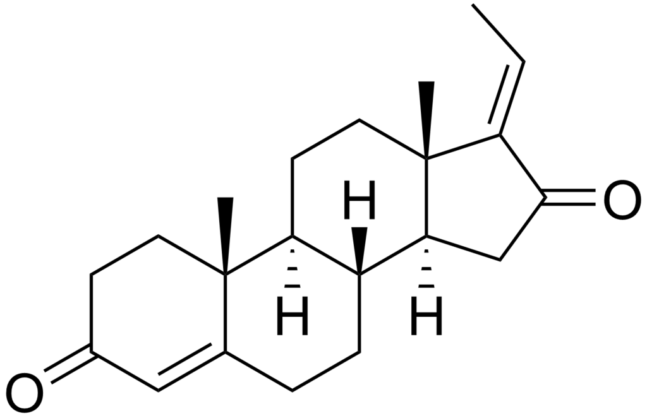
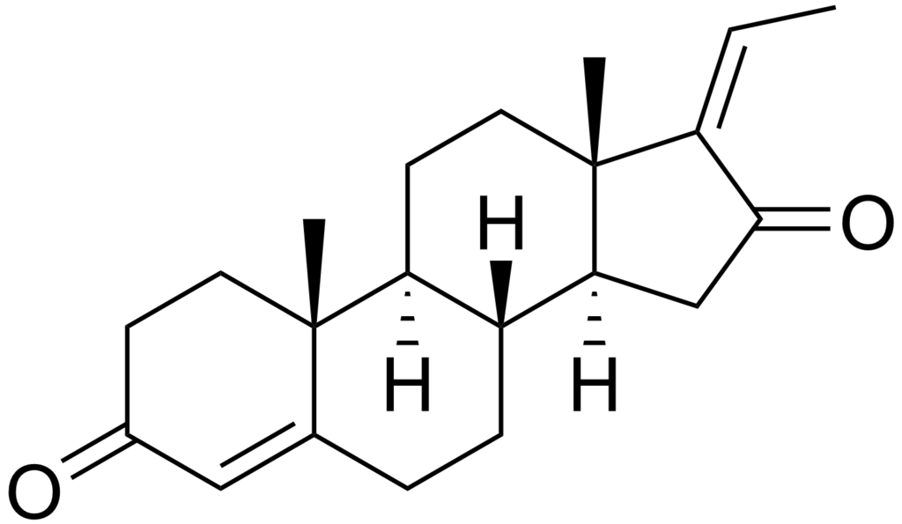
Guggul is sought for its gummy resin, which is harvested from the plant's bark through the process of tapping.
In India and Pakistan, guggul is cultivated commercially.
E AND Z GUGGULSTERONE

Slide 49
Asafoetida, Ferula asafoetida (family Umbelliferae), is a resin gum which comes from the dried sap from the stem and roots of the wild fennel genus Ferula. Chunks of asafoetida resin are too hard to be grated, and require a hammer to crush.
The resin is greyish-white when fresh, but dries to a yellow colour.
Today, the most commonly available form is compounded asafoetida, a fine powder containing 30% asafoetida resin, along with rice flour and gum arabic.
It derives its English and scientific name from the Persian word for resin (asa) and Latin foetida, which refers to its strong sulfurous odor.
Its pungent odour has resulted in its being called by many unpleasant names; thus the French know it, amongst other names, as Merde du Diable (Devil's faeces); in some dialects of English too it was known as Devil's Dung,

Slide 50
Geographical Source
Various species of genus Ferula grow wild from the Eastern Mediterranean to Central Asia. Most important species are F.asafetida, F.alliacea, F.foetida and F.narthex, all from Central Asia (Iran to Afghanistan).
Acrid in taste, it emits a strong onion like odour because of its organic sulfur compounds.
Cultivation
The plant is a perennial of the carrot family and may grow as high as 3.6m. After four years, when it is ready to yield asafetida, the stems are cut down close to the root, and a milky juice flows out that quickly sets into a solid resinous mass. A freshly exposed surface of asafoeida has a translucent, pearly white appearance, but it soon darkens in the air, becoming first pink and finally reddish brown.

Slide 51
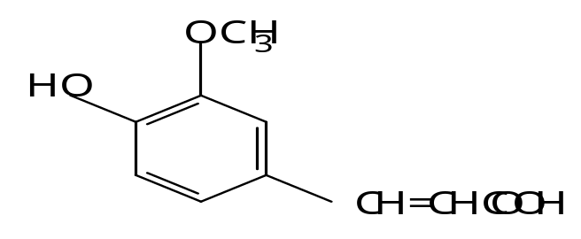
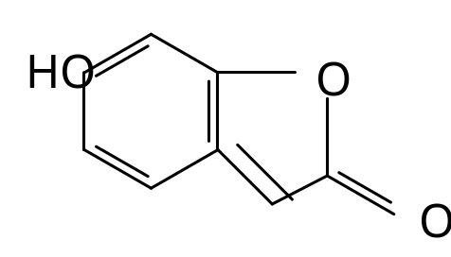
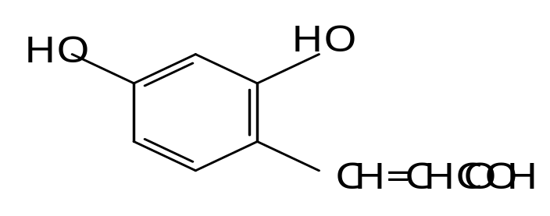
Asafoetida
Two forms –
Tears & Mass
Constituents –
V.oil, resin gum,Sulphur compounds- C₇H₁₄S₂
Ferulic acid Umbellic acid Umbelliferone

Slide 52
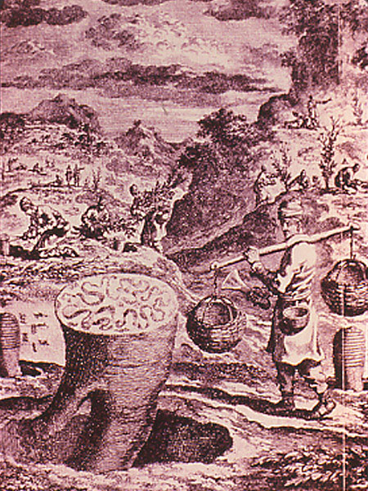
Asafoetida

Slide 53
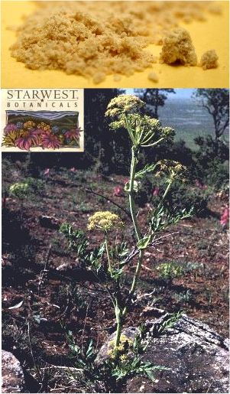
asafoetida

Slide 54
PODOPHYLLUM
Dried roots and rhizomes of Podophyllum peltatum ( Berberidaceae )
Eastern parts of Canada, USA, collected in Virginia, North Carolina, Indiana
Has been used by Indians as Vermifuge and emetic and was introduced in Pharmacopoeia in 1864. Podophyllum hexandrum- Himalaya

Slide 55
Chemical Constituents –
Resin – Podophyllum Resin / Podophyllin –pptn of Alcoholic solution in water.
American Podophyllum – 1-2 % ; Indian –6-12 %. USP- only from American ; B.P.- American / Indian although the resins are not identical.
Chemical group- Lignan ( dimerization of 2 C_{6_-}C₃ units like coniferyl alcohol ) , Podophyllotoxin 20%, β-Peltaltin 10%, α-Peltatin 5 %. Occur as free or Glucosides

Slide 56
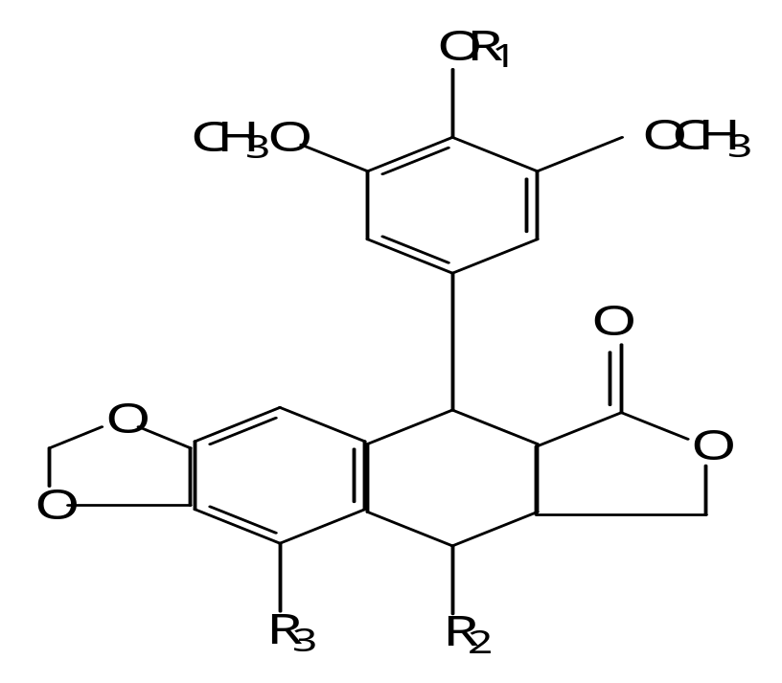
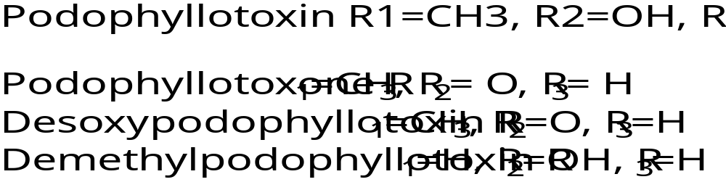

Slide 57
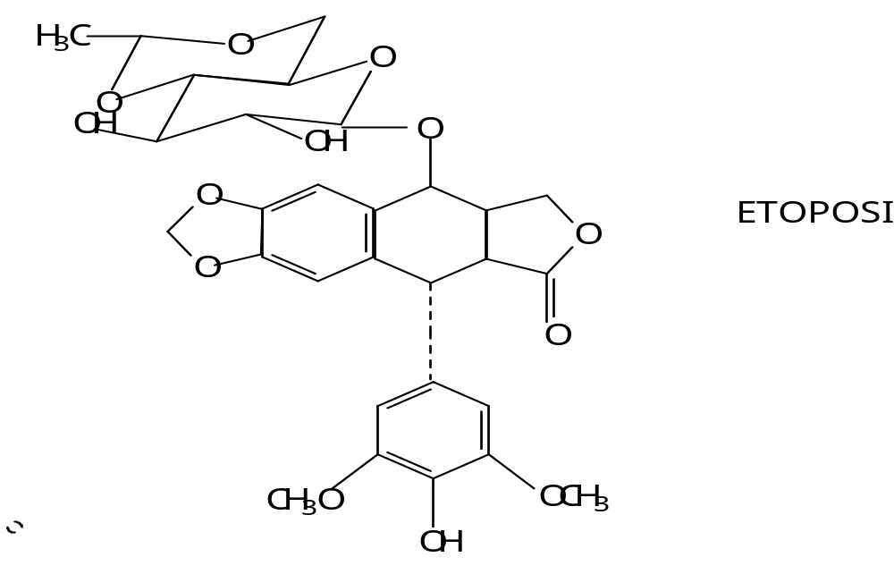
Other constituents – Demethyl and desoxy podophyllotoxin with cytotoxic / antitumor activity.
Etoposide –semi synthetic product from Podophyllotoxin- Lung cancer , testicular cancer.

Slide 58
Uses
Purgative – but replaced by less drastic drugs.
Cytotoxic activity .
Applied locally as paint in treatment of soft venereal and other warts.

Slide 59
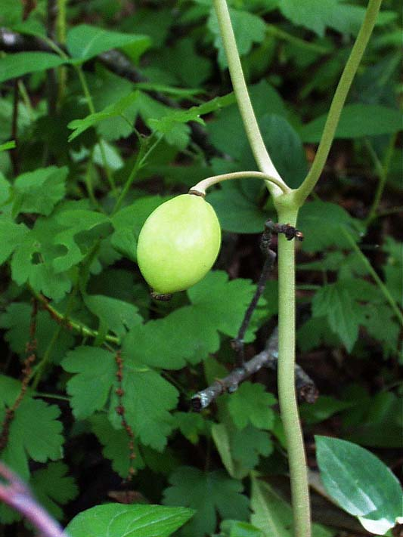

Slide 60
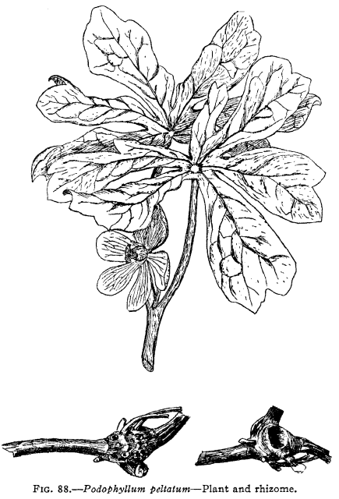

Slide 61
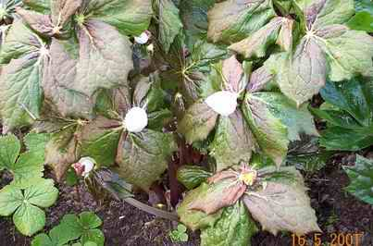
Podophyllum hexandrum

Slide 62
Curcuma - Turmeric
Curcuma; Indian Saffron.
Dried rhizome of Curcuma longa (Zingiberaceae).
Ind. allows both dried and fresh rhizome, and specifies a volatile oil content of not less than 4 %.
It contains curcumin, a yellow pigment which dissolves in alcohol to form a deep yellow solution; alkalis change the colour to reddish-brown.

Slide 63
TURMERIC
Constituents –
5% diaryl heptanoides ( Colouring matter )-Curcumin ( diferuloylmethane ) along with diacaffeoyl methane and caffeoloyl ferulmethane., starch grains.

Slide 64
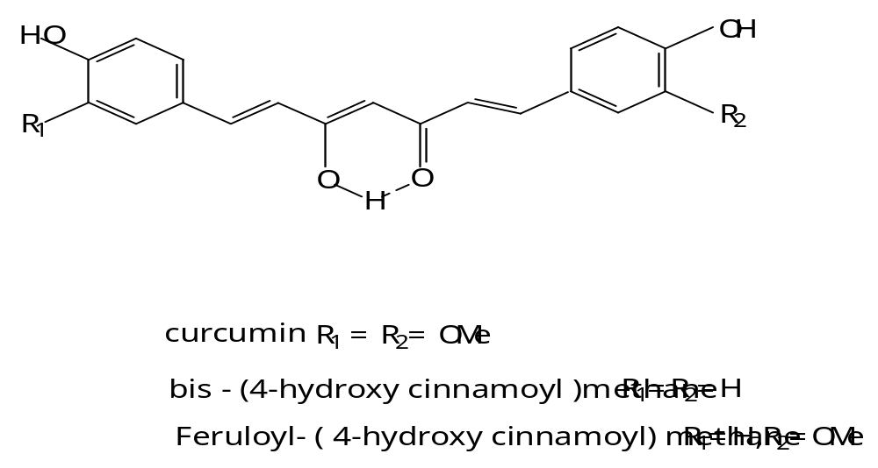

Slide 65
Ginger
Ginger is the dried rhizome of Zingiber officinal, Roscoe. (Fam. Zingiberacece), known in commerce as Jamaica Ginger, Cochin Ginger, and African Ginger.
The outer cortical layers are often either partially or completely removed.
Ginger yields not less than 2 per cent of nonvolatile ether-soluble extractive and not less than 12 per cent of cold water-extractive.
U.S. Ginger is the scraped and dried rhizome of
Zingiber officinale, Roscoe.

Slide 66
There are about seventy species of the genus Zingiber, the commercial ginger being obtained from Zingiber officinale.
-native of tropical Asia, but now extensively cultivated in tropical countries of both the Eastern and Western Hemispheres.

Slide 67
- deprived of roots, and washed, it constitutes the green ginger which is used for condimental purposes.
- Washed in boiling water and rapidly dried, it is known as black ginger.
- peeled and bleached some­times with chlorine or sulphurous acid or coated with lime or having their cork removed from the flattened sides.

Slide 68
In Jamaica the so-called unbleached Jamaica, or white ginger, is produced by carefully peel­ing the washed fresh rhizomes so that the cork and outer part of the cortex are removed.
These are washed again and dried in the sun. The peeled pieces are macerated sometimes in water and sometimes in lime water, finally coating it with chalk.

Slide 69
An inferior white ginger is produced in the East Indies.
The moisture in ginger should not exceed 10 per cent., but in the poorer specimens may constitute one-fourth of the whole weight.
In China the fresh ginger is powder and such dried. Formerly

Slide 70
At present the cultivation of ginger is spread almost over the whole sub-tropical world, and the drug is pro­duced in Jamaica, St. Lucia, Dominica and Africa, India, Cochin-China, Japan, etc.
The chief varieties of ginger grown in India are the Cochin and the Calicut, of which the Cochin is reputed to be the better grade. This occurs in two forms, viz., the white washed and bleached, cut or scraped and the unbleached.
These gingers are sent chiefly from the ports of Cochin and Calicut of Madras to Bombay whence they are exported to England and America.

Slide 71
The recent rhizome, known in commerce as ‘green ginger’ is from one to four inches long, somewhat flattened on its upper and under surface, knotty, obtusely and irregularly branched or lobed, externally of a light ash color with circular rugae internally yellowish-white and fleshy. It sometimes begins to grow when kept in a damp atmosphere.

Slide 72
The black ginger is of the same general shape, but has a dark ash-colored wrinkled epidermis, which, being removed in some places, exhibits patches of an almost black color, apparently the result of exposure.
Beneath the epidermis is a brownish, resinous, almost horny cortical portion. The interior parenchyma is whitish, the cells being filled with starch. The powder is of a light yellowish-brown color.

Slide 73
The unbleached Jamaica ginger is pale yellowish-buff on the outside. The pieces are rounder and thinner, and afford when pulverized a beautiful yellowish-white powder.
The uncoated ginger of the East Indies resem­bles the Jamaica, but is darker, being gray rather than whitish. As the Jamaica commands a much higher price than even the uncoated East India production, the latter is occasionally altered to simulate the former. This is some­times done by coating the exterior with calcium sulphate or carbonate, sometimes by bleaching with the fumes of burning sulphur or in other ways, by which not only the exterior but also the internal parts are rendered whiter than in the unprepared root.

Slide 74
Powdered ginger which has been exhausted in the preparation of essence, technically known as ‘spent ginger,’ is used to a large extent in the adulteration of powdered ginger.
The factors needed for the detection of spent ginger are the ash and the cold water extract. NLT 12 %W/W
Commercial gingers are known as ‘scraped,’ ‘decorticated,’ and ‘coated.’ The scraped gingers are those from which the cortex has been removed in whole or in part by peeling, as seen in the Jamaica, and in some Cochin and Japanese varieties.

Slide 75
In the coated gingers a portion of the outer natural layers are retained as in the African, Calcutta and Calicut varieties.
Bleached and unbleached gingers are also distinguished, the former being lighter in color due to careful washing or special treatment.
The U.S.P. recognizes only the Jamaica, African and Cochin gingers. Of these the Jamaica is the most aromatic and the African the most pungent.

Slide 76
Constituents.
The peculiar flavor of the root appears to depend on the volatile oil; its pungency is due to a yellowish liquid called gingerol.
This is a mixture of homologous phenols of the formula C₁₆H₂₆O₃. (CH₂O) , Zingerone, C₁₁H₁₄O₃, is crystalline and has a sweet odor and an extremely pungent taste; it is chemically related to vanillin, and is formed when gingerol is treated with baryta water (Barium Hydroxide).
The pungency of gingerol, in contrast to that of capsicum, is destroyed by heating with alkaline hydroxides.

Slide 77
The volatile oil is yellow with a sp.gr. of from 0.875 to 0.890 and an optical rotation of about -25° to -45° (the Japanese ginger is said to yield an oil which is dextrorotatory).
It consists largely of a mixture of terpenes, camphone, phellandrene and a sesquiterpene-zingiberene.
V oil also contains- citral, cineol and borneol in the oil. starch.

Slide 78
Uses.
Ginger is a grateful stimulant and carminative and is often given in dyspepsia and flatulent colic.
It is an excellent addition to bitter infusions and tonic powders, imparting to them an agreeable, warming, and cordial operation upon the stomach.
It is especially valuable in alcoholic gastritis. In the serous type of diarrhea, when due to a relaxed con­dition of the bowel, it is a remedy of much ser­vice but should not be employed in the presence of inflammatory conditions.

Slide 79
The hot infusion is popularly employed under the name of Ginger Tea for its diaphoretic effect in colds, espe­cially when accompanied with suppression of the menses. Externally it is rubefacient. Under the name of Essence of Ginger cheap alco­holic preparations of ginger were formerly sold and used as intoxicants. A number of cases of blindness produced by such use have been recorded, the amblyopia having been due to the large use of methyl alcohol in the making of these “essences.” The infusion may be prepared by adding half an ounce of the powdered or bruised root to a pint of boiling water, and may be given in the dose of one or two fluid­ounces (30-60 cc.).

Slide 80
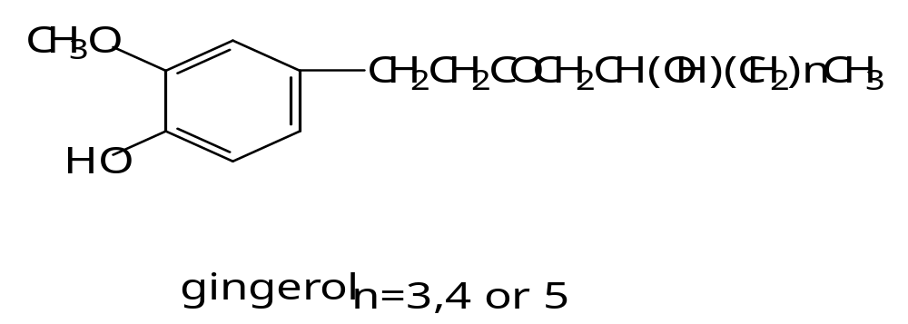
Constituents

Slide 81
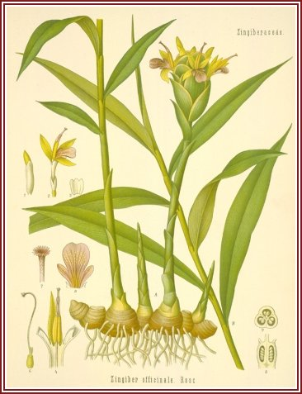
Ginger

Slide 82
