Slide 1
Non-steroidal
Anti-Inflammatory Drugs

Slide 2
Pathways for Arachidonic Acid Metabolism
Arachidonic acid
Cyclo-oxygenase Pathway
lipoxygenase Pathway
PGG₂
HPETE
Prostaglandins
Leukotrienes
Lipoxins
Thromboxanes
HETE

Slide 3
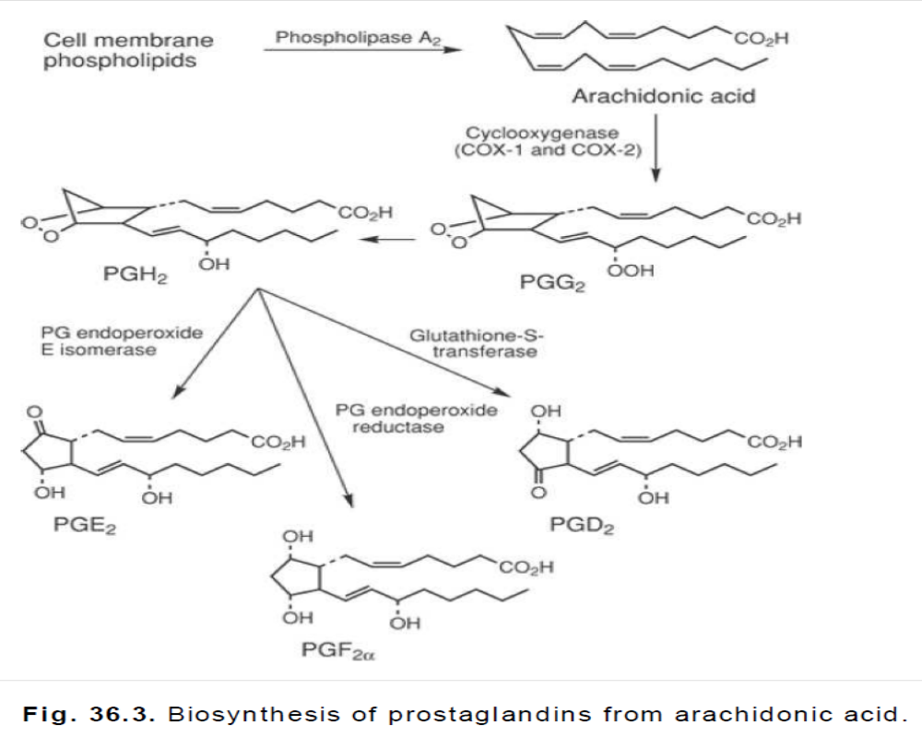

Slide 4
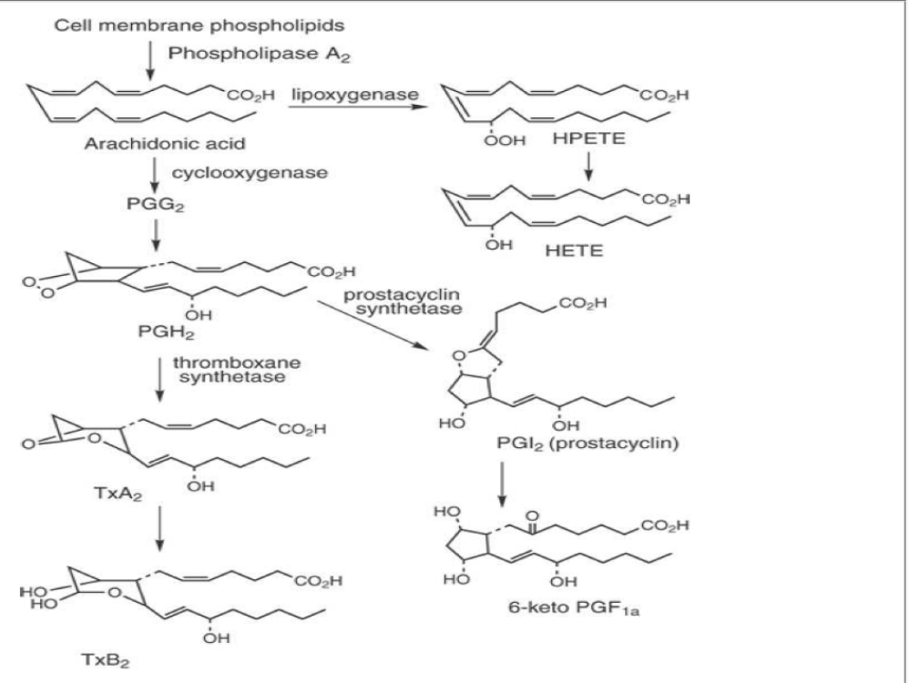

Slide 5
Three isoforms of COX have been identified:
COX-1,
COX-2, and
COX-3.
Both COX-1 and COX-2 are very similar in structure and almost identical in length, varying from 599 (human) to 602 (mice) amino acids for COX-1 and from 603 (mice) to 604 (human) for COX-2.
From a therapeutic viewpoint, the major difference between COX-1 and COX-2 lies in physiological function rather than in structure.
Little COX-2 is present in resting cells, but its expression can be induced by cytokines in vascular smooth muscle, fibroblasts, and epithelial cells means COX-2 to produce prostaglandins at inflammatory sites
COX-1 functions to produce prostaglandins that are involved in normal cellular activity (protection of gastric mucosa, maintenance of kidney function.
Inducible COX-2 linked to inflammatory cell types and tissues is believed to be the target enzyme in the treatment of inflammatory disorders by NSAIDs. Selective COX-2 inhibitors may eliminate side effects associated with NSAIDs because of COX-1 inhibition, such as gastric and renal effects.

Slide 6
PGE2 stimulate the endometrium of the gravid uterus to contract in a manner similar to uterine contractions observed during labor. Thus, PGE2 is therapeutically available as dinoprostone .
Additionally, PGE2 is a potent stimulator of smooth muscle of the gastrointestinal (GI) tract and can elevate body temperature in addition to possessing potent vasodilating properties in most vascular tissue while possessing constrictor effects at certain sites.
Many of these properties are shared by PGF2α that also is therapeutically available as an abortifacient at 16 to 20 weeks of gestation and is avai lable as dinoprost tromethamine.

Slide 7
The PGD2 causes both vasodilation and vasoconstriction.
The PGEs produce a relaxation of bronchial and tracheal smooth muscle, but the PGFs and PGD2 cause contraction.
The PGEs and PGI2 inhibit gastric secretion that may be induced by gastrin or histamine. Prostaglandins appear to play a major cytoprotective role in maintainingthe integrity of gastric mucosa.

Slide 8
The PGE1 exerts a protective effect on gastroduodenal mucosa by stimulating secretion of an alkaline mucus and bicarbonate ion and by maintaining or increasing mucosal blood flow.
Thus, inhibition of prostaglandin formation in joints produces favorable results, as indicated by a reduction in fever, pain and swelling.
Inhibition of prostaglandin biosynthesis in the GI tract is unfavorable, however, because it may cause disruption of mucosal integrity, resulting in peptic ulcer, is commonly associated with the use of NSAIDs and aspirin.
The PGE1 is available as alprostadil (Prostin VR Pediatric) to maintain patency of the ductus arteriosus in neonates until surgery can be performed to correct congenital heart defects.

Slide 9
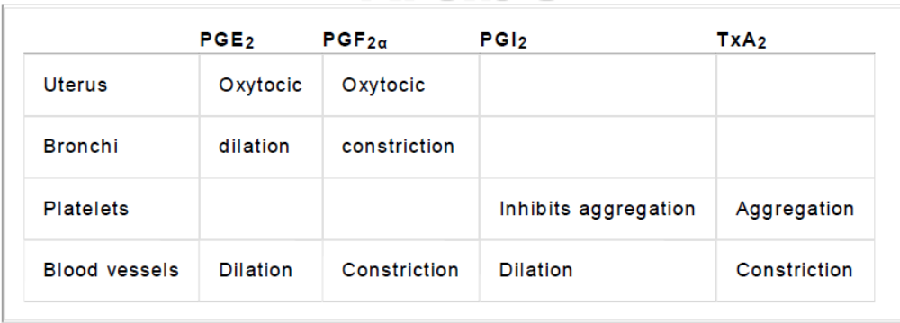

Slide 10
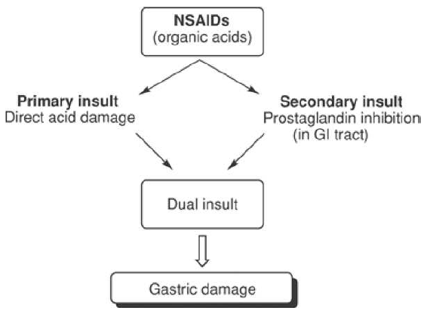
Therapeutic Approach to Arthritic Disorders
a stepwise approach starting with NSAIDs and progressing through more potent drugs such as glucocorticoids, DMARDs, and biologic response modifiers.

Slide 11
Antipyretic Analgetics

Slide 12
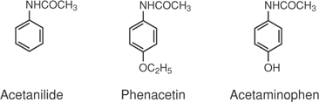
Paracetamol

Slide 13
Mechanism of Action
The antipyretics exert their actions within the central nervous system (CNS), primarily at the hypothalamic thermoregulatory center.
Endogenous leukocytic pyrogens may be released from cells that have been activated by various stimuli, and antipyretics may act by inhibiting the activation of these cells by an exogenous pyrogen or by inhibiting the release of endogenous leukocytic pyrogens from the cells once they have been activated by the exogenous pyrogen.
Acetaminophen may inhibit pain impulses by exerting a depressant effect on peripheral receptors; an antagonistic effect on the actions of bradykinin may play a role.

Slide 14
1886- too toxic
1890-1960s
Weak anti-pyretic activity
1893- big hit after 50yrs

Slide 15
Structure–Activity Relationships
Based on the comparative toxicity of acetanilide and acetaminophen, aminophenols are less toxic than the corresponding aniline derivatives, although p-aminophenol itself is too toxic for therapeutic purposes.
Etherification of the phenolic function with methyl or propyl groups produces derivatives with greater side effects than with ethyl groups.
Substituents on the nitrogen atom that reduce basicity reduce activity unless that substituent is metabolically labile (e.g., acetyl).
Amides derived from aromatic acids (e.g., N-phenylbenzamide) are less active or inactive.

Slide 16
Acetaminophen
N-Acetyl-p-aminophenol,
4-hydroxyacetanilide
Acetaminophen has analgesic and antipyretic activity comparable to those of acetanilid and is used in the same conditions, particularly in those individuals displaying an allergy or sensitivity to aspirin.
It exerts its effects by inhibiting the cyclooxygenase enzyme centrally but has very little effect peripherally.
Acetaminophen, unlike aspirin, is stable in aqueous solution, making liquid formulations readily available, a particular advantage in paediatric cases.

Slide 17
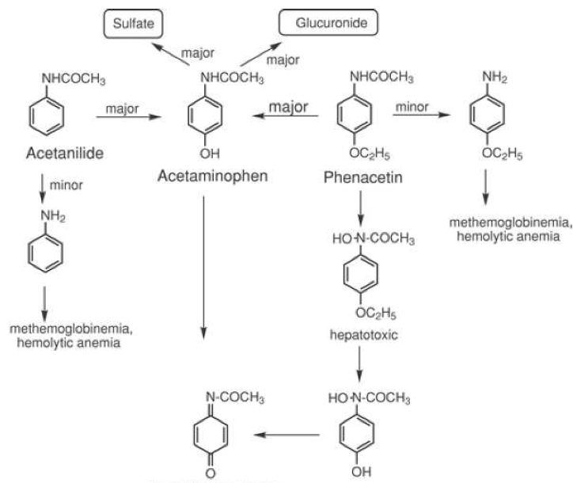

Slide 18
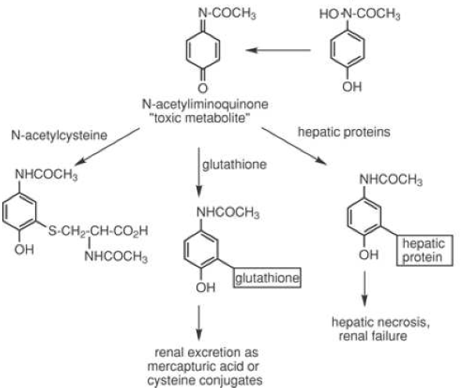

Slide 19
Anti-Inflammatory Drugs

Slide 20
Salicylates
Salicylates exert their antipyretic action in febrile patients by increasing heat elimination of the body via the mobilization of water and consequent dilution of the blood.
This brings about perspiration, causing cutaneous dilatation.
The antipyretic and analgesic actions are believed to occur in the hypothalamic area of the brain.
The salicylates exert their analgesia by their effect on water balance, reducing the edema usually associated with arthralgias.

Slide 21
The possibility of hypoprothromhinemia and concomitant capillary bleeding in conjunction with salicylate administration
accounts for the inclusion of menadione in some salicylate formulations.
A more serious aspect of salicylate medication is the possibility of inducing hemorrhage from direct irritative contact with the mucosa.
The salicylates are readily absorbed from the stomach and the small intestine and depend strongly on the pH of the media. Absorption slows considerably as the pH rises (more alkaline) because of the acidic nature of these compounds and the necessity for the presence of undissociated molecules for absorption through the lipoidal membrane of the stomach and the intestines. Therefore, buffering agents administered at the same time in excessive amounts decrease the rate of absorption.

Slide 22
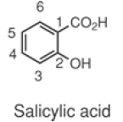
Because salicylates promote the excretion of uric acid, they are useful in the treatment of gouty arthritis.
More recent attention has been given to the ability of salicylates to inhibit platelet aggregation, which may contribute to heart attacks and stroke.
Aspirin appears to inhibit prostaglandin cyclooxygenase in platelet membranes, thus blocking formation of the potent platelet-aggregating factor TXA2 in a manner that is irreversible.
Aspirin is the only NSAID that covalently modifies cyclooxygenase by acetylating Ser-530 of COX-1 and Ser-516 of COX-2. Aspirin, however, is 10 to 100 times more potent against COX-1 than against COX-2

Slide 23
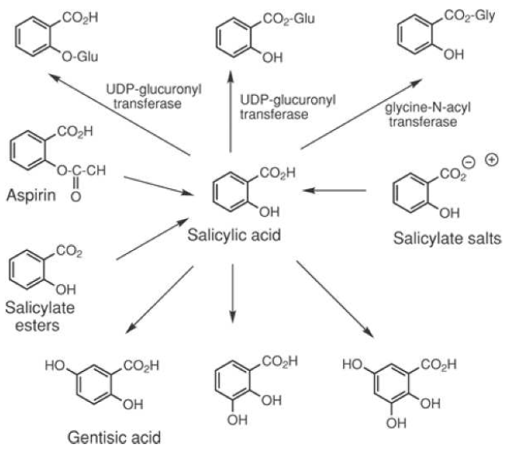
75%, Major metabolite
Responsible for anti-inflammatory activity

Slide 24
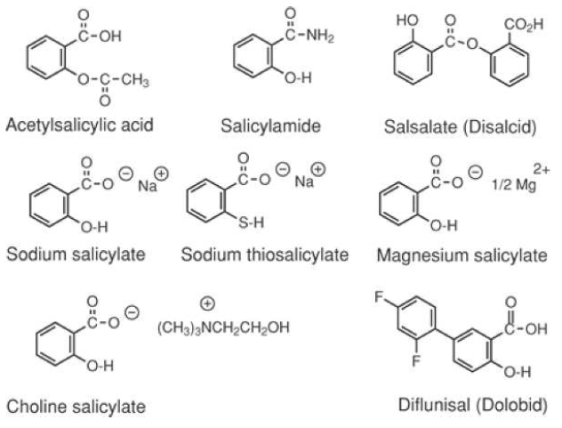

Slide 25
Shared toxicities of NSAIDs due
to prostanoid synthesis inhibition
1. Gastric mucosal damage
  connected with PGE inhibition
2. Bleeding: inhibition of platelet
  function (TxA₂ synthesis)
3. Limitation of renal blood flow
  Na⁺ and water retention
4. Delay / prolongation of labour
  connected with PGF_{2α} inhibition
5. Asthma and anaphylactoid reactions
  connected with PGF_{2α} inhibition

Slide 26
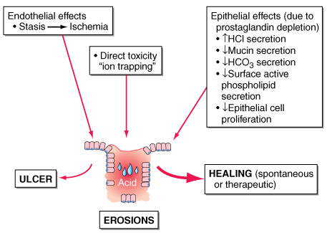

Slide 27
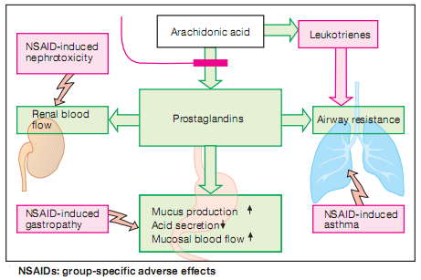

Slide 28
ARYL AND HETERO- ARYL
ACETIC ACID DERIVATIVES

Slide 29
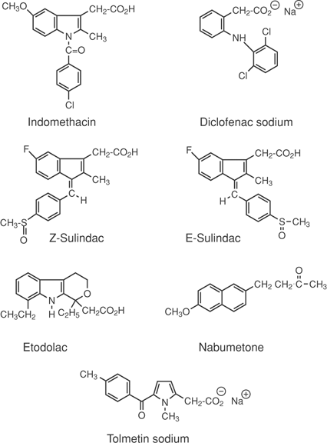
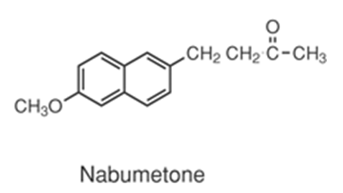

Slide 30
Indomethacin
1 -(p-chlorobenzoyl)-5-methoxy-2-methylindole-3-acetic acid

Slide 31
Aqueous solutions of indomethacin are not stable because of the ease of hydrolysis of the p-chlorobenzoyl group.
It was introduced in 1965 and is still one of the most potent NSAIDs in use, is more potent antipyretic than either aspirin or
Acetaminophen.
The analgetic effect, however, is widely overshadowed by concern over the frequency of side effects.

Slide 32
Structure–Activity Relationships
Replacement of the carboxyl group with other acidic functionalities decreases activity.
Anti-inflammatory activity generally increases as the acidity of the carboxyl group increases and decreases as the acidity is decreased.
Amide analogues are inactive.
Acylation of the indole nitrogen with aliphatic carboxylic acids or aralkylcarboxylic acids results in amide derivatives that are less active than those derived from benzoic acid.
N-Benzoyl derivatives substituted in the para-position with fluoro, chloro, trifluoromethyl, or thiomethyl groups are the most active.

Slide 33
Substituents such as methoxy, fluoro, dimethylamino, methyl, allyloxy, and acetyl at 5-position are more active than the unsubstituted indole ring
The presence of an indole ring nitrogen is not essential for activity, because the corresponding 1-benzylidenylindene analogues (e.g., sulindac) are active
Alkyl groups, especially methyl, at the α-position are more active than aryl substituents
Substitution of a methyl group at the α-position of the acetic acid side chain (to give the corresponding propionic acid derivative) leads to equiactive analogues
The resulting chirality introduced in the molecules is important. Anti-inflammatory activity is displayed only by the S-(+)-enantiomer
The acetic acid side chain is flexible and can assume a large number of different conformations

Slide 34
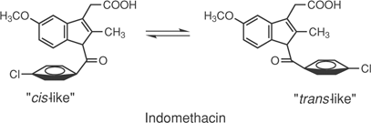
The conformation of indomethacin appears to play a crucial role in its anti-inflammatory actions
The preferred and lower-energy conformation of the N-p-chlorobenzoyl group is one in which the chlorophenyl ring is oriented away from the 2-methyl group (or cis to the methoxyphenyl ring of the indole nucleus) and is noncoplanar with the indole ring because of steric hindrance produced by the 2-methyl group and the hydrogen atom at the 7-position

Slide 35
Sulindac
(Z)-5-fluoro-2-rnethyl- 1-[[p-(methylsulfinyl)phenyl]methylene] -1H-indene-3-acetic acid

Slide 36
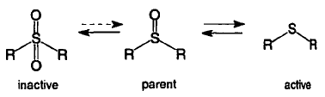
Sulindac was introduced in the United States in 1978 by Merck
Sulindac is a pro-drug and is converted to a metabolite that appears to inhibit the cyclooxygenase system approximately eight-fold as effectively as aspirin.
Sulfoxide
Sulfide

Slide 37
Structure–Activity Relationships
It is a classic example of bio-isosteric changes in medicinal chemistry drug design
The isosteric replacement of the indole ring with the indene ring system resulted in a derivative with therapeutically useful anti -inflammatory activity and fewer CNS and GI side effects but with other undesirable effects, particularly poor water solubility and resultant crystalluria.
The replacement of the N-p-chlorobenzoyl substituent with a benzylidiene function resulted in active derivatives. However, when the 5-methoxy group of the indene isostere was replaced with a fluorine atom, enhanced analgetic effects were observed.
The decreased water solubility of the indene isostere was alleviated by replacing the chlorine atom of the phenyl substituent with a sulfinyl group.

Slide 38
The importance of stereochemical features in the action of sulindac, introduced by the benzylidene double bond, is evidenced by the observation that the (Z)-isomer is a much more potent anti-inflammatory agent than the corresponding (E)-isomer

Slide 39
Absorption and Metabolism
Sulindac is a pro-drug, the sulfoxide function being reduced to the active sulfide metabolite.
Sulindac is absorbed as the sulfoxide, which is not an inhibitor of prostaglandin biosynthesis in the GI tract.
Once sulindac enters the circulatory system, it is reduced to the sulfide, which is an inhibitor of prostaglandin biosynthesis in the joints.
Thus, sulindac produces less GI side effects, such as bleeding, ulcerations, and so on, than indomethacin and many other NSAIDs.
In addition, the active metaboli te has a plasma half-life approximately twice that of the parent compound (~16 hours versus 8 hours)

Slide 40
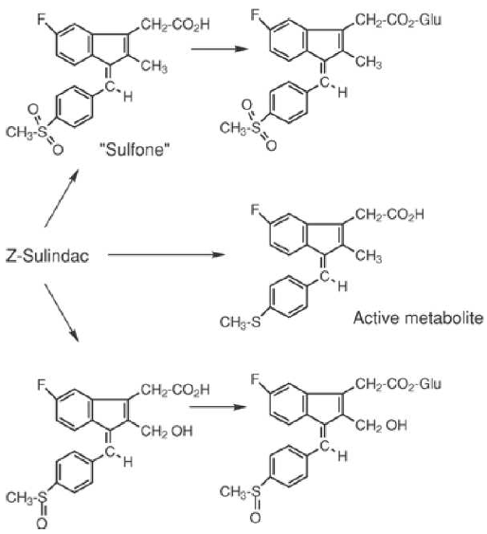

Slide 41
Diclofenac Sodium
sodium [o-(2,6-dichloroanilino)phenyl]acetate

Slide 42
The most widely used NSAID in the world, was introduced in the United States in 1989 but was first marketed in Japan in 1974.
Diclofenac possesses structural characteristics of both arylalkanoic acid and the anthranilic acid classes of anti -inflammatory drugs, and it displays anti-inflammatory, analgetic, and antipyretic properties.
Diclofenac is unique among the NSAIDs in that it possesses three possible mechanisms of action:
inhibition of the arachidonic acid cyclooxygenase system, resulting in a decreased production of prostaglandins and thromboxanes;

Slide 43
2) inhibition of the lipoxygenase pathway, resulting in decreased production of leukotrienes, particularly the pro-inflammatory LKB4; and
3) inhibition of arachidonic acid release and stimulation of its reuptake, resulting in a reduction of arachidonic acid availability.
Structure–Activity Relationships
It does appear that the function of the two o-chloro groups is to force the anilino-phenyl ring out of the plane of the phenyl acetic acid portion, this twisting effect being important in the binding of NSAIDs to the active site of the COX

Slide 44
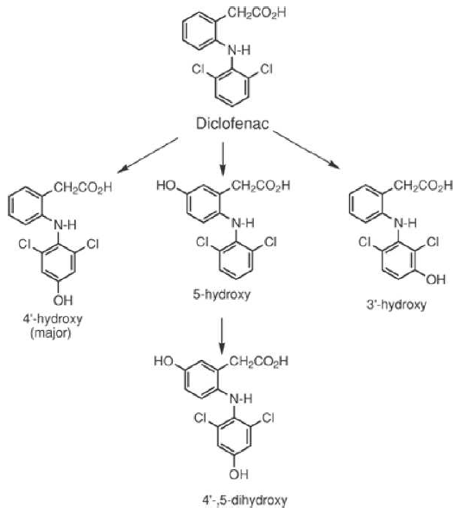

Slide 45
Nabumetone
4-(6-methoxy-2-naphthyl )-2-butanone

Slide 46
Nabumetone is unique among the NSAIDs in that it represents a new class of nonacidic pro-drugs, being rapidly metabolized after absorption to form a major active metabolite, 6-methoxynaphthaleneacetic acid (6-MNA).
Being nonacidic, it does not produce a significant primary insult and is an ineffectual inhibitor of prostaglandin cyclooxygenase in gastric mucosa, thus producing minimum secondary insult.
The result is that gastric side effects of nabumetone appear to be minimized.
However, the active metabolite, (6MNA), is an effective inhibitor of cyclooxygenase in joints.
Nabumetone thus represents a classic example of the prodrug approach in drug design.

Slide 47
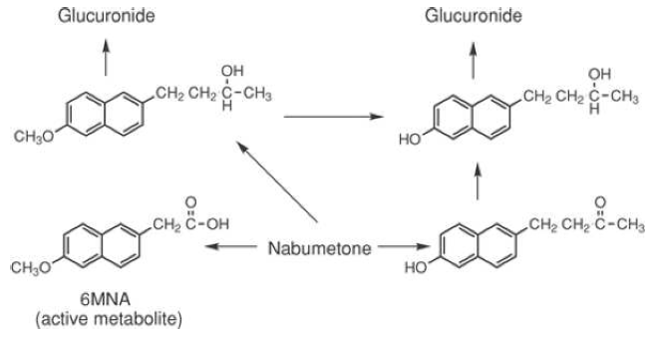

Slide 48



Aryl- and heteroarylpropionic acids

Slide 49
±-Ibuprofen
2-(4-isobutylphenyl)propionic acid

Slide 50
It is marketed as the racemic mixture, although biological
activity resides almost exclusively in the S-(+)-isomer.
Structure–Activi ty Relationships
The substitution of an α-methyl group on the alkanoic acid portion of acetic acid derivatives enhances anti-inflammatory actions and reduces many side effects. For example, the acetic acid analogue of ibuprofen, Ibufenac, is less potent and more hepatotoxic than ibuprofen.

Slide 51
The stereochemistry associated with the chiral center in the arylpropionic acids, but lacking in the acetic acid derivatives, plays an important role in both the in vivo and in vitro activities of these drugs.
As indicated earlier, although marketed as a racemic mixture, the (+)-enantiomer of ibuprofen possess greater activity in vitro than the (–)-isomer.
Interestingly, the R-(–)-enantiomer is inverted to the S-(+)-enantiomer in vivo via an acetyl–coenzyme A intermediate, accounting for the observation that the two enantiomers are bioequivalent in vivo.

Slide 52
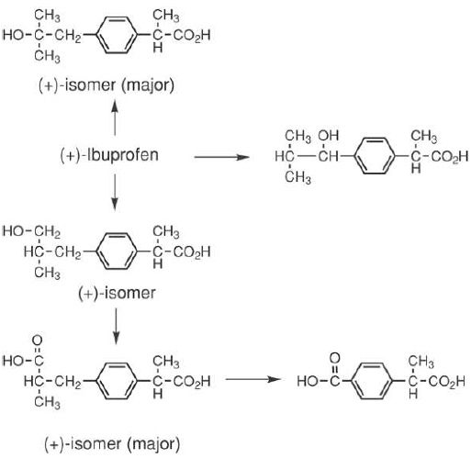
Metabolism
All metabolites are inactive.

Slide 53
±-Ketoprofen
3-benzoyl-α-methylbenzeneacetic acid

Slide 54
Ketoprofen, unlike many NSAIDs, inhibits the synthesis of leukotrienes and leukocyte migration into inflamed joints in addition to inhibiting the biosynthesis of prostaglandins.
It stabilizes the lysosomal membrane during inflammation, resulting in decreased tissue destruction.
Antibradykinin activity also has been observed.
Bradykinin is released during inflammation and can activate peripheral pain receptors.

Slide 55
Naproxen
(+ )-6-methoxy-α-methyl-2-naphthaleneacetic acid
The S-(+)-isomer is the more potent enantiomer.
Naproxen is the only arylalkanoic acid NSAID currently marketed as optically active isomers.

Slide 56

N-Arylanthranilic Acids (Fenamic Acids)

Slide 57
The anthranilic acid class of NSAIDs is the result of the application of classical medicinal chemistry bio-isosteric drug design concepts, because these derivatives are nitrogen isosteres of salicylic acid.
These drugs are potent inhibitors of prostaglandin biosynthesis

Slide 58
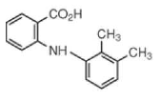
Mefenamic Acid
N-2,3-xylylanthranilic acid
Mefenamic acid is the only fenamic acid derivative that produces analgesia centrally and peripherally.

Slide 59
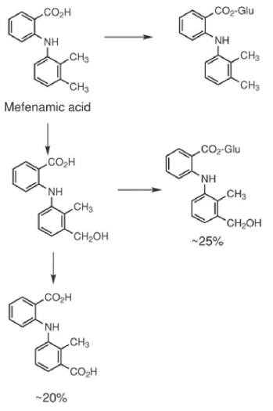

Slide 60
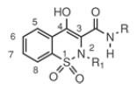
Oxicams
The enolic acid class of NSAIDs has been termed “oxicams”
It is a series of 4-hydroxy-1,2-benzothiazine carboxamides that possess anti-inflammatory and analgetic properties.

Slide 61
Within the series of 4-hydroxy-1,2-benzothiazine carboxamides represented by the general structure shown, optimum activity was observed when R1 was a methyl substituent.
The carboxamide substituent, R, generally is an aryl or heteroaryl substituent, because alkyl substituents are less active.
Oxicams are acidic compounds, with pKa values in the range of four to six. N-heterocyclic carboxamides generally are more acidic than the corresponding N-aryl carboxamides, and this enhanced acidity was attributed to stabilization of the enolate anion by the pyridine nitrogen atom

Slide 62
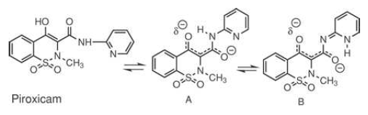

Slide 63
This explains the observation that primary carboxamides are more potent than the corresponding secondary derivatives, because no N-H bond would be available to enhance the stabilization of the enolate anion.
Two major differences, however, are observed when R = heteroaryl rather than aryl : The pKa values generally are two to four units lower, and anti-inflammatory activity increased as much as sevenfold.
The greatest activity is associated with the 2-pyridyl (as in piroxicam), 2-thiazolyl, or 3-(5-methyl) isoxazolyl ring systems, with the latter derivative (isoxicam) having been withdrawn from the European market in 1985 following several reports of severe skin reactions.

Slide 64
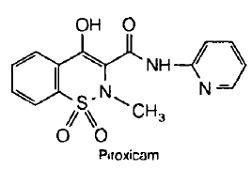
Piroxicam
4-hydroxy-2-methyl-N-2-pyridyl-2H-1,2-benzothiazine-3-carboximide 1,1 -dioxide

Slide 65
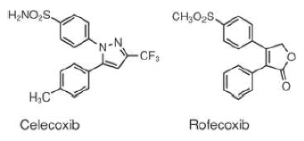
Selective COX-2 Inhibitors

Slide 66
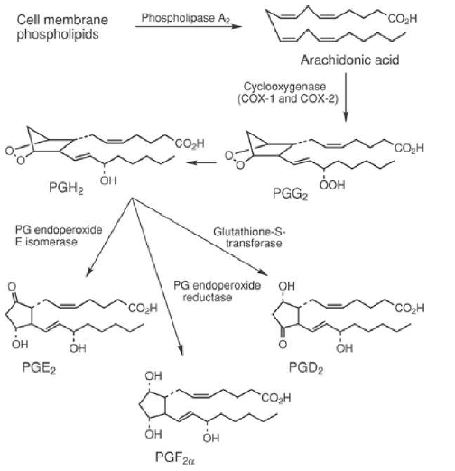

Slide 67
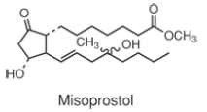
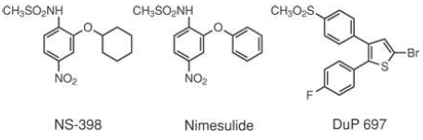
sulides
coxibs

Slide 68
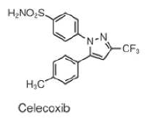
Celecoxib
4-[5-(4-methylphenyl)-3-(trilluorophenyl)-1H-pyrazol-1-yl]benzenesulfonamide

Slide 69
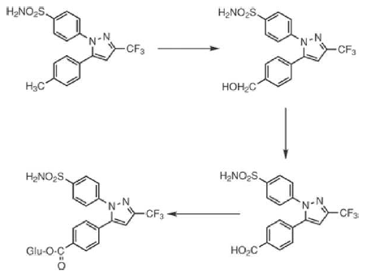
Metabolism

Slide 70
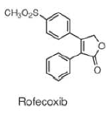
Rofecoxib
4-[4-(methylsulfinyl)phenyl]-3-
phenyl-2(5H)-furanone

Slide 71
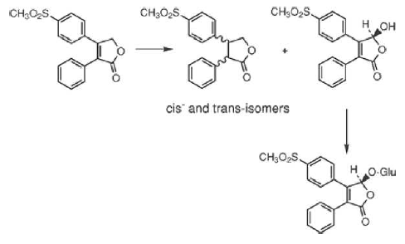
Metabolism

Slide 72
Drugs Used to Treat Gout

Slide 73
Gout is an inflammatory disease characterized by elevated levels of uric acid (as urate ion) in the plasma and urine and may take two forms, acute and chronic.
Acute gouty arthritis results from the accumulation of needle-like crystals of monosodium urate monohydrate within the joints, synovial fluid, and periarticular tissue and usually appears without warning.
Initiating factors may be minor trauma, fatigue, emotional stress, infection, overindulgence in alcohol or food, or drugs, such as penicillin or insulin.
Chronic gout symptoms develop as permanent erosive joint deformity appears.

Slide 74
The increase in extracellular urate may result from increased uric acid biosynthesis, decreased urinary excretion of uric acid, or perhaps, a combination of both.
uric acid is the excretory product of purine metabolism in humans as well as the scavenging of potential harmful oxygen free radicals in the body

Slide 75
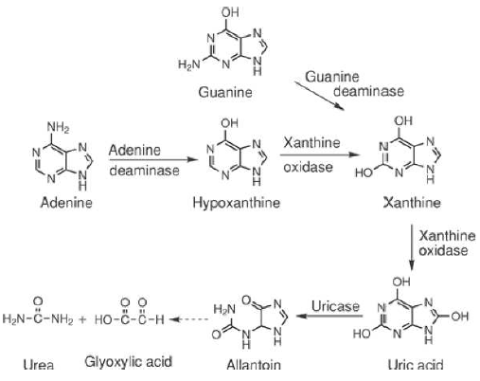

Slide 76
Normal pool levels of uric acid are approximately 1,000 to 1,200 mg in males and half that in females.
In patients suffering from gout, these levels may be as high as two- or three times the normal levels.
Uric acid is a weak acid with two pKa values 5.7 and 10.3, with very low water solubility (~6 mg/100 mL).
At physiological pH, it exists primarily as the monosodium salt, which is approximately 50 times more soluble in aqueous media than the free acid.
Blood levels of urate are maintained by a careful balance between its formation and excretion.

Slide 77
When levels of uric acid in the body increase, either as a result of decreased excretion or increased formation, the solubility limits of sodium urate are exceeded, and precipitation of the salt from the resulting supersaturated solution causes deposits of urate crystals to form.
It is the formation of these urate crystals in joints and connective tissue that initiate attacks of gouty arthritis.

Slide 78
The control of gout has been approached from the following therapeutic strategies:
control of acute attacks by drugs that reduce inflammation caused by the deposition of urate crystals (these drugs may possess only an anti-inflammatory component, such as colchicine, or both anti-inflammatory and analgetic actions, such as indomethacin, phenylbutazone and naproxen),
increasing the rate of uric acid excretion (by definition, these drugs are termed “uricosuric drugs” and include probenecid and sulfinpyrazone), and
inhibiting the biosynthesis of uric acid by inhibiting the enzyme xanthine oxidase by drugs such as allopurinol.

Slide 79
The management of gout has been approached with the following therapeutic strategies:
control of acute attacks with drugs that reduce inflammation caused by the deposition of urate crystals, and
2) control of chronic gout by increasing the rate of uric acid excretion (“uricosuric drugs”) and inhibiting the biosynthesis of uric acid by inhibiting the enzyme xanthine oxidase.

Slide 80
Treatment of Acute Gout
Treatment of acute gout includes NSAIDs, such as indomethacin, colchicines, and glucocorticoids.
The choice of an NSAID generally is based on the side effect profile.

Slide 81
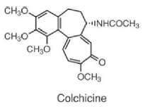
Colchicine

Slide 82
It appears to retard the inflammation process initiated by the deposition of urate crystals.
Acting on polymorphonuclear leukocytes and diminishing phagocytosis, it inhibits the production of lactic acid, causing an increase in the pH of synovial tissue and, thus, a decrease in urate deposition, because uric acid is more soluble at the higher pH.
Additionally, colchicine inhibits the release of lysosomal enzymes during phagocytosis that also contributes to the reduction of inflammation.

Slide 83
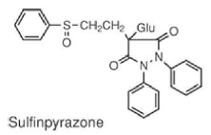
Treatment of Chronic Gout
Drugs That Increase Uric Acid Secretion

Slide 84
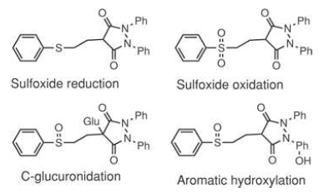
Sulfinpyrazone is a strong acid (enolic OH pKa = 2.8), a factor that is important in the production of the uricosuric effect

Slide 85
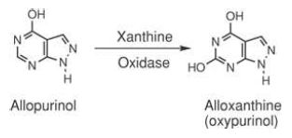
Drugs That Decrease Uric Acid Formation

Slide 86
Allopurinol serves as a substrate for xanthine oxidase (15 to 20 times the affinity of xanthine) and reversibly inhibits that enzyme.
Normally, uric acid is a major metabolic end product in humans.
When allopurinol is administered, however, xanthine and hypoxanthine are elevated in the urine, and uric acid levels decrease.
When the synthesis of uric acid is inhibited, plasma urate levels decrease, supersaturated solutions of urate are no longer present, and urate crystal deposits dissolve, eliminating the primary cause of gout.

Slide 90
Historical Perspective
INTRODUCTION
Indomethacin in the mid-1960s
Ibuprofen in the 1970s
Fenoprofen calcium, Naproxen, Tolmetin, Sulindac, an analogue of Indomethacin, was introduced in the late 1970s
Zomepirac, benoxaprofen, ketoprofen, flurbiprofen, suprofen, and diclofenac sodium in 1980s
Selective COX-2 inhibitors, celecoxib, rofecoxib, and valicoxib in 1990s
WITHDRAWAL
Zomepirac, introduced in 1980; withdrawn in 1983
COX-2 inhibitors----
Numerous other arylalkanoic acids currently are being evaluated in various stages of clinical trials

Slide 91
Mechanism of Action
The arylalkanoic acids share, to various extents, the property of inhibition of prostaglandin biosynthesis by inhibiting COX-1 and COX-2 with varying degrees of selectivity
DRUG | COX-1 | COX-2 | COX-3
Acetaminophen | >1,000 | >1,000 | 460
Phenacetin | >1,000 | >1,000 | 102
Aspirin | 10 | >1,000 | 3.1
Diclofenac | 0.035 | 0.041 | 0.008
Ibuprofen | 2.4 | 5.7 | 0.24
Indomethacin | 0.010 | 0.66 | 0.016
Binding Constants (IC₅₀ mM) of Selected NSAIDs for the COX enzymes

Slide 92
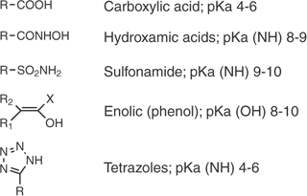
SAR
All nonselective COX inhibitors possess a center of acidity
Represented by a carboxylic acid function, an enolic function, a hydroxamic acid function, a sulfonamide, or a tetrazole ring.
Relationship of this acid center to the carboxylic acid function of arachidonic acid
The activity of ester and amide derivatives of carboxylic acids generally is attributed to the metabolic hydrolysis products.

Slide 93
SAR contd…
The center of acidity generally is located one carbon atom adjacent to a flat surface represented by an aromatic or heteroaromatic ring.
The distance between these centers is crucial, because increasing this distance to two or three carbons generally diminishes activity
Derivatives of aryl or heteroaryl acetic or propionic acids are most common
This aromatic system appears to correlate with the double bonds at the 5- and 8-positions of arachidonic acid
Substitution of a methyl group on the carbon atom separating the acid center from the aromatic ring tends to increase anti-inflammatory activity

Slide 94
SAR contd…
The resulting α-methyl acetic acid, or 2-substituted propionic acid, analogues have been given the class name “profens” by the U.S. Adopted Name Council. Groups larger than methyl decrease activity,
but incorporation of this methyl group as part of an alicyclic ring system does not drastically affect activity
Introduction of a methyl group creates a center of chirality.
Anti-inflammatory activity in those cases in which the enantiomers have been separated and evaluated, is associated with the S-(+)-enantiomer
Interestingly, in those cases in which the propionic acid is administered as a racemic mixture, in vivo conversion of the R-enantiomer to the biologically active S-enantiomer is observed to varying degrees.

Slide 95
SAR contd…
A second area of lipophilicity that is noncoplanar with the aromatic or heteroaromatic ring generally enhances activity
This second lipophilic area may correspond to the area of the double bond in the 11-position of arachidonic acid
This lipophilic function may consist of an additional aromatic ring or alkyl groups either attached to or fused with the aromatic center.

Slide 96
Aryl- and heteroarylacetic acid derivatives
The 5-position of the indole ring is most flexible with regard to the nature of substituents that enhance activity
Substituents such as methoxy, fluoro, dimethylamino, methyl, allyloxy, and acetyl are more active than the unsubstituted indole ring
The presence of an indole ring nitrogen is not essential for activity, because the corresponding 1-benzylidenylindene analogues (e.g., sulindac) are active
Alkyl groups, especially methyl, at the α-position are more active than aryl substituents
Substitution of a methyl group at the α-position of the acetic acid side chain (to give the corresponding propionic acid derivative) leads to equiactive analogues
The resulting chirality introduced in the molecules is important. Anti-inflammatory activity is displayed only by the S-(+)-enantiomer
The acetic acid side chain is flexible and can assume a large number of different conformations

Slide 97
Aryl- and heteroarylacetic acid derivatives contd…
The conformation of indomethacin appears to play a crucial role in its anti-inflammatory actions
The preferred and lower-energy conformation of the N-p-chlorobenzoyl group is one in which the chlorophenyl ring is oriented away from the 2-methyl group (or cis to the methoxyphenyl ring of the indole nucleus) and is noncoplanar with the indole ring because of steric hindrance produced by the 2-methyl group and the hydrogen atom at the 7-position
The importance of stereochemical features in the action of sulindac, introduced by the benzylidene double bond, is evidenced by the observation that the (Z)-isomer is a much more potent anti-inflammatory agent than the corresponding (E)-isomer
This cis-relationship of the phenyl substituent to the aromatic ring bearing the fluoro substituent is similar to the proposed conformation of indomethacin, suggesting that both indomethacin and sulindac assume similar conformations at the active site of arachidonic acid cyclooxygenase.

Slide 98
Structures of aryl- and heteroarylacetic acid derivatives.

Slide 99
Structures of aryl- and heteroarylacetic acid derivatives contd..

Slide 100
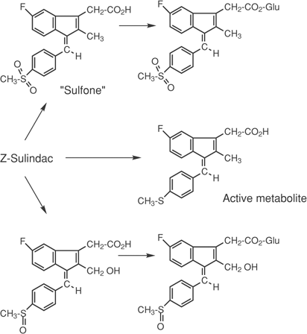
Metabolism of sulindac

Slide 101
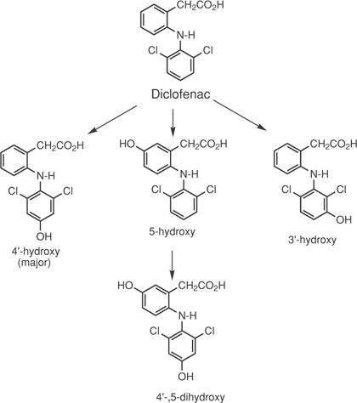
Metabolism of diclofenac

Slide 102
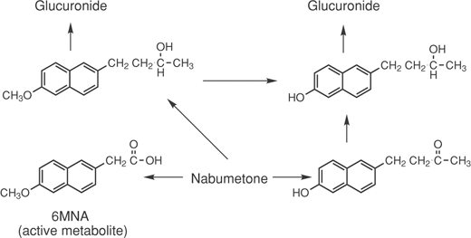
Metabolism of nabumetone- Prodrug

Slide 103
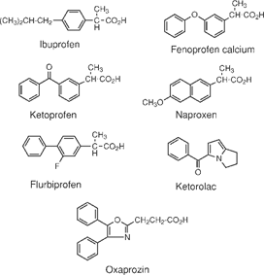
Aryl- and heteroarylpropionic acids

Slide 104
SAR (Ibuprofen)
Ibufenac (p-isobutylphenylacetic acid), is less potent and more hepatotoxic than ibuprofen.
Although marketed as a racemic mixture, the (+)-enantiomer of ibuprofen possess greater activity in vitro than the (–)-isomer
However, because of metabolism, the two enantiomers are equiactive→ R-(–)-enantiomer is inverted to the S-(+)-enantiomer in vivo via an acetyl–coenzyme A intermediate
The (+)-enantiomer of ibuprofen—and of most of the arylpropionic acids under investigation—has been shown to possess the (S)-absolute configuration.

Slide 105
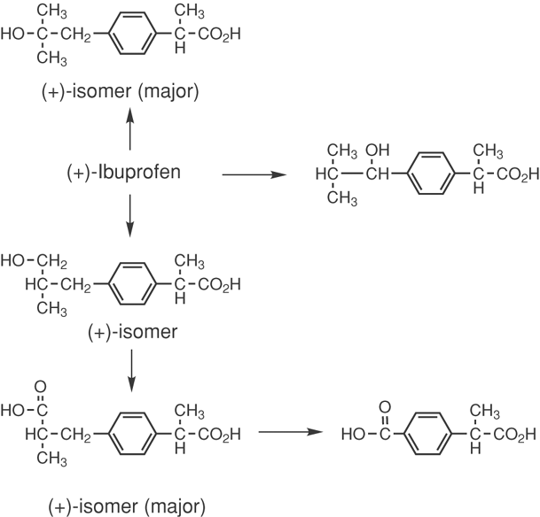
Metabolism of ibuprofen

Slide 106
Naproxen- SAR
In a series of substituted 2-naphthylacetic acids, substitution in the 6-position led to maximum anti-inflammatory activity
Small lipophilic groups, such as Cl, CH₃S, and CHF₂O, were active analogues, with CH₃O being the most potent.
Larger groups were found to be less active
Derivatives of 2-naphthylpropionic acids are more potent than the corresponding acetic acid analogues
Replacing the carboxyl group with functional groups capable of being metabolized to the carboxyl function (e.g., —CO₂CH₃, —CHO, or —CH₂OH) led to a retention of activity
The S-(+)-isomer is the more potent enantiomer
Naproxen is the only arylalkanoic acid NSAID currently marketed as optically active isomers.

Slide 107
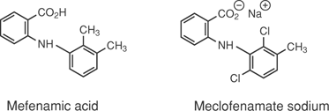
N-Arylanthranilic Acids (Fenamic Acids)
The anthranilic acid class of NSAIDs is the result of the application of classical medicinal chemistry bio-isosteric drug design concepts, because these derivatives are nitrogen isosteres of salicylic acid.

Slide 108
SAR
Why is Mefenamic acid more potent than Meclofenamate sodium
- Enhanced non-coplanarity
The NH-moiety of anthranilic acid appears to be essential for activity, because replacement of the NH function with O, CH₂, S, SO₂, N-CH₃, or N-COCH₃ functionalities significantly reduces activity
Finally, the position, rather than the nature, of the acidic function is critical for activity
Anthranilic acid derivatives are active, whereas the m- and p-aminobenzoic acid analogues are not
Replacement of the carboxylic acid function with the isosteric tetrazole moiety has little effect on activity.

Slide 109

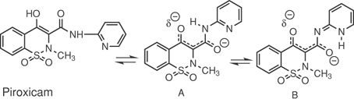
Oxicams

Slide 110
SAR
Within the series of 4-hydroxy-1,2-benzothiazine carboxamides represented by the general structure shown above
Optimum activity was observed when R₁ was a methyl substituent
The carboxamide substituent, R, generally is an aryl or heteroaryl substituent, because alkyl substituents are less active
Oxicams are acidic compounds, with pK_{a} values in the range of four to six.
N-heterocyclic carboxamides generally are more acidic than the corresponding N-aryl carboxamides, and this enhanced acidity was attributed to stabilization of the enolate anion by the pyridine nitrogen atom, as illustrated in tautomer A and additional stabilization by tautomer B
Two major differences, however, are observed when R = heteroaryl rather than aryl:
  The pK_{a} values generally are two to four units lower and
  Anti-inflammatory activity increased as much as sevenfold.
  The greatest activity is associated with the 2-pyridyl (as in piroxicam), 2-thiazolyl, or 3-(5-methyl) isoxazolyl ring systems

Slide 111
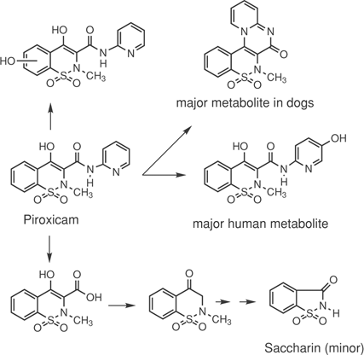
Metabolism of piroxicam

Slide 112
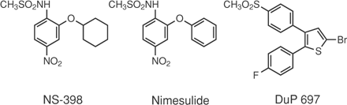
Selective COX-2 Inhibitors
Those NSAIDs with a greater selectivity for COX-1 generally cause greater GI bleeding and renal toxicity than those with greater selectivity for COX-2.
These early studies led to extensive efforts by many laboratories to develop selective inhibitors of the COX-2 isoform with the goal of developing an “ideal” NSAID—that is, one that selectively inhibits COX-2, thus reducing the inflammatory response but not interfering with the GI-protective functions of COX-1
Two early lead compounds were developed, NS-398 and DuP 697, which have served as the basis of the development of two widely explored chemical classes. NS-398 and nimesulide are the prototypes of compounds known as “sulides,” whereas DuP 697 is the prototype of a class of COX-2 inhibitors termed “coxibs.”

Slide 113
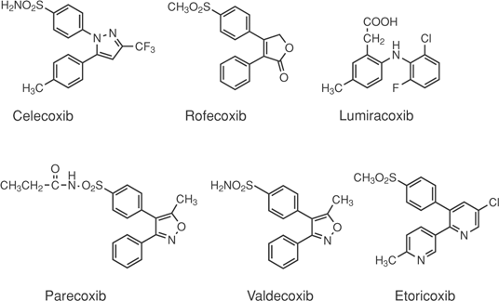
Structures of selective COX-2 inhibitors

Slide 114
Problems
Celecoxib may cause an increased risk of serious cardiovascular thrombotic events, myocardial infarction, and stroke, which can be fatal.
All NSAIDs may have a similar risk
This risk may increase with duration of use.
Patients with cardiovascular disease or risk factors for cardiovascular disease may be at greater risk.
The NSAIDs, including celecoxib, cause an increased risk of serious GI adverse events, including bleeding, ulceration, and perforation of the stomach or intestines, which can be fatal.
These events can occur at any time during use and without warning symptoms. Elderly patients are at greater risk for serious GI events.
Rofecoxib (Vioxx) was voluntarily withdrawn from the United States and the worldwide market on September 30, 2004, because of safety concerns regarding an increased risk for cardiovascular events, including heart attack and stroke, in patients taking rofecoxib.
Valdecoxib (Bextra) was voluntarily withdrawn from the U.S. market on April 7, 2005, because of safety concerns regarding increased risk of cardiovascular events and reports of serious and potentially life-threatening skin reactions, including deaths, in patients taking valdecoxib.

Slide 115

Problems contd..
Analgin
Synonyms: Dipyron; Metamizol; Methapyrone; Sulpyrine; Sodium [(1,5-dimethyl-3-oxo-2-phenyl-pyrazol-4-yl)-methyl-amino]methanesulfonate

Slide 116
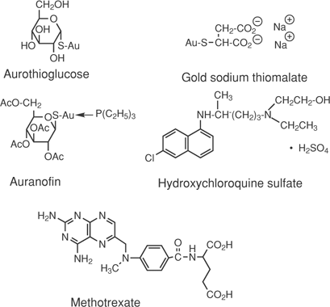
Disease-Modifying Antirheumatic Drugs

Slide 117

Drugs Used to Treat Gout
Formation of uric acid, urea, and glyoxylic acid from purines

Slide 118
Drugs Used to Treat Gout contd…
When levels of uric acid in the body increase, either as a result of decreased excretion or increased formation, the solubility limits of sodium urate are exceeded, and precipitation of the salt from the resulting supersaturated solution causes deposits of urate crystals to form
It is the formation of these urate crystals in joints and connective tissue that initiate attacks of gouty arthritis
The control of gout has been approached from the following therapeutic strategies:
1) control of acute attacks by drugs that reduce inflammation caused by the deposition of urate crystals (these drugs may possess only an anti-inflammatory component, such as colchicine, or both anti- inflammatory and analgetic actions, such as indomethacin, phenylbutazone and naproxen),
2) increasing the rate of uric acid excretion (by definition, these drugs are termed “uricosuric drugs” and include probenecid and sulfinpyrazone), and
3) inhibiting the biosynthesis of uric acid by inhibiting the enzyme xanthine oxidase by drugs such as allopurinol.

Slide 119

Structures of agents used to control gout

Slide 120

Mechanism of Action of Allopurinol
Allopurinol serves as a substrate for xanthine oxidase (15 to 20 times the affinity of xanthine) and reversibly inhibits that enzyme
Normally, uric acid is a major metabolic end product in humans
When allopurinol is administered, however, xanthine and hypoxanthine are elevated in the urine, and uric acid levels decrease
When the synthesis of uric acid is inhibited, plasma urate levels decrease, supersaturated solutions of urate are no longer present, and urate crystal deposits dissolve, eliminating the primary cause of gout.

