Slide 1
Anxiolytics (Tranquilisers)
Oxazepam, meprobamate, tybamate, buspirone

Slide 2

Clinical indications
Anxiety
Is unpleasant state of tension, apprehension or uneasiness-a fear that seems to arise from an unknown source.
The symptoms of severe anxiety are similar to those of fear (such as tachycardia, sweating, trembling, palpitation) & involve sympathetic activation. Episodes of mild anxiety are common life experiences and do not need any treatment.
While the symptoms of severe chronic anxiety may by treated with anti-anxiety drug
Anxiolytics are drugs used for the treatment of symptoms of anxiety

Slide 3
Cause
A variety of neurotransmitters (GABA, Serotonin, norepinephrine) may be involved in the pathophysiology of anxiety.
Anxiolytic agents are –
GABA agonists
Barbiturates are not used as anxiolytics due to their side effects
Benzodiazepines – Diazepam, Chlordiazepoxide, oxazepam
Serotonin receptor agonists
Pyrimidinyl butylpiperazines (azaspirones) - Buspirone

Slide 4
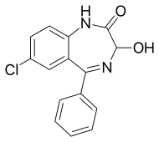

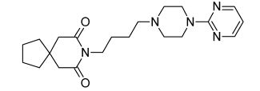
Chemical classification
Benzodiazepines eg. oxazepam
Carbamates eg. Meprobamate and its prodrug tybamate
Azaspirones eg. Buspirone

Slide 5
Benzodiazepines
The benzodiazepines are the prototypic antianxiety agents.
They target the GABA_{A} receptor, and although other molecular targets (e.g., serotonin neuroreceptors) now are exploited for anxiolytic pharmacotherapy, none of the alternative approaches has been shown to match either the efficacy or the rapid onset of the benzodiazepines

Slide 6
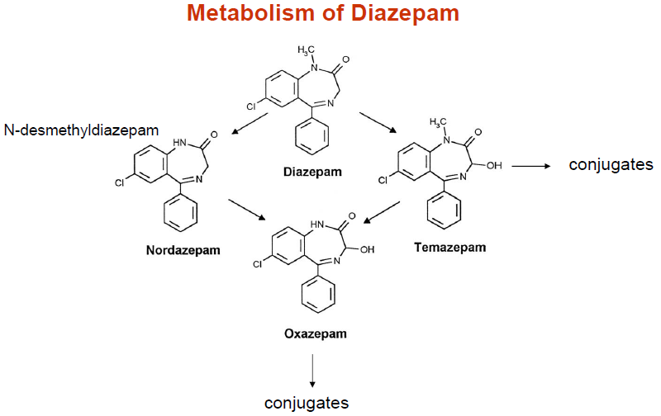
Oxazepam
7-Chloro-3-hydroxy-5-phenyl-1,3-dihydro-1,4-benzodiazepin-2-one
Oxazepam is an active metabolite of both chlordiazepoxide and diazepam and is marketed separately, as a short-acting anxiolytic agent .
It is often tolerated better by patients than other tranquilizers.
Besides being used in conditions of anxiety, it is also used in neurosis, fear, stress, trouble falling asleep, and psychovegatative disorders.

Slide 7
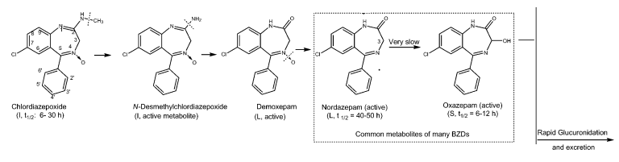
Oxazepam
Oxazepam is rapidly inactivated to glucuronidated metabolites that are excreted in the urine
Cumulative effects with chronic therapy are much less than with long-acting benzodiazepines, such as chlordiazepoxide and diazepam.

Slide 8
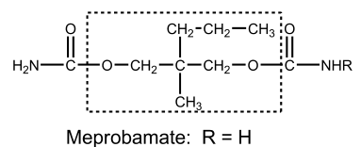
Alcohols and Their Carbamate Derivatives eg.-Meprobamate
It is an officially indicated as an antianxiety agent. It is also a sedative– hypnotic agent
Meprobamate is used primarily as a daytime anxiolytic in treating conditions of anxiety associated with everyday, usual, and common stress.
Meprobamate is also a centrally acting skeletal muscle relaxant.
The agents in this group find use in several conditions, such as strains and sprains that may produce acute muscle spasm
2-methyl-2-propyltrimethylene dicarbamate, 2-methyl-2-propyl-1,3-propanediol dicarbamate

Slide 9
Alcohols and Their Carbamate Derivatives eg.-Meprobamate
Meprobamate was proposed before the introduction of benzodiazepines into medical practice.
The exact mechanism of action of this drug is not known; however, its effects on the CNS are more similar to the effects of barbiturates than to benzodiazepines, but with shorter lasting action.
After the introduction of benzodiazepines into practice, the use of this drug became significantly less.
2-methyl-2-propyltrimethylene dicarbamate, 2-methyl-2-propyl-1,3-propanediol dicarbamate

Slide 10
Meprobamate
Meprobamate's mechanism of action is not completely known.
It has been shown in animal studies to have effects at multiple sites in the central nervous system, including the thalamus and limbic system.
GABA agonism
Meprobamate binds to GABA_{A} receptors which interrupts neuronal communication in the reticular formation and spinal cord, causing sedation and altered perception of pain.
However, it has been shown that meprobamate has the ability to activate currents even in the absence of GABA
This relatively unique property makes meprobamate exceptionally dangerous when used in combination with other GABA-mediated drugs (including alcohol).
Adenosine reuptake inhibitor
It is also a potent adenosine reuptake inhibitor. Adenosine inhibits processes associates with wakefulness which involve neurotransmitters like serotonin.
Related drugs include tybamate (prodrug of meprobamate),

Slide 11
Tybamate
It is an anxiolytic of the carbamate family.
It is a prodrug for meprobamate and is converted to it by N-dealkylation.
v
v
NH₂

Slide 12
Buspirone
Buspirone is an extremely specific drug that could possibly represent a new chemical class of anxiolytics—azaspirones. (azaspirodecane diones)
Unlike most drugs predominantly used to treat anxiety, buspirone's pharmacology is not related to benzodiazepines or barbiturates, and so does not carry the risk of physical dependence and withdrawal symptoms for which those drug classes are known.
As an anxiolytic, its activity is equal to that of benzodiazepines; however, it is devoid of anticonvulsant and muscle relaxant properties, which are characteristic of benzodiazepines.
1
2
6
7
5
8
3
10
9
4
8-[4-(4-pyrimidin-2-ylpiperazin-1-yl)butyl]-8-azaspiro[4.5]decane-7,9-dione

Slide 13
5-HT1A Agonists and Partial Agonists eg. Buspirone
The mechanism of its action is not conclusively known. It does not act on the GABA receptors, which occurs in benzodiazepine use;
However, it has a high affinity for seratonin (5-HT) receptors and a moderate affinity for dopamine (D2) receptors.

Slide 14
Mechanism
It has anxiolytic and antidepressant activities
It does not act on the GABA receptors
It is a partial 5-HT1A receptor agonist. 5-HT1A is a G_{i/o} type of GPCR
Its anxiolytic activity is reportedly caused
by its ability to diminish 5-HT release (via 5-HT1A agonism).
High short-term synaptic levels of 5-HT are characteristic of anxiety.
Buspirone is an agonist at the 5-HT1A receptor. Stimulation of 5-HT1A receptor inhibits further release of 5-HT
Its anxiolytic effects appear only after several days of treatment,
It is effective in the treatment of generalized anxiety disorders that are mild to moderate in severity, but it is not useful for severe anxiety (e.g., with panic attacks).

