Slide 1
NSAIDS
Nonsteroidal Anti-Inflammatory Drugs

Slide 2
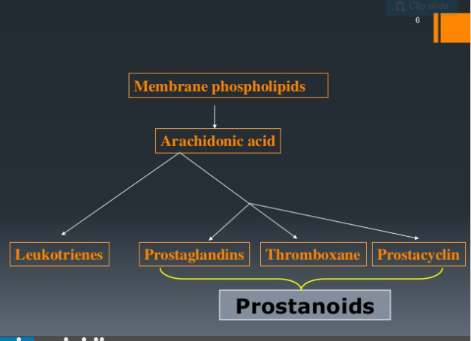

Slide 3
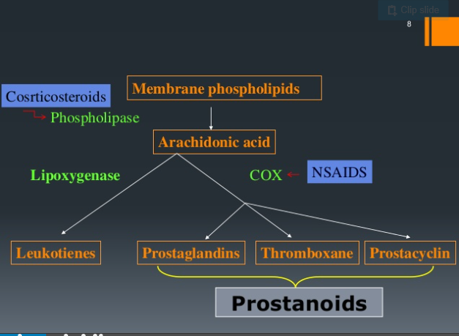

Slide 4
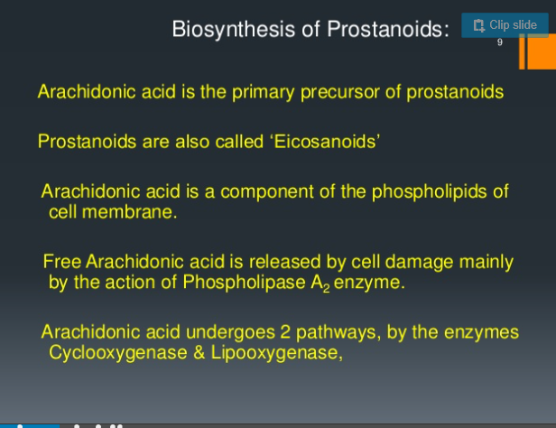

Slide 5
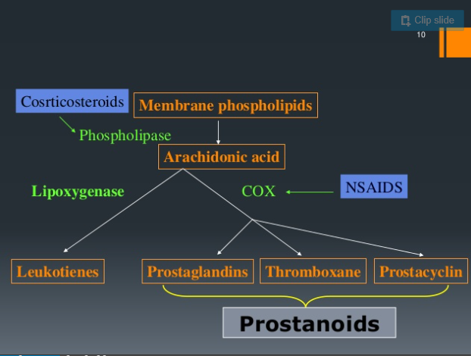

Slide 6
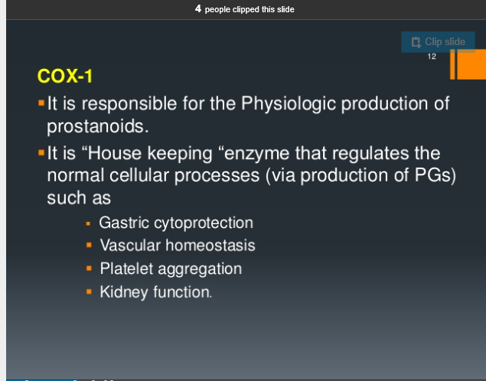

Slide 7
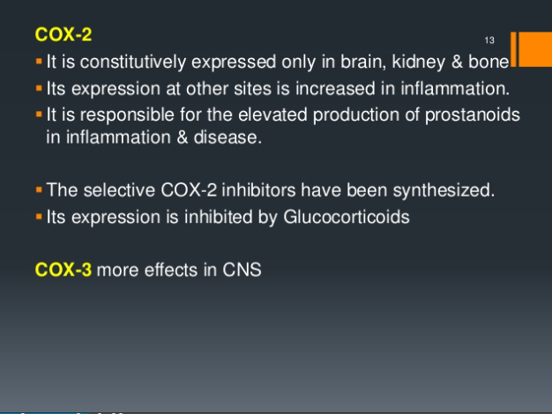

Slide 8
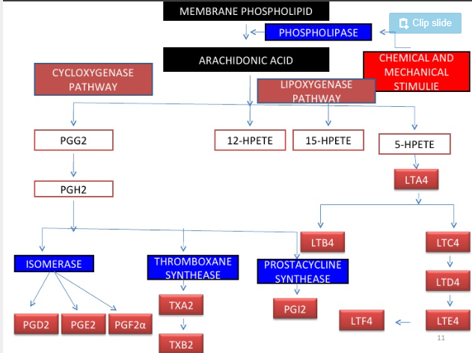

Slide 9
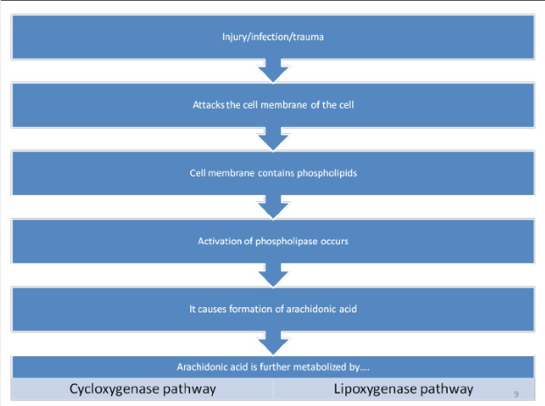

Slide 10
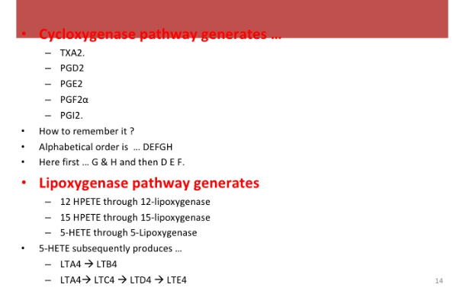

Slide 11
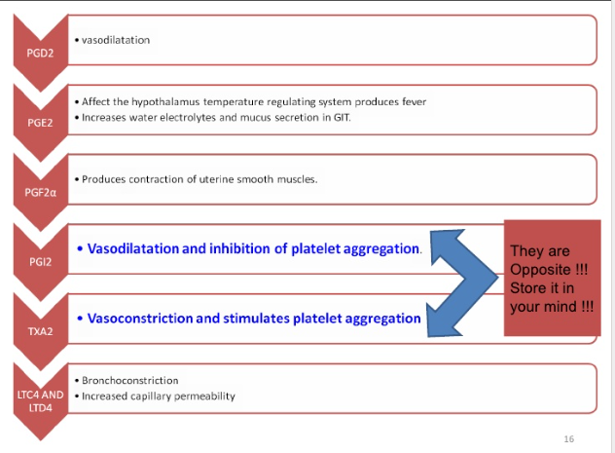

Slide 12
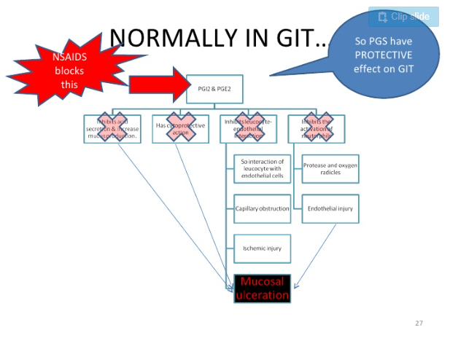

Slide 13
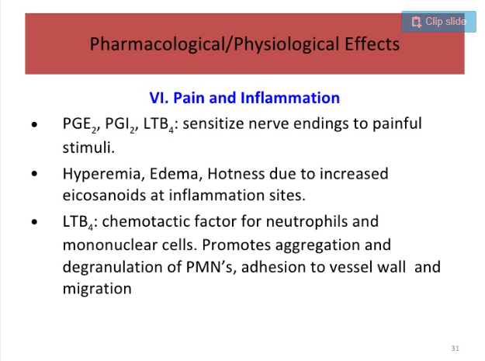

Slide 14
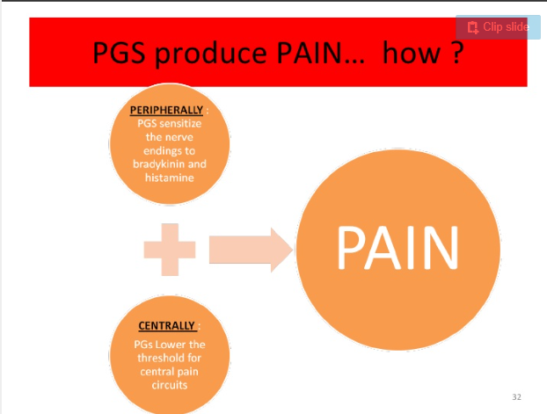

Slide 15
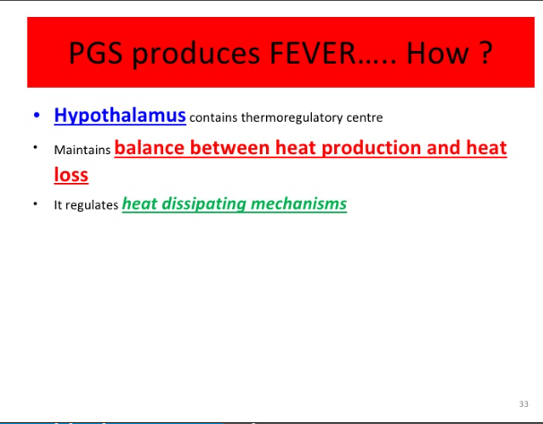

Slide 16
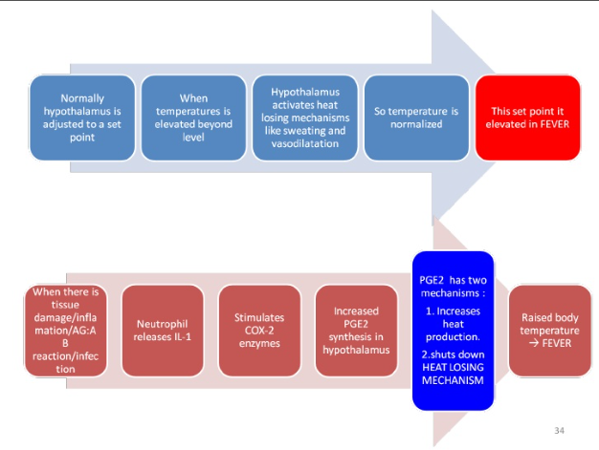

Slide 17
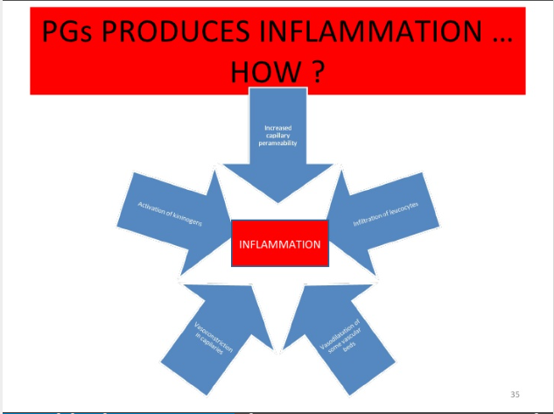

Slide 18
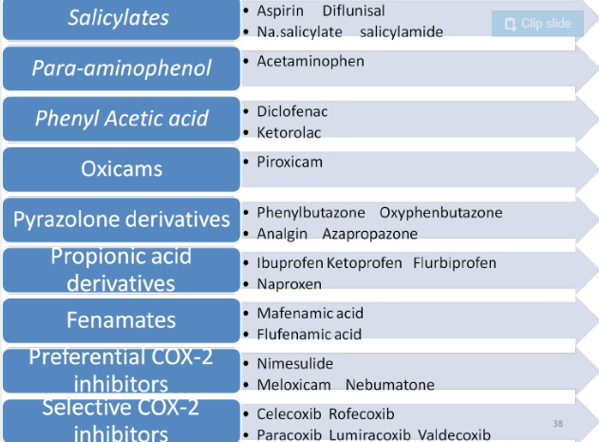

Slide 19
Antipyretic analgesics Eg: Acetaminophen
Anti-inflamatory analgesics Eg: Aspirin and other salicylates, Indomethacin, Diclofenac, Nabumetone, Sulindac, Ibuprofen, Flurbiprofen, Naproxen, Mefenamic acid, Piroxicam
COX-2 inhibitors :Celecoxib, Rofecoxib
Drugs for arthritis: Etanercept, Infliximab, Rituximab, Anakinra, Abatacept
Drugs for the treatment of gout: Colchicine, Probenecid, Sulf inpyrazone, Allopurinol

Slide 20
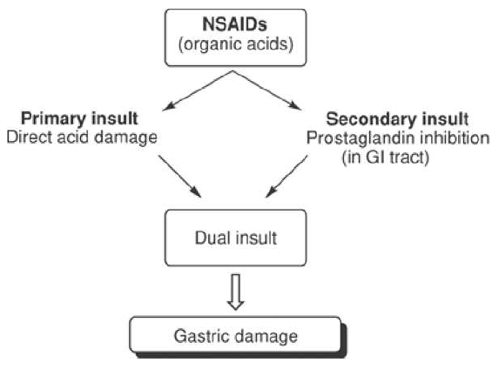

Slide 21
Salicylates: Eg: Aspirin (Acetyl salicylic acid)
Propionic acid derivatives. Eg: Ibuprofen, Naproxen, Flurbiprofen
Acetic acid derivatives Eg: Indomethacin, Sulindac, Diclofencac, Nabumetone
Enolic acid (Oxicam) derivatives: Eg: Piroxicam,
Fenamic acid derivatives: Eg: Mefenamic acid
Pyrozolone derivatives: Eg: Phenyl butazone, Sulfinpyrazone
Selective COX2 inhibitors(Coxibs): Eg: Celecoxib, Rofecoxib
Sulphoanilides: Eg: Nimesulide
Others: Acetaminophen, Diclofenac, Probenecid,Colchicine, Allopurinol
Drugs for arthritis: Etanercept, Infliximab, Rituximab, Anakinra, Abatacept

Slide 22
Selective COX-2 inhibitors have lower risk of GI bleeding but a substantially more increased risk of myocardial infarction than the nonselective inhibitors.

Slide 23
NSAIDS
Treatment of acute and chronic conditions associated with pain and inflammation
Rheumatoid arthritis
Osteoarthritis
Inflammatory arthopathies
(Eg: ankylosing spondylitis, psoriatic arthritis, Reiters syndrome)
Acute gout
Pyrexia
Ileus
Renal colic
Dysmenorrhoea
Metastatic bone pain,
Headache and migraine
Post operative pain

Slide 24
Salicylates

Slide 26
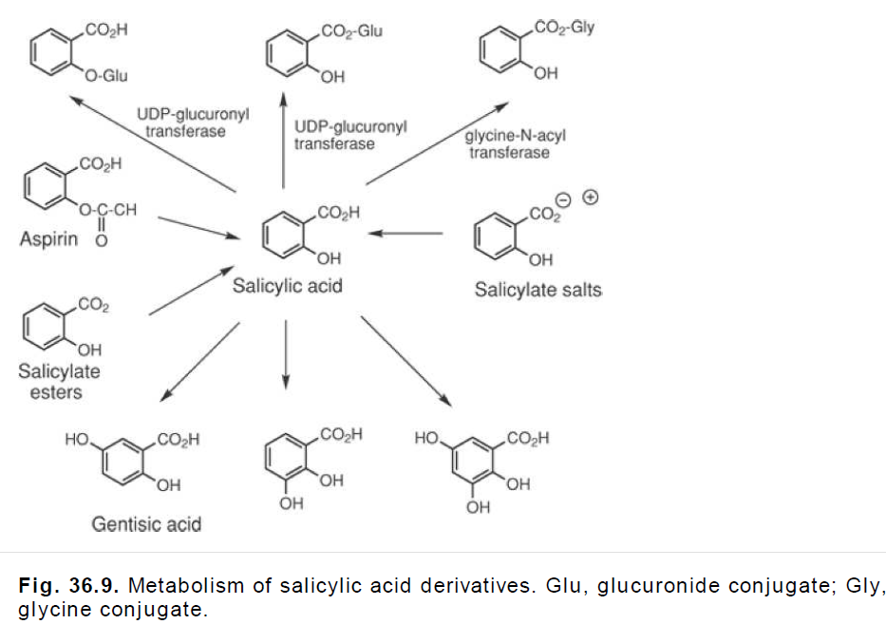

Slide 27
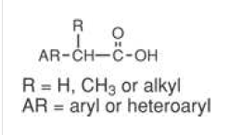
Aryl alkanoic acids

Slide 28
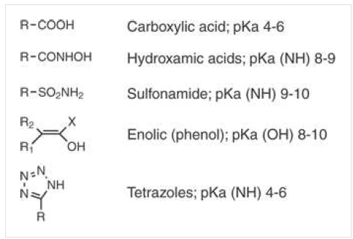

Slide 29
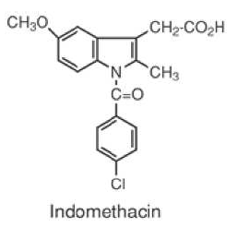
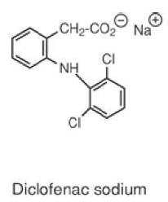
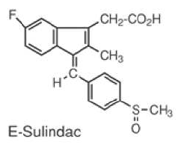
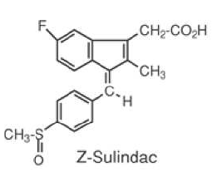
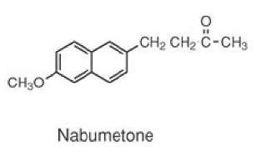

Slide 31
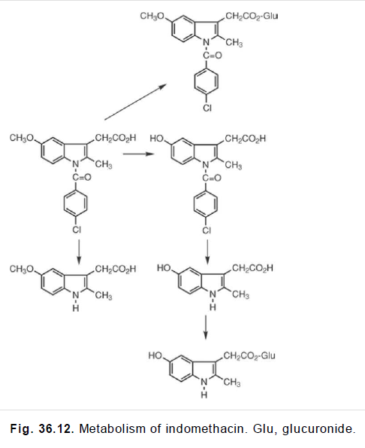

Slide 32
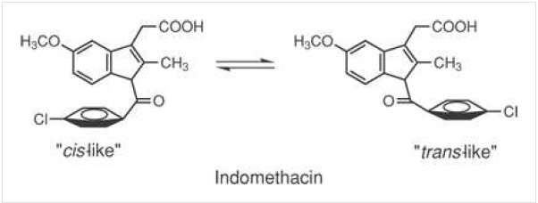
Isosteric replacement indole ring with indene ring
Good anti-inflammatory, few CNS and GI but undesirable
Side effects
Poor water solubility- crystalluria
5-OCH₃ with 5- F in indene isostere increased analgesic
P-chloro with sulfinyl alleviation of decreased double bond
Benzylidene double bond
Conformation at the active site of arachidonic acid
Chiral sulfoxide
Racemate marketed
Reduction to achiral sulfide

Slide 34
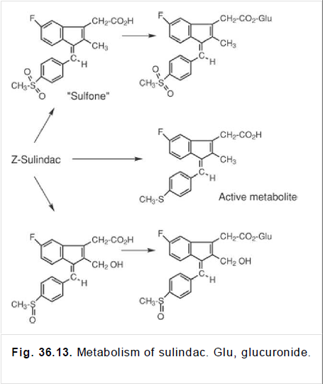

Slide 35
Inhibition of arachidonic acid cox system
Inhibition of Lipoxygenase pathway
Inhibition of arachidonic acid release
and stimulation of its reuptake
2 ortho chloro groups force anilino phenyl ring
Out of the phenylacetic acid portion leads to twisting effect
For binding of NSAIDS to the active site of COX

Slide 36
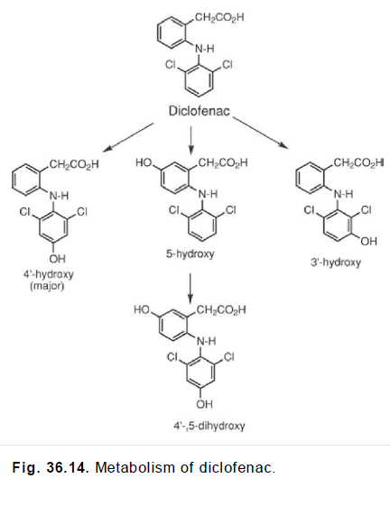

Slide 37
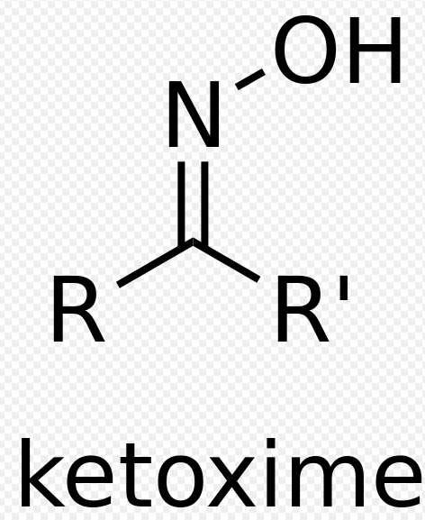
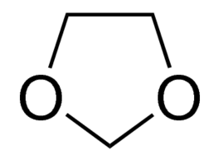
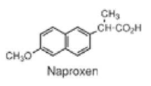
Nonacidic prodrug
Rapidly metabolized to form 6-methoxynaphthalene acetic acid
Produces insignificant primary and secondary insult
In blood metabolized to 6-methoxynaphthalene-2-acetic acid-COX inhibitor in joints
6-methoxy-2-naphthylacetic acid
dioxolane

Slide 38
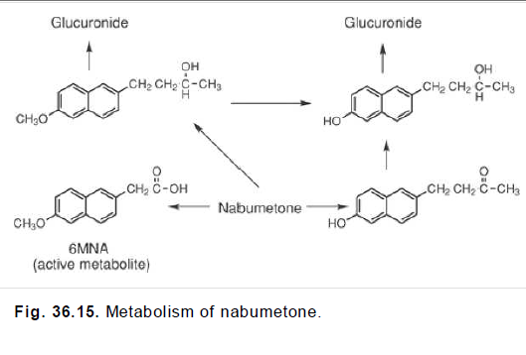

Slide 39
6-methoxynaphthalene-2-acetic acid(active)
4-(6-methoxy-2-naphthyl)pentan-2-one
Naproxen
inactive

Slide 40
6-O-desmethyl metabolite
glucuronidation
Naproxen

Slide 41


Slide 42
Ibuprofen

Slide 43
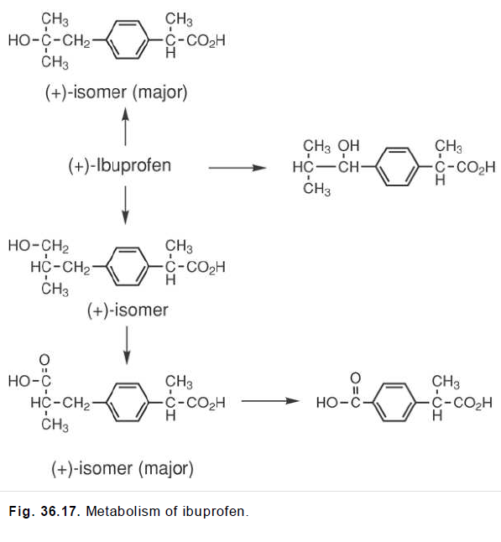

Slide 44
Flurbiprofen

Slide 45
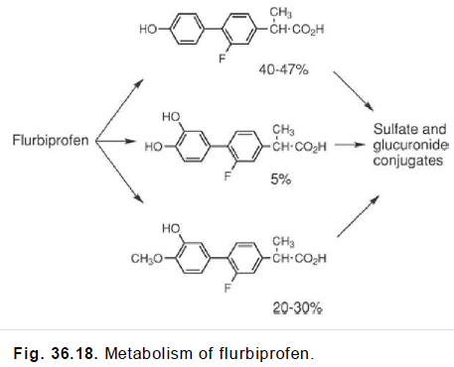

Slide 46
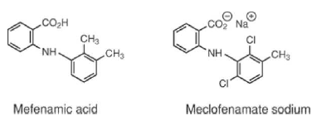

Slide 47
N- Arylanthranilic acids(Fenamic acids)
Acidic function connected to an aromatic ring along with an additional binding site –N-aryl substituent

Slide 48
Regioselective oxidation of 3’ methyl gp and glucuronidation of mefenamic acid
Dicarboxylic acid and glucuronide conjugate
Mefenamic acid
Meclofenamic acid
Flufenamic acid
25 times more active than mefenamic acid
O, CH₂,S,SO₂, N-CH₃, N-COCH₃
Position
Isosteric tetrazole moiety retains activity

Slide 49
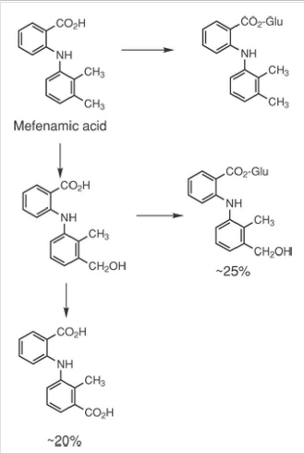

Slide 50
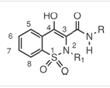
Enolic acid- oxicams
4-hydroxyl-1,2-benzothiazine carboxamides

Slide 51
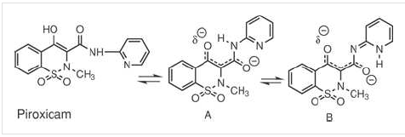

Slide 52
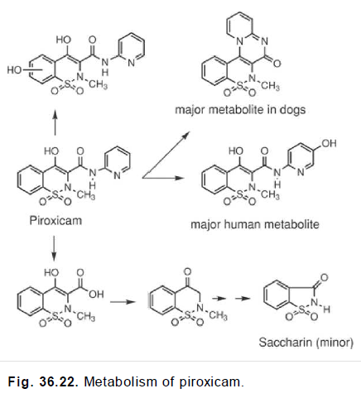

Slide 53
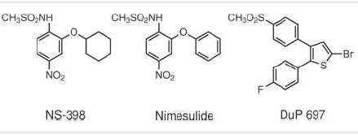

Slide 54
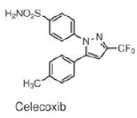
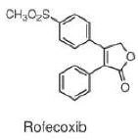

Slide 55
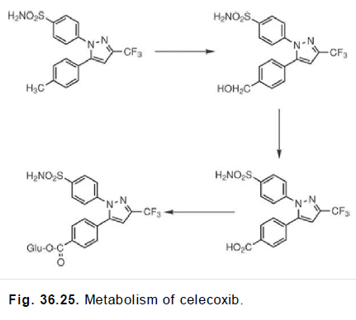

Slide 56
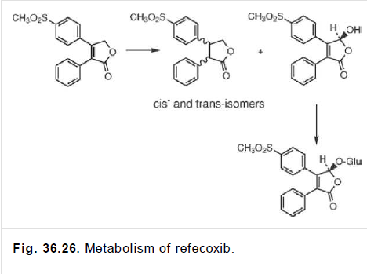

Slide 57
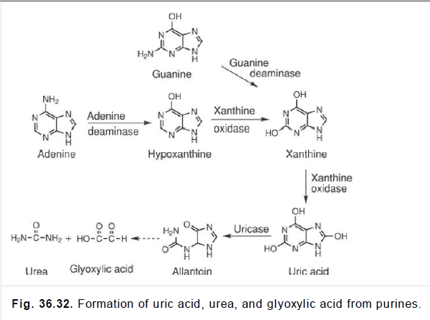

Slide 58
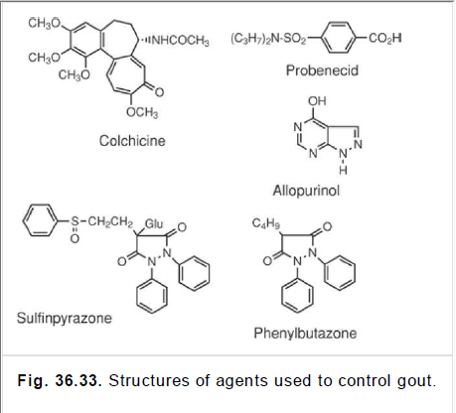

Slide 59
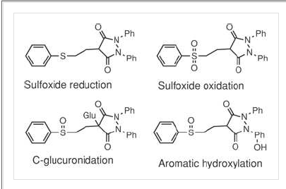

Slide 60
