Slide 1
Adrenocorticosteroids

Slide 2
The adrenal glands are flattened, cap–like structures located above the Kidneys. The inner core ie.medulla of the gland secretes catecholamines while the shell ie. Cortex synthesizes steroid hormone ie. Adrenocorticosteroids
Adrenocorticosteroids are naturally occurring compounds that are released by the adrenal gland.
Stress, anxiety, and the time of day cause the hypothalamus to release corticotropin-releasing hormone which acts on the pituitary gland.
The pituitary gland secretes adrenocorticotropic hormone which stimulates the adrenal cortex to release hydrocortisone.
Once sufficient levels of hydrocortisone have been reached, hydrocortisone causes the pituitary gland and hypothalamus to inhibit the release of their respective hormones.

Slide 3
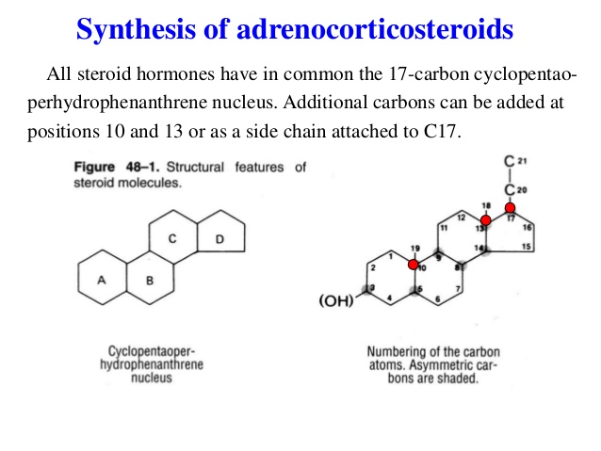

Slide 4
They contain 5 membered Cyclopentane D ring plus 3 rings of Phenanthrene
A perhydrophenanthrene is (rings A, B, C)
A double bond is present between positions 4 & 5 or 5& 6. There is no cis or trans relationship between rings A & B.
The symbol Δ is often used to designate C=C
If the C=C is between positions 4 & 5, the compound referred as Δ⁴ - Steroid.
If the C=C is between positions 5 & 10, the compound referred as Δ⁵ ⁽¹⁰⁾ - Steroid.
Eg. Cholesterol is Δ⁵ - Steroid

Slide 5
Mechanism of Steroid Hormone
They are present in extremely low concentrations eg. 0.1 to 1.0 nmol/L where they exert potent physiologic effects on sensitive tissues and they bind with high affinity to intracellular receptors.
They act on target cells to regulate gene expression and protein biosynthesis via the formation of steroid-receptor complexes, subsequent transactivation of gene expression, receptor dimerization and translocation to the nucleus.

Slide 6
Glucocorticoids and Mineralocorticoids
The Glucocorticoids such as Hydrocortisone (Cortisol) are biosynthesized and released under the influence of Peptide hormones secreted by Hypothalamus and Anterior Pituitary to activateAdrenal Cortex (Hypothalamus-pituitary-adrenal [HPA] axis)
Removal of Pituitary results in Atrophy of the adrenal cortex and marked decrease in rate of Glucocorticoid formation and secretion.
The secretion of Mineralocorticoids, corticosterone and aldosterone is under the influence of octapeptide, Angiotensin II.
The peptide hormone in the Anterior Pituitary that influences Glucocorticoid biosynthesis is ACTH while the peptide hormone in the Hypothalamus is Corticotropin Releasing Factor (CRF).
The production of both ACTH and CRF is regulated by CNS and Negative feedback mechanism.
The CRF is released by Hypothalamus and is transported to the Anterior Pituitary, where it stimulates the release of ACTH into bloodstream.
ACTH is transported to adrenal glands where it stimulates the biosynthesis and secretion of Glucocorticoids.

Slide 7
The circulating levels of Glucocorticoids act on Hypothalamus and Anterior Pituitary to regulate the release of both CRF and ACTH.
As the levels of Glucocorticoids rise, smaller amounts of CRF and ACTH are secreted and negative feedback is observed (HPA suppression).
Stimulii, such as pain, noise and emotional reactions, increase the secretion of CRF, ACTH and consequently Glucocorticoids.
Once the stimulus is alleviated or removed, the negative feedback mechanism inhibits further production and helps to return the body to a normal hormonal balance.
ACTH acts at the adrenal gland by binding to a receptor protein on the surface of the adrenal cortex cell to stimulate the biosynthesis and secretion of Glucocorticoids.
ACTH stimulates the conversion of cholesterol esters to glucocorticoids.
ACTH receptor protein coupled to G protein and to adenyl cyclase and causes activation of adenyl cyclase via G protein. This results in increase in cAMP levels which cleaves cholesterol esters and liberates free cholesterol which is getting converted within mitochondria to pregnenolone which is converted to Adrenocorticoids.

Slide 8
All adrenocorticoiods are well absorbed , undergo little first pass metabolism in the Liver and demonstrates oral Bioavailability of 70-80% except for Triamcinolone.
The degree of Systemic side effects is dose dependent, related to the half life of the drug, frequency of administration, time of day when administered and route of administration.
Higher the plasma corticosteroid concentration and longer the half life, greater will be the systemic side effects.

Slide 9
GLUCOCORTICOIDS

Slide 10
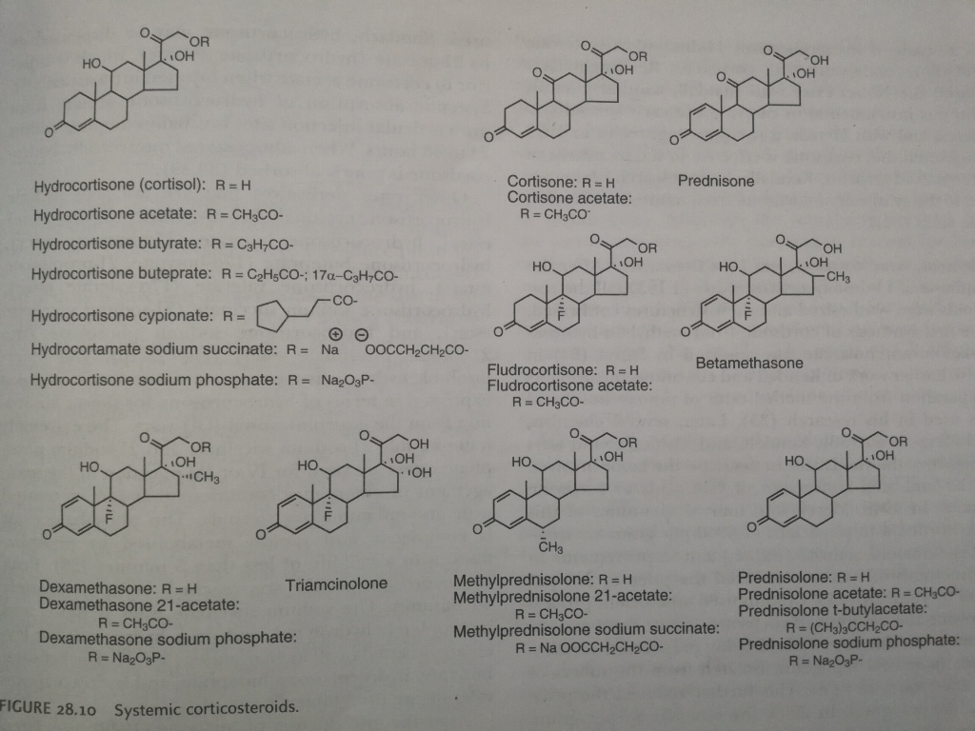

Slide 11
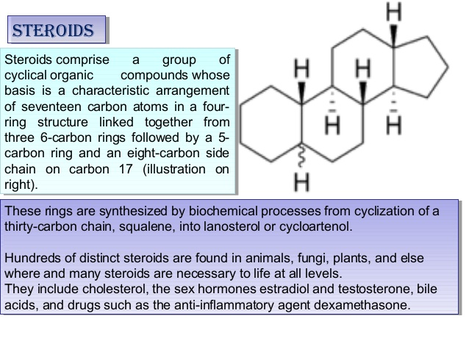

Slide 12
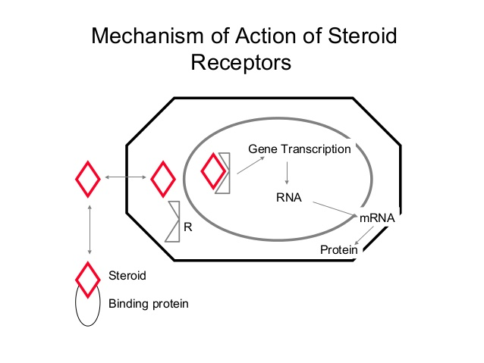

Slide 13
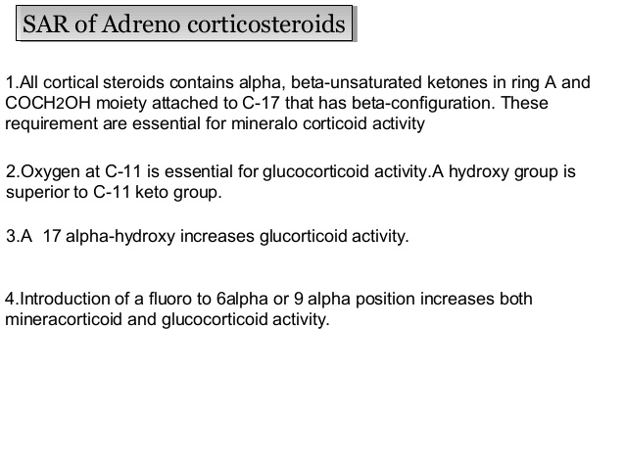

Slide 14
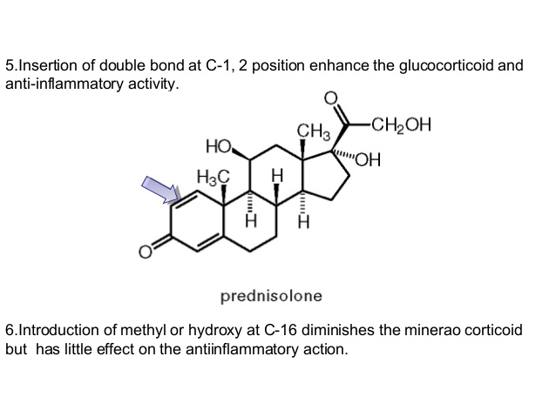

Slide 15
Continued……..
7. Insertion of 2α, 11 α, 21 F group decreases Glucocorticoid activity
8. Insertion of α-CH3 group at position 2,6,16 increases Glucocorticoid activity.
9. Substitution at positions 4 α, 7 α, 11 α and 21 decreases activity.
10. The 12 α, 2 α -CH3 and 9α –Cl substitution contributes equally for Sodium retention.
11. 17 α-OH group reduces sodium retention.
12. 16α –CH3, 16 β-CH3, 16α –CH3O and 6α –Cl groups inhibit sodium retention.

Slide 16
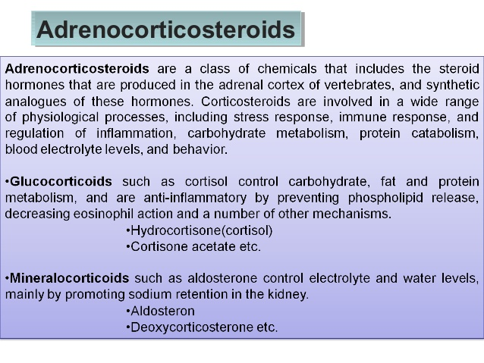

Slide 17
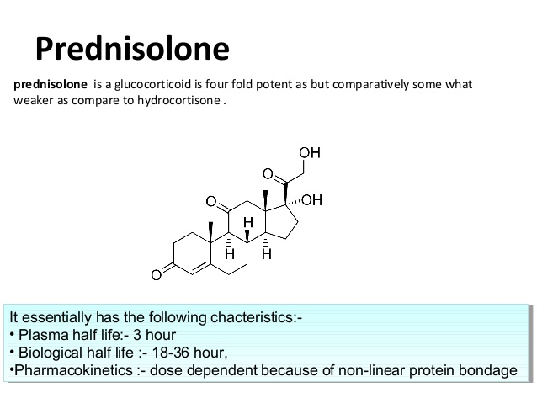
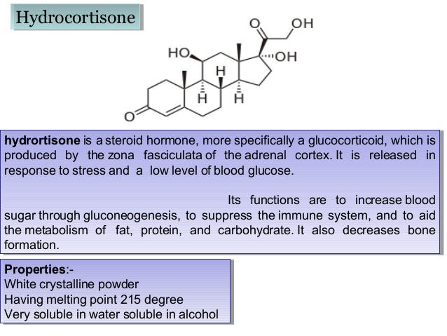
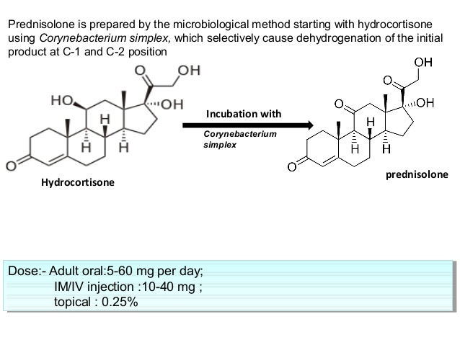

Slide 19
More potent than Cortisone and Hydrocortisone.
When orally administered, completely absorbed, Bioavailability 80%.
It is metabolized into no. of hydrophilic and less active metabolites.
6 β And 16 β Hydroxy are the major metabolites.

Slide 20
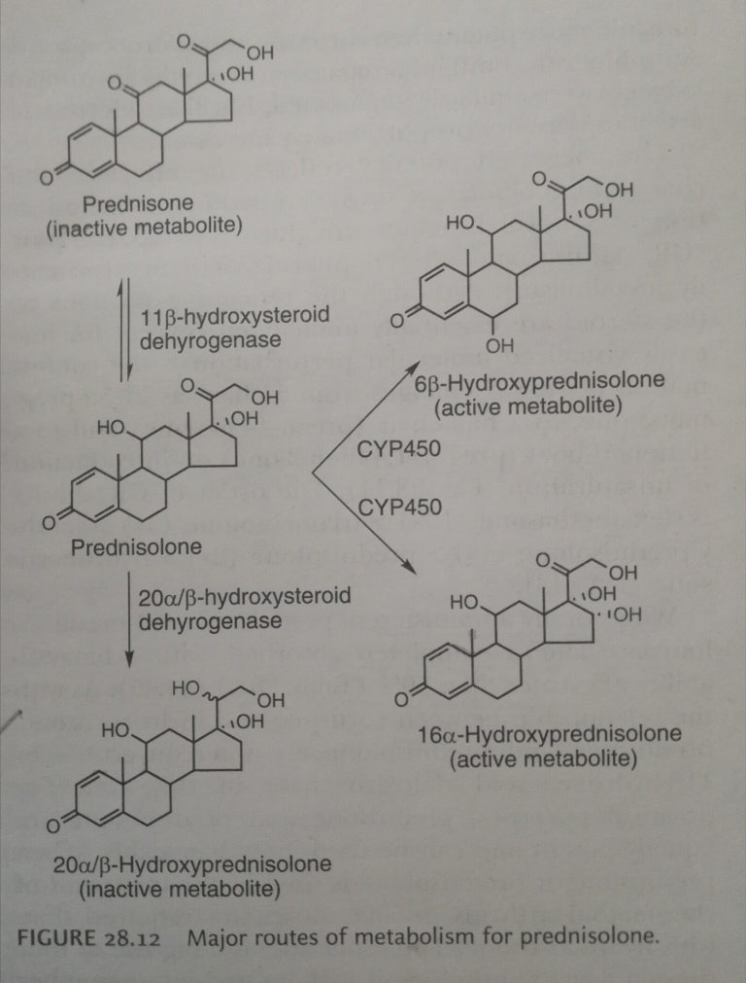

Slide 21
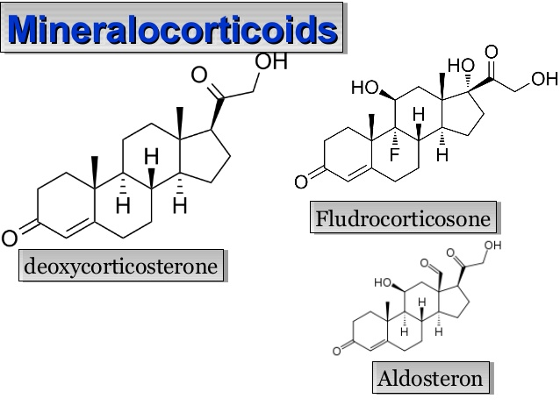

Slide 22
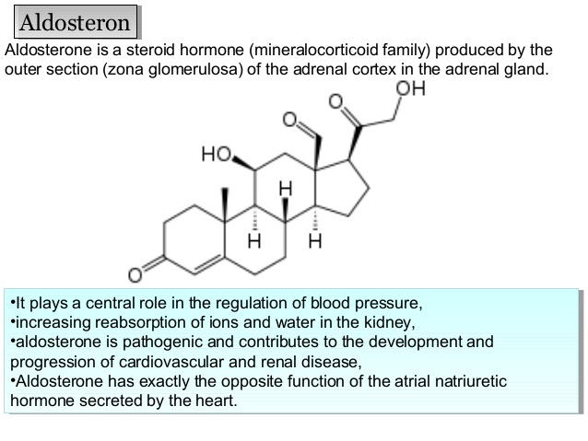

Slide 23
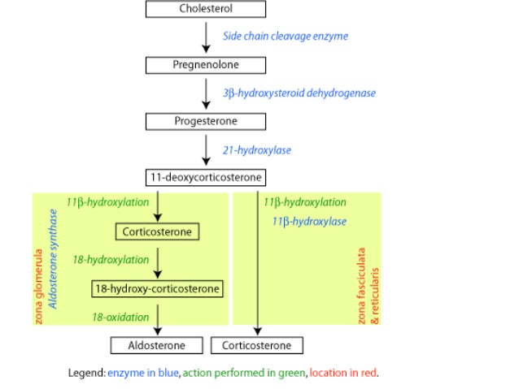

Slide 25
Hydrocortisone (hormonally active) and cortisone (inactive metabolite of Hydrocortisone) are biochemically interconvertible.
Hydrocortisone is metabolized by Liver following administration by any route with a half life of 1to 1.5 hrs.
Hydrocortisone is mainly excreted in urine as inactive O-glucuronide conjugates and minor O-sufate conjugate of urocortisol, 5β-dihydro cortisol and urocortisone.
The tetrahydro metabolite Urocortisol is the major metabolite formed.
Hydrocortisone is extensively bound to plasma proteins primarily to Transcortin with only 5-10% of plasma Hydrocortisone unbound.

Slide 26
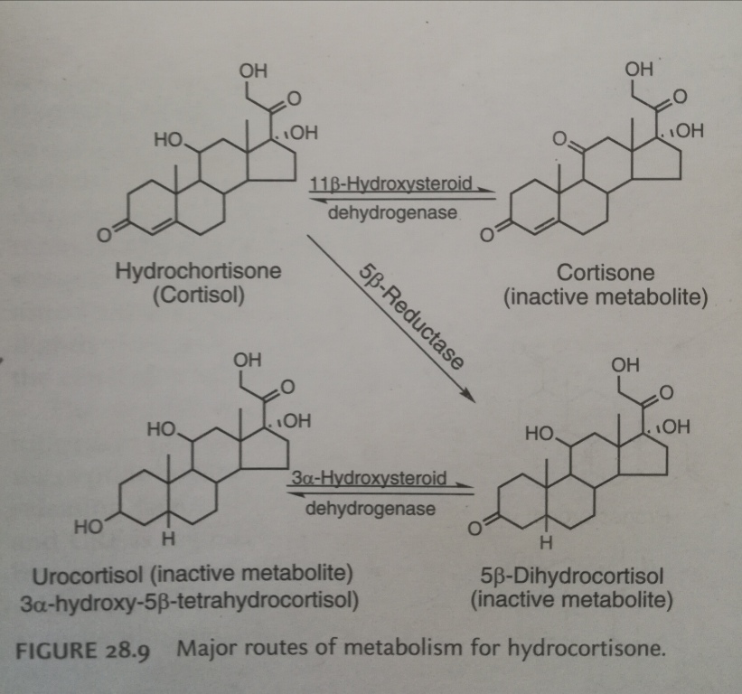

Slide 27
Cortisone is administered orally or by IM
Oral Hydrocortisone is completely absorbed with bioavailability >95% and half life 1-2 hrs.
The acetate ester has increased stability and has a longer duration of action when administered by IM.
When administered intrarectally, hydrocortisone is poorly absorbed.
FLUDROCORTISONE
It is orally administered as its 21-acetate derivative
Effective in Rheumatoid Arthritis
Used in Addison’s Disease

Slide 28
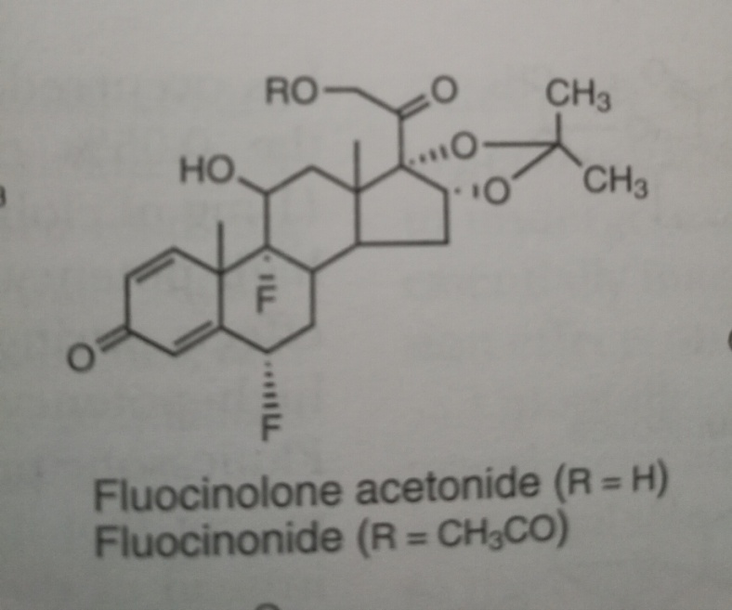
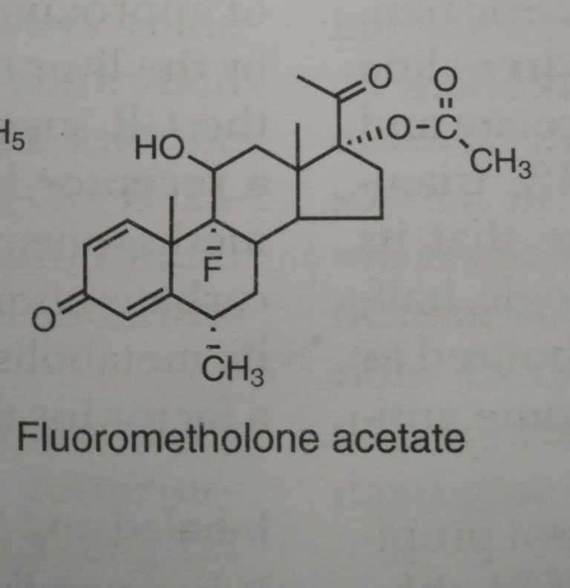

Slide 30


Slide 31


Slide 32
TRIAMCINOLONE
Glucocorticoid activity equivalent to Prednisolone but with decreased Mineralocorticoid activity
Used in Rheumatoid Arthritis
Decreased tendency to cause salt and water retention and edema and can induce sodium and water diuresis including side effects as anorexia, weight loss, muscle weakness, leg cramps, nausea, dizziness and general toxic feeling.
DEXAMETHASONE
Unlike 16-hydroxylation, methyl group increases anti-inflammatory activity by increasing lipophilicity and receptor affinity
Methyl group reduces salt retaining properties of corticosteroids
Anti-inflammatory activity 5 fold more than Prednisolone
Route of metabolism same as Prednisolone

Slide 33
BETAMETHASONE
Used in treatment of Rheumatoid Arthritis and Dermatological Disorders
Less toxic
Side effects: Increased Appetite, weight gain, facial mooning occur with prolonged use

