Slide 1
Gastro-Retentive Drug Delivery Systems (GRDDS)

Slide 2
Oral Controlled Drug Delivery Systems
Osmotic Systems : Osmotic Pumps
Gastro-retentive drug delivery systems (GRDDS)
Multiparticulate drug delivery systems (Pellets)
<number>

Slide 3
Gastrointestinal Tract Physiology

Slide 4
Stomach
The stomach is situated in the left upper part of the abdominal cavity immediately under the diaphragm.
Its size varies according to the amount of distension: up to 1500 ml following a meal; after food has emptied, a collapsed state is obtained with resting volume of 25–50 ml.
The stomach is anatomically divided into three parts: fundus, body, and antrum (or pylorus).
The proximal stomach, made up of fundus and body regions, serves as a reservoir for the ingested materials, while the distal region (antrum) is the major site of mixing motions, acting as a pump to accomplish gastric emptying.
<number>

Slide 5
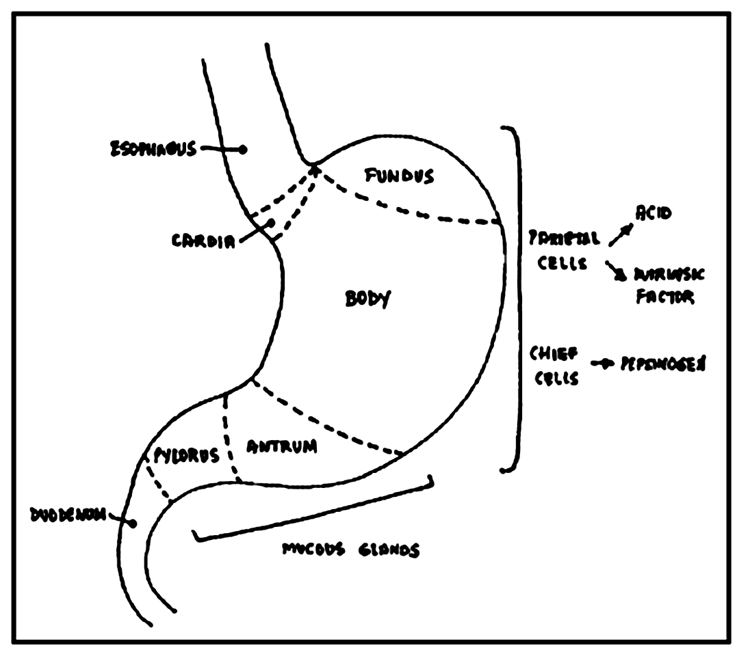
<number>

Slide 6
Gastrointestinal motility
Two distinct patterns of gastrointestinal motility and secretion exist corresponding to the fasted and fed states.
As a result the bioavailability of orally administered drugs will vary depending on the state of feeding.
In the fasted state, it is characterized by an inter-digestive series of electrical event and cycle, both through the stomach and small intestine every 2–3 hours.
This activity is called the interdigestive myoelectric cycle or Migrating motor complex (MMC).
MMC is often divided into four consecutive phases: basal (Phase I), pre-burst (Phase II), burst (Phase III), and Phase IV intervals.
<number>

Slide 7
Phase I (basal phase) lasts for 30-60 min with rare contractions. The quiescent period – lack of secretory activity & contractile motions
Phase II (pre-burst phase) lasts for 20-40 min with intermittent action potential and contractions. As the phase progresses the intensity and frequency also increases gradually.
Phase III (burst phase) lasts for 10-20 min. It includes intense and regular contractions for short periods. Due to this contraction all the undigested material is swept out of the stomach down to the small intestine. This is also known as the ‘housekeeper waves’.
Phase IV lasts for 0–5 min and occurs between phases III and I for two consecutive cycles.
<number>

Slide 8
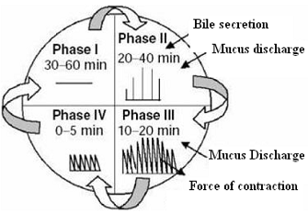
<number>

Slide 9
The motor activity in the fed state is induced 5–10 min after the ingestion of a meal and persists as long as food remains in the stomach.
The larger the amount of food ingested, the longer the period of fed activity, with usual time spans of 2–6 h, and more typically 3–4 h, with phasic contractions similar to Phase II of MMC.
<number>

Slide 10
Regional variability in intestinal absorption- Concept of absorption window
Physico-Chemical Factors
Physiological Factors
Biochemical Factors
<number>

Slide 11
1. Physico-Chemical Factors
pH-dependent solubility-
pH range 1-8 across GIT
To cross biological membrane – solubilized form of drug required
Major mechanism of absorption- passive diffusion which requires unionized form of the drug
Thus, extent of ionized & unionized forms at a certain pH influence predominant absorption from particular region of GIT, leading to phenomenon of ‘Absorption Window’
pH-dependent stability-
pH-dependent degradation of drugs leads to variations in extent of absorption from various regions of GIT
<number>

Slide 12
2. Physiological Factors
Mechanism of absorption –
Drugs absorbed by Active & facilitated absorption mechanism – show regional specificity due to presence of these mechanisms only in particular parts of GIT
Microbial degradation –
The human colon is inhabited by 400 distinct species of bacteria & has upto 1010 bacteria per gram of content
Drugs degraded by microbes – show regional variability in absorption from GIT
<number>

Slide 13
3. Biochemical Factors
Intestinal metabolic enzymes (phase I metabolizing enzymes), CYP 450 (CYP3A)-
Abundantly present in intestinal epithelium
Non-uniform distribution of CYP3A causes regional variability in absorption of drugs that are substrate to this enzyme
The multidrug efflux pump, P-glycoprotein present in the villus tip of enterocytes in the GIT
The intestine (primary absorption organ) also involved in elimination of certain organic acids, bases & neutral compounds
Pgp has the a capacity to interact with vast variety of drugs
It throws back the absorbed drug & reduces its oral bioavailability
<number>

Slide 14
Gastroretentive dosage forms (GRDFs) are designed to be retained in the stomach for a prolonged time and release their active ingredients and thereby enable sustained and prolonged input of the drug to the upper part of the gastrointestinal (GI) tract.
Reasons for targeting Drugs to the stomach:
- To produce a prolonged local action on to the gastrodudonal wall
- For weakly basic drugs with poor solubility in a basic environment
- For drugs which have poor stability in the colon
- For drugs which have a narrow absorption window
- For the drugs which have primarily absorption in the stomach
<number>

Slide 15
Drug candidates for GRDDS:
Narrow absorption window in GI tract, e.g., riboflavin and levodopa
Primarily absorbed from stomach and upper part of GIT, e.g., calcium supplements, chlordiazepoxide and cinnarazine.
Drugs that act locally in the stomach, e.g., antacids and Misoprostol
Drugs that degrade in the colon. e.g., ranitidine HCl and metronidazole.
Drugs that disturb normal colonic bacteria, e.g., amoxicillin trihydrate
<number>

Slide 16
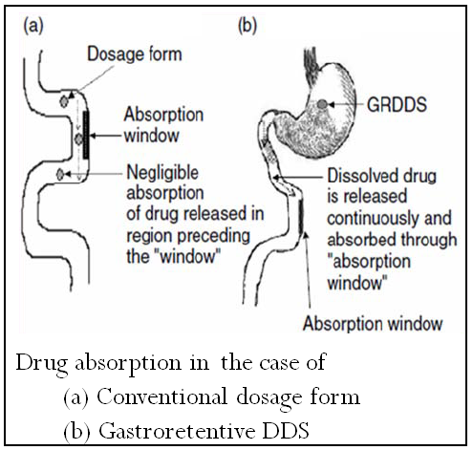
<number>

Slide 17
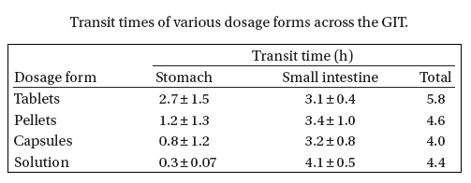
<number>

Slide 18
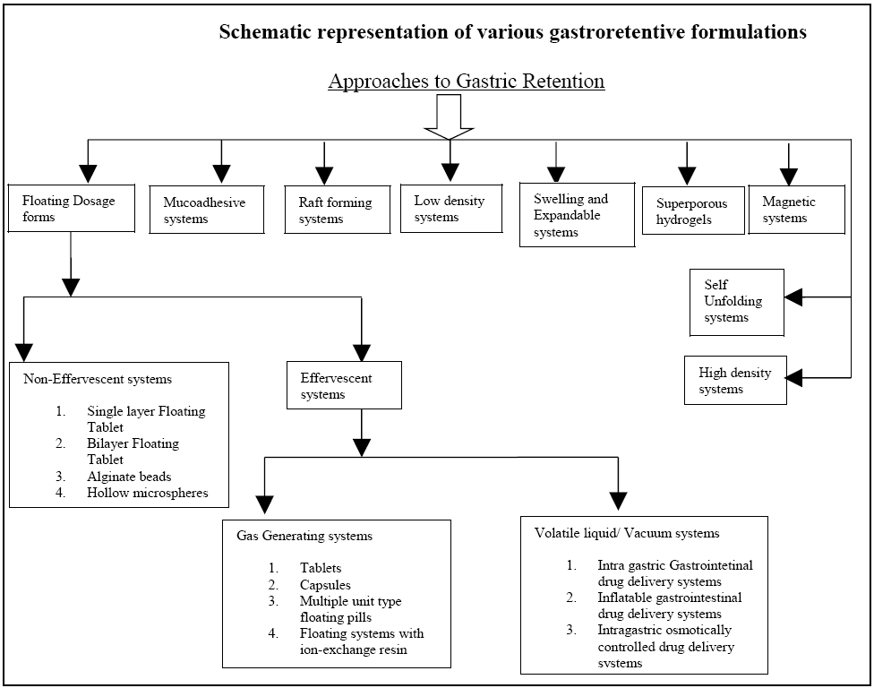
<number>

Slide 19
Approaches concerned -
Low density systems providing sufficient buoyancy to float over the gastric content : Floating drug delivery system (FDDS)
Bioadhesive or mucoadhesive systems enabling the localized retention of the system in the stomach
Swelling & expanding systems in the gastric environment preventing transit from the gastric sphincter – swelling system

Slide 20
Factors Controlling gastric retention of drugs
1.Density
2. size and shape of dosage form
3. Food intake and its nature
4. Posture, gender, age, sleep, BMI
5. Diseased State
6. Administration of drugs with impact on GI transit time. e.g. Atropine
7. Physical Activity

Slide 21
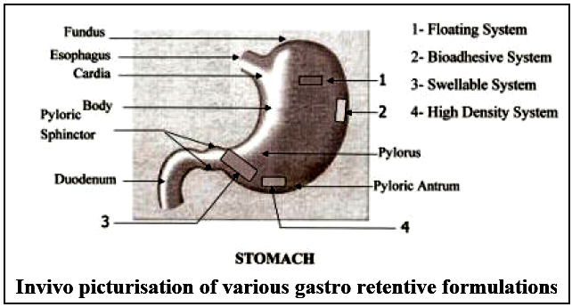
<number>

Slide 22
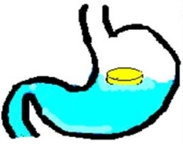
I. Floating Drug Delivery Systems (FDDS)

Slide 23
First described by Davis in 1968
Have a bulk density less than gastric fluids
Low-density systems that have sufficient buoyancy and so remain buoyant in the stomach without affecting the gastric emptying rate for a prolonged period of time.
While the system floats over the gastric contents, the drug is released slowly at the desired rate, which results in increased GRT and reduces fluctuation in plasma drug concentration
<number>

Slide 24
Advantages of FDDS
Improves patient compliance by decreasing dosing frequency.
Better therapeutic effect of short half-life drugs can be achieved.
Gastric retention time is increased because of buoyancy.
Drug releases in a controlled manner for a prolonged period.
Site-specific drug delivery to stomach can be achieved.
Enhanced absorption of drugs which solubilize only in the stomach.
Superior to single unit floating dosage forms as such microspheres release drug uniformly and there is no risk of dose dumping.
<number>

Slide 25
Limitations of FDDS
High level of fluids in the stomach is required for maintaining buoyancy & thus working of FDDS
Not feasible for drugs having solubility or stability problems in gastric fluid.
Drugs such as nifedipine, which is well absorbed along the entire GIT and which undergoes significant first-pass metabolism, may not be desirable candidates for FDDS since the slow gastric emptying may lead to reduced systemic bioavailability.
Limitations to the applicability of FDDS for drugs that are irritating gastric mucosa.
<number>

Slide 26
FDDS can be classified into following types:
Non-effervescent systems
Colloidal-Gel barrier system
Microporous compartment system
Alginate beads
Hollow microspheres
Effervescent systems
Volatile liquid containing systems
Gas generating systems
<number>

Slide 27
Non-effervescent Systems
<number>

Slide 28
This type of system, after swallowing, swells unrestrained via imbibitions of gastric fluid to an extent that it prevents their exit from the stomach.
Non-effervescent systems incorporate a high level (20–75% w/w) of one or more gel-forming, highly swellable, cellulosic hydrocolloids (e.g. hydroxyethyl cellulose, hydroxypropyl cellulose, hydroxypropyl methylcellulose, and sodium carboxymethylcellulose), polysaccharides, or matrix-forming polymers (e.g. polycarbophil, polyacrylates, and polystyrene) into tablets or capsules.
<number>

Slide 29
On contact with gastric fluid, these gel former polysaccharides and polymers hydrate and form a colloidal gel barrier that controls the rate of fluid penetration into the device and consequent drug release.
As the exterior surface of the dosage form dissolves, the gel layer is maintained by the hydration of the adjacent hydrocolloid layer.
The air trapped by the swollen polymer lowers the density and confers buoyancy to the dosage form
<number>

Slide 30
1. Colloidal gel barrier system
This system contains drug with gel-forming hydrocolloids meant to remain buoyant on the stomach content.
This prolongs GRT and maximizes the amount of drug that reaches its absorbtion sites in the solution form for ready absorption.
This system incorporates a high level of one or more gel-forming highly soluble cellulose type hydrocolloid, e.g., hydroxypropyl cellulose, hydoxyethyl cellulose, hydroxypropyl methyl cellulose (HPMC), polysacharides and matrix-forming polymer such as polycarbophil, polyacrylate and polystyrene.
On coming in contact with gastric fluid, the hydrocolloid in the system hydrates and forms a colloid gel barrier around its surface.
This gel barrier controls the rate of fluid penetration into the device & consequent release of drug.
<number>

Slide 31
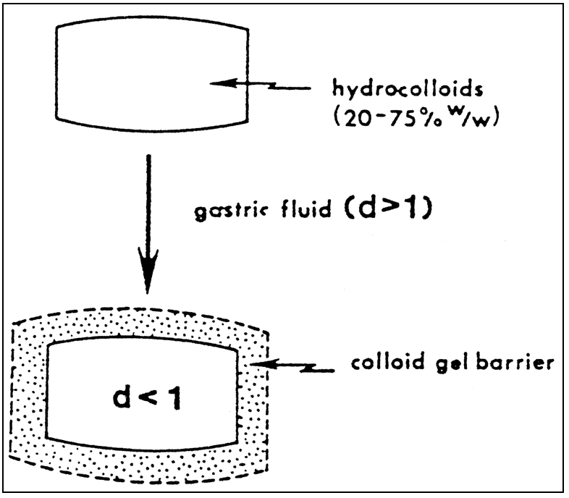
<number>

Slide 32
Hydrodynamically balanced systems (HBS) are best suited for drugs having a better solubility in an acidic environment and also for the drugs having a specific site of absorption in the upper part of the small intestine.
HBS systems can remain in the stomach for long periods and hence can release the drug over a prolonged period of time.
Hence, the problem of short gastric residence time encountered with an oral controlled release formulation can be overcome with these systems.
These systems have a bulk density less than gastric fluid as a result of which they can float on the gastric contents. These systems are relatively large in size and passing from the pyloric opening is prohibited.
<number>

Slide 33
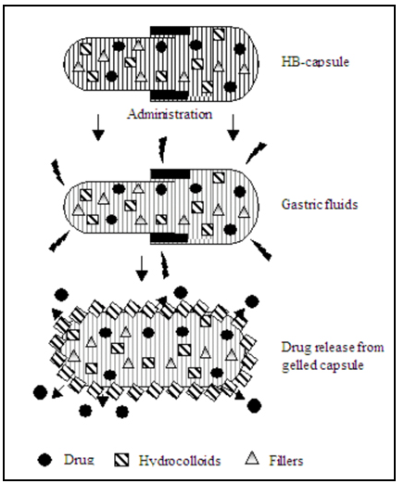
<number>

Slide 34
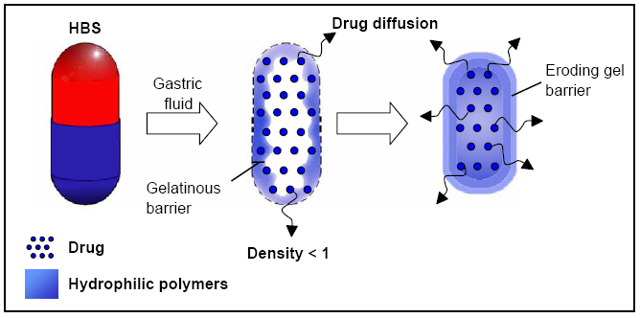
<number>

Slide 35
The HBS must comply with three major criteria:
It must have sufficient structure to form a cohesive gel barrier
It must maintain an overall specific density lower than that of gastric contents
It should dissolve slowly enough to serve as a reservoir for delivery system.
<number>

Slide 36
A bilayer tablet can also be prepared to contain one immediate release & other sustained release layer.
Immediate release layer delivers initial dose, whereas SR layer absorbs gastric fluid & forms a colloidal gel barrier on its surface.
This results in a system with bulk density less than that of gastric content & allow to remain buoyant in the stomach for extended time period.
<number>

Slide 37
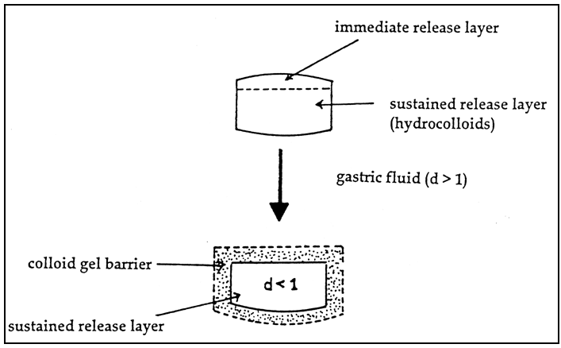
<number>

Slide 38
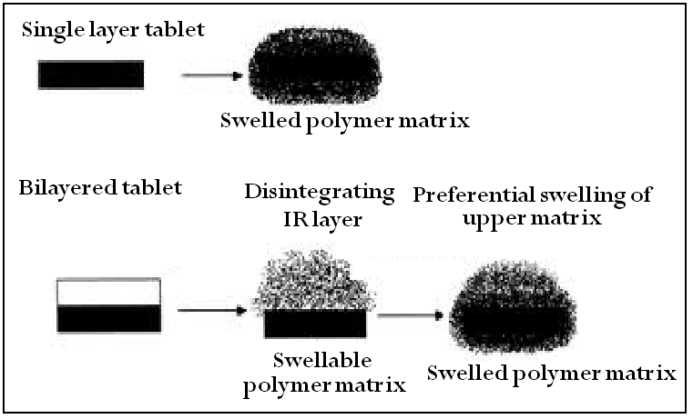
<number>

Slide 39
A multilayered, flexible, sheet-like medicament device that was buoyant in the gastric juice of the stomach and had SR characteristics.
The device consisted of at least one dry, self supporting carrier film made up of a water-insoluble polymer matrix having a drug dispersed or dissolved therein, and a barrier film overlaying the carrier film.
The barrier film consisted of one water-insoluble and a water- and drug-permeable polymer or copolymer.
Both barrier and carrier films were sealed together along their periphery and in such a way as to entrap a plurality of small air pockets, which brought about the buoyancy of laminated films.
<number>

Slide 40
2. Alginate beads
Multi-unit floating dosage forms have been developed from freeze-dried calcium alginate.
Spherical beads of approximately 2.5 mm in diameter can be prepared by dropping sodium alginate solution into aqueous solution of calcium chloride, causing the precipitation of calcium alginate.
The beads are then separated, snap-frozen in liquid nitrogen, and freeze-dried at - 40ºC for 24 hours, leading to the formation of a porous system, which can maintain a floating force for over 12 hours.
These floating beads gave a prolonged residence time of more than 5.5 hours when compared with solid beads which gave short residence time of 1 hour
<number>

Slide 41
3. Hollow microspheres / Microballons
Hollow microspheres loaded with drug in their outer polymer shelf were prepared by a novel emulsion solvent diffusion method.
The ethanol/dichloromethane solution of the drug and an enteric acrylic polymer was poured into an agitated solution of Poly Vinyl Alcohol (PVA) that was thermally controlled at 40ºC.
The gas phase is generated in the dispersed polymer droplet by the evaporation of dichloromethane formed and internal cavity in the microsphere of the polymer with drug.
The microballoon floated continuously over the surface of an acidic dissolution media containing surfactant for more than 12 hours.
<number>

Slide 42
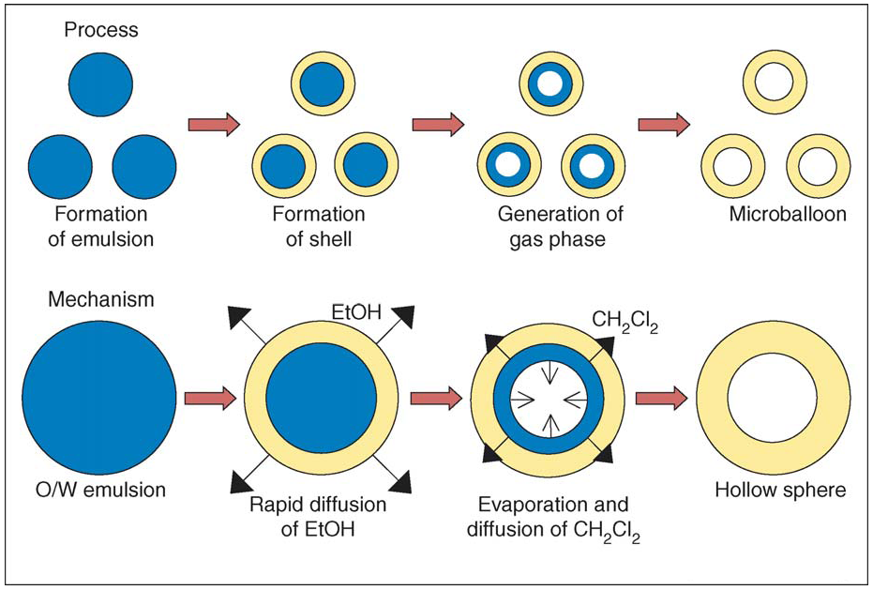
<number>

Slide 43
4. Microporous compartment system
This technology is based on the encapsulation of a drug reservoir inside a microporous compartment with pores along its top and bottom walls.
The peripheral walls of the drug reservoir compartment are completely sealed to prevent any direct contact of gastric surface with the undissolved drug.
In the stomach, the floatation chamber containing entrapped air causes the delivery system to float over the gastric content.
Gastric fluid enters through the aperture, dissolves the drug and carries the dissolved drug for continuous transport across the intestine for absorption.
<number>

Slide 44
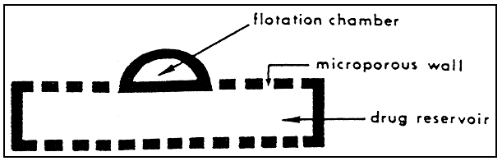
<number>

Slide 45
Effervescent Systems
<number>

Slide 46
Volatile liquid containing systems
The GRT of a DDS sustained by incorporating an inflatable chamber, which contains a liquid e.g. ether, cyclopentane, that gasifies at body temperature to cause the inflation of the chamber in the stomach.
These devices are osmotically controlled floating systems containing a hollow deformable unit that can convert from a collapsed to an expanded position & returns to collapsed position after an extended period.
The deformable system consists of two chambers separated by an impermeable, pressure-responsive, movable bladder.
The first chamber contains the drug & the second chamber contains volatile liquid.
The device inflates & the drug is continuously released from the reservoir into the gastric fluid.
The device may also contain a bioerodible plug made up of PVA, PE that gradually dissolves causing the inflatable chamber to release gas & collapse after a predetermined time to permit the spontaneous ejection of the inflatable system from the stomach
<number>

Slide 47
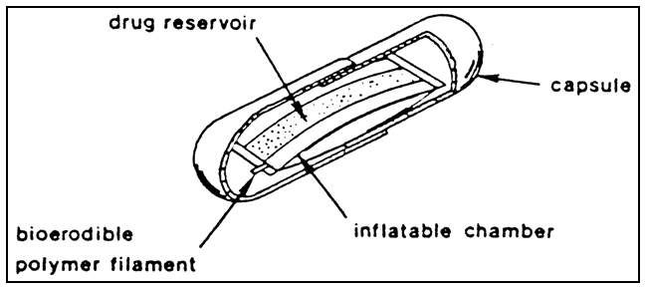
<number>

Slide 48
Intragastric osmotically controlled DDS consists of an osmotic pressure controlled drug delivery device & an inflatable floating support in a bioerodible capsule.
When the device reaches the stomach, bioerodible capsule quickly disintegrates to release the DDS
The floating support is made up of a deformable hollow polymeric bag containing a liquid that gasifies at body temperature to inflate the bag.
The osmotic pressure controlled part consists of two compartments: a drug reservoir compartment & an osmotically active agent containing compartment.
The drug reservoir compartment is enclosed in pressure responsive collapsible bag which is impermeable to vapors & liquid & has drug delivery orifice.
<number>

Slide 49
The osmotic compartment contains an osmotically active salt, & is enclosed within a semi-permeable membrane .
In stomach, water is absorbed through the semi-permeable membrane into the osmotic compartment to dissolve salt.
An osmotic pressure thus created which acts on the collapsible bag & in turn forces the drug reservoir compartment to reduce it volume & release the drug solution through the delivery orifice.
The floating support also contain a bioerodible plug that erodes after a predetermined time to deflate the support, which is then excreted from stomach.
<number>

Slide 50
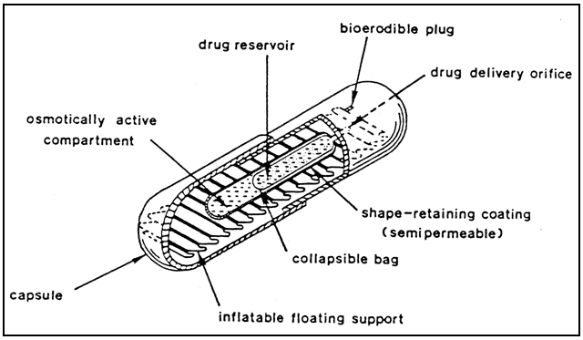
<number>

Slide 51
Gas generating systems:
These buoyant delivery systems utilize effervescent reaction between carbonate/bicarbonate salts & citric/tartaric acid to liberate CO2 which gets entrapped in the gellified hydrocolloid layer of the system, thus decreasing its specific gravity & making it float over chime.
These tablets may be either single layered wherein the CO2 generating components are compressed in one hydrocolloid containing layer, & the drug in the other layer formulated for a SR effect.
<number>

Slide 52
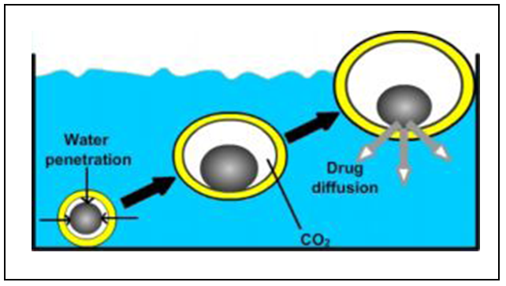
<number>

Slide 53
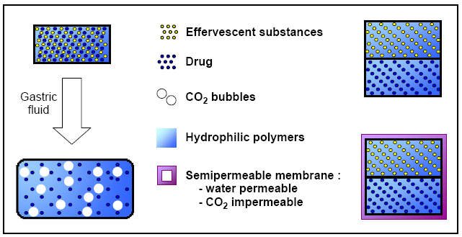
<number>

Slide 54
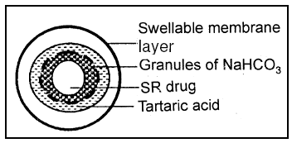
Multi unit types of floating pills
It consists of a SR pill as seed. Surrounded by double layers.
The inner layer - an effervescent layer containing NaHCO3 & tartaric acid
Effervescent layer is divided into two sub layers to avoid direct contact between NaHCO3 & tartaric acid
The outer layer – a swellable polymer like PVA, shellac
<number>

Slide 55
When the system is immersed in the buffer solution at 37°C, swollen pills like balloons are formed having density less than 1gm/ml.
This occurs due to the CO2 by neutralization of the inner effervescent layer with the diffusion of water through the outer swellable membrane layer
These kinds of system float completely with 10 minutes, & remain floating over extended periods of 5-6 hours.
<number>

Slide 56
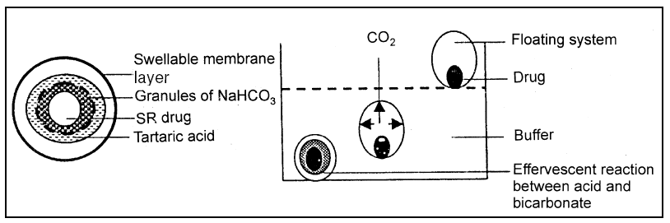
<number>

Slide 57
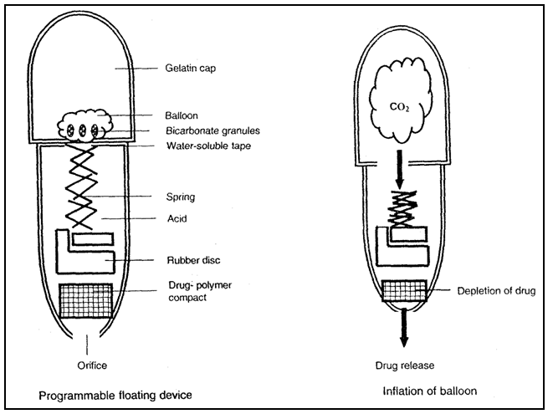
<number>

Slide 58
This system consists of a collapsible spring, which controls the release of drug from the polymer matrix
The device consists of a body made up of a non-digestible, acid-resistant, high density polymer & gelatin cap.
The lower end of body consists of an orifice to control the drug release.
This orifice is occluded by a drug-polymer compact of negligible porosity.
A rubber disc with the horizontal orifice supporting the rubber balloon housing the bicarbonate granules lies above this drug-polymer compact.
In aqueous environment, the gelatin cap & water soluble tape supporting the rubber balloon dissolves.
This is followed by an effervescent reaction between the bicarbonate granules & the acid surrounding the spring, thus leading to generation of CO2 & inflation of rubber balloon providing necessary buoyancy to the dosage form.
<number>

Slide 59
II. Bio/Mucoadhesive Systems

Slide 60
Bio/mucoadhesive systems bind to the gastric epithelial cell surface, or mucin, and increase the GRT by increasing the intimacy and duration of contact between the dosage form and the biological membrane.
The concept is based on the self-protecting mechanism of the GIT.
Mucus secreted continuously by the specialized goblet cells located throughout the GIT plays a cytoprotective role.
Mucus is a viscoelastic, gel-like, stringy slime comprised mainly of glycoproteins.
The primary function of mucus is to protect the surface mucosal cells from acid and peptidases.
In addition, it serves as a lubricant for the passage of solids and as a barrier to antigens, bacteria, and viruses.
<number>

Slide 61
The epithelial adhesive properties of mucin are well known and have been applied to the development of GRDDS through the use of bio/mucoadhesive polymers.
The adherence of the delivery system to the gastric wall increases residence time at a particular site, thereby improving bioavailibility.
A bio/mucoadhesive substance is a natural or synthetic polymer capable of adhering to a biological membrane (bioadhesive polymer) or the mucus lining of the GIT (mucoadhesive polymer).
The characteristics of these polymers are molecular flexibility, hydrophilic functional groups, and specific molecular weight, chain length, and conformation.
<number>

Slide 62
They must be nontoxic and nonabsorbable, form noncovalent bonds with the mucin–epithelial surfaces, have quick adherence to moist surfaces, easily incorporate the drug and offer no hindrance to drug release, have a specific site of attachment, and be economical.
The binding of polymers to the mucin-epithelial surface can be subdivided into three broad categories-
1. Hydration-mediated adhesion
2. Bonding-mediated adhesion
3. Receptor-mediated adhesion
<number>

Slide 63
1. Hydration-mediated adhesion:
Certain hydrophilic polymers tend to imbibe large amount of water and become sticky, thereby acquiring bioadhesive properties.
The prolonged gastroretention of the bio/mudoadhesive delivery system is further controlled by the dissolution of the polymer.
<number>

Slide 64
2. Bonding-mediated adhesion:
The adhesion of polymers to a mucus or epithelial cell surface involves various bonding mechanisms, including physical-mechanical bonding and chemical bonding.
Physical-mechanical bonds can result from the insertion of the adhesive material into the crevices or folds of the mucosa.
Chemical bonds may be either covalent (primary) or ionic (secondary) in nature. Secondary chemical bonds consist of dispersive interactions (i.e., vander Waals interactions) and stronger specific interactions such as hydrogen bonds.
The hydrophilic functional groups responsible for forming hydrogen bonds are the hydroxyl and carboxylic groups.
<number>

Slide 65
3. Receptor-mediated adhesion:
Certain polymers can bind to specific receptor sites on the surface of cells, thereby enhancing the gastric retention of dosage forms.
Certain plant lectins such as tomato lectins interact specifically with the sugar groups present in mucus or on the glycocalyx.
<number>

Slide 66
Classification of Bioadhesive Polymers
Cationic | Anionic | Non-ionic
Polybrene | CMC | BSA
Poly-L-lysine | Dextran sodium | Dextran
Polylysine | Polyacrylic acid | Ficoll
Polyvinyl methyl imidazole | Poly-L-aspartic acid | PEG
 | Polyvinyl sulphate | PVP
 | Heparin
 | Hyaluronic acid
 | Carrageenan
 | Chondrointin sulfate
<number>

Slide 67
III. Swelling & Expanding System

Slide 68
These are the dosage forms, after being swallowed, these dosage forms swell to a size that prevents their passage through the pylorus.
As a result, the dosage form is retained in the stomach for a long period of time.
These systems are sometimes referred to as plug type systems because they tend to remain lodged at the pyloric sphincter.
These polymeric matrices remain in the gastric cavity for several hours even in the fed state.
Sustained and controlled drug release may be achieved by selecting a polymer with the proper molecular weight and swelling properties.
<number>

Slide 69
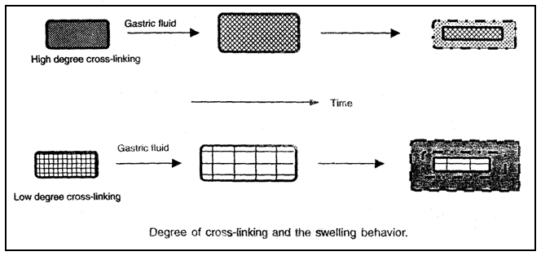
<number>

Slide 70
As dosage form coming in contact with gastric fluid, the polymer imbibes water and swells.
The extensive swelling of these polymers is a result of the presence of physical-chemical crosslink in the hydrophilic polymer network.
These cross-links prevent the dissolution of the polymer and thus maintain the physical integrity of the dosage form.
A balance between the extent and duration of swelling is maintained by the degree of crosslinking between the polymeric chains.
A high degree of crosslinking retards the swelling ability of the system and maintains its physical integrity for a prolonged period.
<number>

Slide 71
On the other hand, a low degree of cross-linking results in extensive swelling followed by the rapid dissolution of the polymer.
An optimum amount of cross-linking is required to maintain a balance between swelling and dissolution.
The swollen system eventually will lose its integrity because of a loss of mechanical strength caused by abrasion or erosion or will burst into small fragments when the membrane ruptures because of continuous expansion.
These systems also may erode in the presence of gastric juices so that after a predetermined time the device no longer can attain or retain the expanded configuration.
<number>

Slide 72
IV. High Density Systems

Slide 73
Gastric contents have a density close to water (1.004 g/cm³).
When high density pellets is given to the patient, it will sink to the bottom of the stomach and are entrapped in the folds of the antrum and withstand the peristaltic waves of the stomach wall.
Sedimentation has been employed as a retention mechanism for high density systems.
A density ~3 g/cm³ seems necessary for significant prolongation of gastric residence time.
Barium sulphate, zinc oxide, iron powder, titanium dioxide may be used to formulate such high density systems due to their high density.
The only major drawbacks with this systems is that it is technically difficult to manufacture them with a large amount of drug (>50%) and to achieve the required density of 2.4–2.8 g/cm³.
<number>

Slide 74
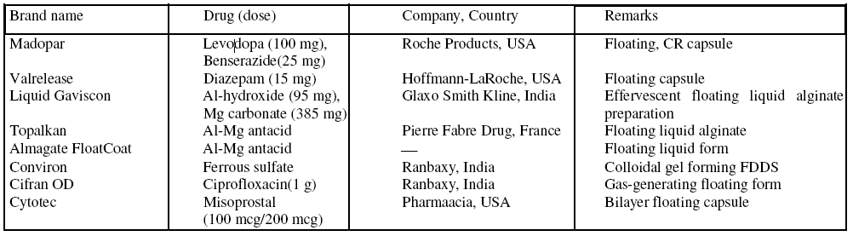
<number>

Slide 75
Factors Affecting GRT
<number>

Slide 76
Formulation related factors
Density – Gastric retention time (GRT) is a function of dosage form buoyancy that is dependent on the density.
Size – Dosage form units with a diameter of more than 7.5 mm are reported to have an increased GRT compared with those with a diameter of 9.9 mm.
Shape of dosage form – Tetrahedron and ring shaped devices with a flexural modulus of 48 and 22.5 kilo pounds per square inch (KSI) are reported to have better GRT 90% to 100% retention at 24 hours compared with other shapes.
Single or multiple unit formulation – Multiple unit formulations show a more predictable release profile and insignificant impairing of performance due to failure of units, allow co-administration of units with different release profiles or containing incompatible substances and permit a larger margin of safety against dosage form failure compared with single unit dosage forms.
<number>

Slide 77
Idiosyncratic factors
Fed or unfed state – Under fasting conditions, the GI motility is characterized by periods of strong motor activity or the migrating myoelectric complex (MMC) that occurs every 1.5 to 2 hours. The MMC sweeps undigested material from the stomach and, if the timing of administration of the formulation coincides with that of the MMC, the GRT of the unit can be expected to be very short. However, in the fed state, MMC is delayed and GRT is considerably longer.
Nature of meal – Feeding of indigestible polymers or fatty acid salts can change the motility pattern of the stomach to a fed state, thus decreasing the gastric emptying rate and prolonging drug release.
Caloric content – GRT can be increased by 4 to10 hours with a meal that is high in proteins and fats
Frequency of feed – The GRT can increase by over 400 minutes when successive meals are given compared with a single meal due to the low frequency of MMC.
<number>

Slide 78
Gender – Mean ambulatory GRT in males (3.4±0.6 hours) is less compared with their age and race matched female counterparts (4.6±1.2 hours), regardless of the weight, height and body surface.
Age – Elderly people, especially those over 70, have a significantly longer GRT.
Posture – GRT can vary between supine and upright ambulatory states of the patient.
Concomitant drug administration – Anticholinergics like atropine and propantheline, opiates like codeine and prokinetic agents like metoclopramide and cisapride can affect floating time.
Biological factors – Diabetes and Crohn’s disease, etc.
<number>

Slide 79
Evaluation of GRDDS

Slide 80
I. Measurement of buoyancy capabilities of the FDDS
1. Floating time
The test for floating time measurement is usually performed in stimulated gastric fluid or 0.1M HCl maintained at 37°C.
It is determined by using USP dissolution apparatus containing 900ml of 0.1M HCl as the dissolution medium at 37°C.
The time taken by the dosage form to float is termed as floating lag time and the time for which the dosage form floats is termed as the floating or flotation time
<number>

Slide 81
2. Specific gravity
It can be measured by the displacement method using benzene as a displacing medium
3. Resultant weight test:
An in vitro measuring apparatus has been conceived to determine the real floating capabilities of buoyant dosage forms as a function of time.
It operates by measuring the force equivalent to the force F required to keep the object totally submerged in the fluid .
This force determines the resultant weight of the object when immersed and may be used to quantify its floating or nonfloating capabilities.
The magnitude and direction of the force and the resultant weight corresponds to the vectorial sum of buoyancy ( F _{bouy} ) and gravity ( F _{grav} ) forces acting on the object as shown in the equation
<number>

Slide 82
F = F _{buoy} – F _{grav}
F = d _{f} gV – d _{s} gV = (d _{f} - d _{s} ) gV
F = (df – M / V) gV
F is the total vertical force (resultant weight of the object),
g is acceleration due to gravity,
d _{f} is the fluid density,
d _{s} is the object density,
M is the object mass, and
V is the volume of the object .
By convention, a positive resultant weight signifies that the force F is exerted upward and that the object is able to float, whereas a negative resultant weight means that the force F acts downward and that the object sinks.
<number>

Slide 83
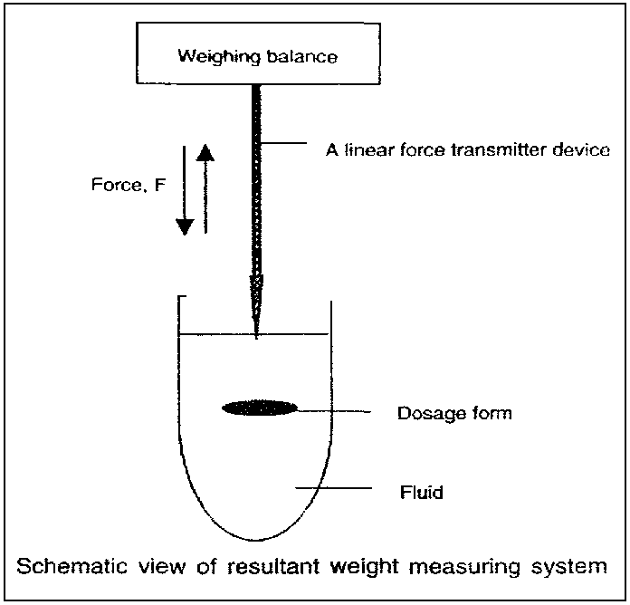
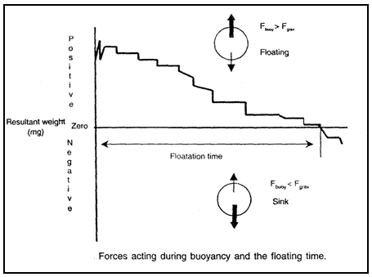
<number>

Slide 84
The crossing of the zero base line by the resultant weight curve from positive toward negative values indicates a transition of the dosage form from floating to nonfloating conditions.
The intersection of lines on a time axis corresponds to the floating time of the dosage form.
<number>

Slide 85
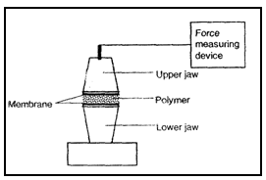
II. Bio/Muco-adhesion System
The bioadhesive strength of a polymer can be determined by the measurement of force required to separate the polymer specimen sandawiched between the layers of either as artificial (cellophane) or biological (rabbit stomach tissue) membrane.
This force can be measured by using either a modified precision balance or an automated texture analyzer.
<number>

Slide 86
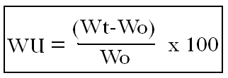
III. Swelling System
Weight gain & water uptake
The swelling behavior of dosage unit can be measured by either by studying its dimensional changes, weight gain or water uptake.
It is done by immersing the dosage from in the simulated gastric fluid at 37°C & determining these factors at regular intervals.
The dimensional changed can be measured in increase in the tablet diameter &/or thickness with time.
Water uptake is measured in terms of % weight gain as given by-
Wt & Wo are the weight of the dosage forms at time t & initially
<number>

Slide 87
Drug release:
Dissolution tests are performed using the dissolution apparatus.
Samples are withdrawn periodically from the dissolution medium with replacement and then analyzed for their drug content after an appropriate dilution.
<number>

Slide 88
In-vivo methods of evaluation of GRDF
1. γ-Scintigraphy
γ-Scintigraphy can be use to evaluate in-vivo buoyancy and in-vivo release performance of different type of GRDF.
In this technology a stable radioisotope like ¹¹¹In is formulated within the developed system and administered in healthy human volunteers.
Major drawbacks with such a technique are associated ionization radiations, limited topographic information, low resolution, and complicated and expensive preparation of radiopharmaceuticals.
<number>

Slide 89
2. Radiology
This method includes pre-clinical estimation of gastroretention.
In comparison to γ-scintigraphy, radiology is a more simple and cost effective technique.
However, limitations regarding exposure to X-rays decline its popularity because for optimum evaluation of buoyancy a high amount of contrasting agent (BaSO₄) is generally required.
Radiographs were taken after ingestion of the dosage form, to locate the floating and non-floating (fabricated) dosage forms at various periodic time intervals.
<number>

Slide 90
3. Gastroscopy
This is considered a minimally invasive procedure since it does not require an incision into one of the major body cavities.
This technique involves visual inspection of GRDF in the stomach.
Basically it is a type of peroral endoscopy which comprises optic fibers and a video camera.
For more detailed information the evaluated system can be drawn out from the stomach.
However, on the other hand the quality of study and its interpretation are highly dependent on the expertise of the endoscopist.
Active uncontrolled bleeding, retained blood in the stomach, and retained food or antacids may also lead to an inadequate study.
<number>

