Slide 1
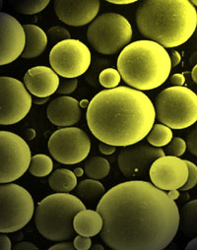
MICROSPHERES

Slide 2
Definition :
Micro-particles are defined as the polymeric entities falling in the range of 1-1000 μm, covering two types of the forms as follows:
Microcapsules: micrometric reservoir systems
Polymer Drug
Microspheres: micrometric matrix systems.
Drug
Polymer

Slide 3
MANUFACTURING TECHNIQUES OF MICROSPHERES
Polymer phase separation
→ Polymer phase separation in non-aqueous media, by non-solvents or polymer addition, also referred to as ‘Coacervation.’
Method:
The coacervation of a polymer such as poly-(d,l-lactic acid-coglycolic acid) (PLAGA) dissolved in methylene chloride with a second polymer such as silicone oil that allows the formation of matrix systems.
If crystals of active principles are placed in suspension at the beginning of this process, they will be captured in these matrices after the desolvation of PHCA (poly-alpha-hydroxy-carboxylic acids)

