Slide 1
Why Validation of Equipment?
Equipment validation is Vital for
Safety
Fewer interruptions of work
Lower repair costs
Elimination of premature replacement
Less standby equipment
Identification of high maintenance cost
Reduction of variation in results
Greater confidence in the reliability of results

Slide 2
Equipment
Possible Issues
Poor design
Lack of safety
Poor quality finishes
Lack of cleaning
Lack of maintenance
No usage log or record
Use of inappropriate weighing equipment
Open-plan location of compressing machines

Slide 3
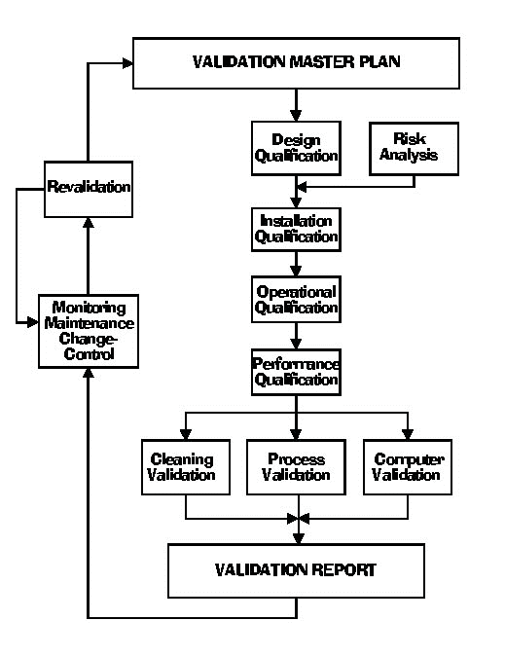
Prospective Validation Life Cycle
Prospective Validation Life Cycle

Slide 4
Retrospective Validation Life Cycle

Slide 5
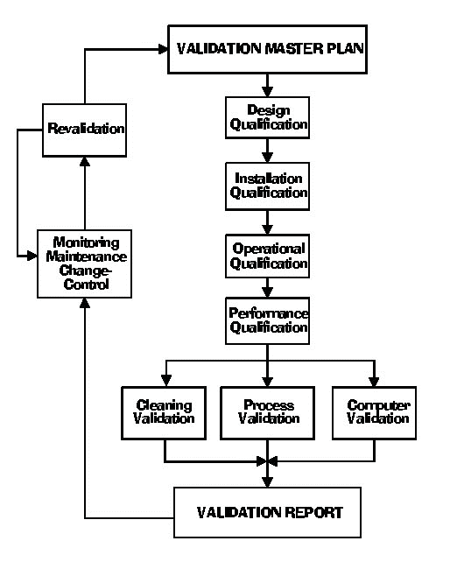
Concurrent Validation Life Cycle

Slide 6
Who should do Equipment Validation?
The vendor or the user
The user has the ultimate responsibility for the accuracy of the analysis results and also for equipment qualification.
DQ should always be done by the user.
While IQ for a small and low cost instrument is usually done by the user, IQ for large, complex and high cost instruments should be done by the vendor.
OQ can be done by either the user or the vendor.
PQ should always be done by the user because it is very application specific, and the vendor may not be familiar with these. As PQ should be done on a daily basis, this practically limits this task to the user.

Slide 7
Validation
Defined schedule
Results of calibration
maintenance,
verification
Frequency based on
Factors
Periodic
Requalification
After change
Extent based on
Risk assessment
Part of
Change control procedure
Notes:
Requalification
8.1 Requalification of systems and equipment should be done in accordance with a defined schedule. The frequency of requalification may be determined on the basis of factors such as the analysis of results relating to calibration, verification and maintenance.
8.2 There should be periodic requalification.
8.3 There should be requalification after changes. The extent of requalification after the change should be justified based on a risk-assessment of the change. Requalification after change should be considered as part of the change control procedure.

Slide 8
Equipment qualification
Equipment qualification / validation includes following things:
Design qualification (DQ)
Installation qualification (IQ)
Operational qualification (OQ)
Performance qualification (PQ)

Slide 9
Validation of Autoclave

Slide 10
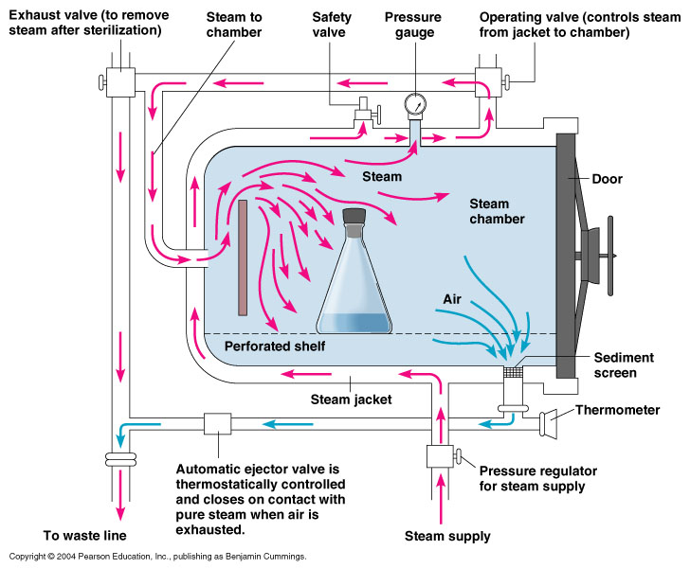

Slide 11
A. Introduction
Sterile products have several unique dosage form properties, such as
Freedom from micro-organisms,
Freedom from pyrogens,
Freedom from particulates,
Extremely high standards of purity and quality;
However, the ultimate goal in the manufacture of a sterile product is absolute absence of microbial contamination.

Slide 12
Introduction(Con..)
Three principles are involved in the validation process for sterile product.
1. To build sterility into a product
2. To demonstrate to a certain maximum level of probability that the processing and sterilization methods have established sterility to all units of a product batch
3. To provide greater assurance and support of the results of the end product sterility test

Slide 13
D value
“It is time required for a 90% reduction in microbial population. Quantitative expression of rate of killing of micro organism.”
In other words, the D value will be affected by
The type of microorganism used as BI,
The formulation components and characteristics
The surface on which the micro-organism is exposed
The temperature, gas concentration, or radiation dose of sterilization process.

Slide 14
D value found by 2 methods,
1) Survivor curve method (log number of surviving organism versus time/gas concentration/radiation dose)
2) Fraction negative method
Z value
Used exclusively in validation of heat sterilization process. Z value is reciprocal of slope of plot of log D verses T at which D value is found i.e. increase in temperature required to reduce D value of organism by 90 % (1 log reduction) The z-value is a measure of the change of the D-value with varying temperature, and is a simplified version of an Arrhenius equation.
F value
Used exclusively in validation of heat sterilization process. It is time in min required to kill all spores in suspension at 121ºC. Measures equivalent time
FoValue
The term "Fo " is defined as the number of equivalent minutes of steam sterilization at temperature 121.1°C delivered to a container or unit of product calculated using a z-value of 10°C

Slide 15
Methods of Sterilization of Products
1.Heat
Moist heat (autoclave)
Dry heat oven or tunnel
2.Gas
Ethylene oxide
Peracetic acid
Vapor phase hydrogen peroxide
Chlorine dioxide
3.Radiation
Gamma
Beta
Ultraviolet

Slide 16
B. Qualification and Calibration
Mechanically Checking, Upgrading, and Qualifying the Sterilizer Unit
The main concern with steam sterilization is the complete removal of air from the chamber and replacement with saturated steam.
Autoclaves can also involve air–steam mixtures for Sterilizing flexible packaging systems and syringes.
When autoclave system is used, the unit must be installed properly and all operations qualified through installation qualification and operation qualification (IQ/OQ).

Slide 17
2) Selection and Calibration of Thermocouples
Thermocouples must be durable for repeated use as temperature indicators in steam sterilization validation and monitoring.
Copper constantan wires coated with Teflon are a popular choice as thermocouple monitors.
Accuracy of thermocouples should be 0.5°C. Temperature accuracy is especially important in steam sterilization validation.
Thermocouple accuracy is determined using National Bureau of Standards (NBS).

Slide 18
3) Selection and Calibration of BI
Sr. No | Sterilization process | Biological Indicator(BI)
1. | Autoclave | B. steriothermophillus spores B. subtilis var. niger spores B. subtilis, 5230 spores B. coagulance spores Clostridium sporogenes spores
2. | Dry heat | B. subtilis var. niger spores B. subtilis, 5230 spores
3. | Ethylene Oxide | B. subtilis var. niger spores
4. | Radiation | B. pumilus spores Micrococcus radiodurans vegetative cells

Slide 19
C. Heat-Distribution Studies
Heat-distribution studies include two phases:
1) Heat distribution in an empty autoclave chamber
2) Heat distribution in a loaded autoclave chamber.
The trips where the wires are soldered should not make contact with the autoclave interior walls or any metal surface.

Slide 20
Cont..
Heat-distribution studies may employ thermocouples as the cool spot in the chamber.
The principle is the location of the cool spot and the effect of the load size and/or configuration on the cool spot location.
The difference in temperature between the coolest spot and the mean chamber temperature should be not greater than 2.5°C .
Greater temperature differences may be indicative of equipment malfunction.

Slide 21
D. Heat-Penetration Studies
This is the most critical component of the entire validation process.
The main purpose is to determine the F0 value of the cold spot inside the commodity.
The container cold spot for containers ≥100 ml is determined using container-mapping studies.
Thermocouple probes are inserted within a container and repeat cycles are run to establish the point inside the container.

Slide 22
Cont..
Thermocouples will be placed both inside and outside the container at the cool spot location(s), in the steam exhaust line, and in constant-temperature baths outside the chamber.
F0 value will be calculated based on the temperature recorded by the thermocouple inside the container at the coolest area of the load.
F0 value will indicate whether the cycle is adequate or alterations are needed.

Slide 23
Heat-Penetration Studies(Con..)
Three critical parameter associated with all wet heat sterilization Processes:
A minimum F value
A design F value
A sterilization process time
Any changes in the load size, load configuration, or container characteristics must be accompanied;
To prove that the cool spot location has not changed or,
If it has, that it receives the design F0 time exposure from the sterilization cycle used.

Slide 24
E. Equipment Qualification
Prior to the initiation of process, it is important that the sterilizer be suitably qualified to perform its function.
Typical critical requirements that are considered to affect the sterilization process (e.g.“quality” requirements) are:
Accurate temperature and pressure measurement
Air removal to some predefined level of vacuum
Temperature distribution and uniformity in the chamber.

Slide 25
The qualification of a sterilizer should include the following :
1.Calibration of temperature and pressure sensors (traceable to national or international standard)
2.Air removal (usually measured by vacuum level achieved vs. defined requirement)
3.Demonstration of the sequence of operations,
4.Confirmation of alarms and interlocks
5.Precision of temperature control
6.Temperature distribution and uniformity

Slide 26
F. Microbiological Challenge Studies
Microbiological challenges studies are employed to provide additional necessary assurance that adequate lethality has been delivered to all parts of the load.
Calibrated BIs used as bioburden models providing data that can be employed to calculate Fo.
The microorganisms used to challenge moist heat sterilization cycles are G. stearothermophilus and Clostridium sporogenes.

Slide 27
After the sterilization cycle is complete, the inoculated items or spore strips are recovered and subjected to microbiological test procedures.
Strips are immersed in a suitable growth medium (soybean casein digest medium is typical) and incubated for up to seven days.

Slide 28
G. Sterilizer Filter Evaluation
Microbial filters are employed on most parts of sterilizers to ensure that loads are not contaminated by air used to vent the chamber as it cools or dries.
Product loads are protected from such contamination by their primary containers (vials, bags) and many nonproduct loads are protected by wraps to provide a microbial barrier.

Slide 29
For filters, two issues are of concern:
Sterility and Integrity.
If the load will undergo a bioburden cycle, it may be necessary to sterilize the filter in a separate phase of the cycle.
To ensure that filters will remain functional under all expected conditions, the integrity tests should be done following the maximum cycle time and temperature.
Triplicate studies are recommended.

Slide 30
Validation Protocols of Autoclave

Slide 31
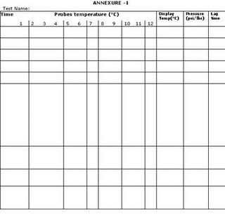

Slide 32
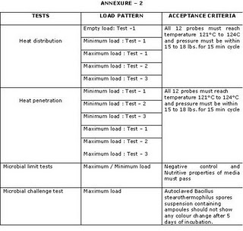

Slide 33
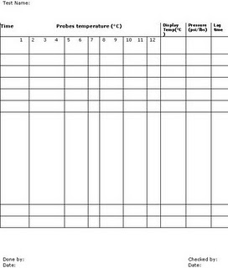

Slide 34
QUALIFICATION REPORT
After the empty and loaded-chamber studies and bio-challenge studies have been completed, the data must be analyzed to ascertain that all testing requirements have been achieved.
The results of the biochallenge studies and F value computation must demonstrate the required degree of lethality according to the protocol.
The following information should be provided in the process qualification validation report:
1. Protocol achievement
2. Summary of data
3. Deviations
4. Diagram

Slide 35
References
Berry I.R., and Nash R.A., ”Pharmaceutical Process validation” second edition, revised and expanded; Marcel Dekker series; 83-110.
Agalloco J.A, Carleton F.A, ”Validation of Pharmaceutical Process, Third Edition, 175,223.
www.fda.gov
Wood, R.T; Journal of Parental drug association; volume 34; 286-294
Groves, M.J.; Journal of Parental Technology; 2nd edition; 432

Slide 36
Operation Qualification:
Following are the contents of equipment
operation qualification: 1. Application S.O.P’s,
2. Utilization List, 3. Process Description, 4.
Test Instrument Utilized To Conduct Test, 5.
Test Instrument Calibration, 6. Critical
Parameters, 7. Test Function (List), 8. Test
Function Summaries

Slide 37
RAPID MIXER GRANUALATOR
1. Homogenous mixing of dry & wet powders, deaglomeration of wet mass and fast dispersion of binding agent.
2. Dust free, high free flowing dosing particles, high uniformity of granule size.
3. Frequency control for bottom driven Impeller Mixer with 3 or 4 blades with exclusive scrape side design and Chopper positioned to make granules.

Slide 38
Installation Qualification:
• An IQ establishes confidence that the equipment is properly installed. The installation must meet the manufacturer's
specified guidelines, along with design changes at installation. Also the supporting electrical utilities must meet all electrical codes.

Slide 39
• Equipment control functions:
• Impeller, timer, bowl on/off & slow/fast
buttons.
• Emergency, discharge port on/off
• Alarm, wash down walls on/off

Slide 40
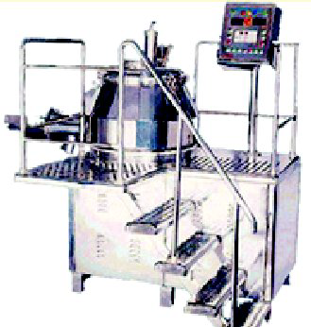
Rapid mixer granulator

Slide 41
Equipment identification:
• Record the equipment identification
number, with equipment manufacturer,
purchase order, model number, and
equipment number.

Slide 42
Required Documentation:
The manufacturers operation and maintenance
manual and SOPs that cover the set up.
• Utility requirements
• Power
• Water
• Compressed air, spraying, impeller
movement, pneumatic discharge port

Slide 43
Calibration Requirements:
• Ammeter
• Voltmeter
• Water pressure gauge
• Air pressure gauge
• Equipment major specifications:
• Mixing bowl material of contact, surface finishing, dimensions, capacity.
• Motors two are required
• Discharge port
• Lid
• Liquid air dispersing system
• Nozzle
• Components coming in contact with
product
• Lubrication/ filter

Slide 44
Equipment Safety Features:
• Emergency stop button, barrier guard,
electrical inter locking system, alarms
Control Functions:
• Regulators, discharge port opening,
spraying button Operational Qualification:
• Calibration requirements for temp, timer,
pressure gauges, ammeter

Slide 45
Equipment operation:
• On empty the impeller should run at low speed and also check direction and speed.
Performance Qualification:
By using placebo max/min conditions are
verified

Slide 46
Thank You

