Slide 1
“Process validation” “SOLID DOSAGE FORMS”

Slide 2
Process validation
of
specific process
is
Established documented evidence
Which give
high degree of assurance
of
Consistently
&
quality characteristics
(At Pre-determined Specifications )

Slide 3
systematic approach :
identifying,
measuring,
evaluating,
Documenting
re-evaluating
a series of critical steps
in the manufacturing process that require control
to ensure
reproducible final product

Slide 4
basics:
For assurance of product quality
Selection of quality components and materials
adequate product and process design
control (statistical) of the process
in-process testing..
end-product testing

Slide 5
FDA’s Current Good Manufacturing Practices (CGMPs) 21CFR 211.110
For avoiding Variability
Controlling of
monitor output
validating
process performance

Slide 6
quality control procedures steps : finished product testing
1.Establishment of
*specifications
*performance characteristics
2. For Specifications testing
Selection
of
methodology,
Equipment
instrumentation
3 final product testing
using validated
analytical method
testing methods

Slide 7
new addition
4 Qualification
processing facility and its equipment
5 Qualification and validation
manufacturing process
6 Auditing, monitoring, sampling, or challenging
the key for conformation of specification
7 Revalidation if significant change in process

Slide 8
four keys
1 Definition---desirable attributes & undesired
2 . Establishment of limitations or constraints for
attributes
3. Determination of the controls or testing parameters used for
measuring or testing
4.Initiation of studies to establish
control or boundary limits
for
key attributes
that influence
product,
process,
quality,
performance

Slide 9
Reasons for validation programming
law to conform to CGMP regulations
good business (rejected or recalled batches)
ensuring product
uniformity,
reproducibility,
quality

Slide 10
VALIDATION OF RAW MATERIALS
Validation begins with the raw materials,
active pharmaceutical ingredients (APIs)
excipients
raw materials, major causes of product variation or deviation from specification
API most uncontrollable component in the complete product/process validation scheme
because
morphology
particle size/surface area
not be completely defined this early
Also when synthesis of the new API is not finalized

Slide 11
raw materials & preformulation
At early exploratory phase preformulation program :
rarely considered part of validation
but represents
critical steps in the development cycle

Slide 12
raw materials & its importance
Chemical characteristics : drug impurities can affect the stability
Physical properties : drug morphology, solubility & particle size/surface area may affect drug bioavailability.
The particle size, shape , and density can affect material flow and blend uniformity.
The hygroscopic drug in handling the material and the reproducibility of the manufacturing process

Slide 13
Particle size & its effects
water-insoluble drug milled or micronized for
rapid dissolution
& in-vitro availability
Particle size directly alter processing variables. Eg
flow,
blend uniformity,
granulation solution
binder uptake,
compressibility,
& lubricant efficiency
random distribution
Segregation or sedimentation
Stability

Slide 14
Wet granulation / direct compression process variables
Factors critical for uniform blending
or (reproducible particle size distribution)
or (content uniformity)
compatibility issues with others
particle size,
density,
and shape
volume of granulating solution or binder
fine particles v/s coarser particles
particle size/surface area ratio must be considered.
certification/validation of excipients (1%or 99%) is extremely important.
and attributes Important are :
(1) the grade and source of the excipients,
(2) particle size and shape characteristics,
(3) lot-to-lot variability.
Magnesium stearate (lubricant) causes hydrophobic coating , so the disintegration and dissolution hindered
aluminum lake in geometric addition or preblend approach ;if not as fine powder the mottling defects common there

Slide 15
steps for raw materials validation :CGMPs formal written documentation
Each raw material validated by testing at least 3 batches from primary & alternate supplier ; representing the ranges, both high and low.
Depending on the susceptibility aging, physical, chemical, and/or microbiological stability should be assessed
If under acceptable range, especially for materials sensitive to small changes; then appropriate to use several lots of raw material with low and high ends of the specification
The final step of raw material validation should involve an on-site inspection of the vendors to review the manufacturing operations, controlling & conforming to regulatory requirements.

Slide 16
Analytical method validation
Prior to any validation program analytical criteria must be assessed are
Accuracy of method: true value
Precision of method: estimate reproducibility
Specificity: accurately measure a SPECIFIC analyte in the presence of other components.
In-day/out-of-day variation:
Between-operator variation
Between-instrument variation
Between-laboratory variation

Slide 17
CONTROL OF PROCESS VARIABLES
Process validation :is for consistent Production ;by challenging a process during development to determine variables to be controlled
(for as quality means & specification compliance)
credible data (Pertinent data from preformulation stage & additional inputs during formulation ,evaluation, process development, and full-scale manufacture) of the testing programs are evaluated for consistence as well as relevance
(process pre-optimized)
all four stages informations i.e. parameters is evaluated for its use as possible tools for ensuring product is under control

Slide 18
major steps in the development of a validation program
From using test data
determine the numerical range of each parameter :
Eg tablet hardness of batches achieved an acceptable friability, disintegration, and dissolution.
for a given parameter ; Establishing specification limits of extremes of acceptable hardness (high and low) provide 95% assurance for the friability, disintegration, and dissolution specifications would be met.
By challenging the process at extreme of the specification limit determination of how well specification control the process.
Certifying testing equipment & Ensuring operating conditions (e.g.,
rpm, temperature, power utilization) are within specification limits
under variations of product load.
After this samples are tested
during the manufacture (in-process tests)
or on the finished product (finished product tests)

Slide 19
In-Process Tests
1.Moisture content of “dried granulation
(usually less than 2% moisture)
2.Granulation particle size distribution: content uniformity
3.Blend uniformity: content uniformity
4.Individual tablet/capsule weight:content &hardness
5.Tablet hardness: dissolution
6.Tablet thickness: hardness, uniform content & dissolution
7.Disintegration: hardness & dissolution

Slide 20
Finished Product Tests
Appearance
Assay:
Content uniformity
Tablet hardness
Tablet friability:
Dissolution
key test parameters which are the major processing variables in solid
dosage forms are evaluated------
Mixing time and speed in blenders and granulators
Solvent addition rates in granulators
Time, temperature, and airflow conditions in dryers and coaters
Screen size, feed rate, and milling speed in mills
Machine speed and compression force in tablet presses
Machine speed and fill volume in encapsulators.

Slide 21
GUIDELINES FOR PROCESS VALIDATION : : SOLID DOSAGE FORMS (TABLETS)
Tablet Composition: Reason for each one with
Solubility :: at physiological pH range:
Particle size distribution and surface area:
Morphology:
True and bulk density:
Material flow and compressibility:
Hygroscopicity:
Melting point:

Slide 22
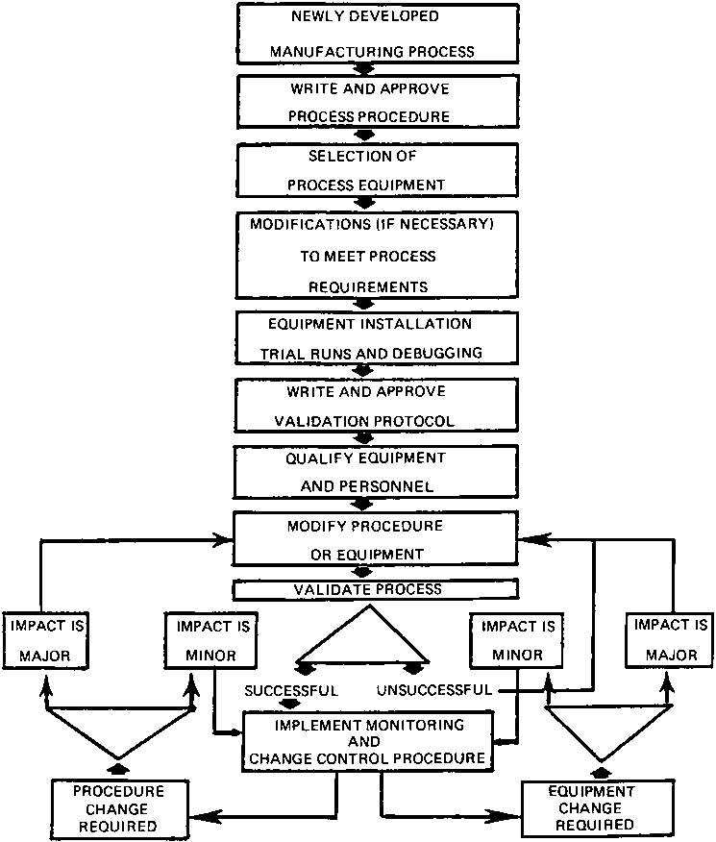
Validation of new processes. (AstraZeneca Pharmaceuticals LP, Wilmington, Delaware.)

Slide 23
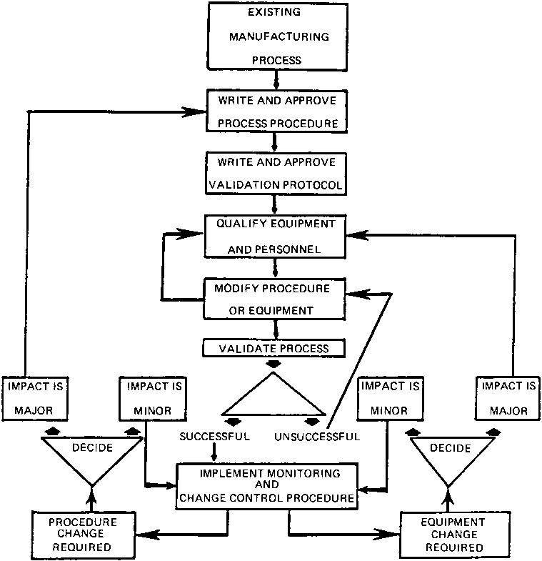
Validation of existing processes.

Slide 24
Process Evaluation and Selection
1. Mixing or Blending
physical properties which are factors in creating a uniform mix or blend
Bulk density
Particle shape
Particle size distribution
Surface area
Mixing or blending technique
Diffusion (tumble) ,
convection (planetary or high intensity),
or pneumatic (fluid bed) techniques .
Mixing or blending speed:
Mixing or blending time:
Equipment capacity/load:
Drug uniformity:
Excipient uniformity (color & lubricant):

Slide 25
2. Wet Granulation
Binder addition:
Binder concentration:
Amount of binder solution/granulating solvent:
Binder solution/granulating solvent addition rate:
Mixing time:
Granulation end point:
3. Wet Milling
Equipment size and capacity:
Screen size
Mill speed
Feed rate

Slide 26
4. Drying
Various drying technique used
tray,
fluid bed,
microwaver
Moisture content by: loss-on-drying techniques
near infrared (NIR) spectroscopy
Parameters affecting drying:
Inlet/outlet temperature
Airflow:
Moisture uniformity
Equipment capability/capacity:

Slide 27
5. Milling
1.Mill type:
impact or screen
2.Screen size:
3.Mill speed:
4.Feed rate:
Notes:
Feed rate:

Slide 28
6. Tablet Compression
Tooling:
Compression speed:
Compression/ejection force:
in-process tests:
Appearance
Hardness
Tablet weight
Friability
Disintegration
Weight uniformity

Slide 29
7. Tablet Coating
coting improves the---
Stability
Taste masking
Controlled release
Product identification
Aesthetics
Safety–material handling
different techniques may used
sugar,
film,
Compression

Slide 30
Key parameters :
Tablet properties
Equipment type:
Coater load
Pan speed:
Spray guns:
Application/spray rate:
Tablet flow:
Inlet/outlet temperature and airflow:
Coating solution:
Coating weight:
Residual solvent level:
Appearance testing of coating:
Cracking or peeling
Intagliation fill-in
Surface roughness
Color uniformity

Slide 31
Equipment Evaluation:
Selection:
formulation, ?
safety requirements,?
handling/production efficiencies, and ?
commercial demands.?
1. Mixer/granulator:
types ?
method of mixing?
capable of providing low and/or high shear?
mixing rate controle?
monitoring system?
working load range and capacity?
Way material charged and discharged?
granulating fluid introduction facility?
2. Blender:
Types?
positioning of the axis rotation (slant or horizontal)?
working load range and capacity?
Features automation , charging, discharging ?
Sampling ease?
dead spots (inefficient mixing areas)?
easily cleaned?
heat the powder blend if needed?

Slide 32
3. Dryer
operating principle?
wet material be static (e.g., tray) or fluid (e.g., fluid bed)?
working load range and capacity?
heating range and airflow capabil?ities
heat distribution?
pulling a vacuum?
handling different types of filter bags?
filter bag shaking mechanism?
4. Mills
mill type (e.g., impact or screen)?
configuration of the mill?
type or size hammers or pin/disc
impeller position?
size screens or plates?
speed on the impeller/screen variable?
throughput range?
type of feed system?
wet- and/or dry-mill materials?
generate a significant amount of heat?
portable?
Notes:
wet material be static (e.g. handle different types of filter bags, tray) or fluid (e.g., fluid
bed)

Slide 33
5. Tablet compressor:
compression stations no.?
operating range (rpm)?
output range of the compressor?
powder feeding capabilities?
compression force range?
monitoring compression and ejection force?
Pre compression capabilities?
without routine maintenance running time?
turnaround time for complete cleaning?
automated weight control capability?
require specialized tooling,?
perform a specialized function addition of?
protect the operator and environment?

Slide 34
6. Tablet Coater:
coater type (e.g., pan or fluid bed)?
pan perforated?
accommodate different size pans?
working capacity range of the coater
“variable drive” capability? achieve proper tablet mixing?
angle of the pan’s pitch?
air input (volume and temperature) and vacuum drag-off?
spray system
utilize the equipment for various coating?
modify the pan with the installation of baffles?
various solvents (ethanol)
require a specialized room condition (e.g.,being explosion-proof)?

Slide 35
CAPSULES
A. Capsule Composition:
1. Capsule Shell:
reason for the presence of each ingredient
Justify the level and grade of each ingredient.
selection of the capsule size and shape.
need for capsule identification (e.g., color or imprinting).
2. Capsule Shell Contents:
Compatibility
hygroscopic nature of the capsule formulation
B. Process Evaluation and Selection

Slide 36
C. Encapsulation
encapsulated materials have to be good flow properties, compressible and a consistent density.
Factors to consider
Encapsulation type
Auger: Capsugel Type B or Elanco No. 8
Vacuum: Perry
Vibratory: Osaka
Dosing disk: H&K
Dosator: MG2 or Zanasi
type of technique
Encapsulation speed:
in-process tests
Appearance
Capsule weight
Disintegration
Weight uniformity

Slide 37
Equipment Evaluation of encapsulation
encapsulation mechanism (e.g., auger, dosing disk, dosator)?
encapsulation stations?
operating range of the unit?
output range of the encapsulator (i.e., capsules per min)?
powder feeding capabilities?
pecialized function in ad dition to basic encapsulation . (e.g., tablet in capsules with excipient backfill)?
equipment operate without routine maintenance?
turnaround time for complete cleaning?
protect the operator and environment?
automated weight control capability?

