Slide 1



Hackwave 2024
Problem Statement Title: Next-Gen Open-Source Authentication System .
Team Leader Name: Jeet Manjrekar
Institute Name: A. P. Shah Institute of Technology
Name of Group Member: Jeet Manjrekar
Chirag Sawant
Devesh Sali
Harshal Deshmukh

Slide 2
Introduction
Proposed Solution and Approach
Problem Statement: In today's digital landscape, Passwords are a hassle and unsafe, while even new methods like multi-factor authentication and biometrics have drawbacks. We need a better way! Open-source technology can create a new, secure login system that's both user-friendly and works across all our apps.
Objectives:This project will design a secure, user-friendly authentication system using open-source technologies. It aims to move beyond passwords and biometrics by exploring decentralized identity, zero-trust authentication, or behavioural biometrics for enhanced security and a seamless login experience.
Proposed Solution:
Secure & Easy Login: Leverages DID + ZTA + behavioural Biometrics for a new paradigm in user authentication.
Future-proof Security: Enhances security posture by eliminating reliance on static credentials and implementing Zero-Trust Architecture (ZTA) for continuous access verification.
Improved User Experience: Offers a frictionless user journey through streamlined login process and unobtrusive user identification with behavioural Biometrics.
Privacy-Preserving: Protects user privacy by minimizing data collection and storage.
Approach:
Revolutionize Logins: Break the password mold with a future-proof system combining DID, ZTA & behavioural Biometrics for ultimate security.
Empower Your Users: Put them in control with Decentralized Identity, ensuring user-centric data ownership and privacy.
Frictionless Experience: Simplify logins with unobtrusive biometrics, making access effortless and user-friendly.

Slide 3
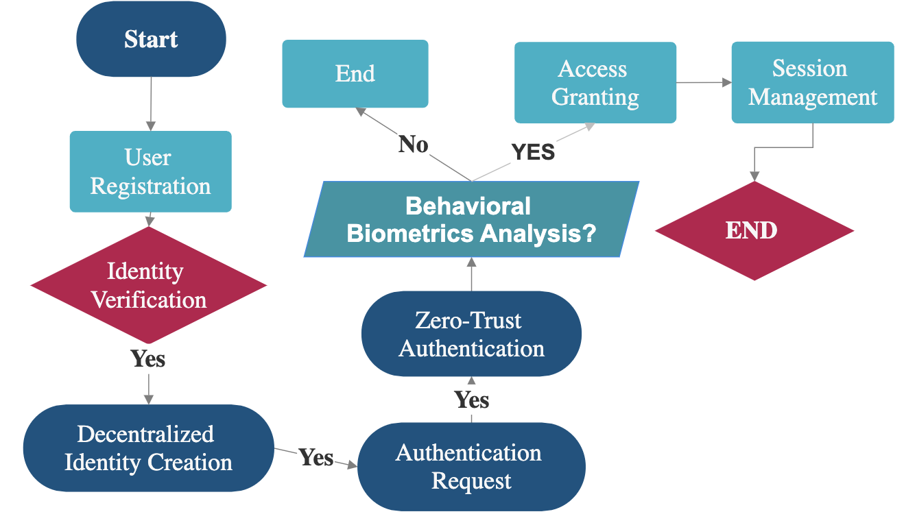
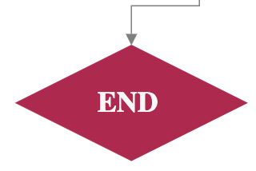
Workflow
Technology Stack
Cryptography: Encryption, hashing, digital signatures.
Distributed Ledger Technology: Blockchain, DLT consensus mechanisms.
Multi-factor Authentication: Biometrics, OTP, smart cards.
Machine Learning: Anomaly detection, pattern recognition.
Risk-based Authentication: Dynamic risk scoring, adaptive access controls.
Feedback
Machine will learn from the feedback
(Improvement)

Slide 4
Use Cases
Innovation
In the AI industry:
Decentralized identity enables secure access across sectors, including finance and healthcare, enhancing data integrity and user control.
Zero-trust authentication ensures continuous security in remote AI development environments, eliminating password vulnerabilities.
Behavioral biometrics enhance authentication within AI-powered educational platforms and government AI solutions.
The broad application of decentralized identity,
zero-trust authentication, and behavioral
biometrics extends throughout the AI industry,
addressing security needs in various sectors like
Defence and National Security.
Introducing Quantum-Secure Authentication for Defense Systems:
Utilizes quantum mechanics for top-tier security.
Quantum key distribution (QKD) resists attacks, ensuring secure communication.
Detects eavesdropping attempts instantly, safeguarding sensitive data.
Future-proofs defense against quantum computing threats.
Represents a revolutionary advancement in defense cybersecurity, protecting vital military assets.

Slide 5
THANK YOU

