Slide 1
100% GEMMA
GemmaCaption
Multi-Style Video Captioning
Four voices for one video — every caption fact-checked against the frames.
formal
sarcastic
humorous_tech
humorous_non_tech
AMD Developer Hackathon · Track 2 — Video Captioning · Best Use of Gemma
Notes:
GemmaCaption: an all-Gemma pipeline that captions a video in four styles and fact-checks every witty caption against the frames.

Slide 2
THE TASK
Four voices, one video
For every clip, GemmaCaption writes four captions of the SAME scene — each in a distinct voice.
The judge scores exactly two things:
Accuracy — faithful to what is on screen.
Style match — nails the requested tone.
formal
Professional, factual news-wire tone.
sarcastic
Dry, deadpan, lightly mocking.
humorous_tech
Funny, with a software / dev metaphor.
humorous_non_tech
Everyday humor, zero tech words.
Notes:
Four styles, same scene. Scored on accuracy and style match only.

Slide 3
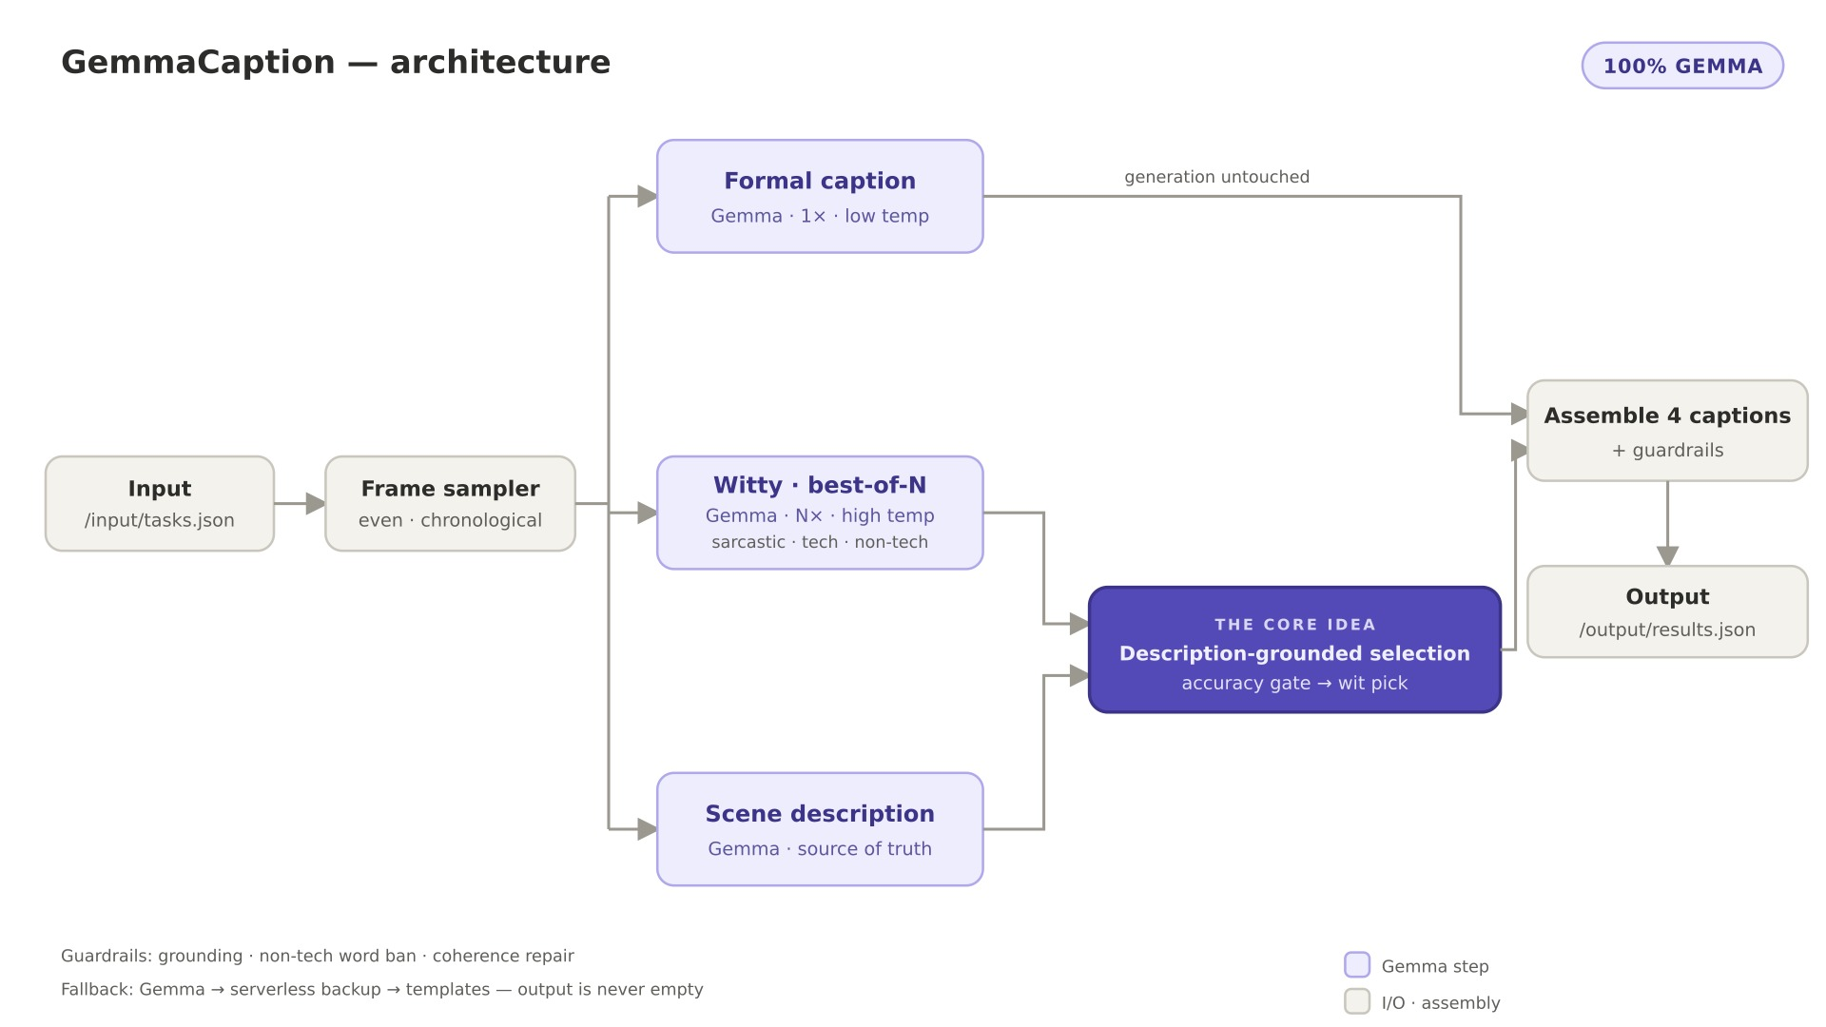
HOW IT WORKS
An all-Gemma pipeline
Notes:
Frames fan out to three parallel Gemma steps, then a description-grounded selector picks the best witty caption. Every model call is Gemma.

Slide 4
THE VOICES
Four hand-tuned personas
formal
News-wire / stock-footage register. Present tense, third person, every clause an independently checkable fact.
sarcastic
Deadpan irony aimed at one real thing on screen. The facts stay true; only the attitude bites.
humorous_tech
One sustained software metaphor — deploys, merge conflicts, latency — mapped onto the actual action.
humorous_non_tech
Warm everyday comedy: anthropomorphize, exaggerate tiny stakes. A hard ban on any technology word.
Notes:
The gold personas are the biggest quality lever — detailed register contracts, not one-word labels.

Slide 5
THE CORE IDEA
Best-of-N + description-grounded selection
1
Draft N candidates
Gemma writes several witty captions at high temperature.
2
Ground the truth
Gemma writes a factual scene description — the source of truth.
3
Two-criterion pick
Accuracy gate then wit pick: drop hallucinations, keep the boldest.
Live example — the accuracy gate catches a hallucination the frames don't support:
“… a collection of cars and a blue bus …” — the clip shows a red bus.
REJECTED
“… a handful of cars… vibrant yellow autumn trees…” — accurate, and still the wittiest draft.
SELECTED
Notes:
Generation is untouched; the description only drives selection. Best-of-N gives the alternatives so the gate can pick a clean one.

Slide 6
SAFETY NET
Guardrails & reliability
Grounding rules
Never invent names, brands, counts, or on-screen text.
Non-tech word ban
Regenerates humorous_non_tech if a tech word slips in.
Coherence repair
Catches high-temp garbling and regenerates once.
Fallback chain
Gemma to serverless to templates. Output is never empty.
Complete at t=0
A valid results.json is written up front, then overwritten.
Time watchdog
Every run stays under the harness time cap.
Notes:
Guards regenerate at most once; the fallback chain guarantees a complete results.json.

Slide 7
BEST USE OF GEMMA
One model. Four roles.
Every model call in the pipeline is Gemma-4-31B — no other model touches the captions.
Perceive
reads the frames
Gemma
Write
drafts every style
Gemma
Describe
builds the source of truth
Gemma
Select
picks the best caption
Gemma
4 roles to 1 model — and Gemma writes the final captions, so it stays prize-eligible.
Notes:
Perception, writing, scene description, and selection all run on Gemma — a pure Gemma showcase.

Slide 8
ONE CLIP, FOUR VOICES
Same office scene, four takes
formal
“A woman with dark hair in a high bun sits at a white desk in a modern office, typing on a white keyboard with pink-manicured nails; a potted plant sits behind her.”
sarcastic
“A truly riveting display of human productivity: she engages in a high-stakes staring contest with her monitor, managing the Herculean task of tapping a few keys.”
humorous_tech
“A developer mid production-incident — her face shifts from 'this should work' to 'why is it doing that' as she attempts a hotfix at the keyboard.”
humorous_non_tech
“She stares at her desk with a look of pure, unadulterated betrayal, trying to make sense of whatever is happening in front of her.”
Notes:
Real GemmaCaption outputs for one office clip — same scene, four unmistakable voices.

Slide 9
SHIP IT
One container, two files
Single Docker image (linux/amd64), fully self-contained.
Reads /input/tasks.json, writes /output/results.json.
Downloads each video itself and samples frames.
Keys baked at build time — the judge injects nothing.
Always complete — a caption for every style, every task.
# input /input/tasks.json
[{ "task_id": "clip-001",
"video_url": "https://...",
"styles": ["formal", ...] }]
# output /output/results.json
[{ "task_id": "clip-001",
"captions": {
"formal": "...",
"sarcastic": "...",
"humorous_tech": "...",
"humorous_non_tech": "..." }}]
Notes:
One self-contained container: read tasks.json, write results.json.

Slide 10
GemmaCaption
Four voices. One model. Zero hallucinated buses.
formal
sarcastic
humorous_tech
humorous_non_tech
Thank you · AMD Hackathon Track 2 · Best Use of Gemma
Notes:
Thanks! GemmaCaption — all-Gemma, best-of-N with description-grounded selection.

