Slide 1
AI FINANCE FOLLOWUP CREDIT AGENT PROJECT
Credit Follow-Up
Email Agent
AI-Powered Generation
Tone-Aware Escalation
Full Audit Trail
Deveshi Nautiyal
UPES Dehradun

Slide 2
THE
PROBLEM
Manual & Time-Consuming
Inconsistent Tone
Staff draft individual emails for dozens of overdue invoices — repetitive, error-prone work.
No standardised escalation path. Different writers damage client relationships.
Finance Teams Waste
Hours Chasing
Late Payments
No Audit Trail
High DSO
Who sent what, when, to whom? Compliance gaps are common with manual follow-ups.
Days Sales Outstanding climbs as payment follow-ups slip through the cracks.

Slide 3
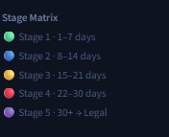
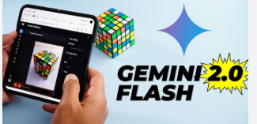



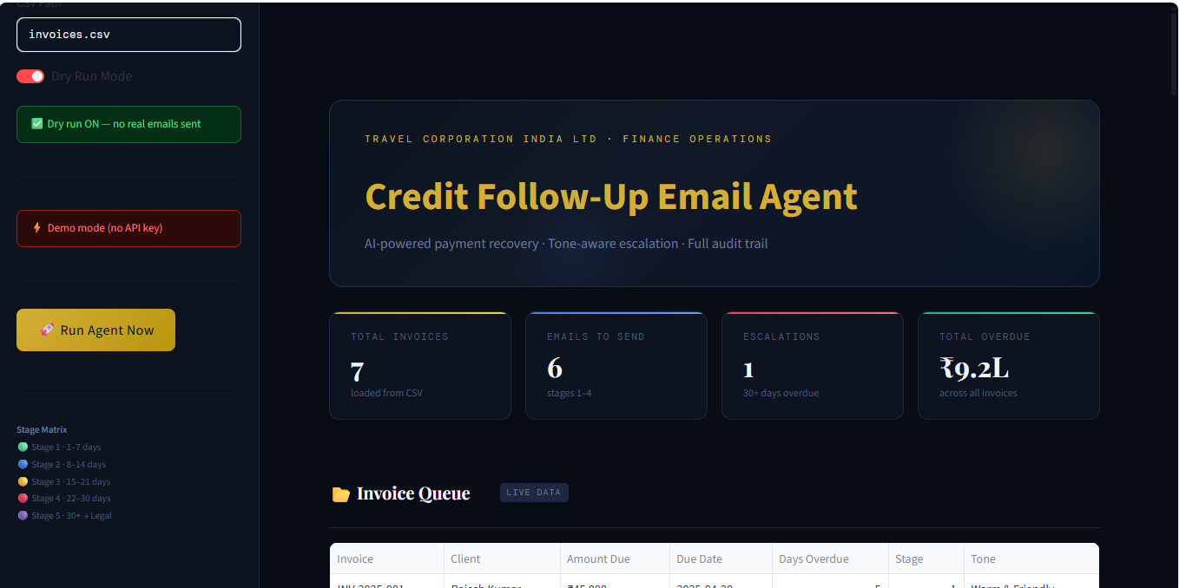

THE SOLUTION
An AI Agent That Does It All — Automatically
Reads overdue invoices · Detects escalation stage · Generates personalised emails via Gemini 2.0 Flash · Logs every action with PII masking · Live Streamlit dashboard
CSV Ingestion
Stage Detection
Gemini 2.0 Flash
Email Generation
SQLite Audit
Legal Escalation
Live Dashboard
PII Masking

Slide 4
ARCHITECTURE
ReAct-Style Pipeline · No Framework Overhead
1
2
3
4
5
6
Data Ingestion
Stage Detection
Email Generation
Dry-Run Send
Audit Trail
Dashboard
pandas.read_csv()
get_stage(days_overdue)
Gemini 2.0 Flash + Pydantic
logs/dry_run.jsonl
SQLite + PII Mask
Streamlit Report
⚡ Stage 5 Bypass
EscalationFlag Pydantic model intercepts Stage 5 invoices before any API call — no email generated, flagged for legal review automatically.

Slide 5
ESCALATION MATRIX
5-Stage Tone Escalation Engine
Stage
Trigger
Tone
Key Message
CTA
Stage 1
1–7 days
Warm & Friendly
Gentle reminder, assume oversight
Pay now link
Stage 2
8–14 days
Polite but Firm
Payment still pending
Confirm payment date
Stage 3
15–21 days
Formal & Serious
Escalating concern, credit impact
Respond within 48 hrs
Stage 4
22–30 days
Stern & Urgent
Final reminder before escalation
Pay immediately or call
Stage 5
30+ days
🚨 Legal Flag
Human review required
Assign to finance manager

Slide 6
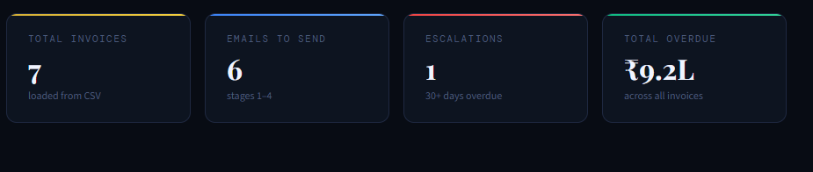
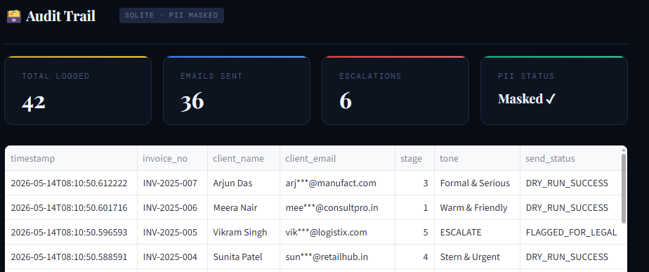
RESULTS
Live Run on 7 Invoices — ₹9.2L Overdue Portfolio
📋 Audit Trail Highlights

Slide 7
TECHNICAL STACK
Decisions & Trade-offs
Gemini 2.0 Flash
Custom ReAct Pipeline
Free-tier API; 1M context; strong JSON instruction-following; no credit card needed for internship use.
No LangChain/CrewAI overhead. Linear workflow is easier to debug. Audit logic stays explicit.
Pydantic v2
SQLite + python-dotenv
EmailOutput & EscalationFlag models enforce schema — hallucinations are rejected before any email is sent.
Zero-setup audit storage. API key loaded from .env, never hardcoded. PII masked via _mask() utility.
Streamlit Dashboard
Rapid UI build — metrics, invoice queue, email previews, and scrollable audit table in under 200 lines.

Slide 8
SECURITY MITIGATIONS
Built for Production Readiness
Prompt Injection
API Key Exposure
PII / Data Privacy
CSV data passed as structured key-value pairs, not raw concatenation. Pydantic rejects unexpected output.
Client emails masked in all logs (abc***@domain.com). CSV data sent per-row only — not in bulk.
Loaded via python-dotenv from .env (in .gitignore). .env.example ships with placeholder values only.
Hallucination Risk
Unauthorised Trigger
Legal Escalation Leak
Pydantic EmailOutput rejects empty fields. Financial data injected from CSV post-generation. Temp = 0.2.
Dry-run mode is default ON. No exposed HTTP endpoint — local execution only.
EscalationFlag model hard-exits before API call for Stage 5. No email generated, ever.

Slide 9
KEY LEARNINGS
What This Project Taught Me
01
Prompt Engineering Is Iterative
02
Pydantic Is a Superpower for Agents
v1 produced hallucinated data. v2 added field constraints. v3 added 'NEVER use markdown' + regex fallback. Three iterations to get reliable JSON output.
Using Literal['ESCALATE_TO_LEGAL'] made Stage 5 handling deterministic — no if/else chains, no runtime surprises. Schema validation caught errors early.
03
Custom Pipelines Over Frameworks
04
Dry-Run First, Always
LangChain adds abstraction that makes debugging harder. A 150-line custom ReAct loop is easier to trace, audit, and extend than a framework-wrapped equivalent.
Building dry-run mode before real send capability forced me to design the audit trail first. The log format became the source of truth for the dashboard.

Slide 10
THANK YOU
Credit Follow-Up Email Agent
📄 CSV → AI → Email in one automated loop
🔢 5-stage tone escalation engine
🛡️ Pydantic hallucination guard + PII masking
📊 Streamlit dashboard with full audit trail
Deveshi Nautiyal
UPES Dehradun

