Slide 1
Mobile Price Range Prediction
By Devesh Samant

Slide 2
Introduction
Mobile price prediction aims to determine the price range of a mobile phone based on its specifications. Accurate price prediction helps manufacturers, retailers, and consumers make informed decisions.
The dataset contains various features related to mobile specifications such as battery power, RAM, and camera quality. The target variable is the price range categorized into four classes (0 to 3).

Slide 3
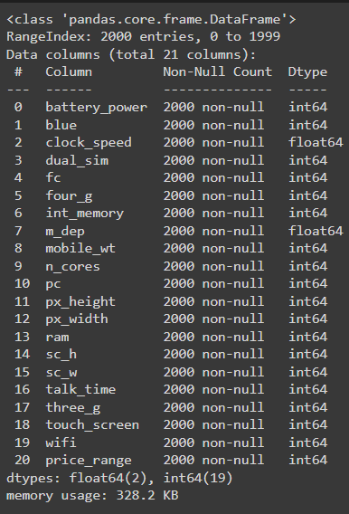
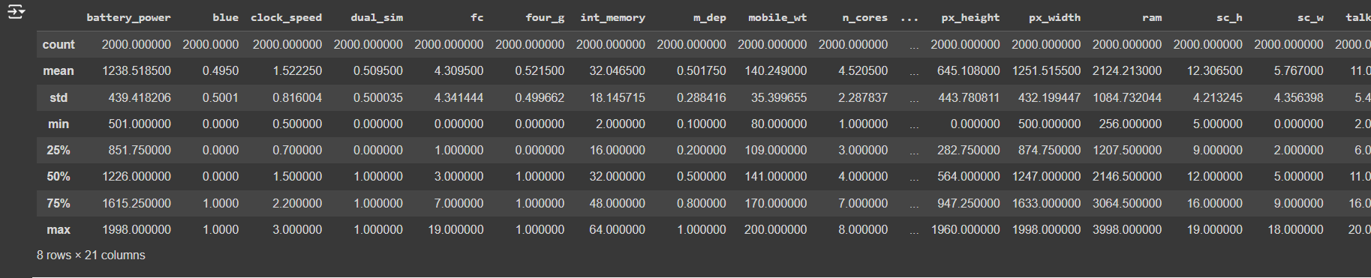
Data Exploration
Basic Statistics and Data Types:
The dataset contains 2000 entries
and 21 columns.
Data types and summary
Statistics are provided.

Slide 4
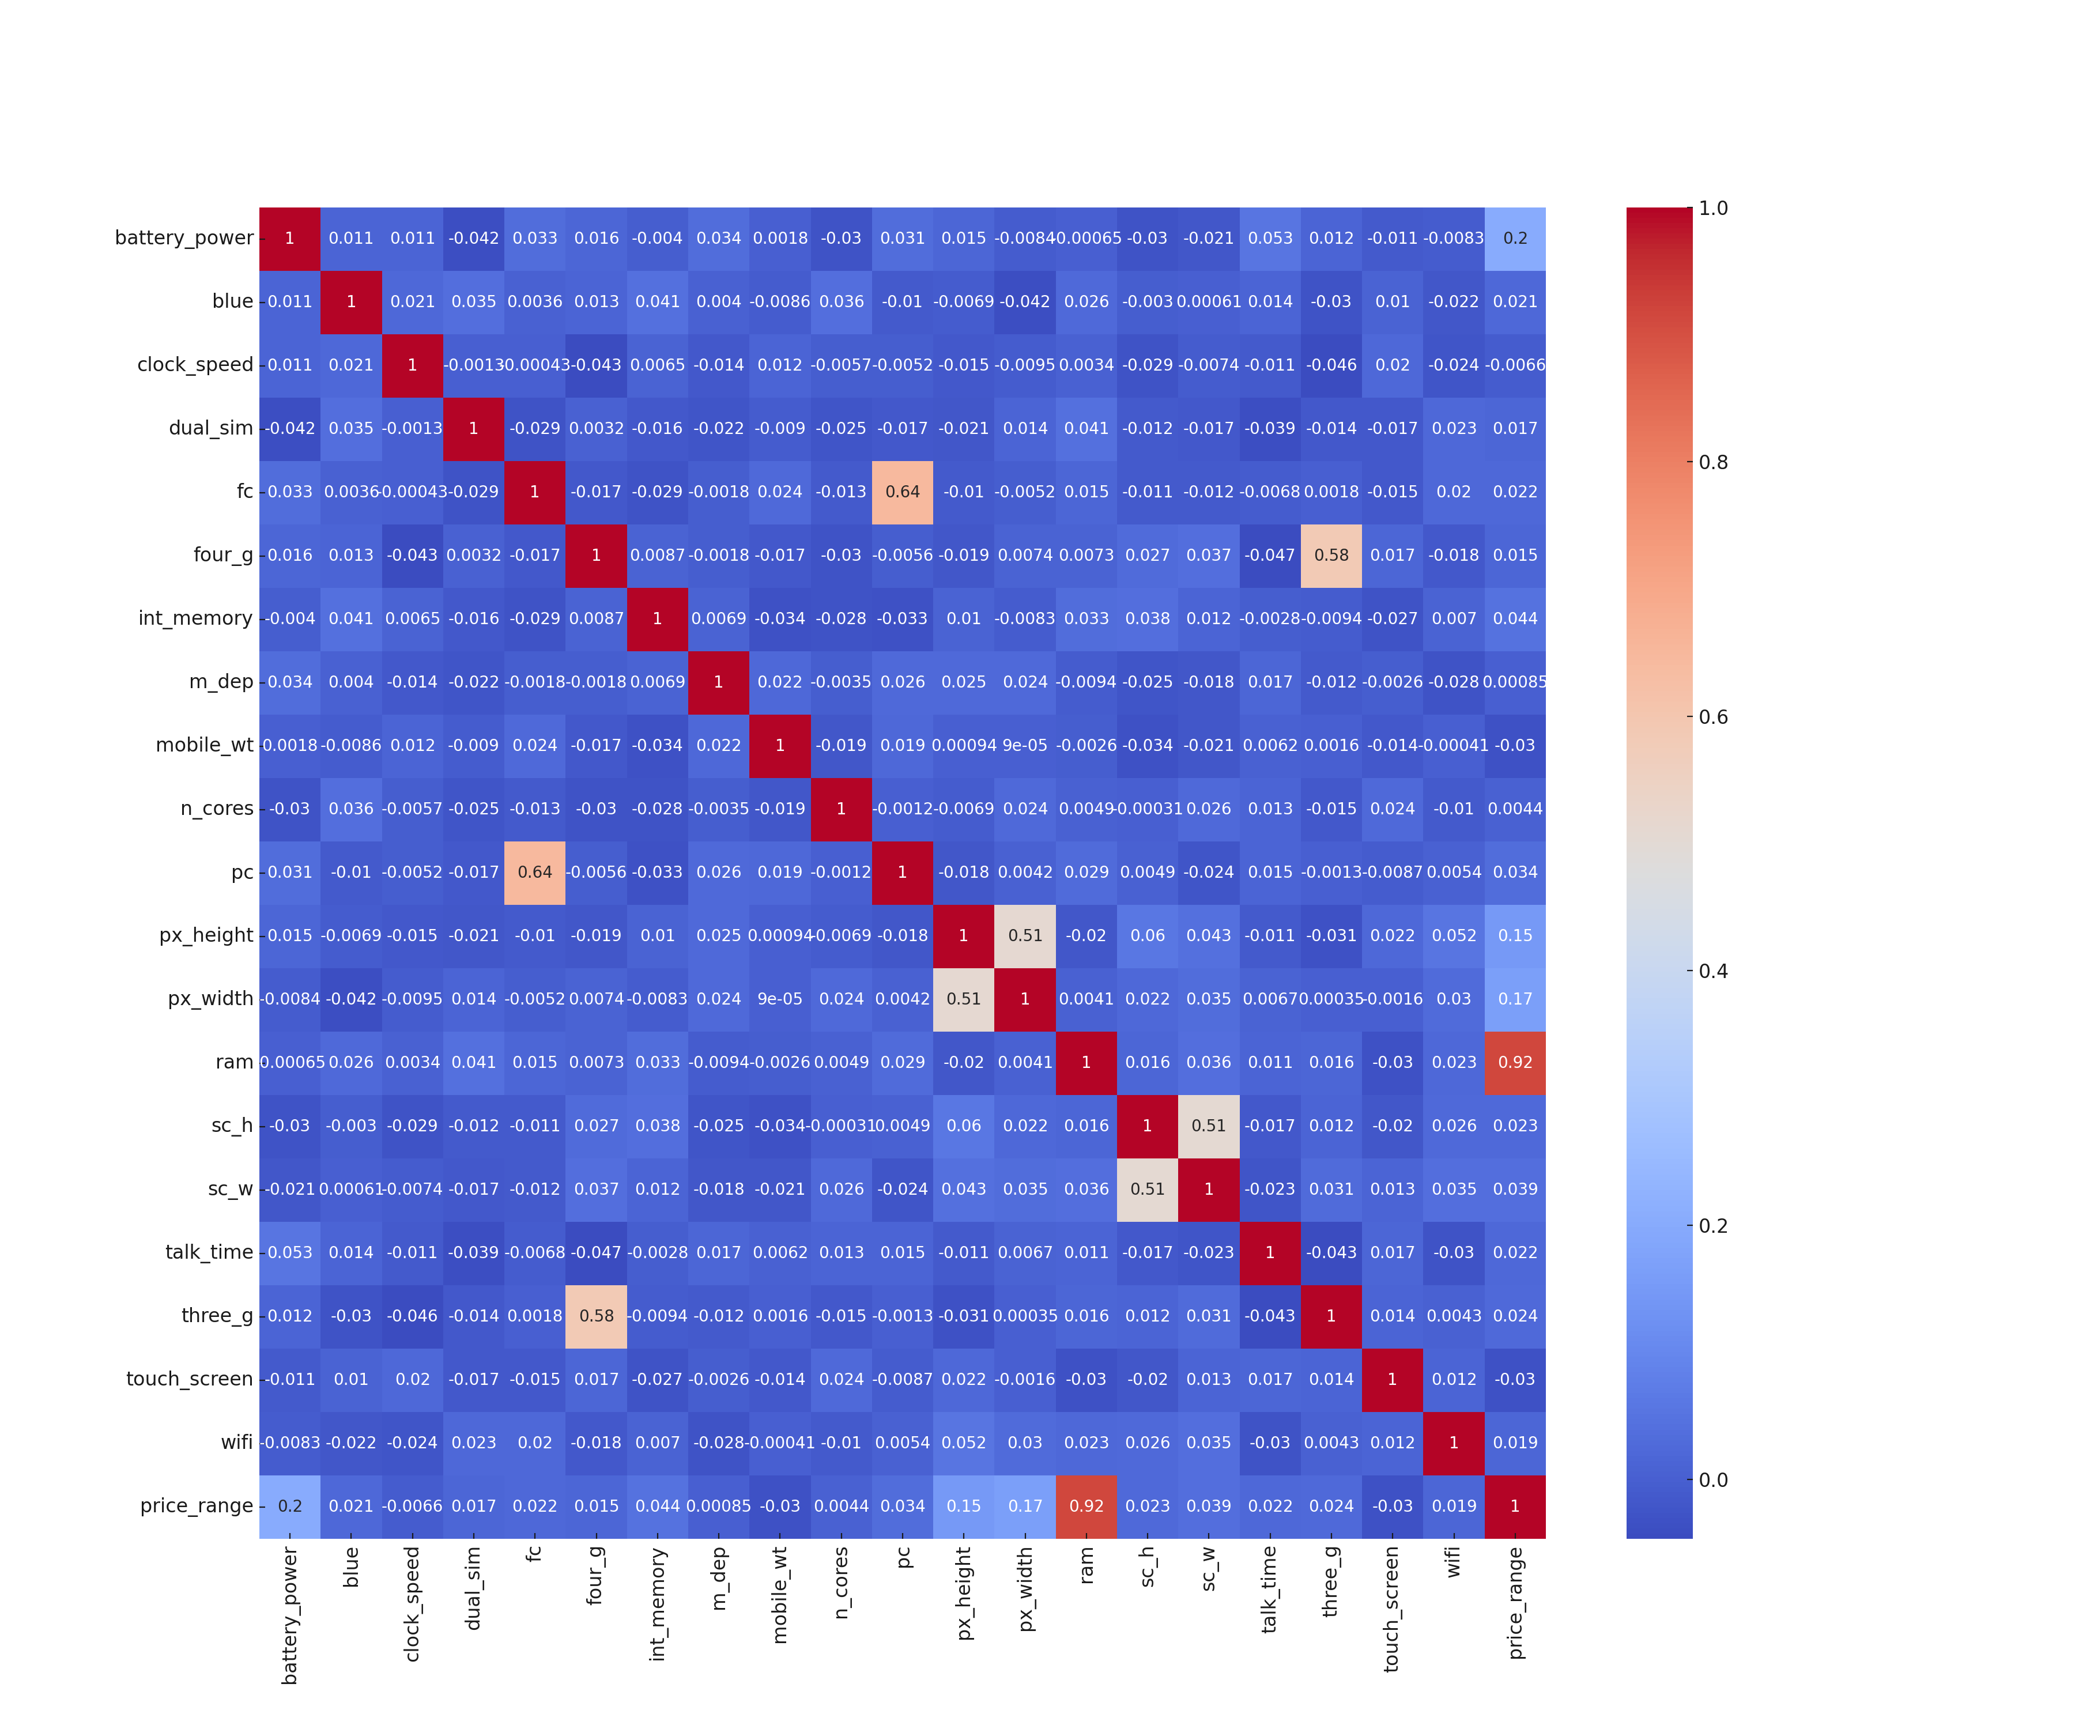

Slide 5
Correlation Analysis
A correlation matrix helps in understanding the relationships between different features.
Features highly correlated with the target variable are identified.
# Correlation matrix
correlation = df.corr()
plt.figure(figsize=(18, 15))
sns.heatmap(correlation, cmap='coolwarm', annot=True)
plt.show()

Slide 6
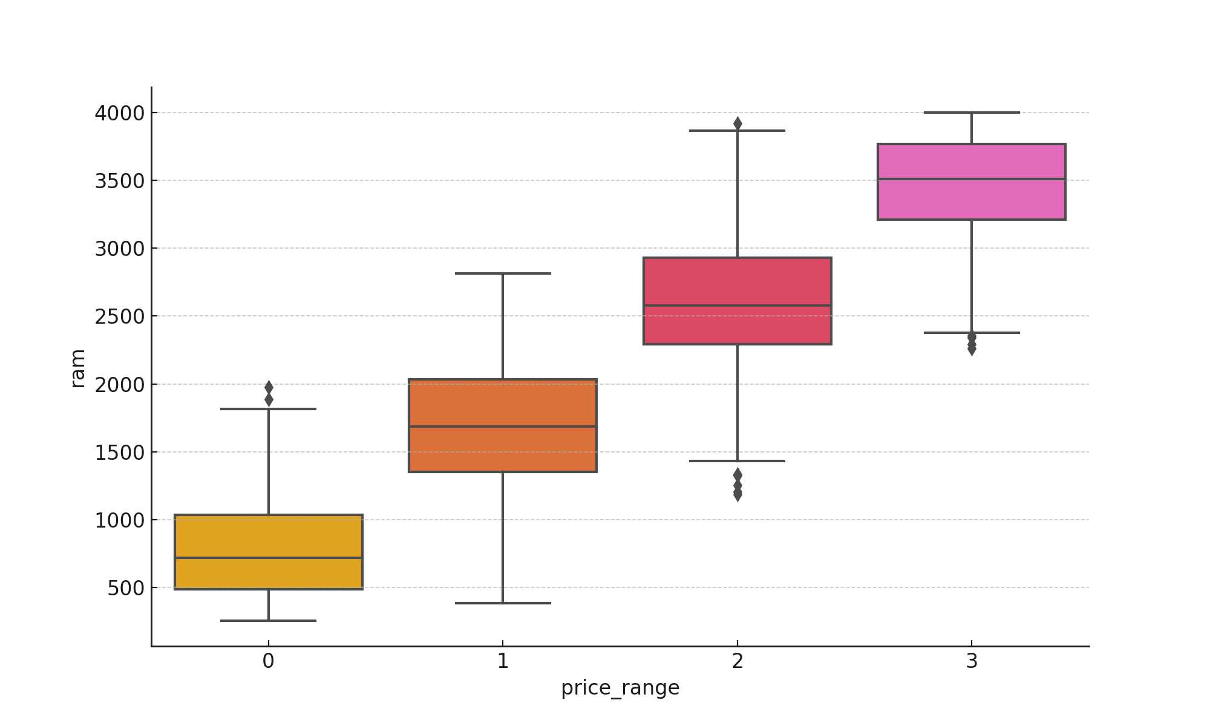
Visualization of Key Features
Boxplots and pie charts are used to visualize the distribution of key features like RAM, WiFi support, and the target variable.
Boxplot

Slide 7
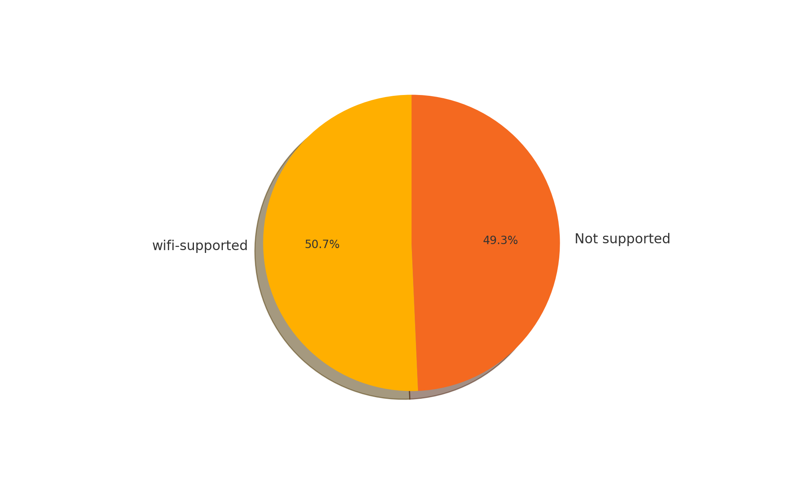
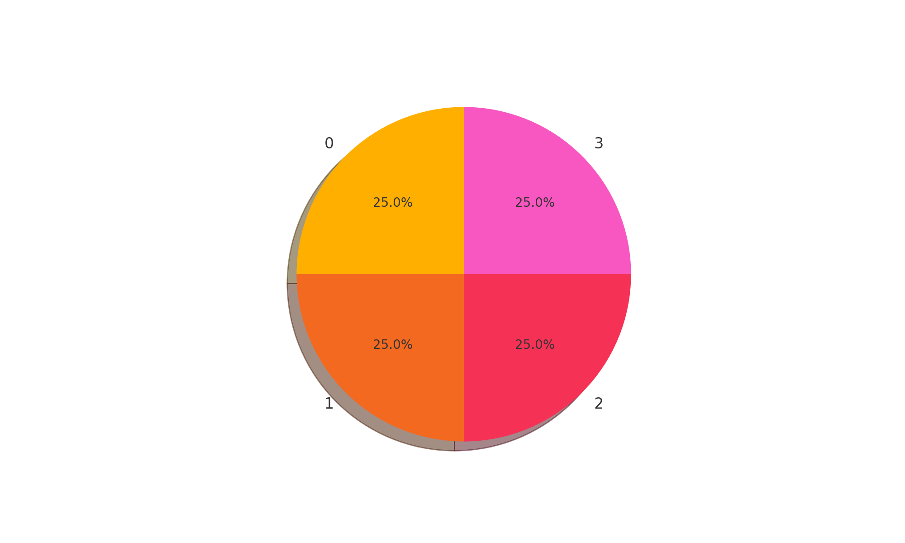

Pie Charts

Slide 8
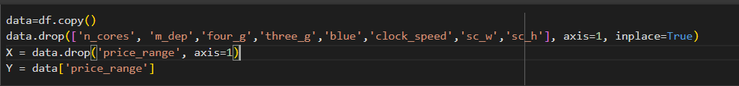
Feature Selection
Feature selection is the process of choosing the most relevant features for training the model.

Slide 9
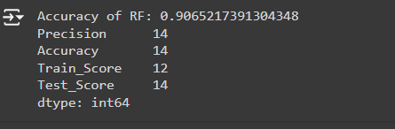
Model Training
Random Forest classifier is chosen for training due to its robustness and accuracy.
The model is trained and evaluated using various metrics.

Slide 10
Hyperparameter Tuning
Hyperparameter tuning is a crucial step in optimizing the performance of a machine
learning model. It involves adjusting the parameters that govern the training process to
find the optimal set of values that yield the best model performance.
Importance of Hyperparameter Tuning:
Enhances Model Accuracy: Proper tuning can significantly improve the
model’s accuracy and predictive power.
Prevents Overfitting: By finding the right balance, hyperparameter tuning
helps in preventing the model from overfitting to the training data.
Optimizes Performance: It ensures the model is both efficient and
effective in its predictions.
Method Used: Custom Tuning with Random Forest
We implemented a custom hyperparameter tuning method for the Random Forest
classifier. The code iteratively tests different values for the max_depth parameter, which
controls the maximum depth of each tree in the forest.
Process:
Parameter Initialization: We initialized the Random Forest classifier
with a fixed random state to ensure reproducibility.
Train-Test Split: The data was split into training and testing sets with a test size of
23%.
Iterative Training and Evaluation: For each value of max_depth from 1 to 30,the model
was trained and evaluated using precision, accuracy, training score, and testing score.
Result Collection: The performance metrics for each max_depth value were collected
and analyzed.

Slide 11
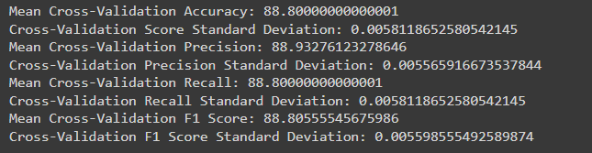
Model Evaluation Metrics
The accuracy score, confusion matrix, and other relevant metrics are used to evaluate the model's performance.
Metrics such as precision, recall, and F1 score are considered.

Slide 12
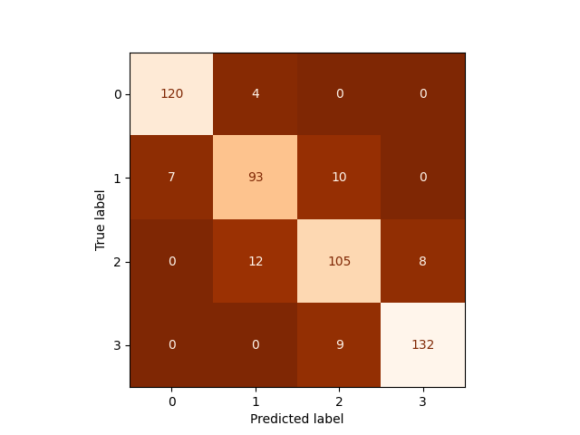
Confusion Matrix
The confusion matrix provides insights into the model's performance in predicting each class.

Slide 13
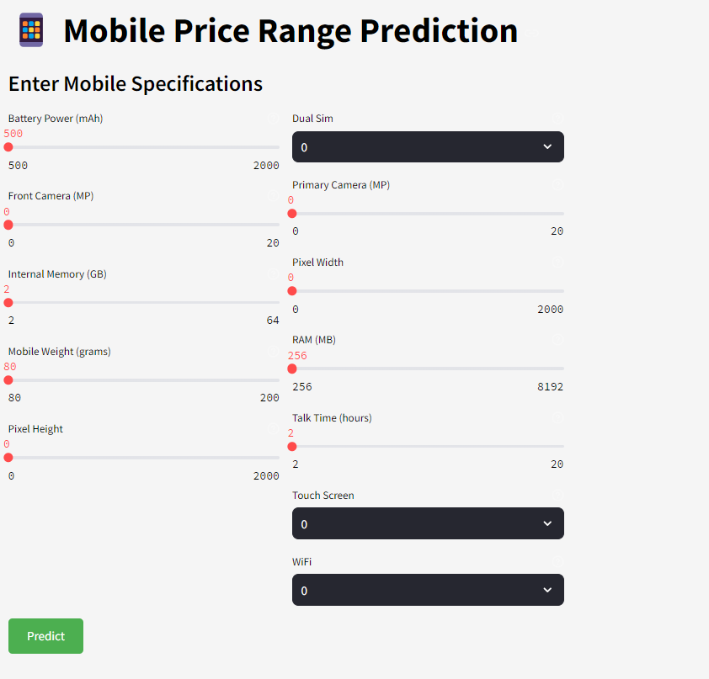
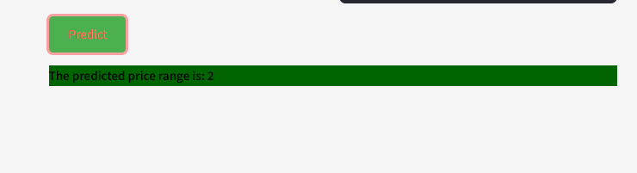
UI
Result

Slide 14
Conclusion
This study aimed to develop a robust model to predict mobile price ranges based
on various features. Through comprehensive data exploration, feature
engineering, and rigorous model training and evaluation, we achieved significant
insights and results.
Key Findings:
Data Exploration: We identified key features such as RAM, battery power, and
pixel resolution that are highly correlated with the price range.
Visualization: Boxplots and pie charts provided a clear understanding of
feature distributions and their impact on the target variable.
Model Training: A Random Forest classifier was used, achieving high accuracy
and robust performance metrics.
Evaluation: The model was evaluated using accuracy, precision, recall, and F1
score, confirming its reliability.
Future Work:
Feature Enhancement: Including more advanced features such as user
reviews and market trends could improve the model.
Model Optimization: Experimenting with other machine learning algorithms
and deep learning techniques could enhance prediction accuracy.
Deployment: Developing a user-friendly application for real-time price
prediction could provide practical benefits for consumers and manufacturers.

