Slide 1
SECURE DATA HIDING IN IMAGES USING STEGANOGRAPHY
CAPSTONE PROJECT
Presented By:
Student Name : E. Nangalya Devi
College Name & Department : Vel Tech University & B.Tech CSE(AI&ML)

Slide 2
OUTLINE
Problem Statement
Technology used
Wow factor
End users
Result
Conclusion
Git-hub Link
Future scope

Slide 3
Problem Statement
Secure communication of confidential information is a major challenge in the digital world. Traditional encryption methods can be complex and easily detectable, making them vulnerable to attacks. Image steganography provides a solution by embedding secret messages within images, ensuring discreet and secure transmission. This project focuses on developing a Python-based approach to hide and extract messages efficiently while maintaining image quality. Additionally, passcode protection enhances security, making the method more reliable for transmitting sensitive data.

Slide 4
Technology used
Programming Language: Python
Libraries: OpenCV (for image processing), Struct (for data encoding)
Image Formats Supported: JPG, PNG
Security: Passcode protection for message retrieval
Steganography Technique: Least Significant Bit (LSB) modification
Development Environment: IDLE (Python)
Version Control: Git & GitHub for project management
Image Processing Method: Pixel-based embedding in the red channel
Encryption Format: Storing message length in the image for accurate retrieval
Storage Method: Message hidden without altering the overall image quality

Slide 5
Wow factors
Automated Message Length Storage – Ensures accurate decryption without manual input.
Passcode Protection – Adds security, preventing unauthorized access.
Supports JPG & PNG – Works with multiple image formats for flexibility.
Minimal Image Distortion – Embeds data without noticeable quality loss.
Fast & Lightweight – Simple yet efficient Python-based implementation.
Beginner-Friendly – Clean, readable code for easy understanding.
Open-Source on GitHub – Allows collaboration and future enhancements.

Slide 6
End users
Individuals & Privacy Enthusiasts – Securely hide personal messages in images.
Cybersecurity Professionals – Explore and test steganography techniques.
Journalists & Activists – Safely transmit confidential information.
Forensic Experts & Law Enforcement – Detect and analyze hidden messages.
Students & Researchers – Learn about image processing and data hiding.
Software Developers – Implement and improve steganography-based applications.

Slide 7
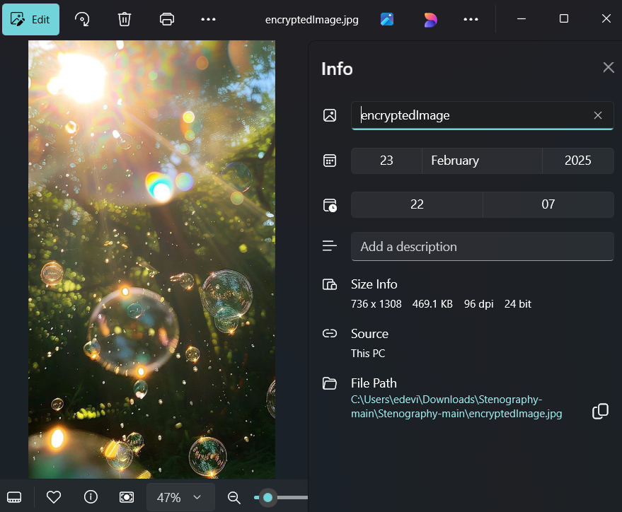
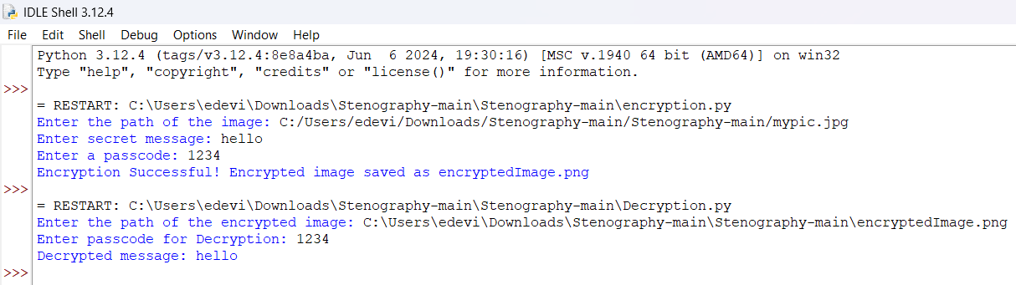
Results
Encrypted Image:
Encryption output:
Decryption output:

Slide 8
Conclusion
This project successfully implements image steganography to securely hide and retrieve messages within images. By addressing the problem of secure and hidden communication, it ensures accurate message retrieval through automated length storage and passcode protection. The system maintains image quality, supports JPG and PNG formats, and offers a lightweight yet efficient solution for privacy-focused communication. With its user-friendly approach, this project demonstrates the potential of steganography in cybersecurity, digital forensics, and secure data transmission.

Slide 9
GitHub Link
GitHub Link: https://github.com/Devi-E/Image-Steganography-project.git
Key Highlights:
Includes README.md with setup & usage instructions
Contains encryption.py & decryption.py for secure message hiding & retrieval
encryptedImage.jpg & mypic.jpg for demonstration purposes
Uses password.txt for authentication in decryption
stego.py it contains the full code of both encryption and decryption

Slide 10
Future scope
Enhanced Security: Implement stronger encryption techniques for better message protection.
GUI Integration: Develop a user-friendly interface for easy encryption and decryption.
Support for More File Formats: Extend compatibility beyond JPG and PNG to formats like BMP or GIF.
Increased Storage Capacity: Optimize algorithms to embed larger messages efficiently.
Mobile and Web Application: Expand the project into a mobile or web-based tool for wider accessibility.

Slide 11
THANK YOU

