Slide 1
Employee Data Analysis using Excel
STUDENT NAME: R.DEVISREE
REGISTER NO:312206491
DEPARTMENT:COMMERCE COLLEGE: AGURCHAND MANMULL JAIN COLLEGE

Slide 2
PROJECT TITLE
Employee Performance Analysis using Excel

Slide 3


AGENDA
Problem Statement
Project Overview
End Users
Our Solution and Proposition
Dataset Description
Modelling Approach
Results and Discussion
Conclusion
3/21/2024 Annual Review

Slide 4

PROBLEM STATEMENT
This analysis is created to track the performance of the employees, in order to provide promotions, incentives to the respective employees.Use a Pivot Table and chart visualization to highlight key areas where employee turnover is most significant, providing insights for targeted HR interventions.

Slide 5

PROJECT OVERVIEW
Employee Performance Analysis is
created to analyse all the data like
attendance, gender, age, high, medium,
low, very high skilled employees of the
organisation.Utilizing Excel's Pivot Tables and charting tools, we will create visual representations of the data to provide clear insights into areas with high turnover or strong retention. The findings will guide HR strategies and interventions to improve employee satisfaction and retention rates.

Slide 6

WHO ARE THE END USERS?
Employees
Managers
Employers
Managerial organisations
Industrial organisations
Human Resources (HR) Department
Department Managers and Supervisor
Executive Leadership

Slide 7

OUR SOLUTION AND ITS VALUE PROPOSITION
Conditional formatting - missing
Pivot tables - summary
Charts – trend
Filtering and Formula - performance
Graph – data visualization

Slide 8
Dataset Description
Employee = Kaggle
26 – Features
9 - Features
Employee id – numerical values
Name – text
Employee type
Performance level
Employee rating – numerical values

Slide 9

THE "WOW" IN OUR SOLUTION
Performance level =IFS(Z8>=5,”VERY
HIGH”,Z8>=4,”HIGH”,Z8>=3,”MED”,TRUE,”LOW”)
3/21/2024 Annual Review

Slide 10
MODELLING
Data collection
Downloaded from Edunet dashboard
Data cleaning
Identified the missing values
Filter out missing values
Performance level
Created a formula
Summary
Pivot table
Graph

Slide 11
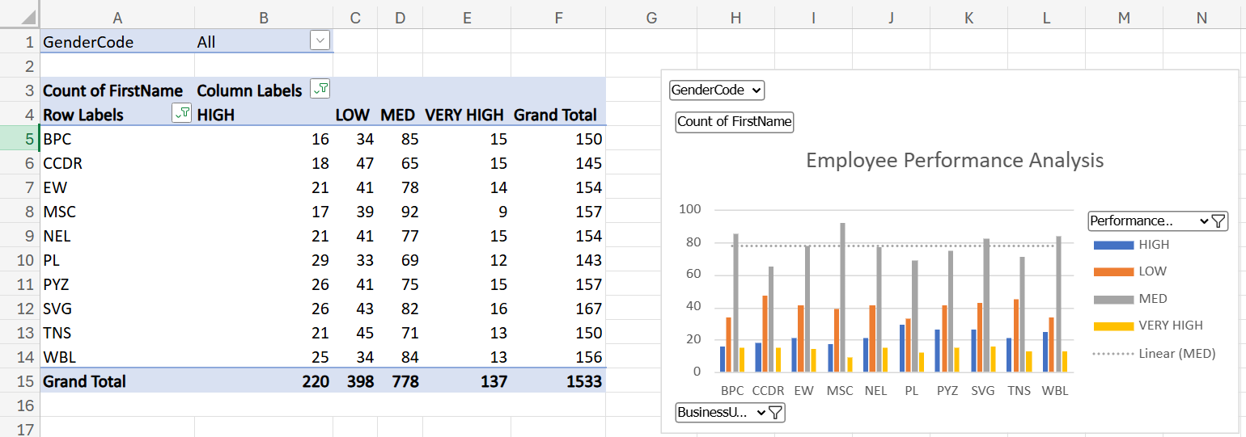
RESULTS

Slide 12
conclusion
While we comparing the performance of the employees, the number of employees are highly performed PL sector of the organization.
We should motivate the employees of the other sectors by giving different kinds of tasks based on their strength, in order to improve the standard of the organization

