Slide 1
IBM University Engagement Project Submission
“Exploring the Power of Agentic AI with IBM Granite and LangFlow”

Slide 2

Project Tile – Research Agent
Domain of Project – Education
Student Name | Recent Passport Photo | Email ID | Mobile number [WhatsApp]
Devi Prasad Chakraborty |  | deviprasadchakraborty31949@gmail.com | +91 8210447474

Slide 3
Problem Statement - Research Agent
The Challenge
Academic and scientific research often involves extensive literature reviews, searching through numerous research papers, extracting relevant findings, and organizing references. Researchers frequently struggle with information overload, fragmented research sources, time-consuming data extraction, and identifying gaps in existing studies. Without intelligent research assistance and contextual information retrieval, conducting comprehensive literature reviews and generating meaningful research insights can become inefficient and challenging.
The Objective
Build an AI-powered Research Agent that automates and streamlines the research process by providing intelligent literature discovery, contextual analysis, and research assistance for students, academicians, and industry researchers. The solution should:
Intelligent Literature Discovery – Search and retrieve relevant research papers, academic publications, journals, and scientific articles based on natural-language queries.
Research Paper Summarization – Generate concise summaries of research papers, highlighting objectives, methodologies, findings, and conclusions.
RAG-Based Knowledge Retrieval – Retrieve contextually relevant information from research documents and provide evidence-backed responses with citations.
Automated Reference Management – Organize research sources, extract bibliographic information, and generate citations in standard academic formats.
Multi-Agent System –
  Literature Discovery Agent – Finds and retrieves relevant academic publications.
  Research Analysis Agent – Analyses papers, methodologies, findings, and research gaps.
  Knowledge Retrieval Agent – Fetches contextual information using RAG and generates cited responses.
  Reference Management Agent – Extracts, organizes, and formats academic references.
  Report Generation Agent – Generates structured research reports and assists in drafting research sections.
Research Insights & Visualization Dashboard – Display research trends, publication insights, keyword relationships, identified research gaps, and organized literature collections.

Slide 4
Proposed Solution: Research Agent
The proposed solution is a multi-agent AI-powered Research Agent built using LangFlow, IBM watsonx.ai, and IBM Granite Models to automate and streamline academic and scientific research. The system addresses challenges in literature discovery, research paper analysis, information retrieval, and reference management through an intelligent, modular architecture.
At its core, the solution uses a Retrieval-Augmented Generation (RAG) pipeline to retrieve relevant information from trusted academic sources such as research repositories, scientific journals, and scholarly databases. Research documents are processed, embedded, and stored in a vector database, enabling contextual information retrieval, evidence-based responses, and accurate summarization using IBM Granite models.
The system consists of five key agents:
Literature Discovery Agent searches and retrieves relevant research papers, academic publications, journals, and scientific articles based on natural-language queries.
Research Analysis Agent analyses research papers, extracting key objectives, methodologies, findings, conclusions, and potential research gaps.
Knowledge Retrieval Agent retrieves contextually relevant information from research documents using RAG and generates evidence-backed responses with source citations.
Reference Management Agent automatically extracts bibliographic information, organizes research sources, and generates citations in standard academic formats.
Report Generation Agent generates structured research reports, synthesizes findings from multiple publications, and assists in drafting research paper sections.
The solution includes a user-friendly research dashboard (built using Streamlit or React) that displays retrieved publications, paper summaries, research trends, identified knowledge gaps, citation details, and organized research collections.
LangFlow is used to orchestrate multi-agent workflows, while IBM watsonx.ai provides model deployment, embedding capabilities, and AI governance. IBM Granite models power natural-language understanding, reasoning, document summarization, contextual question answering, and research report generation.
Overall, this solution delivers an end-to-end intelligent research assistant that enhances research productivity through automated literature discovery, evidence-based insights, intelligent document analysis, and streamlined academic report generation.

Slide 5
Technology Used
LangFlow Platform – For visually designing, developing, and orchestrating multi-agent research workflows.
IBM Granite Models – For example, ibm-granite-3-2-8b – For natural language understanding, reasoning, research paper summarization, contextual analysis, and report generation.
IBM Cloud – Provides the infrastructure to build, deploy, and scale the Research Agent efficiently, ensuring a reliable, secure, and scalable environment.
RAG (Retrieval-Augmented Generation) – Retrieves relevant information from research papers and academic sources before generating responses, ensuring context-aware, evidence-backed answers with citations.
IBM watsonx.ai – For foundation model deployment, embedding generation, inference, and AI governance.
Vector Database (FAISS/Chroma) – For storing document embeddings and enabling semantic search and context-based retrieval of research papers.
Python – For document processing, data extraction, backend development, and integration of AI components.
Streamlit / React – For developing an interactive research dashboard and user interface.
Academic Data Sources (arXiv, Crossref, Semantic Scholar) – For retrieving research papers, publication metadata, abstracts, and scholarly references.

Slide 6
Langflow component Used -
1) Chat Input – Interface where users enter natural-language research queries, specify research topics, or request literature reviews and paper analysis.
2) IBM watsonx AI Agent – Processes user queries using IBM Granite models to perform research analysis, retrieve relevant information, summarize publications, and generate evidence-based responses.
3) Name of IBM Granite Model – Granite-4.0-8B-Instruct → Used for natural-language understanding, reasoning, research paper summarization, and contextual question answering.
4) Chat Output – Displays AI-generated responses, including research summaries, literature reviews, analytical insights, and cited answers.
5) File Component – Uploads and processes research papers (PDFs and documents), enabling document extraction, analysis, summarization, and knowledge retrieval.
6) Split Text Component – Divides research papers into smaller, meaningful text chunks to facilitate efficient document processing and RAG-based retrieval.
7) Embedding Component – Converts research document chunks into vector representations for semantic search and contextual information retrieval.
8) Vector Store Component (Chroma / FAISS) – Stores document embeddings and retrieves relevant research content based on semantic similarity.
9) Prompt Template Component – Structures instructions and research queries to guide Granite models in generating accurate, context-aware, and well-organized responses.
10) Parser Component – Structures and formats AI-generated outputs, such as research summaries, extracted findings, and bibliographic information.
11) Retriever Component – Fetches the most relevant document chunks from the vector database to provide supporting context to the AI agent.
12) IBM watsonx Embeddings Component – Generates embeddings for uploaded research documents and user queries, enabling semantic retrieval within the RAG pipeline.

Slide 7
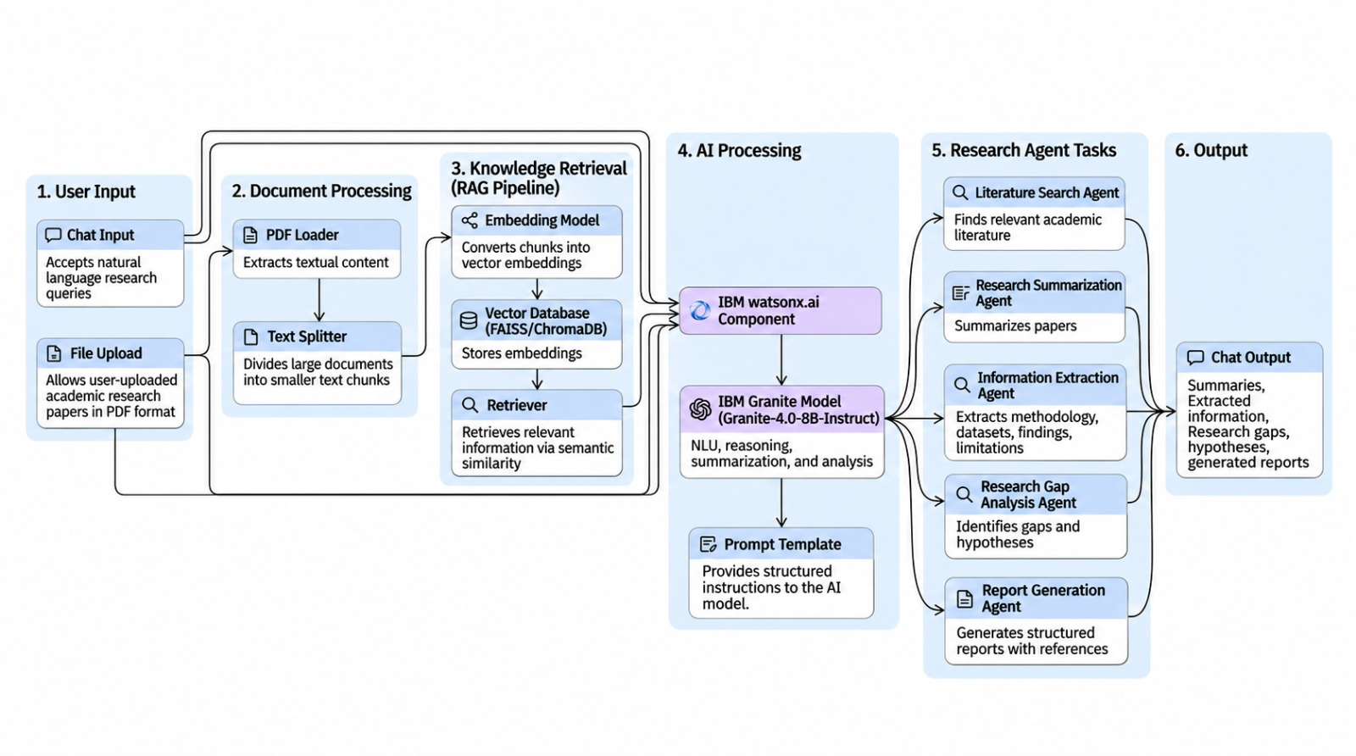
Langflow workflow -

Slide 8
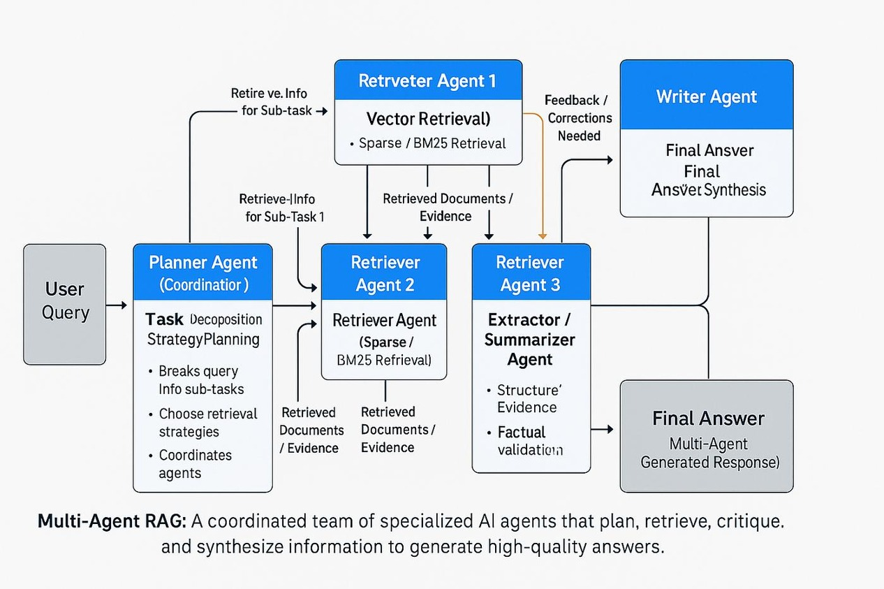
Architecture blueprint

Slide 9

Role of Agentic AI in the solution
Agentic AI enables the Research Agent to autonomously perform complex research tasks by coordinating multiple specialized AI agents. Instead of simply responding to user queries, the system intelligently plans, executes, and manages the research workflow using IBM Granite models and LangFlow orchestration.
Autonomous Research Planning – Understands research queries, identifies user requirements, and determines the appropriate research workflow.
Intelligent Literature Discovery – Searches academic sources and retrieves relevant research papers based on contextual relevance.
Multi-Agent Collaboration – Coordinates specialized agents for literature discovery, research analysis, knowledge retrieval, reference management, and report generation.
Contextual Knowledge Retrieval (RAG) – Retrieves relevant information from research documents to generate accurate, evidence-based responses with citations.
Automated Research Analysis – Extracts methodologies, findings, conclusions, and potential research gaps from multiple publications.
Intelligent Report Generation – Synthesizes information from multiple sources to generate structured research summaries and draft research sections.
Continuous Workflow Optimization – Uses intermediate agent outputs to determine subsequent actions, refine retrieval, and improve the relevance of generated results.

Slide 10
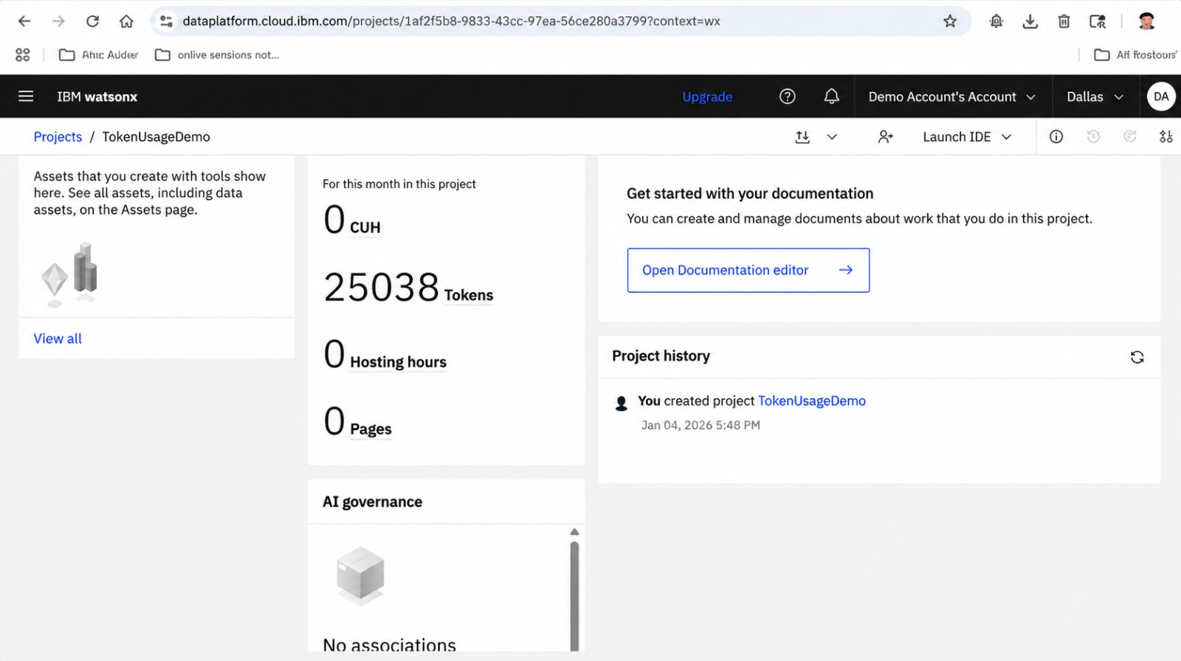
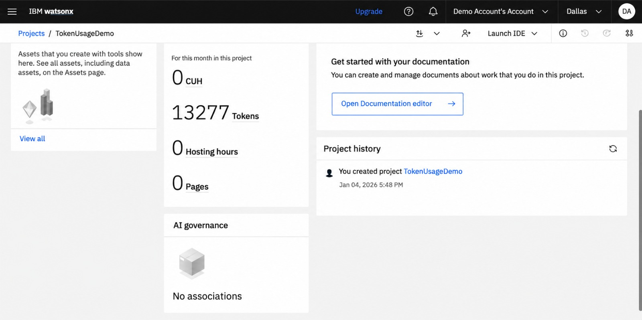
Token Usage
11,761 tokens are used
Before Prompt
After the Prompt
·
·
·

Slide 11
Novelty and Uniqueness
The proposed Research Agent stands out by combining Agentic AI, Retrieval-Augmented Generation (RAG), and autonomous research automation into a unified intelligent system.
- Multi-Agent Intelligence – Instead of a single chatbot, multiple specialized agents collaborate to perform literature discovery, paper analysis, knowledge retrieval, reference management, and report generation.
- RAG-Based Accuracy – Retrieves information directly from academic papers and trusted research sources before generating responses, reducing hallucinations and providing evidence-backed answers with citations.
- Autonomous Research Workflow – Understands research queries, plans subsequent actions, and coordinates multiple research tasks with minimal human intervention.
- Intelligent Research Gap Identification – Analyses findings across multiple publications to identify knowledge gaps, emerging research trends, and potential areas for further investigation.
- Context-Aware Paper Analysis – Extracts and compares research objectives, methodologies, experimental results, and conclusions across multiple research papers.
- Automated Citation Management – Extracts bibliographic details, organizes references, and generates citations in standard academic formats, reducing manual effort.
- Intelligent Report Generation – Synthesizes insights from multiple research publications to generate structured literature reviews, research summaries, and draft research sections.
- Scalable & Enterprise-Ready – Built using IBM watsonx.ai, IBM Granite models, and IBM Cloud, providing a scalable infrastructure with responsible AI capabilities and governance.

Slide 12
Git Hub Link
Github URL – https://github.com/Devi2006/research-agent
·
·
·

Slide 13
Future Scope
Advanced Multi-Agent System – Introduce specialized agents for hypothesis generation, experimental design, and statistical analysis.
Expanded Research Database Integration – Connect with IEEE Xplore, SpringerLink, PubMed, Scopus, and other academic repositories.
Automated Research Gap Identification – Identify unexplored research areas and suggest potential research hypotheses.
Multimodal Paper Analysis – Extract and interpret tables, graphs, equations, and diagrams from research publications.
Research Trend Prediction – Identify emerging research topics and forecast potential research directions.
Collaborative Research Workspace – Enable researchers to share papers, annotations, references, and reports.
·
·
·

Slide 14
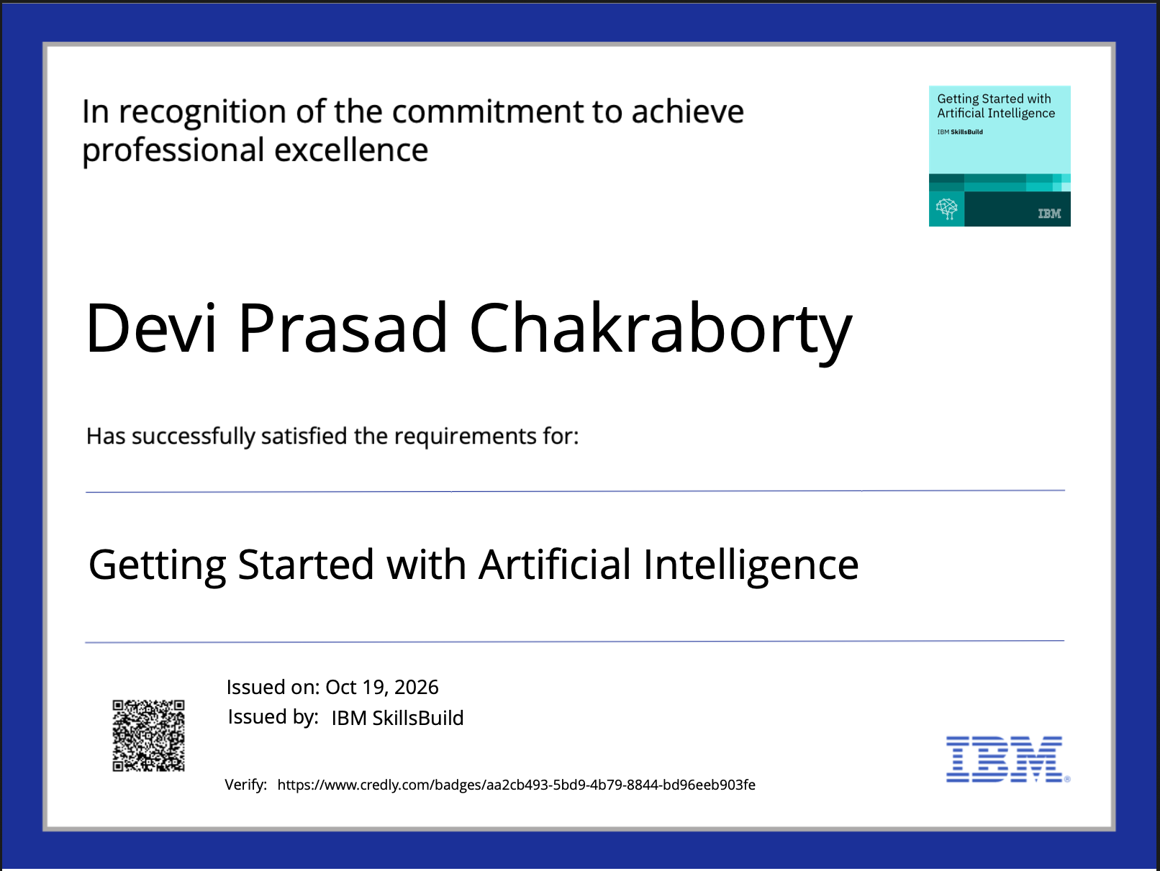
Certificates Earned:

Slide 15
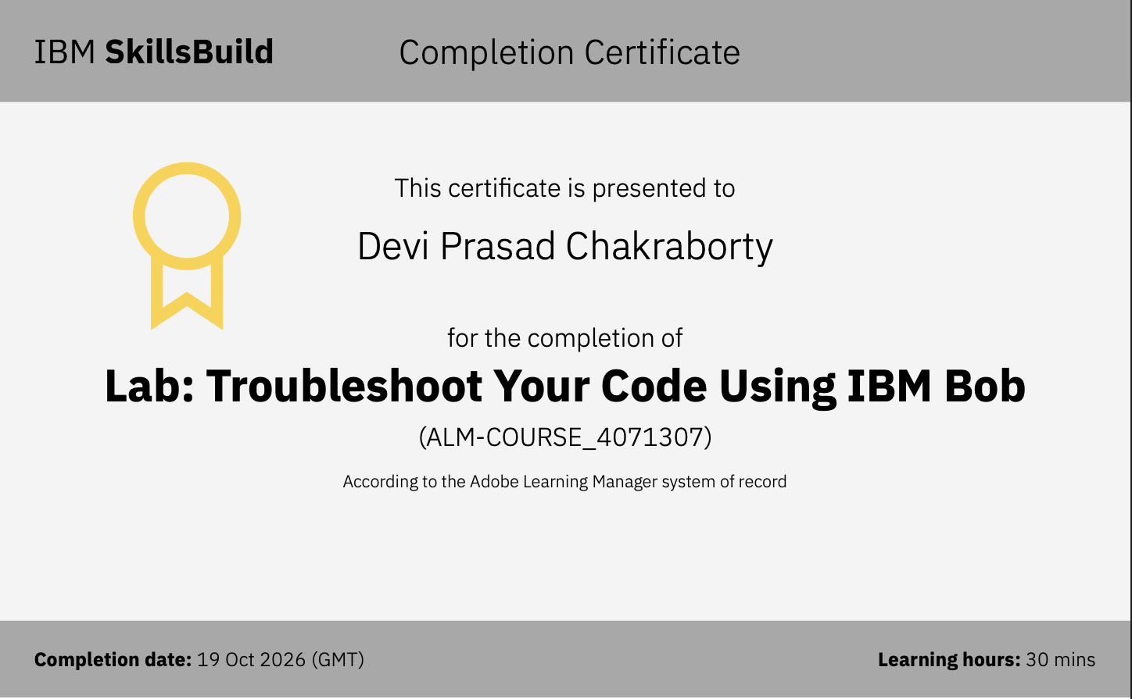
Certificates Earned:​

Slide 16


