Slide 1


Consumer Goods Analytics
At Atliq Hardware
Presented By
G.Devika

Slide 2
Atliq Hardware:Problem Statement
AtliQ Hardware is a global leader in hardware products, including PCs, printers, mice, and computers, serving customers worldwide.
As AtliQ Hardware’s data grew, using Excel led to major issues like slow processing and unresponsiveness. To fix this, the company started a project to upgrade its data management system.
The company hired data analysts to move from Excel to MySQL, a stronger database system. This shift helps AtliQ gain useful insights from data, make better decisions, and improve operations leading to higher efficiency and growth.

Slide 3
Project Overview
This project focuses on Analyzing AtliQ Hardware's database to extract meaningful insights. The database contains information about products, customers, sales and Regions. The objective is to address crucial questions regarding revenue patterns, market trends, consumer behavior. By exploring this data, we strive to make more informed decisions and enhance business efficiency.

Slide 4
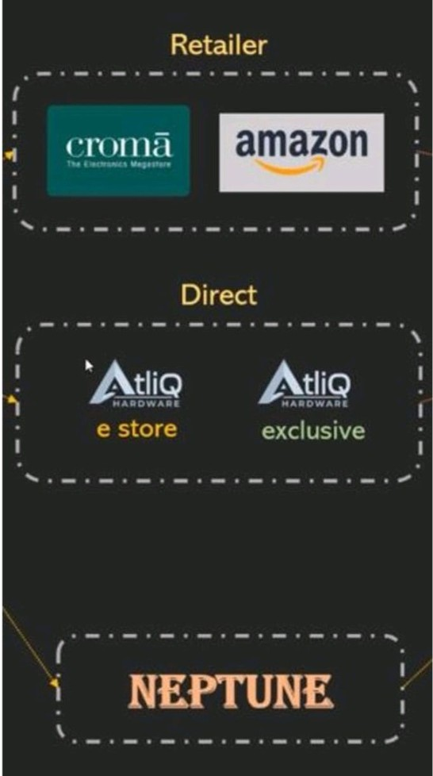
Atliq Hardware: Business Model
Customer Channels
Customers
Customer Platforms
Croma
Brick and Mortar
E- Commerce
Best Buy
Amazon
Flipkart
Croma
Best buy
Staples
Flipkart

Slide 5
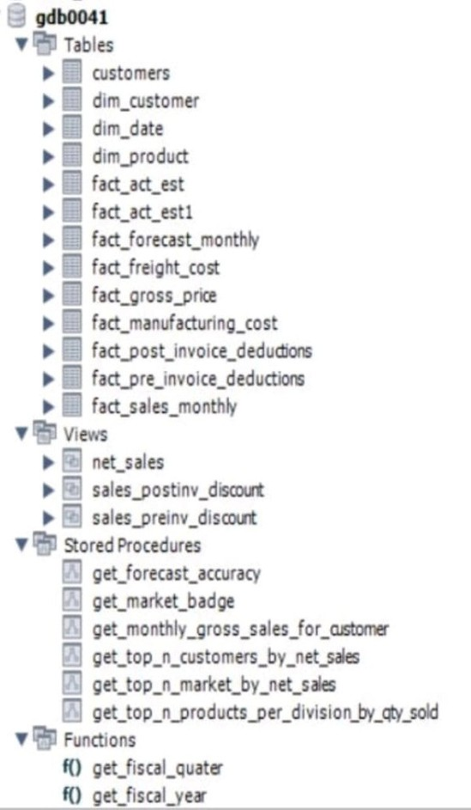
Datasets
The fact and dimension table dataset is provided by the Atliq Hardware
Views allow you to save and reuse complex SELECT statements, making it easier to query large datasets without repeating the same logic.
A stored procedure in MySQL is a precompiled set of SQL statements that encapsulates business logic, enhances reusability, performance, security, and maintainability, and reduces network traffic.
A function in MySQL is a stored program that returns a single value and can be used in SQL statements, providing reusability, modularity, and the ability to encapsulate logic for calculations or data manipulations.

Slide 6
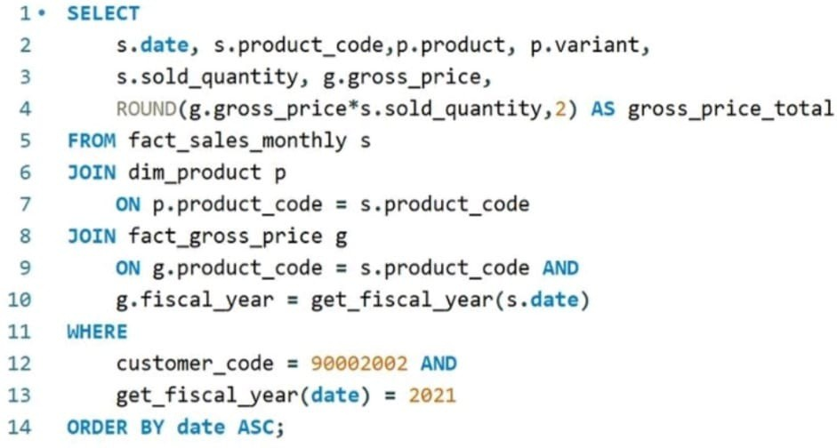
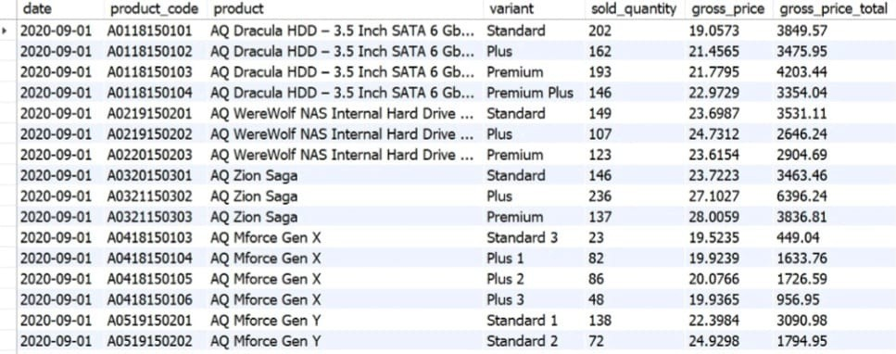
Croma india product wise sales report for fiscal year-2021

Slide 7
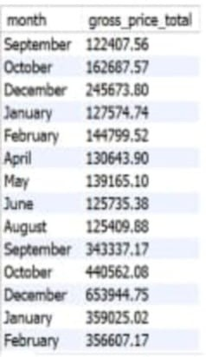
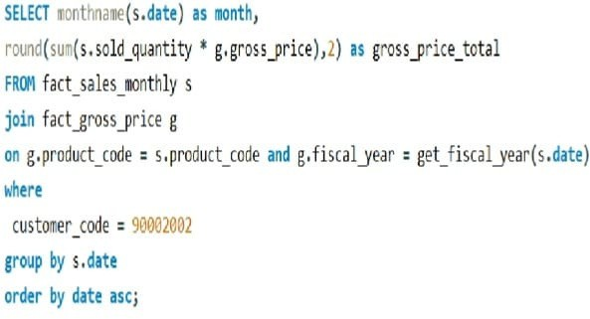
Generate a Monthly Total sales report for Croma india

Slide 8
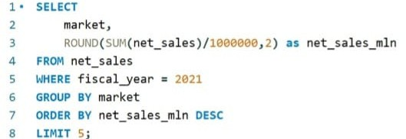
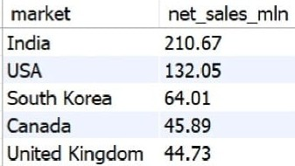
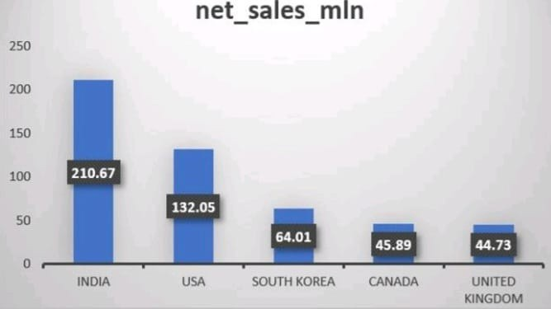
Generate a report getting Top 5 markets by Net Sales in Fiscal Year 2021

Slide 9
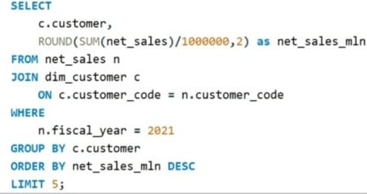
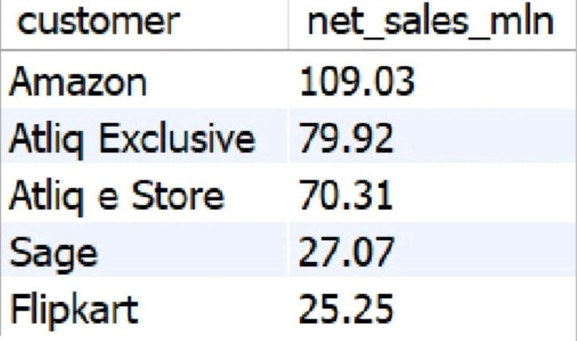
Generate a report getting Top 5 Customers by Net Sales in Fiscal Year 2021

Slide 10
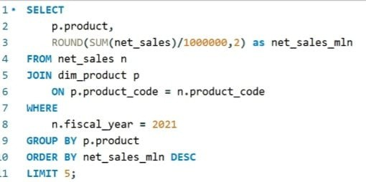
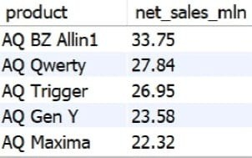
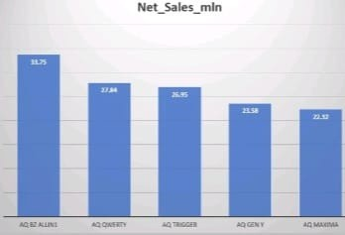
Generate a report getting Top 5 Products by Net Sales in Fiscal Year 2021

Slide 11
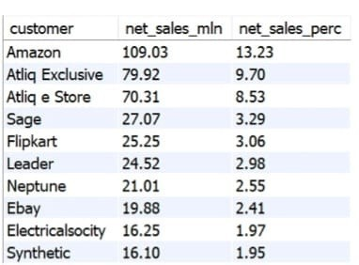
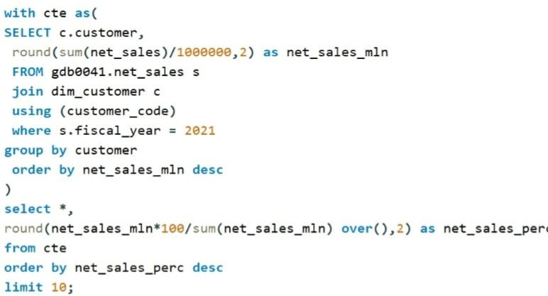
Generate a report for Net sales% share by Customers

Slide 12
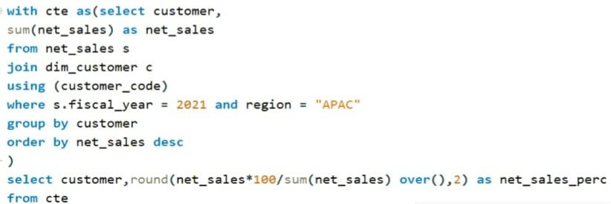
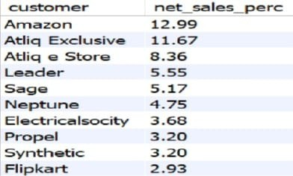
Generate a report for Net sales% share by Region

Slide 13
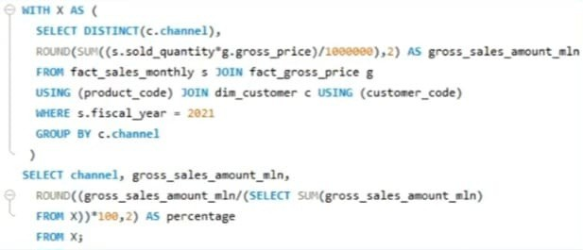
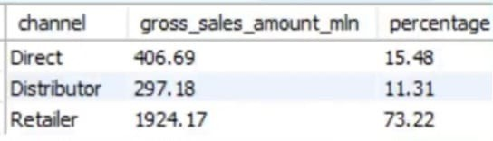
Generate a report Which channel helped to bring more gross sales in the fiscal year 2021 and the percentage contribution.

Slide 14
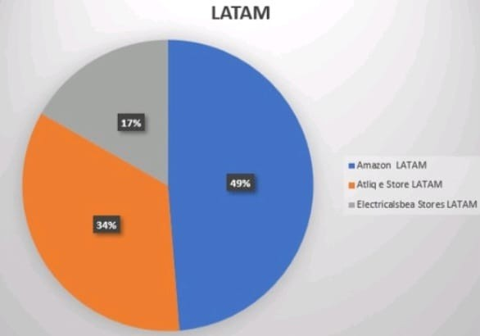
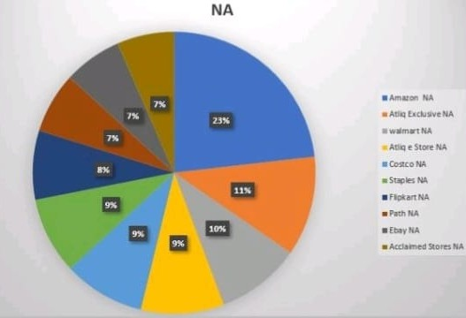
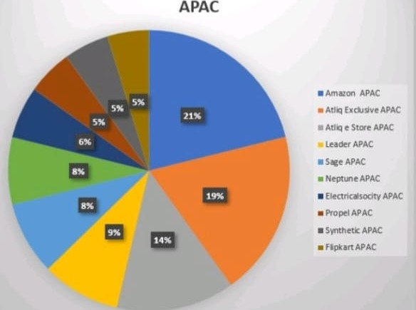
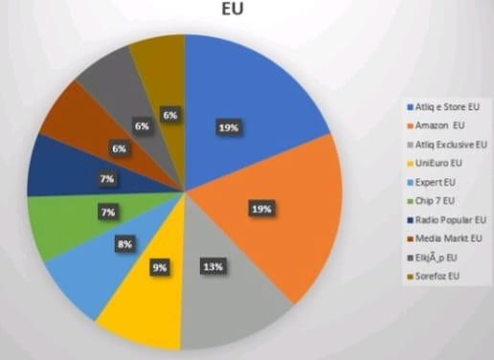
Market Share% for Top customers in different regions

Slide 15
Conclusion
AtliQ Hardware made record-breaking sales in 2022.
India was the biggest market in 2021, with sales of $210.67M. Amazon had the highest earnings in 2021, making $109.03M.
The AQ BZ All-in-One was the best-selling product in 2021, with sales of $33.75M. Amazon had the largest market share in APAX, LATAM, and NA regions.
AtliQ's online store was the top seller in the EU region.

Slide 16
THANK YOU!

