Slide 1
How Health and Lifestyle Impacts Sleep
By: Nick Brannum, Kevin Ho, Devi Balao Santhi Raman

Slide 2
Dataset Used: Sleep Health and Lifestyle Dataset
Topics Analyzed
Which occupation has best/worst sleep?
How sleep disorders affect sleep quality and sleep duration?
How physical activity affects sleep duration and sleep quality?
Sleep quality, duration, stress level Male vs Female

Slide 3
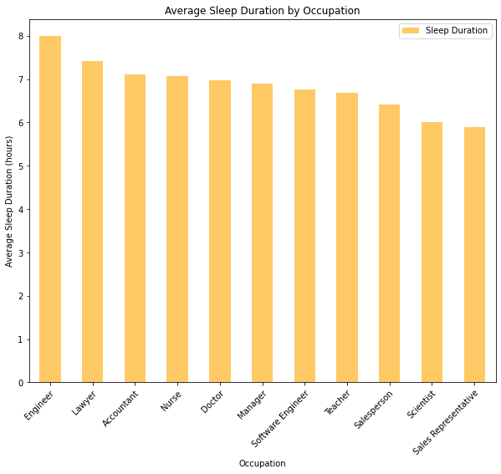
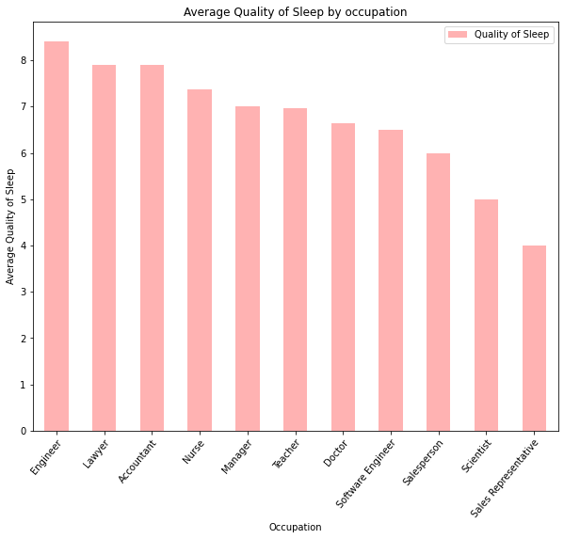
Average Sleep Duration and Sleep Quality by Occupation
The Bar charts show that Engineers have the best sleep (the average sleep duration and average quality of sleep is highest for Engineers).
Notes:
The Bar charts show that Engineers have the best sleep (the average sleep duration and average quality of sleep is highest for Engineers).

Slide 4
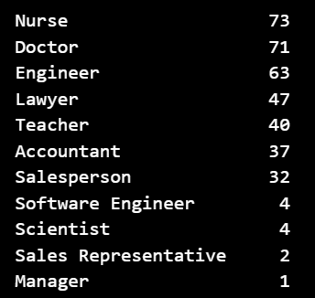
Determining the category for sleep disorder analysis
Out of the categories with least sleep duration and quality, there is not sufficient data for Sales Representative (2) and Scientist (4) to make conclusions about the Sleep Disorder distribution.
So will proceed with the Salesperson (32) category to analyze further.

Slide 5
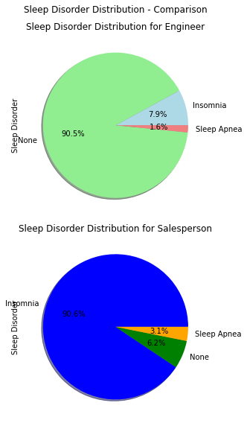
Sleep Disorder distribution - Comparison (Engineers, Salesperson)
Engineers:
90.5% have no sleep disorders.
7.9% have Insomnia
1.6% have Sleep Apnea
Salesperson
90.6% have Insomnia.
6.2% have no sleep disorders
3.1% have Sleep Apnea
Conclusion: Engineers have best sleep. Salespersons have the lowest sleep.

Slide 6
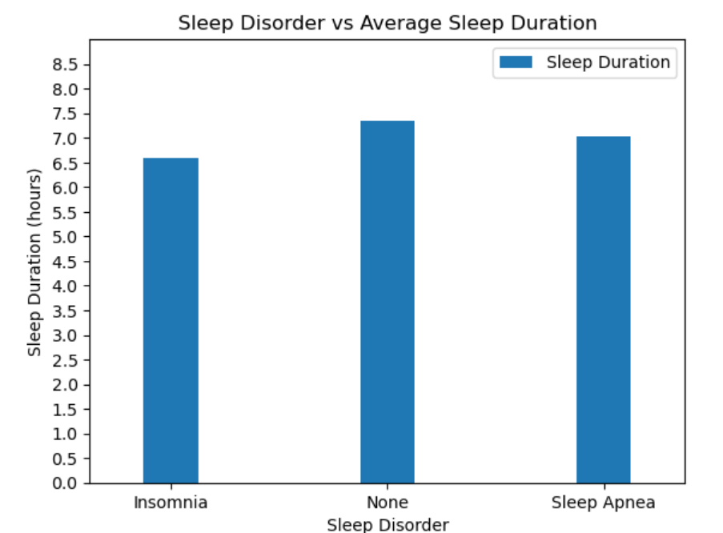
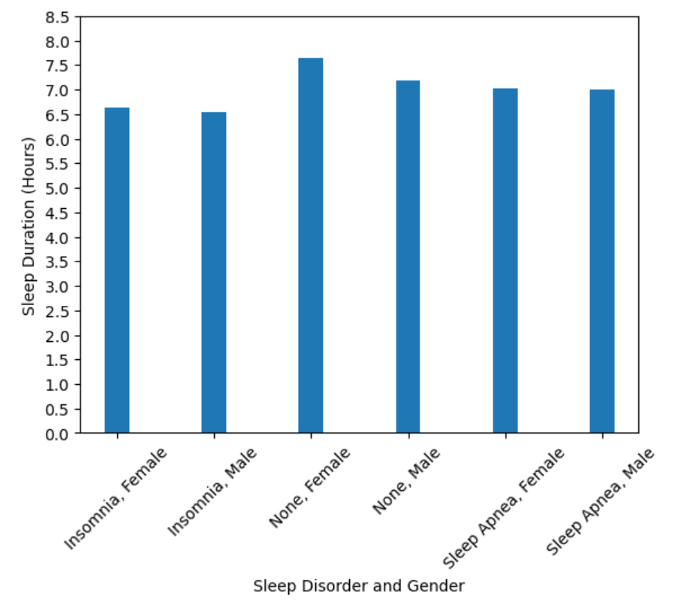
How Sleep Disorders Impact Sleep Duration
Notes:
Sleep duration combined does not show much difference between sleep disorders and no sleep disorder
When split into gender groups the difference in sleep duration is more distinct however the difference in duration between genders with the same disorder are not great

Slide 7
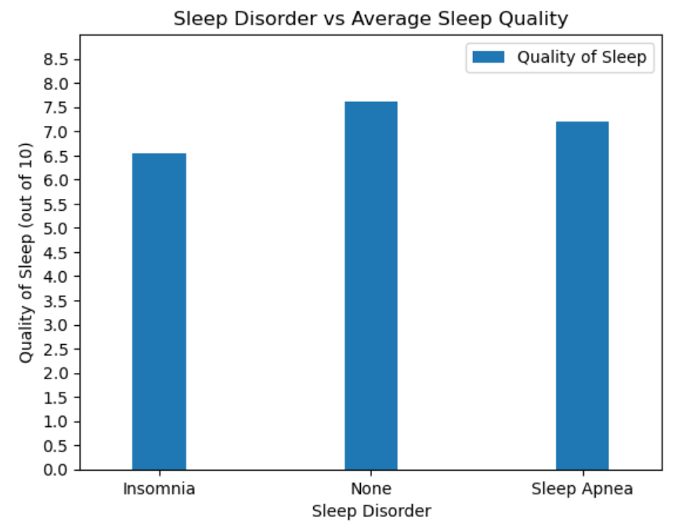
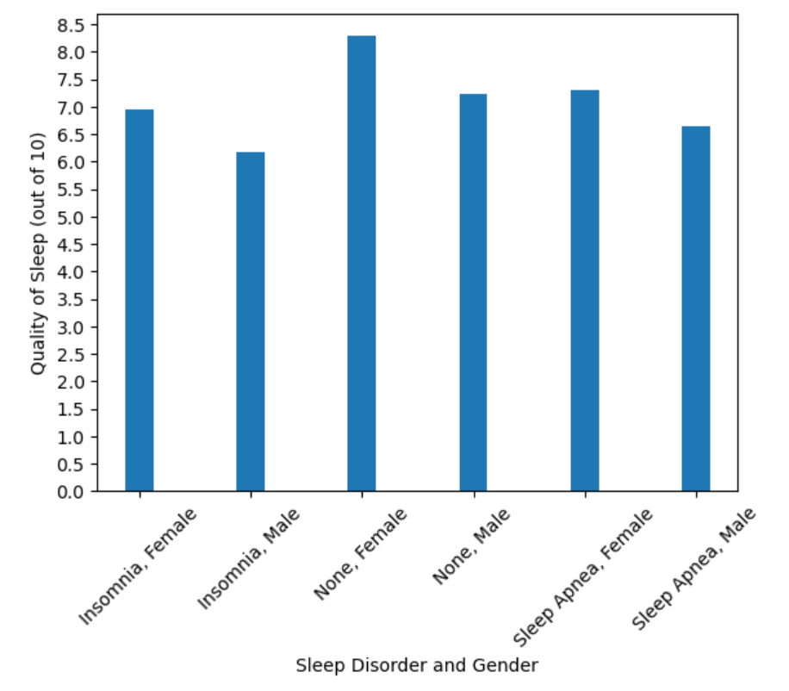
How Sleep Disorders Impact Sleep Quality
Notes:
Sleep quality has more distinct differences in ratings with disorders compared
Differences are more defined however once those sleep disorders are separated in regards to gender with females without a sleep disorder having the highest quality of sleep and males with insomnia having the lowest quality of sleep

Slide 8
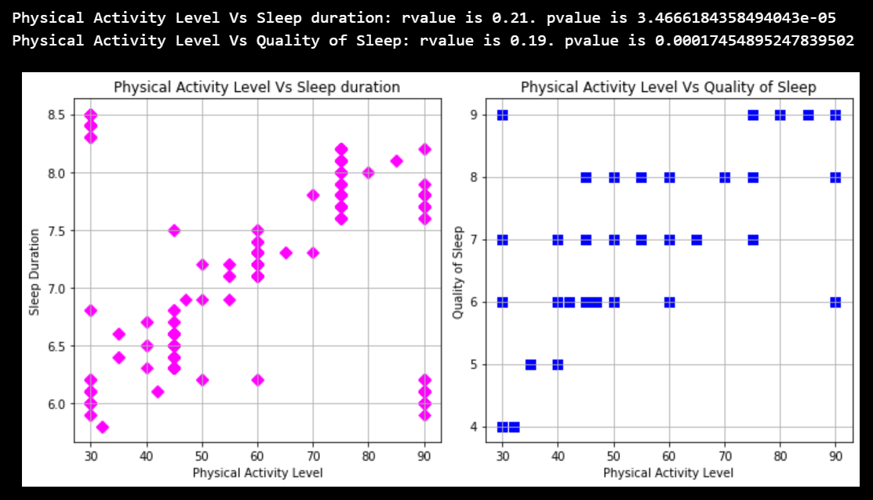
Analysis of Physical Activity Level Vs Sleep Duration and Physical Activity Level Vs Sleep Quality
When Physical Activity Level combined with Sleep Duration, Stress Level and Age is analyzed with Quality of Sleep, it has a higher R² value(0.89)
Conclusion: Physical Activity Level ,Sleep Duration, Stress Level and Age combined has a stronger positive correlation on Quality of Sleep.
Notes:
When Physical Activity Level alone is analyzed with Sleep quality or Sleep duration, there seem to be a weak positive correlation, But the pvalue < 0.05 means Physical Activity Level has a significant impact on Sleep Duration and Sleep Quality respectively. So there is no clear conclusion.

Slide 9
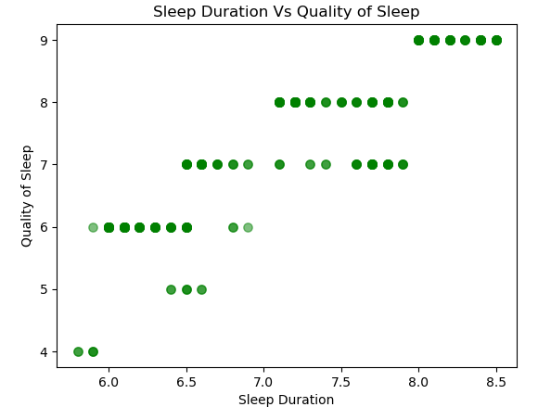
Sleep Duration and Quality of Sleep

Slide 10
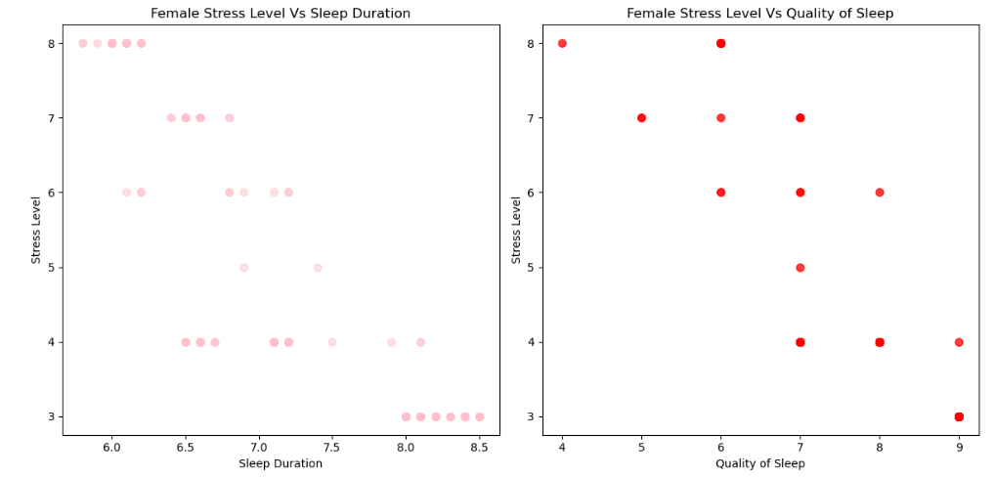
Female Sleep vs Stress

Slide 11
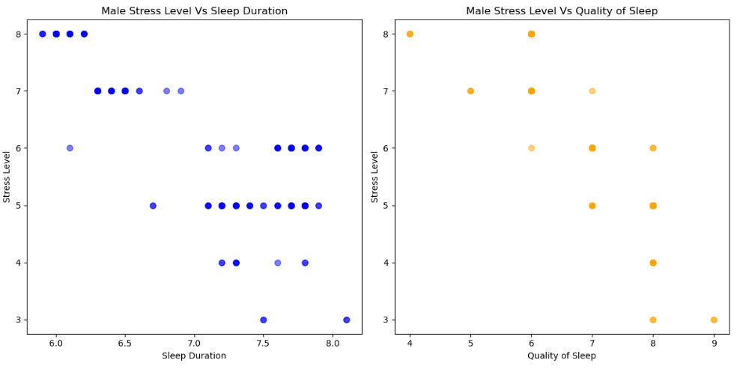
Male Sleep vs Stress

Slide 12
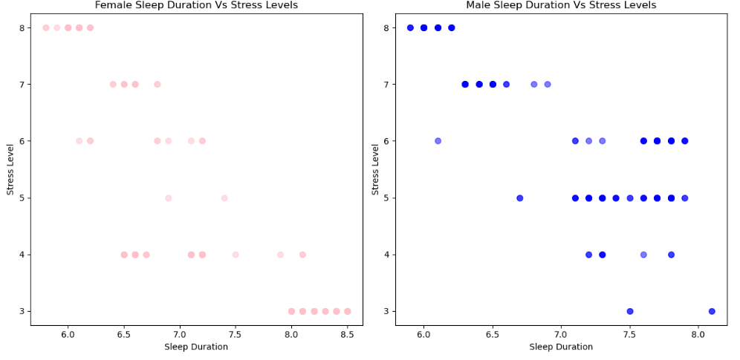
Stress Levels vs Sleep Duration

Slide 13
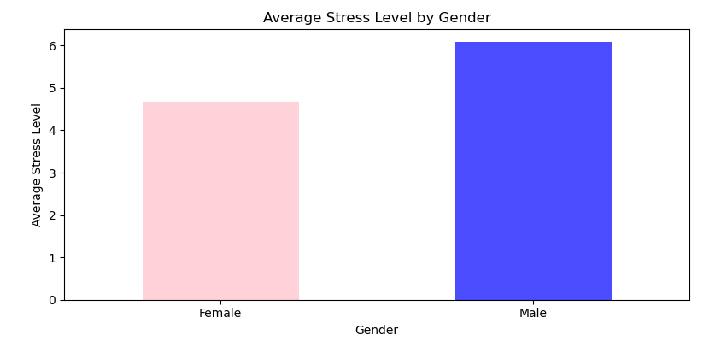
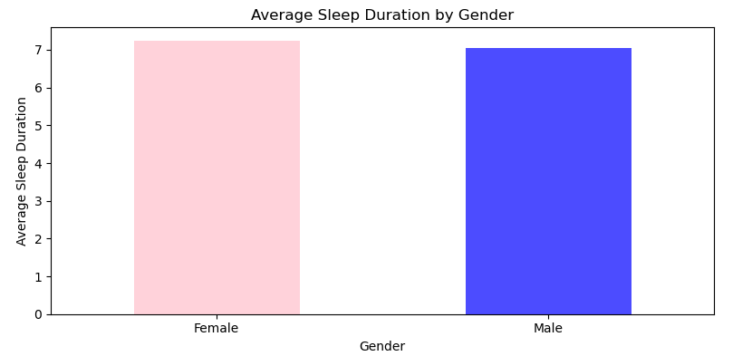
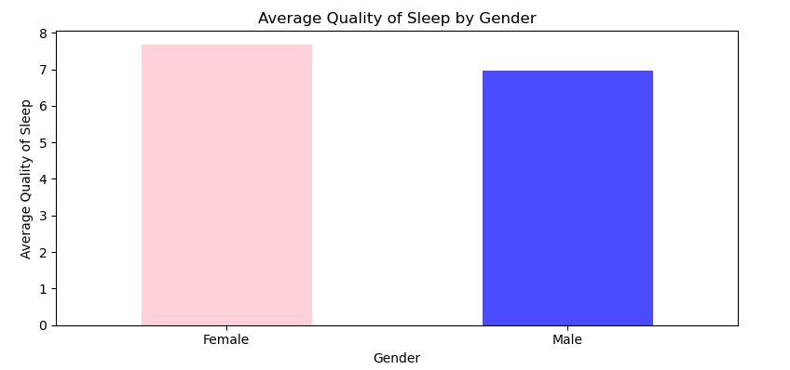
Average by Gender

Slide 14
Thank You
GitHub: Sleep Data Analysis

